Slide 2
Summary
Not exactly the solution I had hoped
Acceptable for demoin
AWS infrastructure
IdentityServer4 identity-server.mfaester.dk
Pure stubs
Website
API
Integration with external web apis.
To broad – nothing is entirely complete, most is incomplete

Slide 3
AWS
Load balancer
ECS cluster
Three services
Autoscaling
Definitions in /infrastructure folder
Not overtly parametrized terraform.

Slide 4
IdentityServer4
Running (working, but simplifications in config storage etc)
Based on QuickStart templates
In-memory configuration
Stores user info, grants and user data in SimpleDB
No persistant DataProtection -> Secret validation amnesia on restarts
https://identity-server.mfaester.dk
/src/idp

Slide 5
Convention API
Is a stub
Connects with IS4
Validates tokens
Integration with brewery API
https://convention-api.mfaester.dk (but not much to look at)
/src/convention-api

Slide 6
Convention website
IS a stub
Login against IS4 using OIDC
https://convention-website.mfaester.dk
/src/convention-website

Slide 7
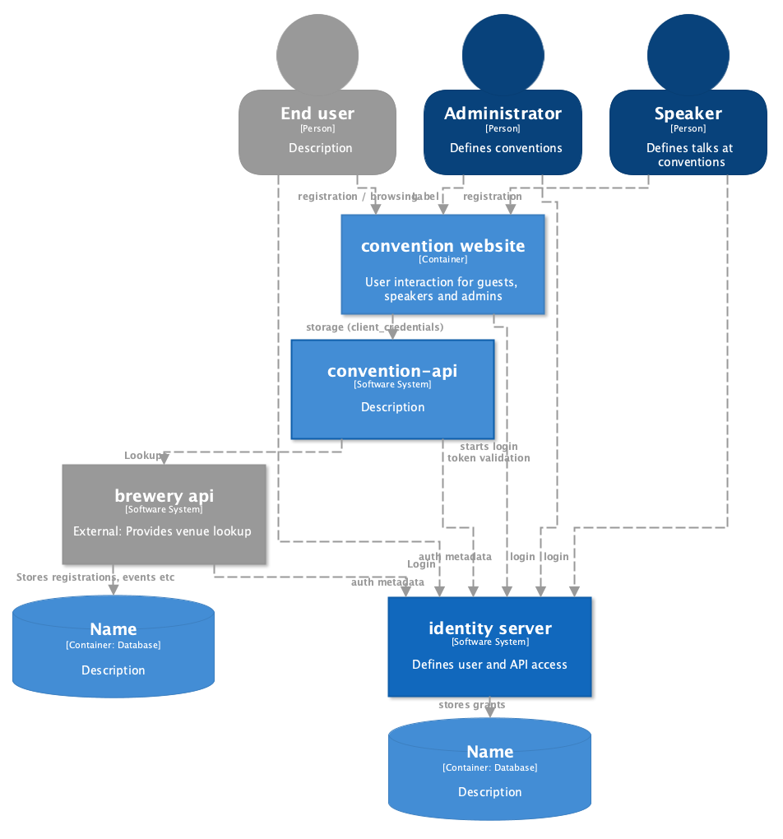
Overall intentions
Users connect to website using oidc
Website authorizes users based on oidc role claim.
Websites has full trust against API (client credentials, scope “convention-admin”)
API should be able to authorize based on user tokens for JS heavy apps
role in ID

Slide 8
OIDC connect (PO)
Users are handled one place
Less implementation

Slide 9
Libs I like
Not that many – its probably me:(
All have their idiosynchrasies
Used Microsoft.AspNetCore.Authentication.OpenIdConnect which apparantly only supports PKCE in pure ”code” mode.

