Slide 1
Digital Signals and Image Processing Project
Faezeh Azhir
Mahmoud Ferig
Jan Robert Eljasiak

Slide 2
Content
ECG Arrhythmia Classification using Deep Learning
CNN for flower classification
Image retrieval (CBIR) system for the Flowers dataset

Slide 3
Classification of flowers using CNN and Transfer Learning.
Objective: Train a deep learning model to classify images of flowers into 102 categories.
Approach:
Data exploration and Topic: Task classification of flowers using CNN and Transfer Learning.
Objective: Train a deep learning model to classify images of flowers into 102 categories.
Approach:
Data exploration and preprocessing.
Training a CNN model from scratch.
Model evaluation and insights.

Slide 4
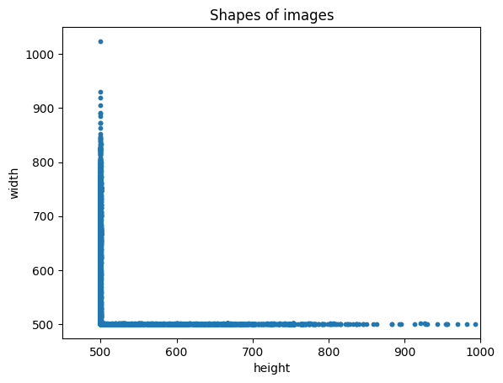
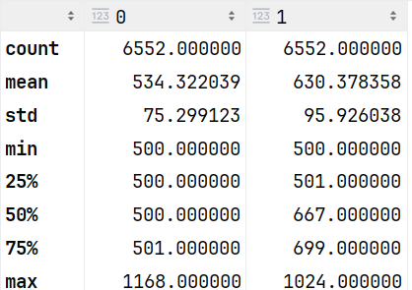
Data Exploration
Key Analysis:
Image resolutions were analyzed to determine variations.
Summary statistics of image heights and widths.
Visualization of image size distribution.

Slide 5
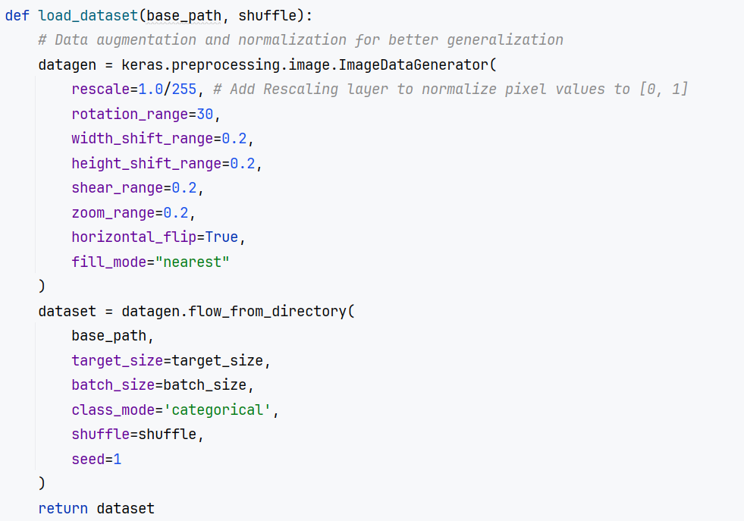
Data Preprocessing
Applied transformations:
Rotation, shifting, shear, zoom, flipping
Normalization (pixel values scaled to [0,1])

Slide 6
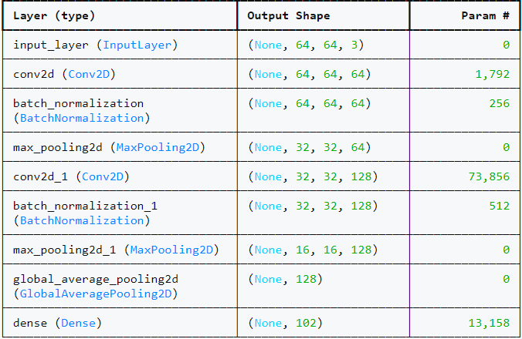
Model architecture

Slide 7
Model Evaluation
Model Training
Optimizer: RMSprop with ExponentialDecay learning rate
Loss function: Categorical Crossentropy
Early stopping applied to prevent overfitting
Training on 150 epochs (with early stopping
Final Model Performance:
Test Accuracy: 47.31%
Test Loss: 2.48

Slide 8
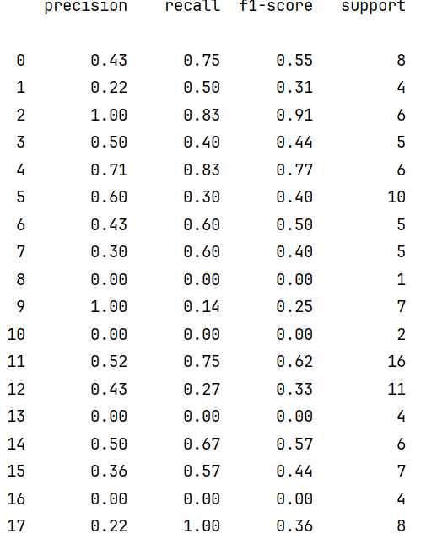
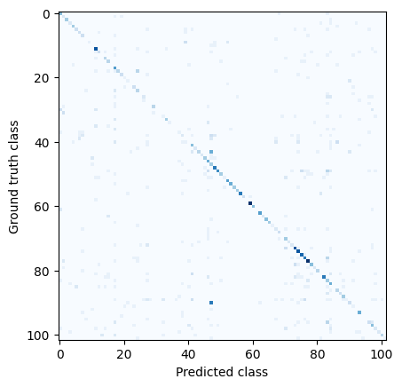

Slide 9
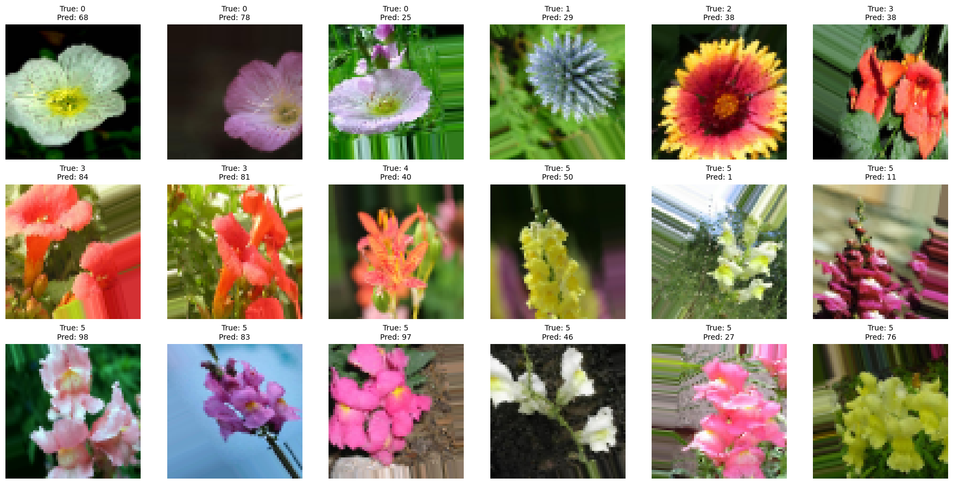
Mislabelled images

Slide 10
Overall Model Performance
Accuracy: 47%
-The model performs significantly better than random guessing (1% for 102 classes) but is still not optimal for real-world applications.
-The confusion matrix shows a concentration of predictions along the diagonal, indicating that the model is correctly classifying many instances.
-The model has a solid foundation but needs improvements to handle all 102 classes effectively

Slide 11
ECG Arrhythmia Classification using Deep Learning
A Deep Learning Approach to Detecting Arrhythmias from ECG Signals (Mono-Dimensional Signal Processing).
Goal
Develop a deep learning model to classify ECG arrhythmias using MIT-BIH Arrhythmia Database.
Implement a CNN-LSTM hybrid model for accurate detection.
Classify five heartbeat types: Normal, Left Bundle Block, Right Bundle Block, Atrial Fibrillation, and Premature Ventricular Contraction.

Slide 12
Dataset Description
MIT-BIH Database
Source: Kaggle
Classes: Five heartbeat types (N, L, R, A, V).
Preprocessing:
Denoising using wavelet transformation.
Normalization with z-score.
Segmentation centered on annotations.
Balanced dataset for fair training.

Slide 13
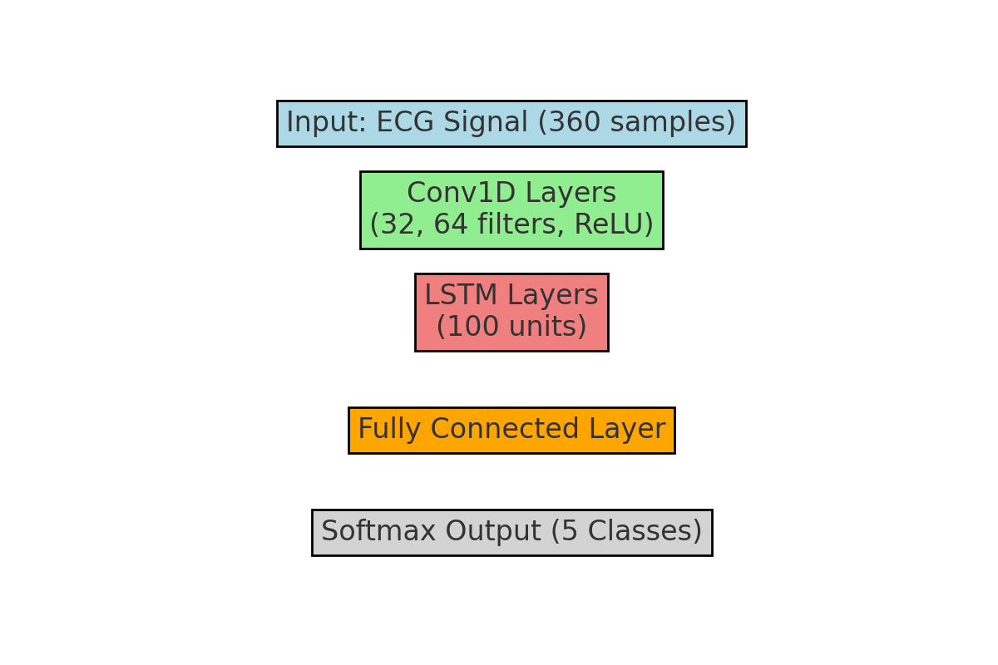
Model Architecture
Hybrid CNN-LSTM Approach
CNN layers for spatial feature extraction.
LSTM layers for temporal dependencies.
Fully connected layers with a softmax classifier.
Model Layers
Conv1D (32, 64 filters, ReLU) + MaxPooling
Dropout (50%) for regularization
LSTM (100 units) for sequential learning
Softmax output for 5 heartbeat classes

Slide 14
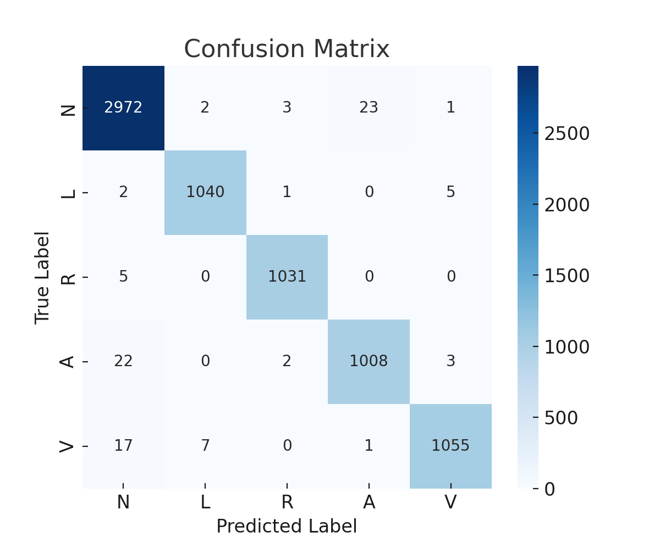
Model Training & Performance
Training Process
Optimizer: Adam
Loss Function: Categorical Cross-Entropy
Metrics: Accuracy
Trained on ECG dataset with high accuracy.
Performance Results
Test Accuracy: 98.69%
Test Loss: 0.0418

Slide 15
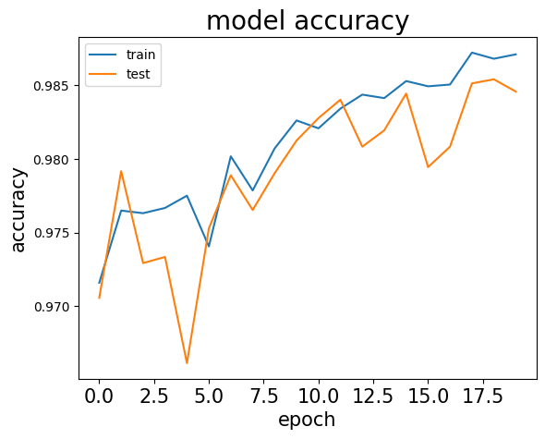
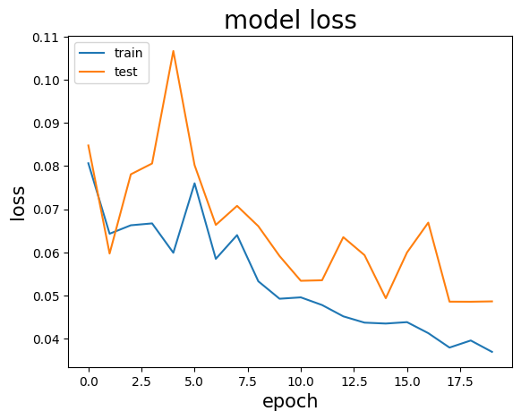
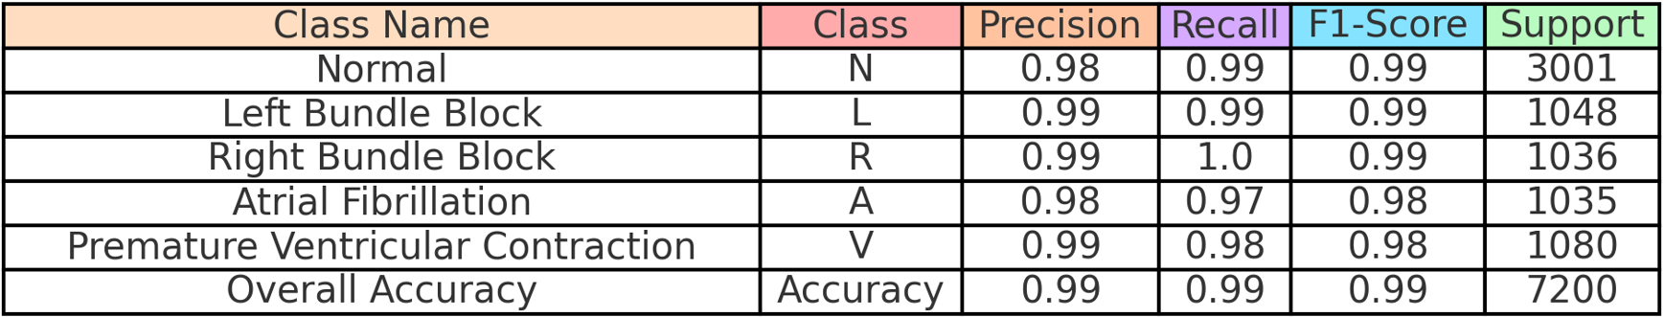
Confusion Matrix & Key Metrics
Evaluation Results
Train Accuracy: 99.05%, Train Loss: 0.0274
Test Accuracy: 98.69%, Test Loss: 0.0418
Classification Report

Slide 16
Conclusion & Future Work
Key Takeaways
CNN-LSTM architecture effectively classifies ECG signals.
Achieved 99% accuracy, suitable for arrhythmia detection.
Dropout layers prevent overfitting, improving generalization.
Future Enhancements
Explore transformers for ECG analysis.
Improve real-time processing and mobile health deployment.
Conduct further clinical validation.
References
MIT-BIH Database: https://www.kaggle.com/datasets/mondejar/mitbih-database
Paper: https://arxiv.org/pdf/2011.06187
Libraries Used: TensorFlow, NumPy, Pandas, Matplotlib, Scikit-learn, WFDB, PyWavelets, Seaborn.

Slide 17
Introduction to CBIR
Dataset & Preprocessing
Content-Based Image Retrieval (CBIR) retrieves images from a database based on visual content (colors, shapes, textures) instead of text
1. Images are collected and categorized.
2. Preprocessing steps:
- Resize images to 224x224
- Normalize pixel values
- Convert to NumPy arrays for deep learning processing.

Slide 18
Feature Extraction using Deep Learning
Image Similarity & Retrieval
Pre-trained models used:
ResNet50 : Extracts high-level patterns
VGG16 : Uses deep convolutional layers
InceptionV3 : Captures fine image details
These models convert images into feature vectors for comparison.
1. Query image is processed and features extracted.
2. Cosine similarity is computed between query and dataset images.
3. Top-N most similar images are retrieved and displayed.

Slide 19
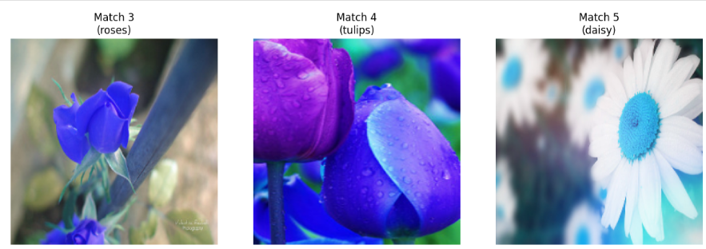
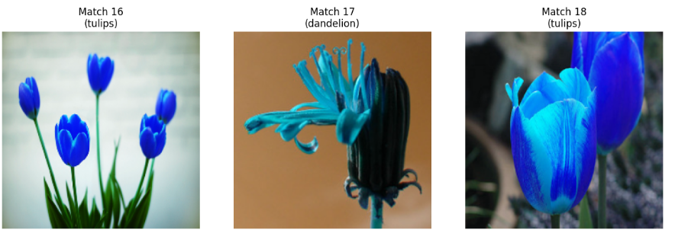
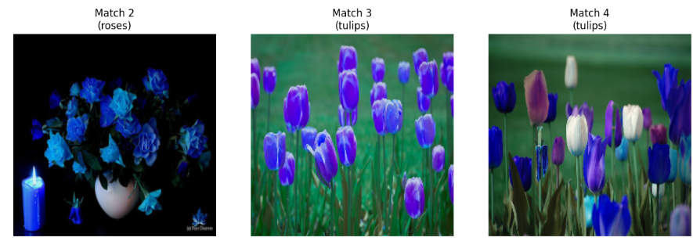
ResNet50
InceptionV3
VGG16

Slide 20
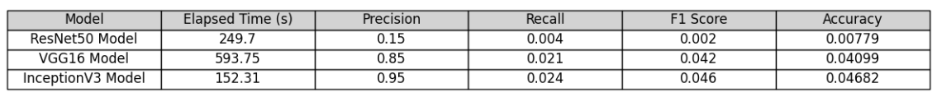
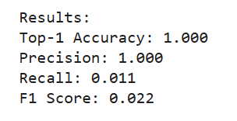
Evaluation Metrics
InceptionV3 outperformed other models with the highest precision (0.95), an F1 score of 0.046, and the fastest execution time (~152s). VGG16 showed good precision (0.85) but was inefficient due to its long execution time (~593s). ResNet50 had the lowest performance, likely needing more fine-tuning..We try to use fine tunning for VGG16 Model that we obtain this result:
Conclusion: InceptionV3 is the best model for retrieving similar flower images based on visual features.

Slide 21
Introduction to GANs
Generative Adversarial Networks (GANs) consist of:
Generator : tries to creat fake images and fool the Discriminator
Discriminator : tries to distinguish the images and label them as fake(0) or real(1)
DCGANs
The DCGAN training loop involves:
Discriminator Training: Learns to differentiate between real and generated images, updating its weights using loss from classification errors.
Generator Training: Generates fake images to fool the discriminator, updating its weights based on how convincing the generated images are.
Generated Image Results: The generator created colorful flower-like images with similar patterns and shapes. However, they were a bit blurry and noisy, meaning more training or improvements are needed for clearer results.

Slide 22
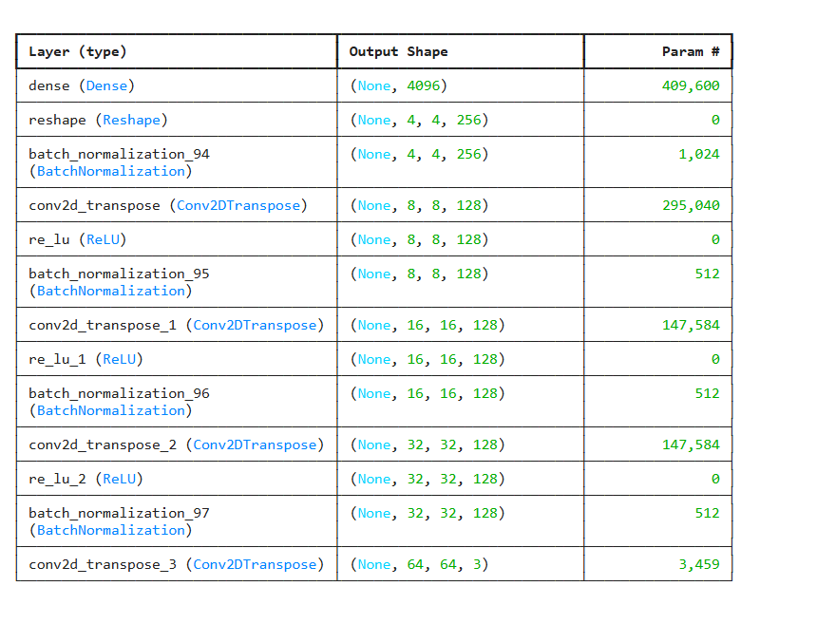
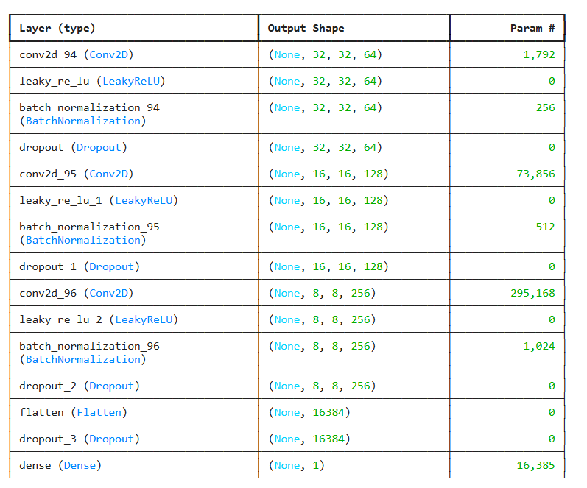
Building Generator
Building Discriminator

Slide 23
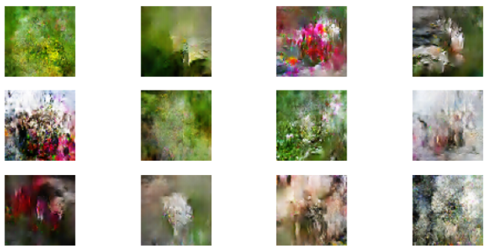
Generating New Images
Conclusion
•After training, the Generator creates new images resembling the dataset.
InceptionV3 was the best for retrieving similar flower images with high precision and speed. The GAN successfully generated floral-like images but needs further training for realistic results.
More training epochs lead to higher quality image generation

Slide 24
Thank you for your attention

