Slide 1
App Fingerprinting
Members:
Runze Zhang
Binhan Wang
Menghua Liu
Wenjie Li
Hafez Eslami Manoochehri

Slide 2
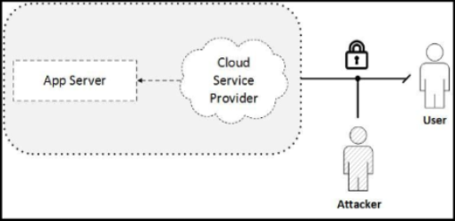
Introduction
The attacker gathers encrypted packets from
the network and tries to predict the name of the
app by data analytics/machine learning techniques.
This is called App Fingerprinting.

Slide 3
Tasks
1. Collect Data just like App Fingerprinting project
2. Consider more categories while selecting the apps
3. Make the category of an app the output variable or class label
4. Divide your data into training set and testing set randomly.
5. Include a report that describes your procedure of collecting data and feature extractions.

Slide 4
Data Collection
1- Dynamic analysis: 30,000 apps from three categories of Finance, Social and Communication are installed on the phone. After the app is lunched, each trace per app is collected over a 30-sec period.
Filter those packets from port 80, 8080 and 443. The filter the apps that used HTTPS data.
2- Data analysis: Various features from network packets are extracted and then used alongside machine learning techniques to train a model that can identify an app from its network traffic.

Slide 5
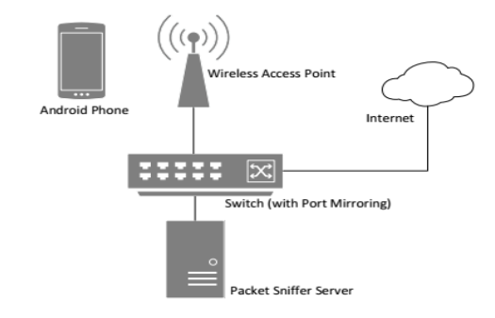
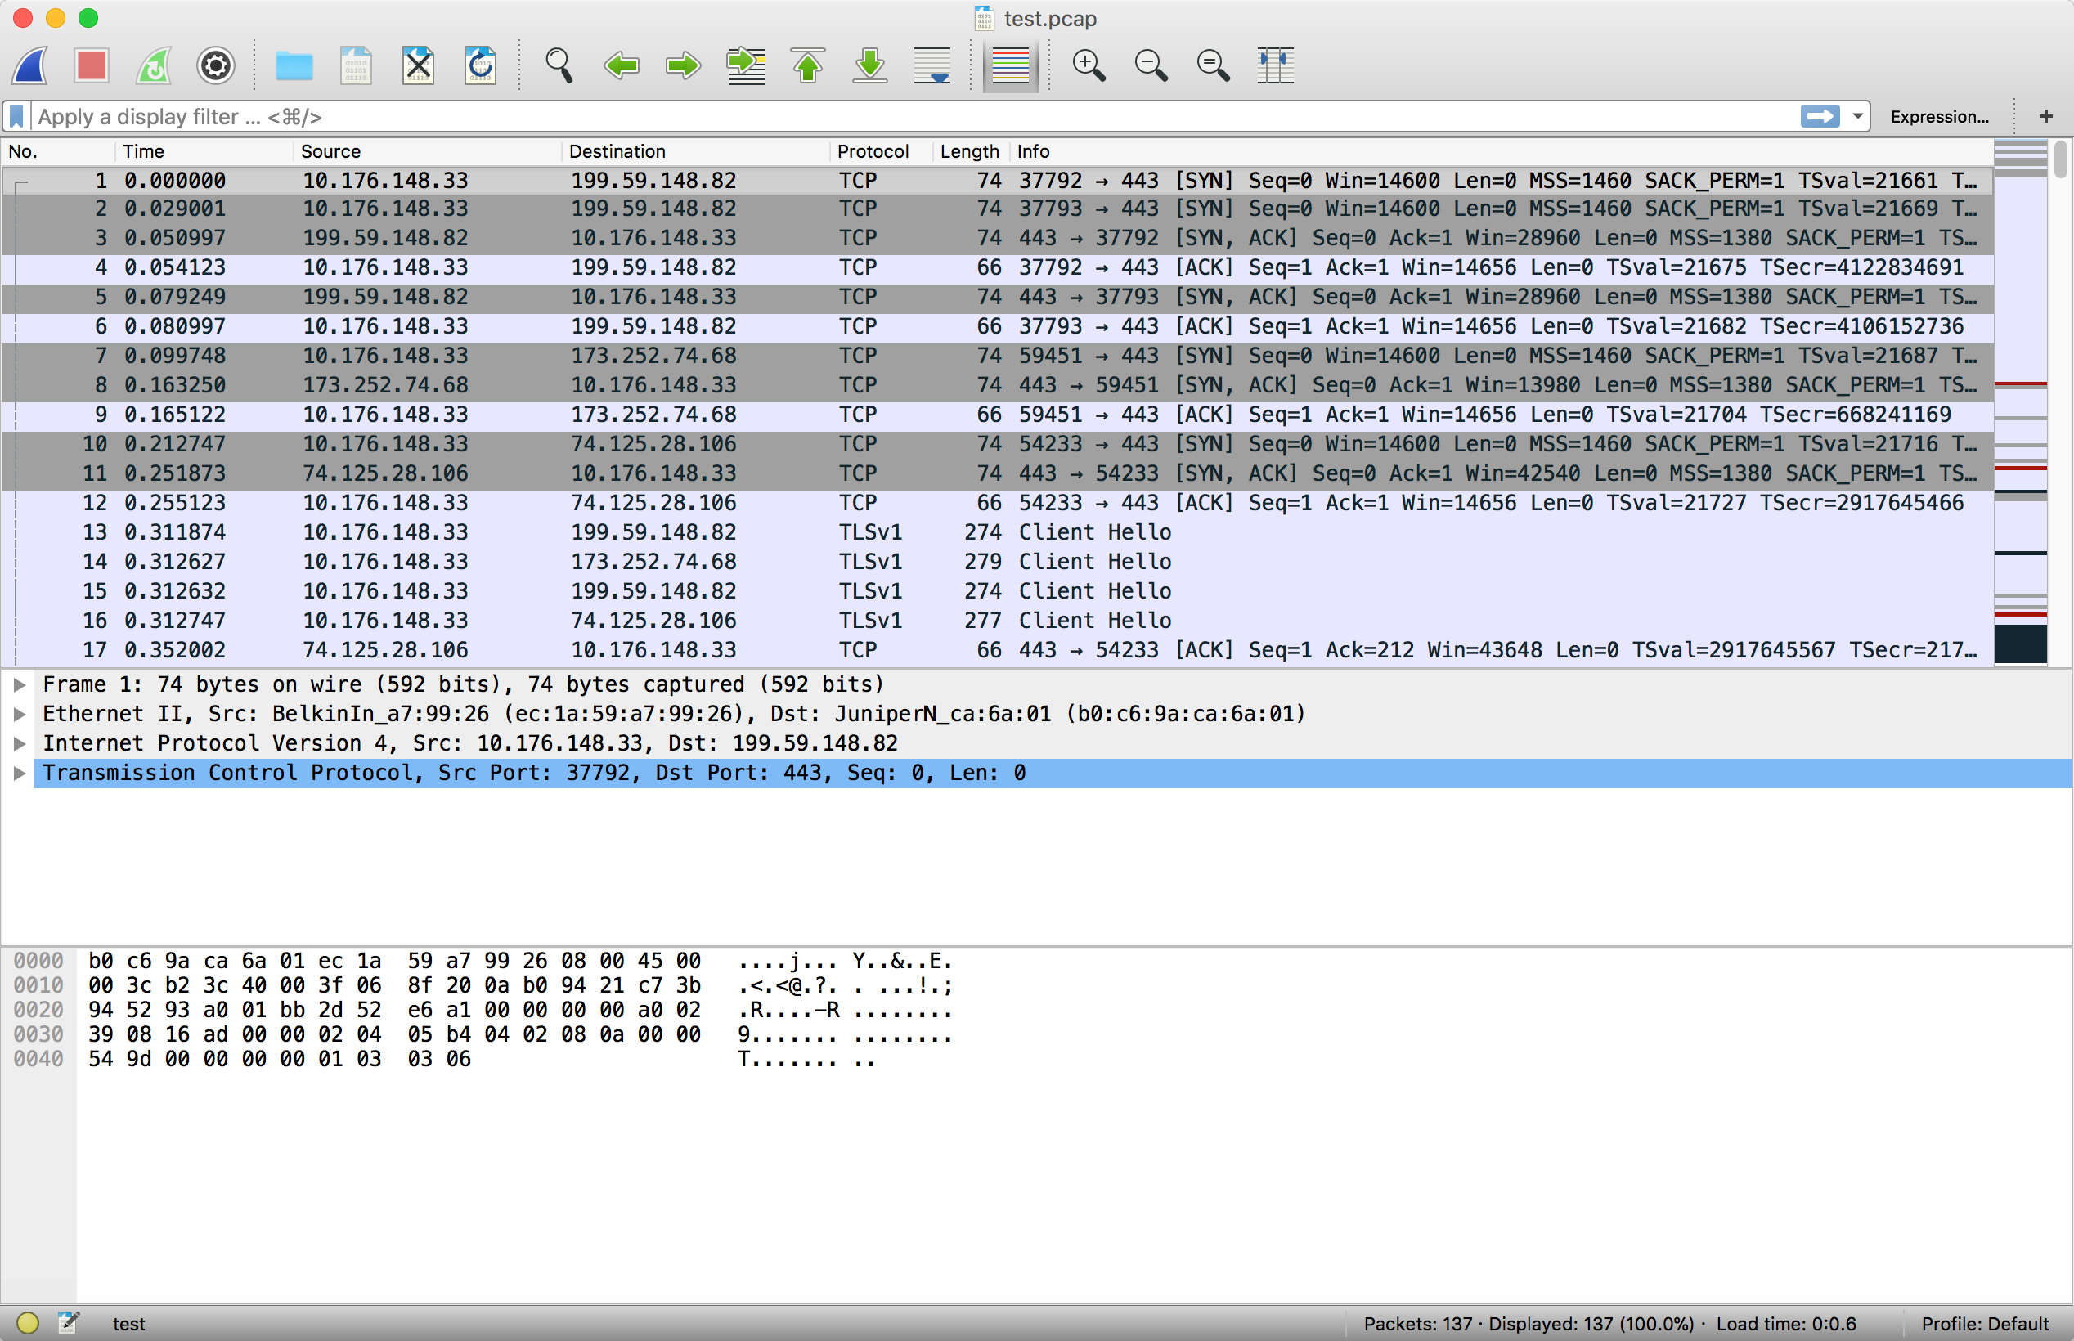
Data Collection - Dynamic analysis
Sniffed network traffic is done by WireShark

Slide 6
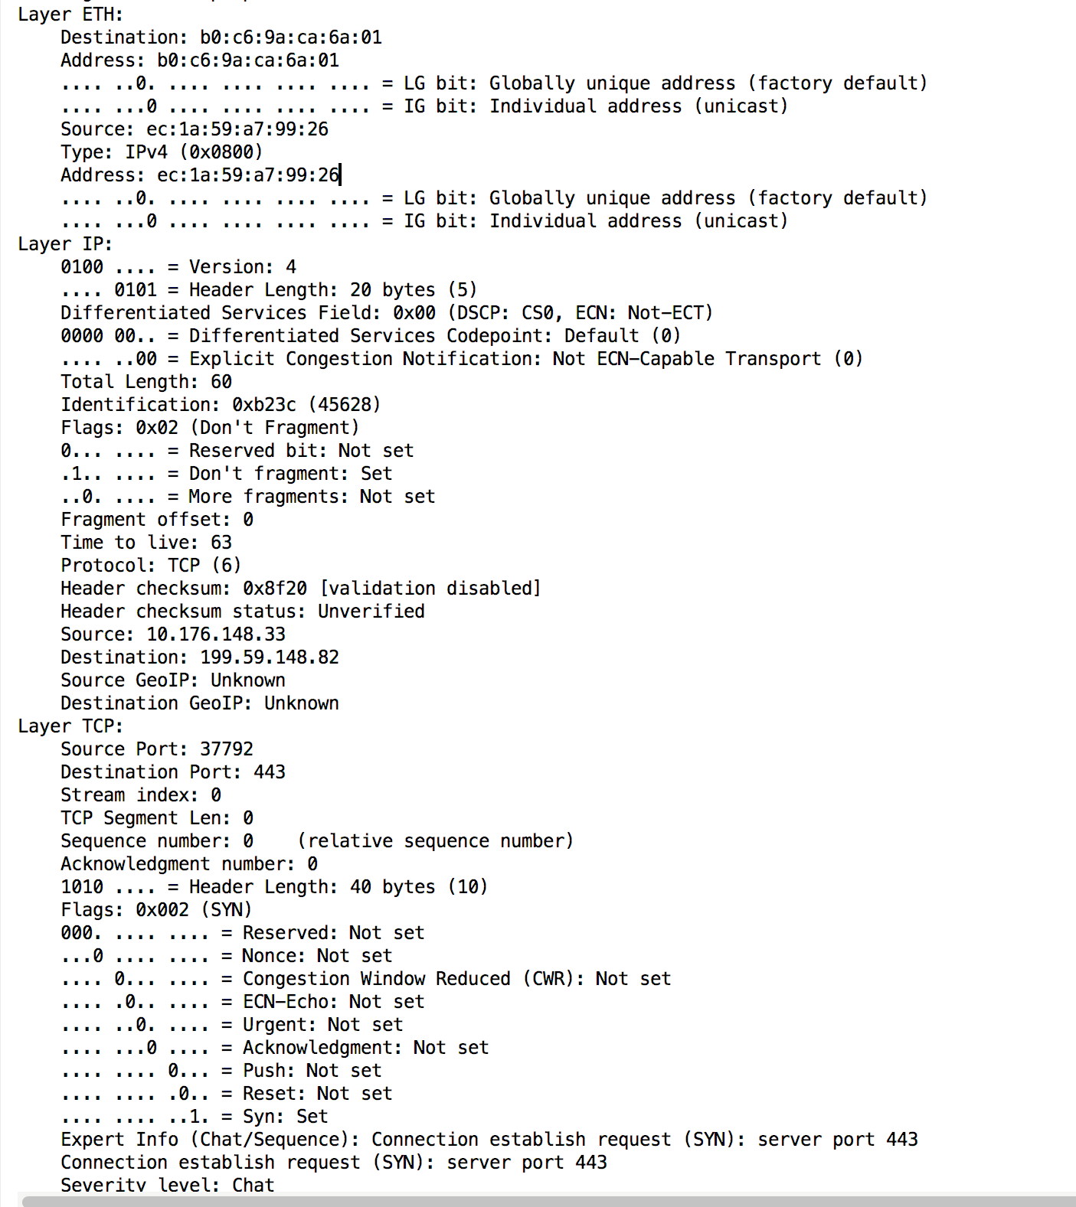
Data Collection – Dynamic analysis
We use PyShark to process the PCAP file to extract useful features.

Slide 7
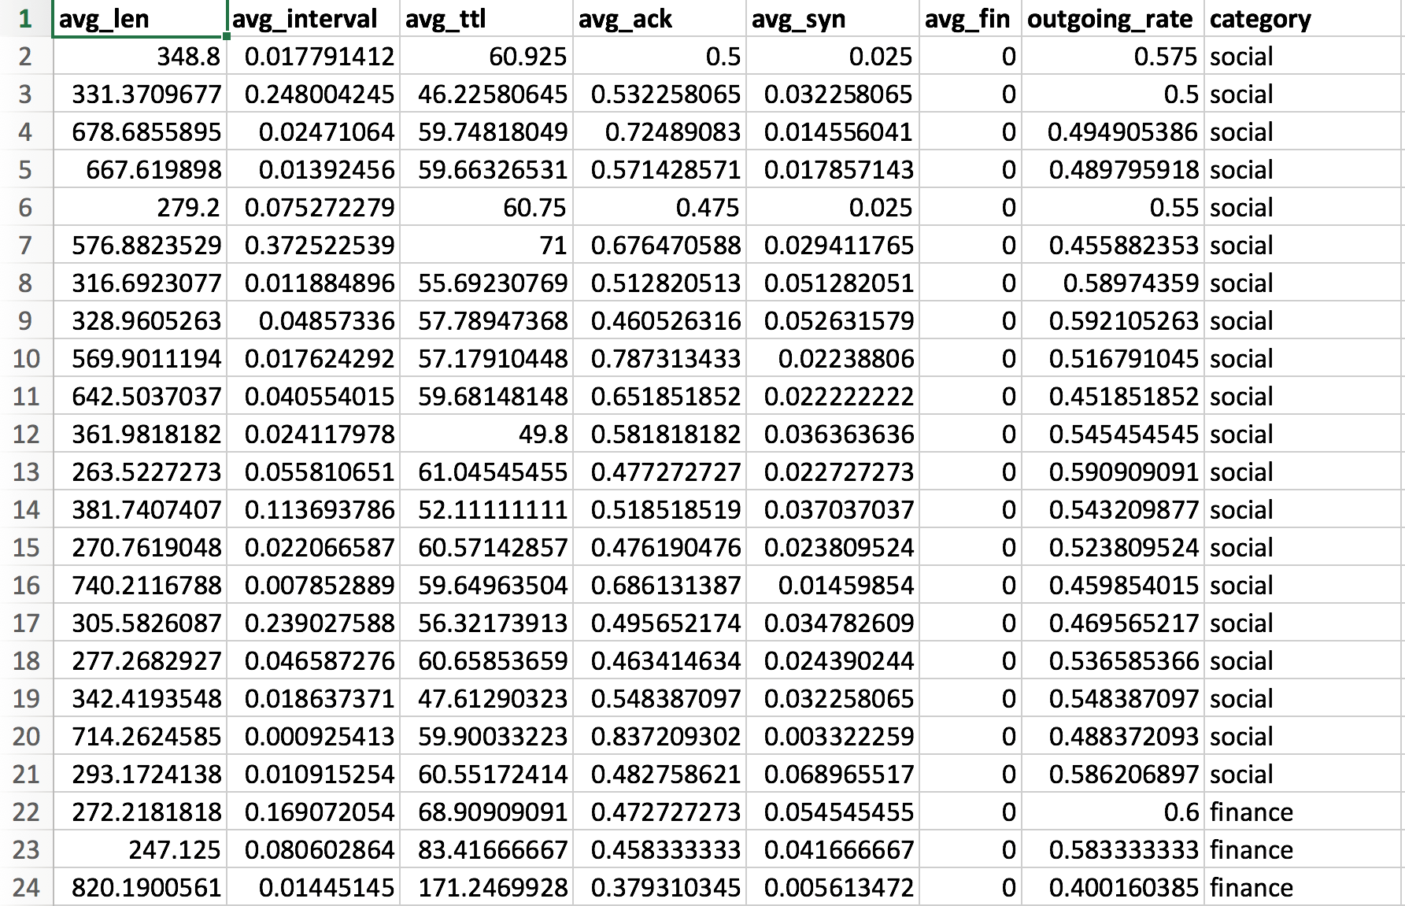
Feature Extraction - Data analysis
The features we extracted are:
1- Average length
2- Average interval
3- Average Time To Live
5- Average Ack TCP flag count
6- Average Syn TCP flag count
7- Average Fin TCP flag count
8- Outgoing rate
Final Data

Slide 8
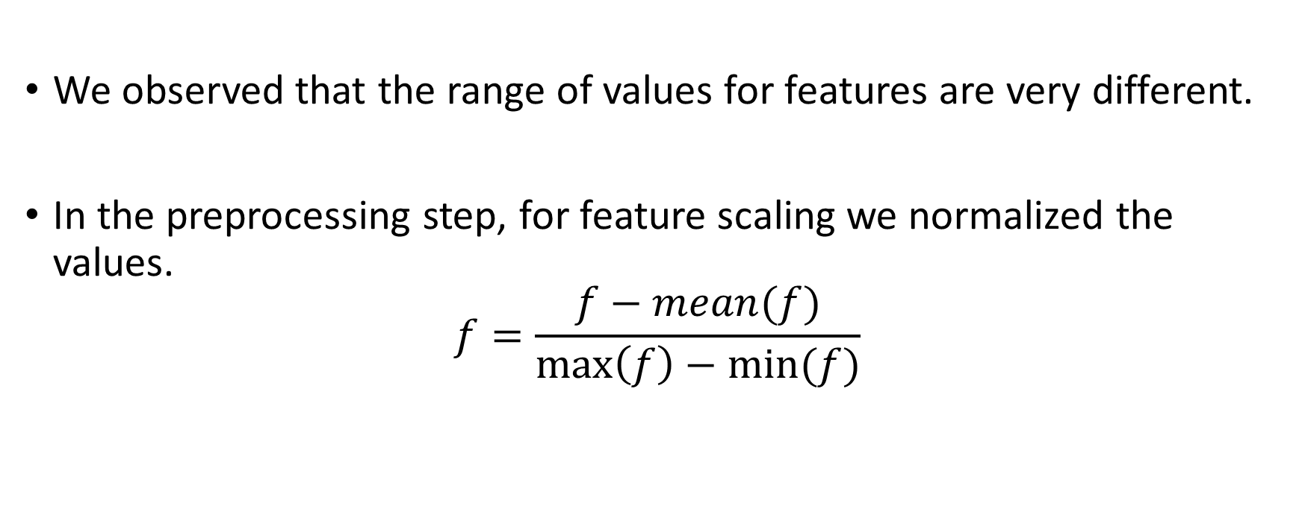
Data Preprocessing
We observed that the range of values for features are very different.
In the preprocessing step, for feature scaling we normalized the values.
$$f=\frac{f−mean(f)}{\max\left(f\right)−min⁡(f)}$$

Slide 9
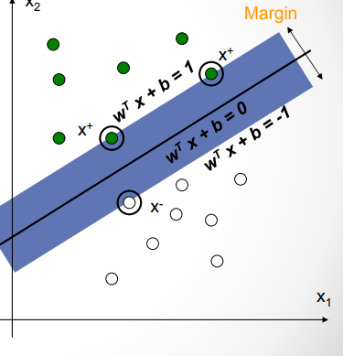
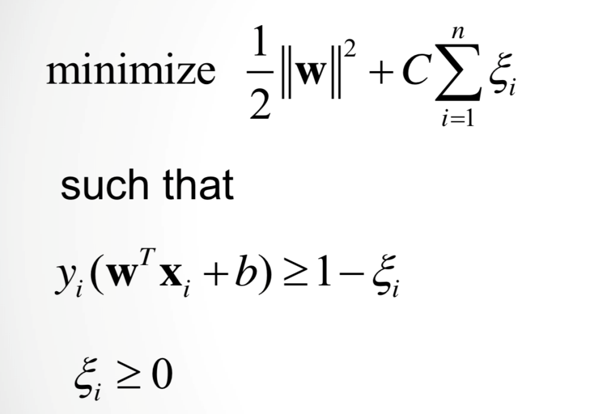
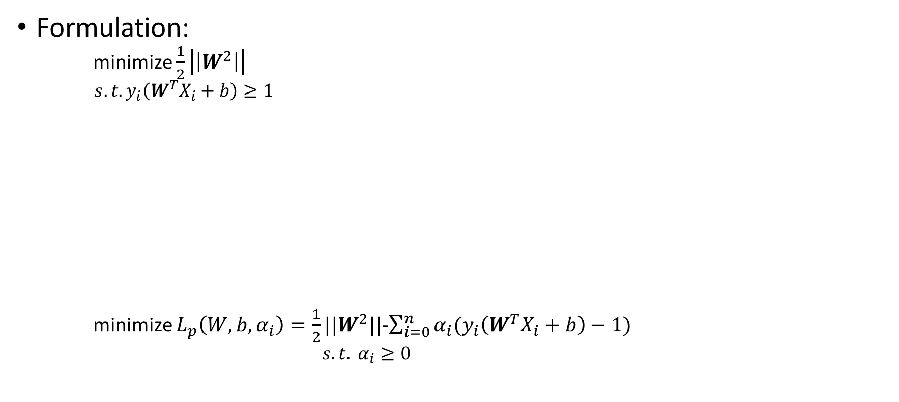
SVM
Slack variable
Formulation:
minimize $\frac{1}{2}\left|\left|W^{2}\right|\right|$
$s.t. y_{i}\left(W^{T}X_{i}+b\right)≥1$
minimize $L_{p}\left(W,b,α_{i}\right)=\frac{1}{2}||W^{2}||$-$\sum_{i=0}^{n}{α_{i}(y_{i}\left(W^{T}X_{i}+b\right)−1)}$
$s.t. α_{i}≥0$
Lagrangian Function

Slide 10
Results
To report the accuracy, we used 10-fold cross validation.
 |  | Accuracy
SVM | Parameters | Dataset1 (58 samples with 3 classes) | Dataset2 (120 samples with 4 classes)
 | Kernel = rbf | 0.762097902098 | 0.884126482213
 | kernel= sigmoid | 0.844382284382 | 0.667494071146
 | kernel= poly, degree=3 | 0.795664335664 | 0.708980237154
 | kernel= poly, degree=8 | 0.844382284382 | 0.698798418972
 | kernel= poly, C=10,degree=8 | 0.829230769231 | 0.749675889328

Slide 11
Thank you!

