Slide 1
Overview

Slide 2


Company Overview
Cinchcast is a cloud-based, enterprise solution webcasts and conference calls of
any size.
Founded in 2006
HQ in New York, NY
Powering thousands of events every day
Helping companies better connect and communicate, while significantly reducing event costs. Companies such as…

Slide 3






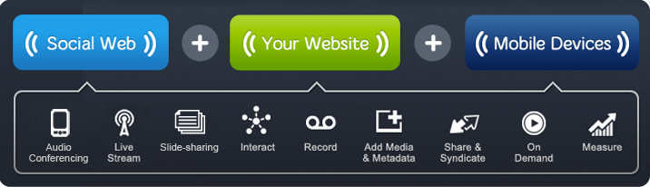
The Cinchcast Connect Platform
Secure, Scalable, Easy-to-Use

Slide 4

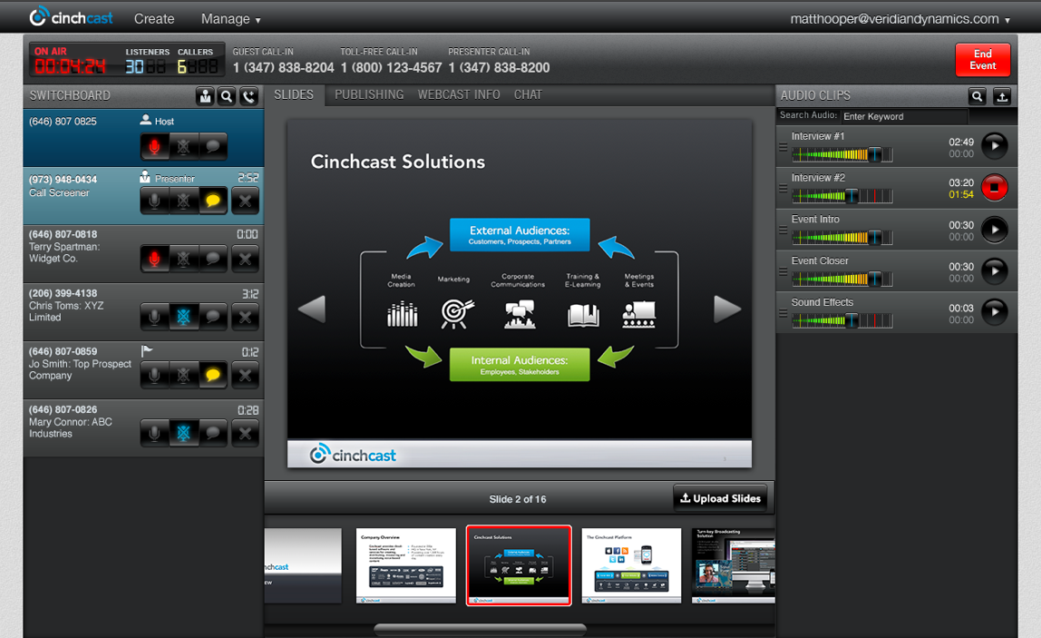
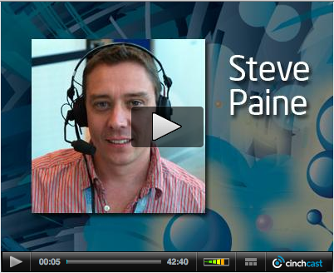
Turn-key Broadcasting Solution
The Cinchcast Connect Studio

Slide 5
What Makes Cinchcast Different?
Improved Participant
Experience
Flexibility and Control
Moderate phone-based Q&A without expensive operators
Self-provision and manage events from a streamlined management console
No hold times for call-in participants
No download's or plugins required
Easily enables mobile participation across devices
Integration and Ease-of-Use
Simple, Affordable Pricing
Audio conference is fully-integrated with web stream
Slide-sharing, audio file playback, caller switchboard and chat available in one web-based console.
Dedicated dial-in numbers for both host and listeners
Cost-effective per event and subscription-based pricing
No hidden charges
No fees for unused services

Slide 6
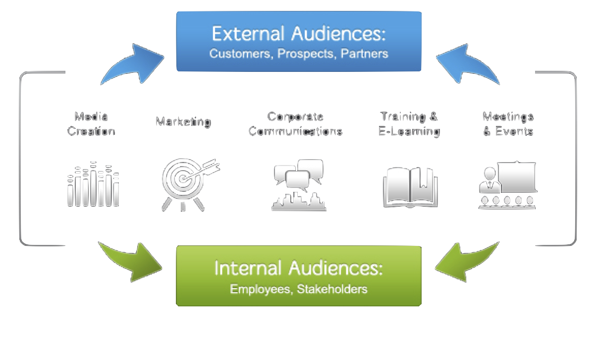
Solutions for External & Internal Communications

Slide 7
Turn-key Broadcasting Solution
Applications
External Conference Calls of Any Size
Marketing Webinars or Webcasts
Investor Relations Calls
Product Training
On-demand Slideshows or Podcasts
Partner Communications and Training
Internal Conference Calls of Any Size
Employee Town Halls
Team Meetings
All-Hands or Departmental Employee Presentations
Online Training

Slide 8
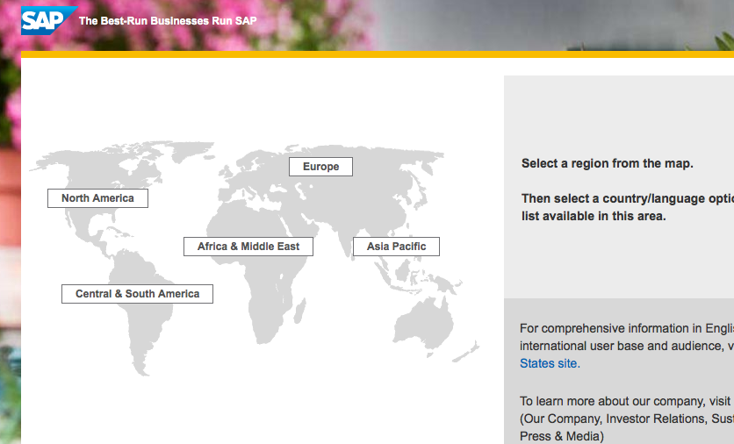
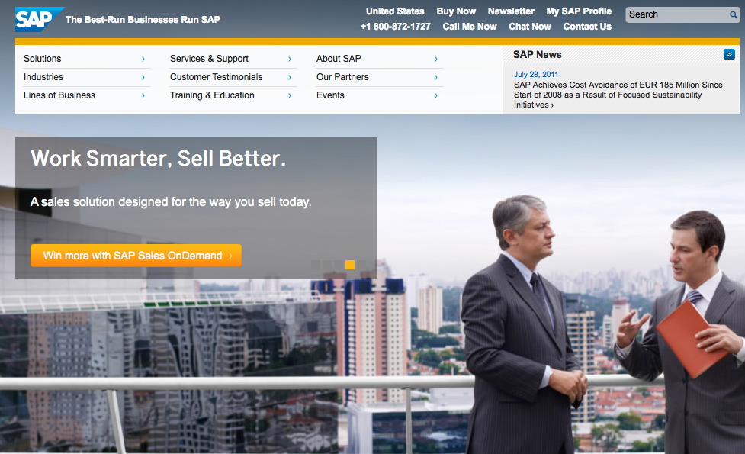
SAP Case Study Enhancing communications with its global salesforce
SAP conducts a regular call-in event to discuss key sales priorities, sales approaches, and new solutions and services.
Sales professionals worldwide tune in on their computers, phones, or web-enabled devices.
Team members call in to ask questions and contribute to the conversation.
Sessions are automatically archived for later listening.

Slide 9
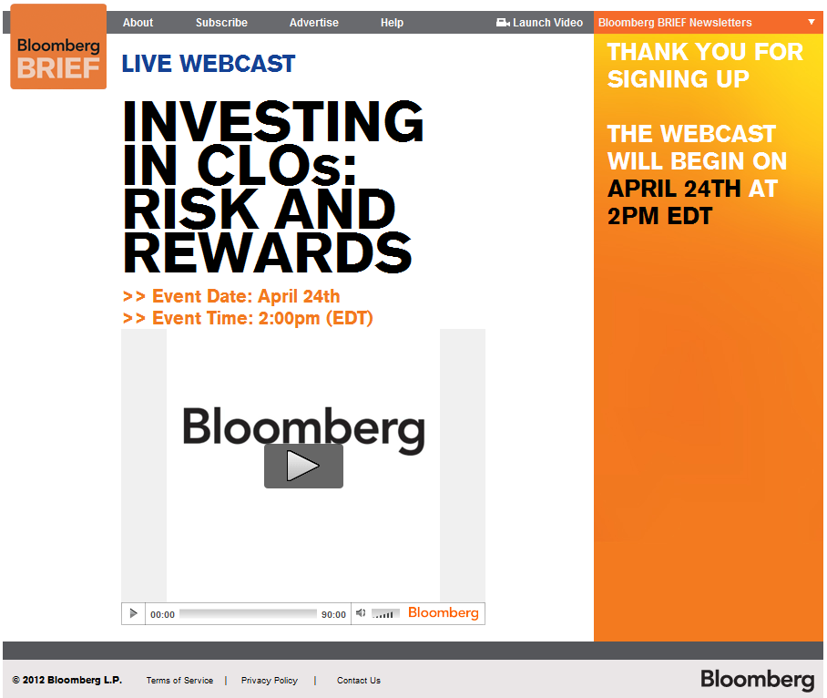
Bloomberg Effectively generating leads with high-impact web events
Bloomberg is leveraging Cinchcast to power its online events efforts.
Offer live and archived events.
All events available behind registration wall to drive lead generations.

Slide 10
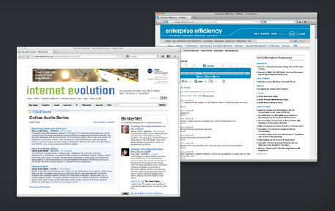
UBM Case Study Leveraging interactive audio events to increase reach, engagement, and revenue
Launched live and archived broadcasts on 6 properties
Content is easily integrated into their current web, advertising, and content management infrastructures
User engagement with events is exceeding others content mediums
Content is garnering high-value sponsorships and advertising

Slide 11
Thank You

