Slide 1


Company Overview
Cinchcast is a cloud-based, enterprise solution webcasts and conference calls of
any size.
Founded in 2006
HQ in New York, NY
Powering thousands of events every day
Helping companies better connect and communicate, while significantly reducing event costs. Companies such as…

Slide 2






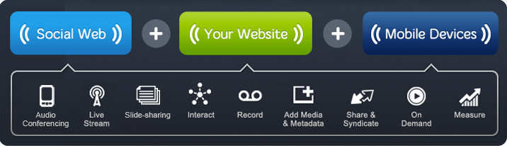
The Cinchcast Connect Platform
Secure, Scalable, Easy-to-Use

Slide 3
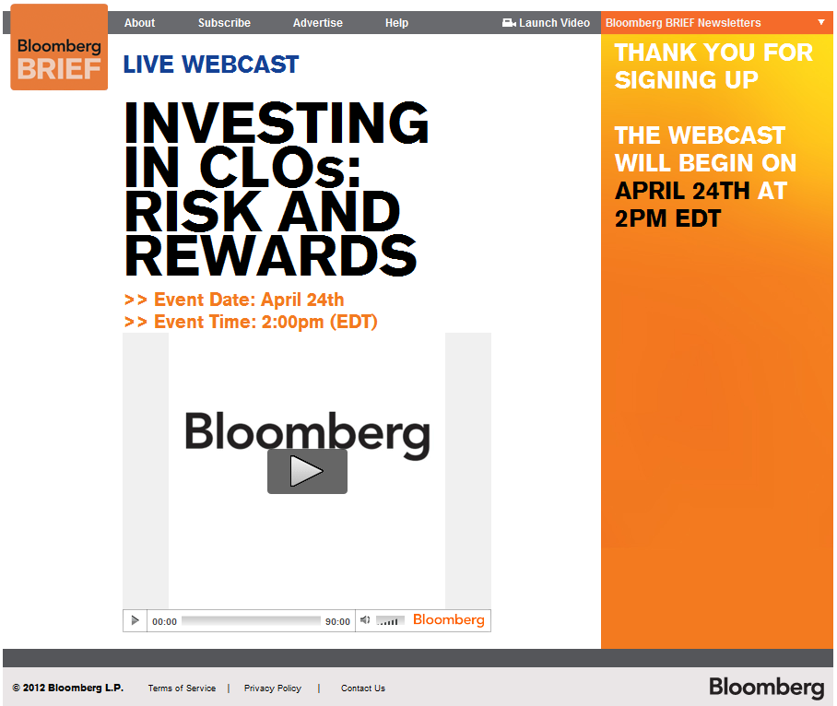
Bloomberg Effectively generating leads with high-impact web events
Bloomberg is leveraging Cinchcast to power its online events efforts.
Offer live and archived events.
All events available behind registration wall to drive lead generations.

Slide 4
Thank You

