Slide 1

VLSI Design of CRC-Based Fingerprinting on MIPS8 Architecture
Georgi Kostadinov, Xinchi Chen, Kaushik Boga, Mojing Liu
Department of Electrical and Computer Engineering
McGill University
Notes:
Hi,
Today we are going to talk about our implementation of a CRC based fingerprinting on a MIPS 8 Architecture.

Slide 2
Approach
Fingerprinting in 3 easy steps:
Extract data from processor
Compress data into fingerprints
Store fingerprints for comparison
Notes:
So in the presentation we will present our implementation in three simple steps.

Slide 3
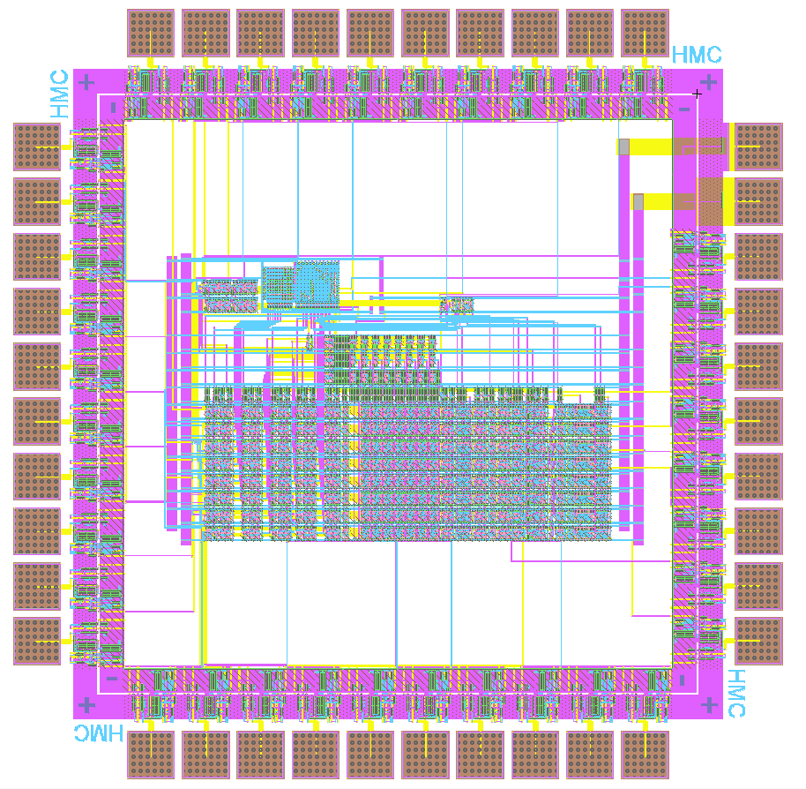
Extracting the Data
Memory write address and data
Register data
Other options also possible
Original MIPS8 packaging
9 additional pins (8 bit register data + register control signal)
Notes:
The data that we decided to fingerprint is memory write address and data as well as register data updates. We have to add additional export to the original chip which turn out to be a perfectly using all the pins. So we were able to maintain the original MIPS8 packaging, therefore eliminating the cost of a new package, and we made use of the 9 remaining pins that were available. 8 of them are for the 8 bit register data and a control signal that tells us if a register was written.

Slide 4
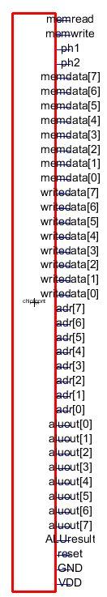
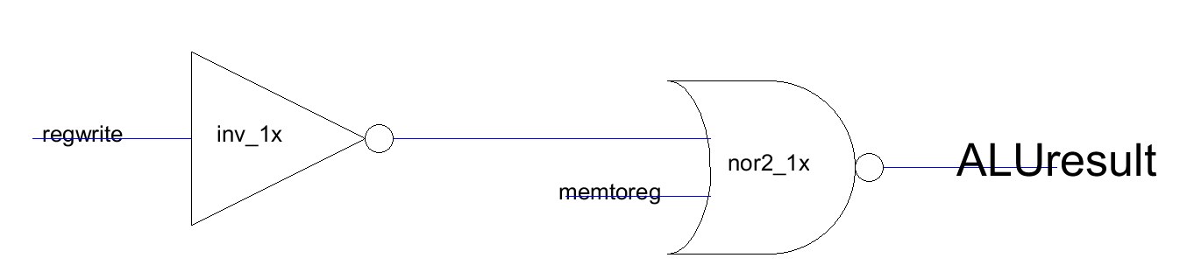
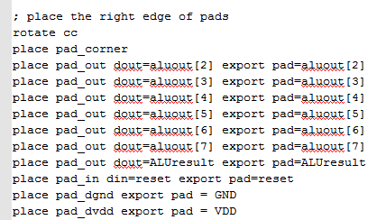
Extracting the Data
And it passes DRC,ERC,NCC
Notes:
The data that we decided to fingerprint is memory write address and data as well as register data updates. We have to add additional export to the original chip which turn out to be a perfectly using all the pins. So we were able to maintain the original MIPS8 packaging, therefore eliminating the cost of a new package, and we made use of the 9 remaining pins that were available. 8 of them are for the 8 bit register data and a control signal that tells us if a register was written.

Slide 5
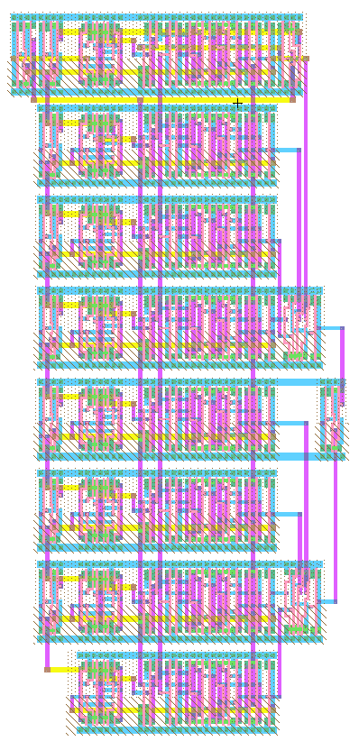
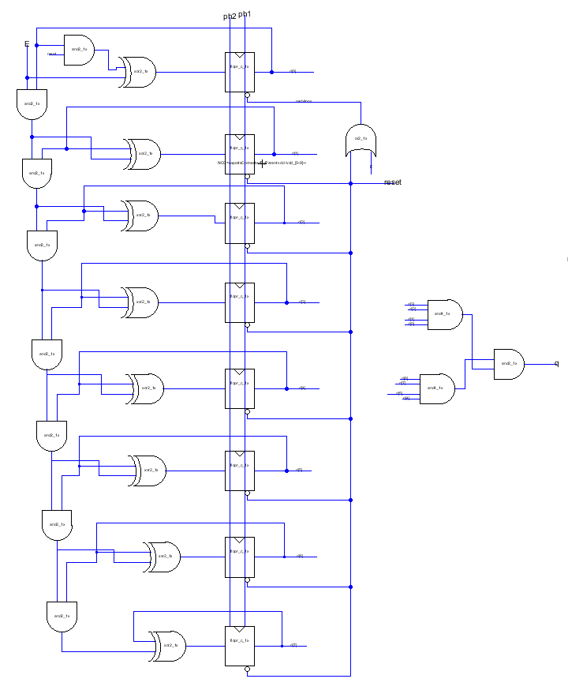
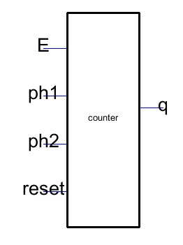
Counter
And it passes DRC,ERC,NCC
Notes:
The data that we decided to fingerprint is memory write address and data as well as register data updates. We have to add additional export to the original chip which turn out to be a perfectly using all the pins. So we were able to maintain the original MIPS8 packaging, therefore eliminating the cost of a new package, and we made use of the 9 remaining pins that were available. 8 of them are for the 8 bit register data and a control signal that tells us if a register was written.

Slide 6
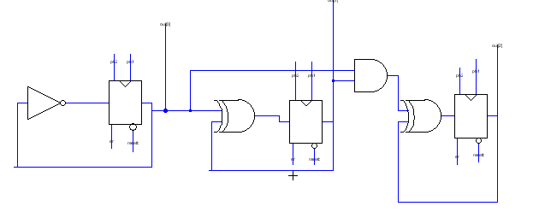
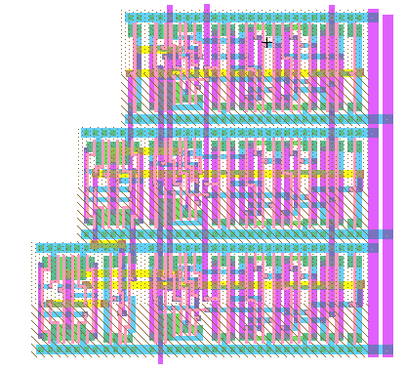
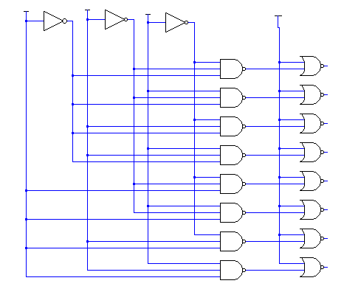
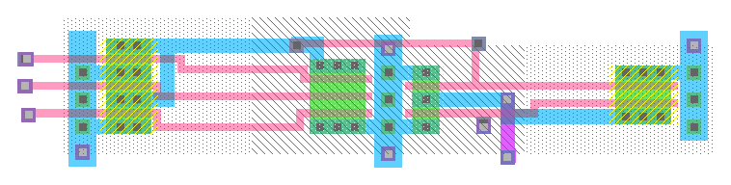

Slide 7
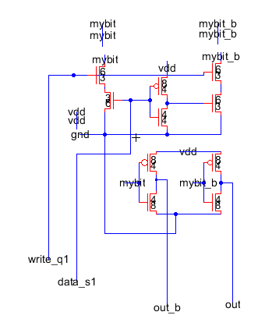

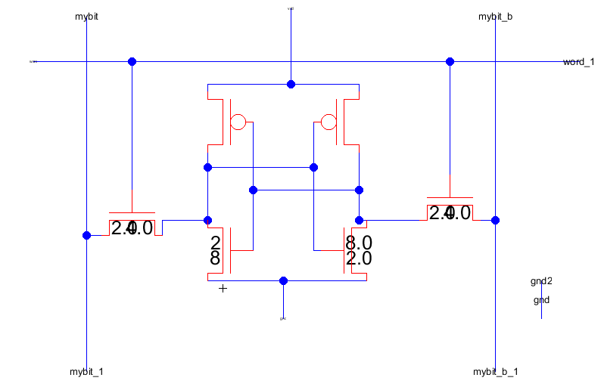
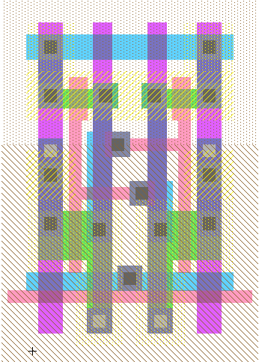
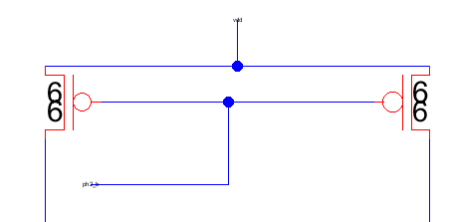
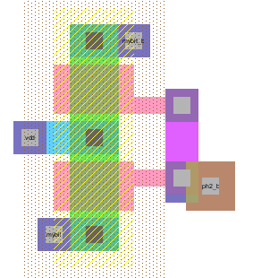

Slide 8
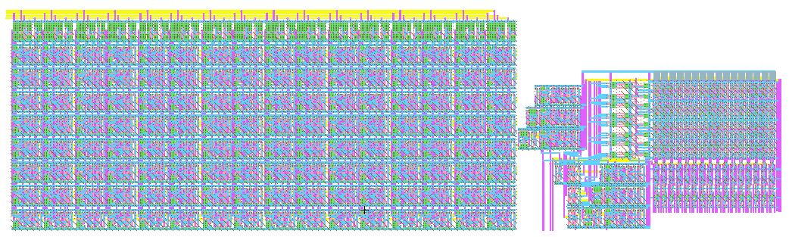

Slide 9
SRAM IRSIM Snapshots time
(Manually shown to zoom in and explain various features)

