Slide 1

VLSI Design of CRC-Based Fingerprinting on MIPS8 Architecture
Georgi Kostadinov, Xinchi Chen, Kaushik Boga, Mojing Liu
Department of Electrical and Computer Engineering
McGill University
Notes:
Hi,
Today we are going to talk about our implementation of a CRC based fingerprinting on a MIPS 8 Architecture.

Slide 2
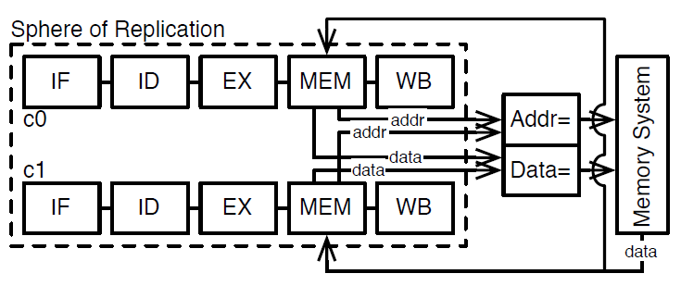
Background and Motivation
SER and MBU increase
Lockstep Execution: Area Overhead
Lockstep Execution
Notes:
As you may all have hear before, processor are vulnerable to soft errors. Soft errors are errors introduced mainly by neutron radiation but also alpha particles. Soft errors are transient, purely random through time and space but also unpredictable. This caused eventually enormous problem in safety critical systems. For example, imagine your processor is calculating the amount of fuel to inject in an aircraft motor and one or more bits in that number get exposed to radiation and becomes corrupted. This is a very dangerous situation where we would never want to be in. Therefore, industry has provided protection against such error through ECC. However ECC is very expensive in terms of computational power. The processor needs to compute for every value the protection bits than compare it. Hence, a more relevant solution that is widely used, is DMR in lockstep. Lockstep execution provides protection through the duplication of a core. To the outside world, it behaves as one. But in the inside, the two processor operates in parallel on independent resource preferably, and compares the data that they obtained. If the comparison is valid, then the change is committed outside of the sphere of replication. Eventually, as soft errors are rare, and that the ressources are independent, a an error can be caught. However, this is not a very efficient design. First, a lot of power is used in data comparison, second, the cost is doubled for the same performance and last but not the least, as our systems get more and more complicated, dealing with this lockstep synchronization and clock distribution becomes a nightmare.

Slide 3
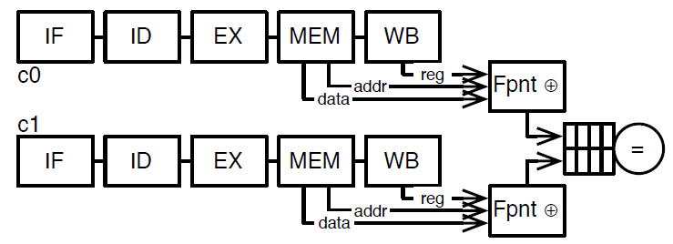
Execution Fingerprinting
Data Compression -> Less communication overhead
No Lockstep -> Better schedulability and performance
Execution Fingerprinting
Notes:
This is why we turned to execution fingerprinting. Fingerprinting first used TMR, which allows processors to execute out of sync, thus breaking the lockstep. This will create much more freedom in terms of schedulabilty and allowing us to apply a second technique called RD which allows our processor to also execute non critical tasks. Both techniques comes from papers that prof Meyer has published and I invite you all to have a look.
So back to fingerprinting, as the processor are out of sync, in order to compare the execution data, we need to save it somewhere. However, directly saving this data would take a look of space, hence we compress it into a single word called fingerprint. The compression algorithm can be chosen by the designer and will have different impact in terms of error coverage and detection.

Slide 4
Goals of this Project
Implementation of Fingerprinting
Area overhead estimation of two fingerprinting technique
Fingerprinting performance analysis
Notes:
So the goal of our project is to
First, implement fingerprinting in terns of sch and layout.
Then we would like to look at the varying area overhead estimation for two fingerprinting technique. Indeed, exaction information is vast and you can choose which type of information you would fingerprinting leading to different storage need. In our case, we took fingerprinting memory addresses and data and register data updates.
Last but not the least, we will look at the timing performance of fingerprinting. We want to know if fingerprinting is realistically possible and will not slow down the processor.

Slide 5
Approach
Fingerprinting in 3 easy steps:
Extract data from processor
Compress data into fingerprints
Store fingerprints for comparison
Notes:
So in the presentation we will present our implementation in three simple steps.

Slide 6
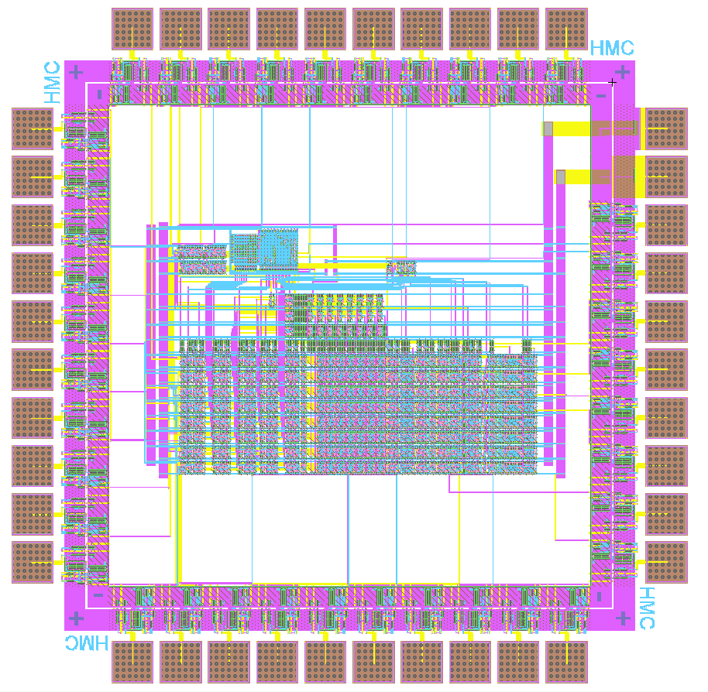
Extracting the Data
Memory write address and data
Register data
Other options also possible
Original MIPS8 packaging
9 additional pins (8 bit register data + register control signal)
Notes:
The data that we decided to fingerprint is memory write address and data as well as register data updates. We have to add additional export to the original chip which turn out to be a perfectly using all the pins. So we were able to maintain the original MIPS8 packaging, therefore eliminating the cost of a new package, and we made use of the 9 remaining pins that were available. 8 of them are for the 8 bit register data and a control signal that tells us if a register was written.

Slide 7
Compressing the Data
Use Cyclic Redundancy Check (CRC) algorithm
Widespread, simple, and designed for error detection
Chose 16-bit wide for better error coverage

Slide 8
Parallel CRC
Maximum 16 bits of data at a time
Compute CRC in parallel – no need for input buffer
Use 0x755B polynomial – good for larger block sizes
Use method from “A Practical Parallel CRC Generation Method” by E. Stavinov to come up with matrices
M[10] = N[0] ^ Mp[0] ^ N[3] ^ Mp[3] ^ N[5] ^ Mp[5] ^ N[6] ^ Mp[6] ^ N[7] ^ Mp[7] ^ N[8] ^ Mp[8] ^ N[9] ^ Mp[9] ^ N[10] ^ Mp[10] ^ N[11] ^ Mp[11] ^ N[12] ^ Mp[12] ^ N[13] ^ Mp[13] ^ N[14] ^ Mp[14];

Slide 9
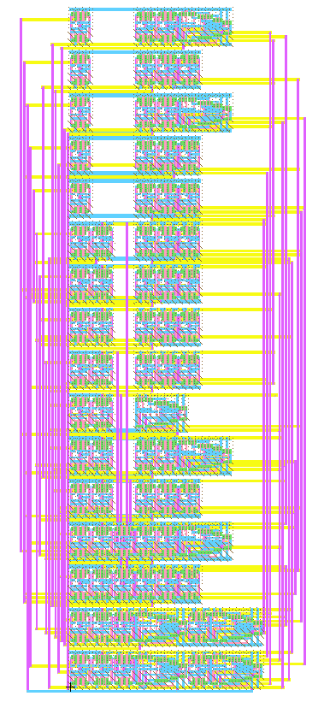
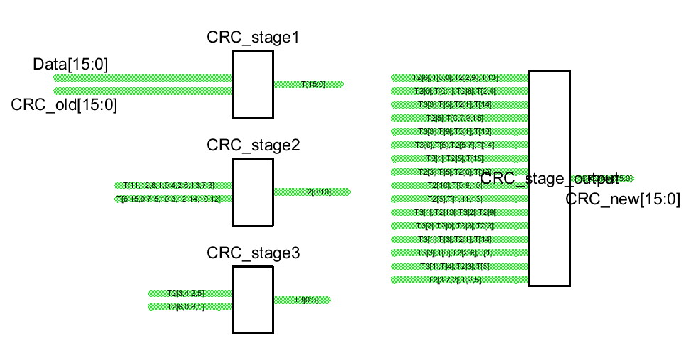
Implement the Circuit
Lots of XORs and lots of wires
Minimize by combining common operations
Split up into stages

Slide 10
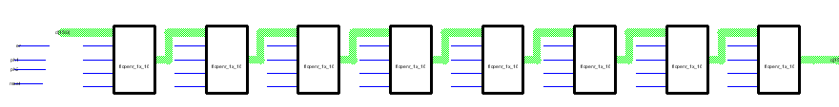
Storing the Fingerprints
Initial implementation: Shift Register
Drawbacks:
30 Transistors per flip-flop
To store 16 X 8 = 128 bits, need 3872 transistors (not area efficient).

Slide 11
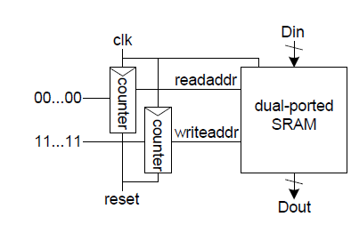
Improved implementation: SRAM
Keep large amounts of data in SRAM
Move read/write pointers to SRAM than data itself

Slide 12
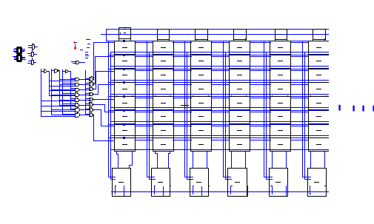
SRAM Implementation
6T SRAM Cell
Bit line conditioning
Read/write drivers
Row decoder
3 bit counters
Testing issues encountered

Slide 13
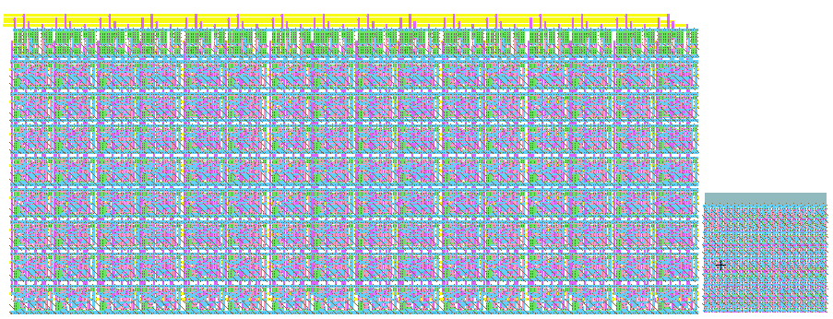
Evaluation – Area Estimation
Transistor count: 3872vs 1374
2350 X 1026 vs 500 X 450 lamda

Slide 14
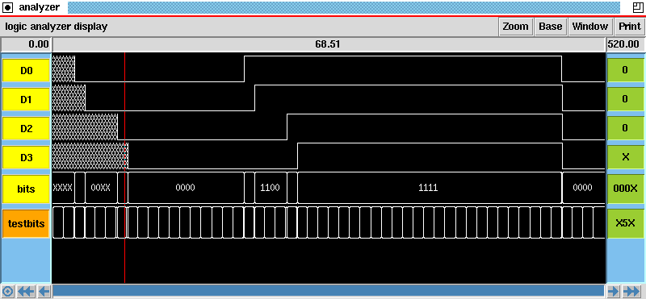
Evaluation - Timing
IRSIM
IRSIM is a tool for simulating digital circuits. It is a "switch-level" simulator; that is, it treats transistors as ideal switches. Extracted capacitance and lumped resistance values are used to make the switch a little bit more realistic than the ideal, using the RC time constants to predict the relative timing of events.
Notes:
thank you XXX. Ok, so now I will talk about the timing analysis of our design. As Georgi just stated, we can do functional simulation by Modelsim. However, as this is a transistor-level design, we need to take the actual transistor attributes into consideration. Therefore, only functional simulation from modelsim is not sufficient, and we need to implement a transistor level timing simulation.
Irsim is a tool for simulating digital circuits, and extracted capacitance and lumped resistance values are used to enhance the simulation performance. Also RC time constants are used to predict the relative timing of events.

Slide 15
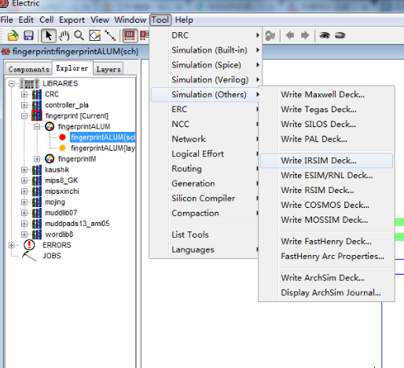
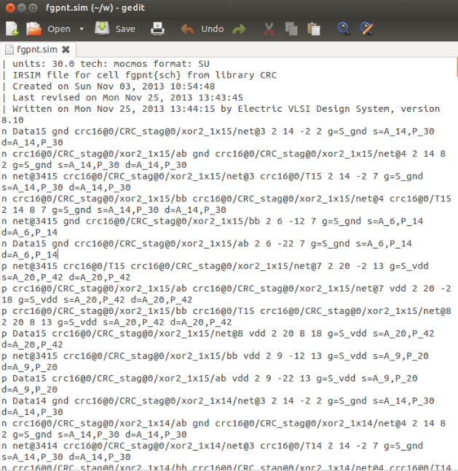
Timing Analysis
Notes:
In electric, we can generate a irsim deck. This is basically a description of the circuit, including all the transistors involved in the chosen schematic. It is very similar to spice file, and how the pins of each transistors connected is detailed listed. Also, the information of the transistor, including the type, size, are also included.
The figure on the left is how to generate the deck, and the right figure is a screenshot of the generated irsim deck file. All the timing simulation are based on those generated deck.

Slide 16
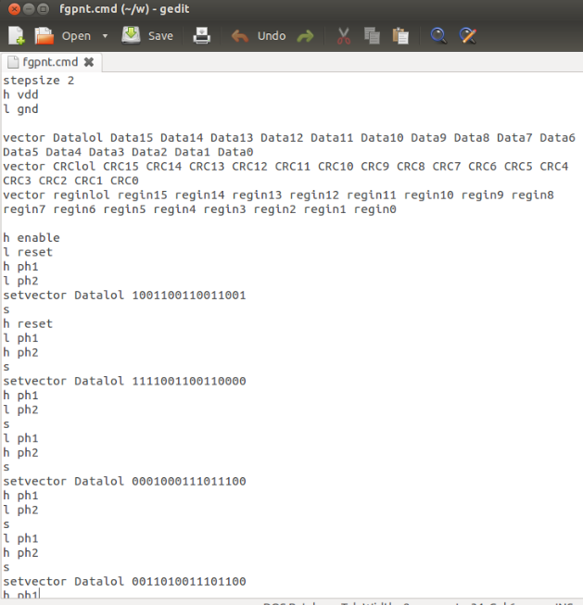
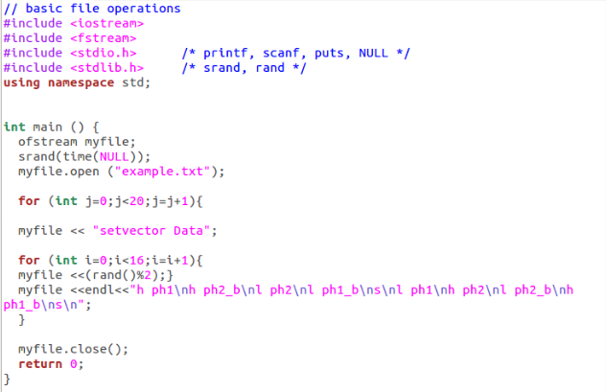
Timing Analysis
Notes:
Now I will introduce a little bit about how to write the testbench. The figure on the right is a script written in C++. It will automatically generate the testbench information based on the Irsim language grammar. And the right figure is the sample testbench for the fingerprinting part. In this testbench, the timed pin switch information, including the close frequency, is detailly specified.

Slide 17
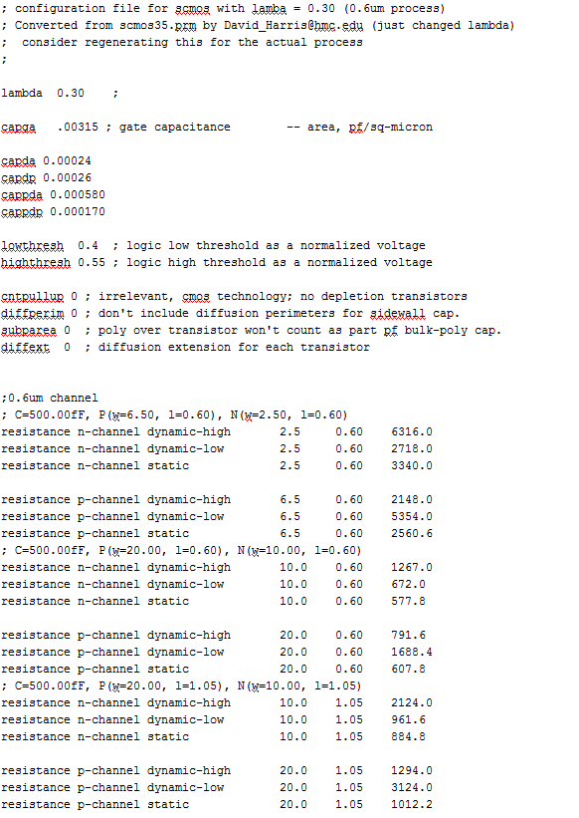
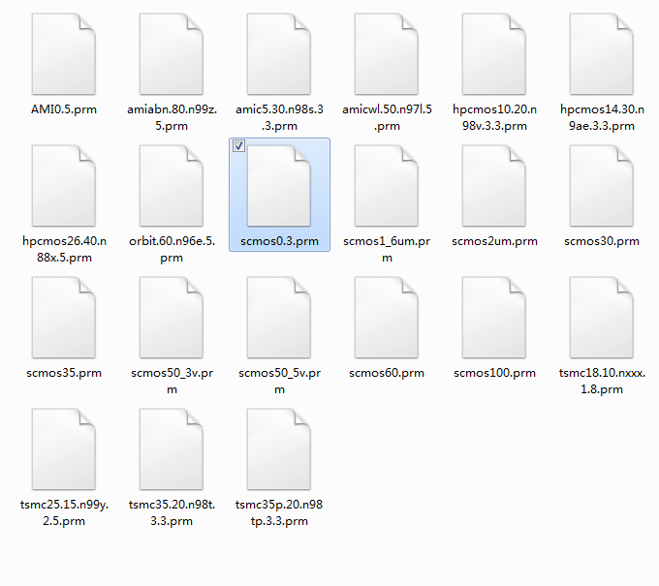
Timing Analysis
Notes:
We also need a prm file for our presentation. The prm file are included in the irsim library, as shown on the left. This file includes the capacitance and resistance information of the transistor, based on which technology we are using. In your case, we use a 0.6micrometer process, and all the capacitance and resistance info are specified on the right.

Slide 18
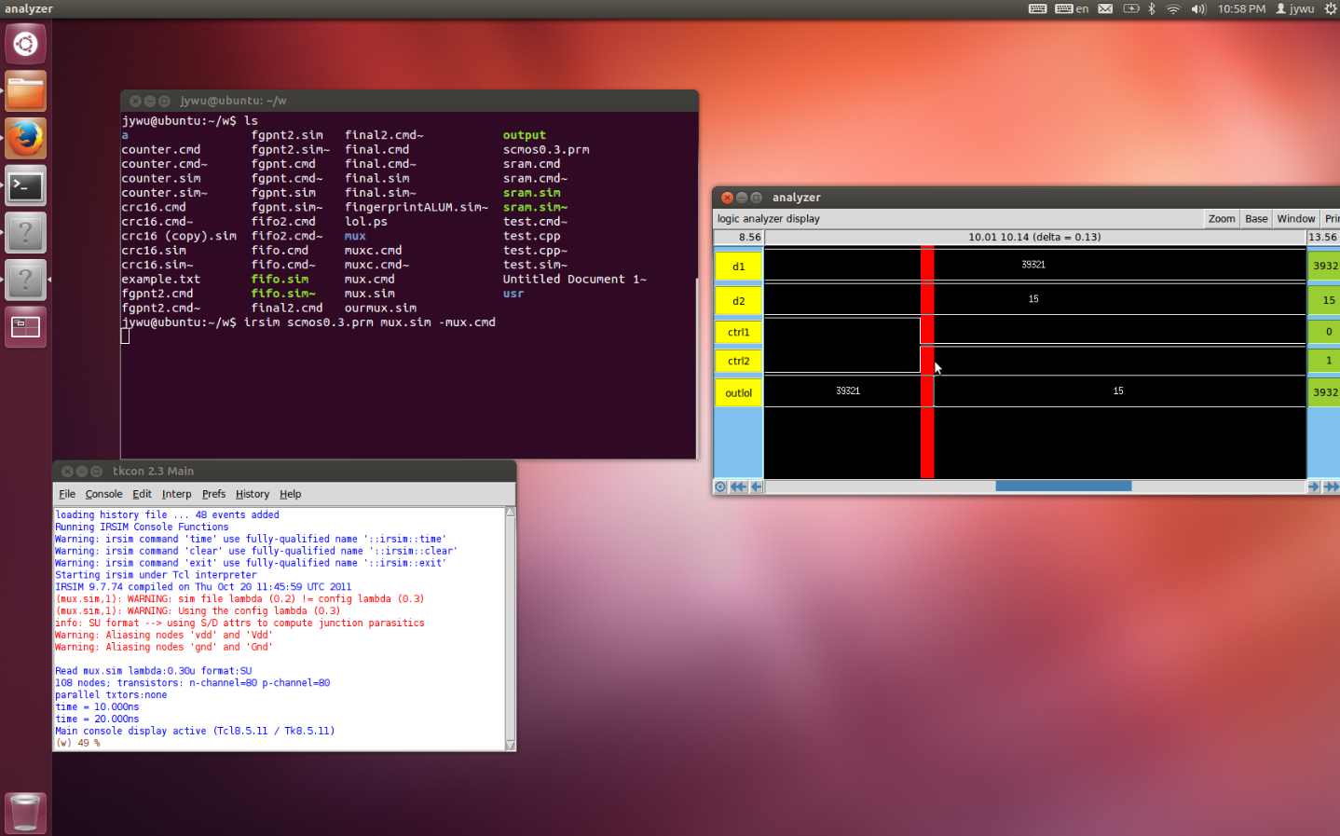
Timing Analysis
Notes:
After we in stall the irsim in linux, we can activate the simulation by typing the command irsim prm sim and cmd. Where .sim file and .cmd file are the irsim deck and testbench respectively. The left bottom windows is the interface of the commanding window of irsim software, and the right windws is the simualted waveform with timing information.

Slide 19
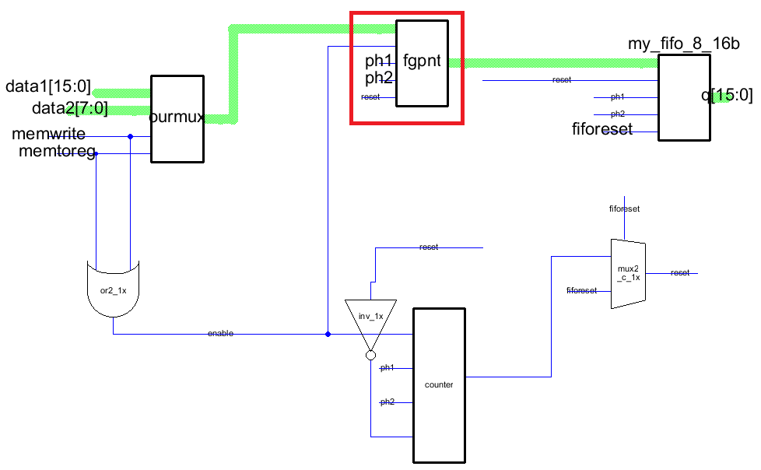
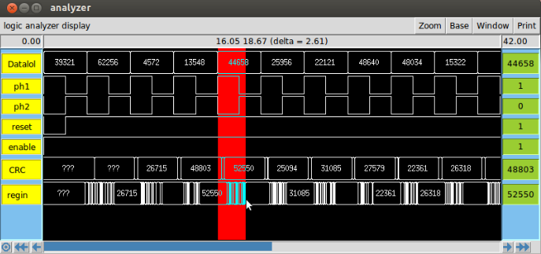
Finger Printing
mux | 0.16ns
fgpnt | 2.61ns
counter | 0.94ns
Shift Reg | 0.60ns
t=2.61ns
Tcritical path = 3.37ns
fmax = 296.7M Hz
Notes:
Here is an example of the timing simulation, and this is the simulation of fingerprinting part of the circuit. The regin is where the newly generated CRC code. As shown on the left, after a rising clock edge, it takes 2.61 ns for the new CRC code generation to complete. The delay time may have a slightly variance based on different edges, and the mentioned delay is the worst case in this simulation.
Similarly, we got the delay of multiplexer and counter to be 0.16ns and 0.94ns respectively from simulation. Besides, the delay of the shift register can be gotten from here to here(point at slide), which is 0.60ns.
As the circuit has a critical path fro mux to fingerprinting, then to shift register. The overall delay can be calculated as 0.16+2.61+0.60, which is 3.37 ns. Therefore, our maximum operating frequency can be 296.7M Hz.

Slide 20

Evaluation – Validation
Validate each schematic with test benches
Randomly generate thousands of test vectors
Make circuit modifications when needed

Slide 21
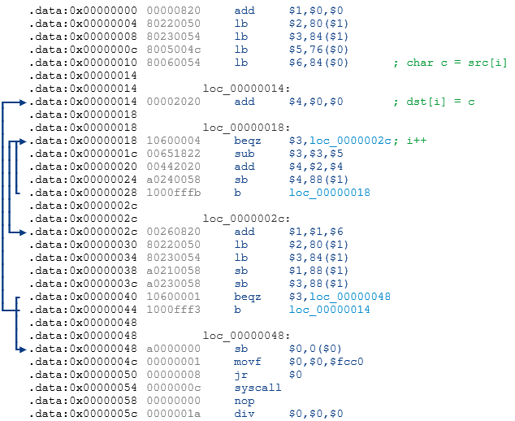
Evaluation – Validation
Benchmark to run on MIPS core

Slide 22
Evaluation – Validation
Register operations VS. memory writes
Fingerprinting works in conjunction with MIPS core

Slide 23
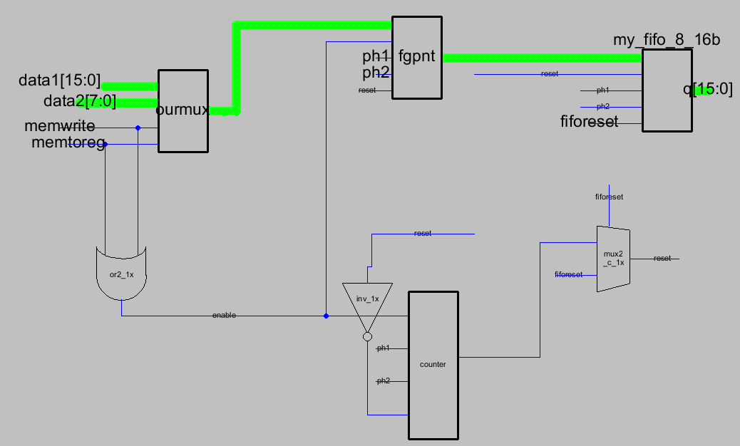
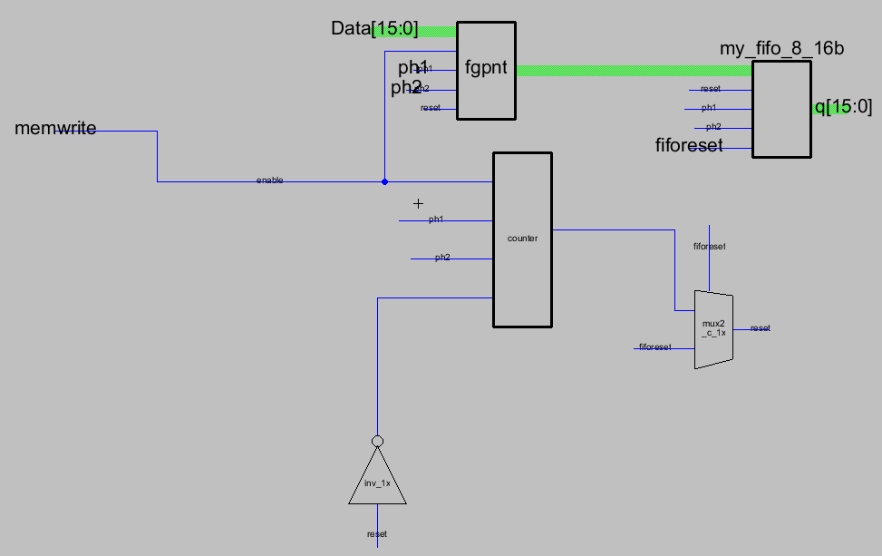
Final Design

Slide 24
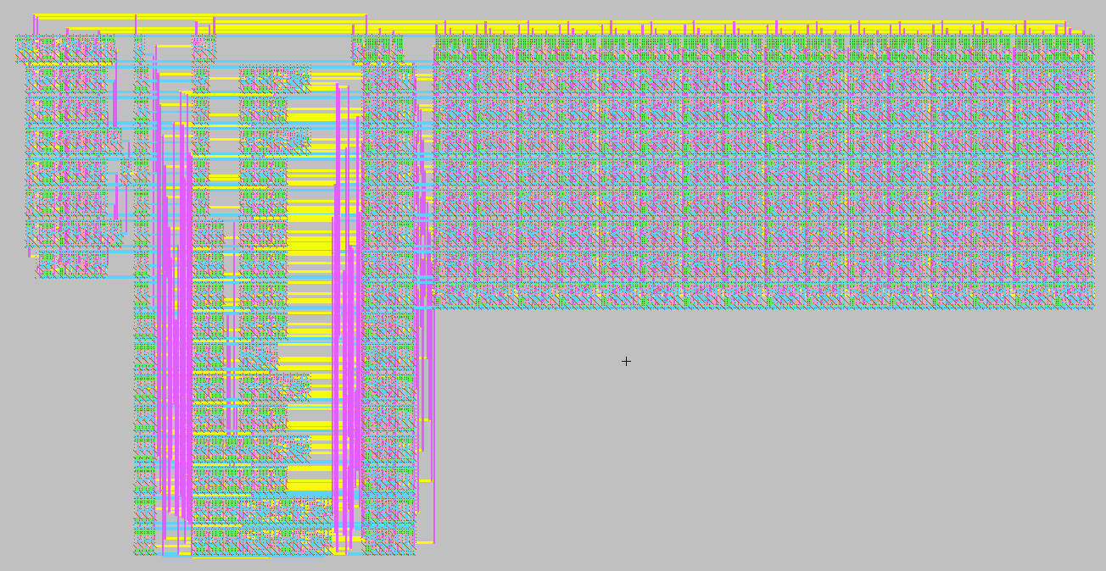
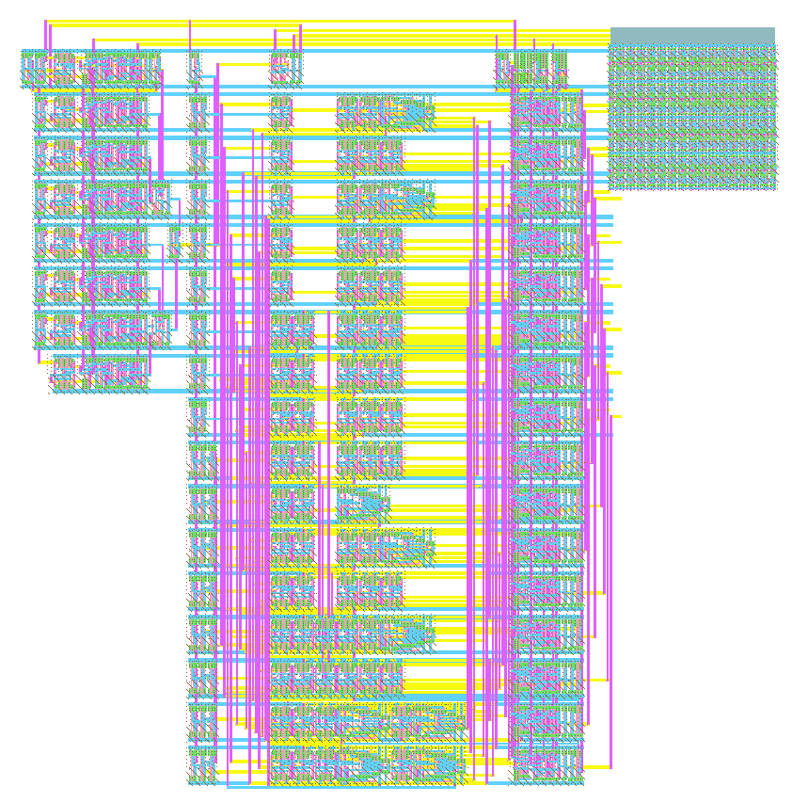
Final Design

Slide 25
Conclusion
Shift Register Memory Only Detection:
5660 transistors
SRAM with Memory and Register Detection:
6074
7.3% Additional overhead for much better error detection capabilities
255 times decrease in processor communication
Max operating frequency of ~300 MHz which is acceptable for most embedded systems

