Slide 1
Song Similarities via Homology of Chroma Features
Samuel Leventhal and Zahra Fahimfar

Slide 2
Background
Similarity of music found currently with data-mining / machine learning over common features and co-occurrence in user data.
Common features studied via matrix representations of pitch, melodic similarity, rhythmic pattern similarity, ect…

Slide 3
Motivation
Introduce a novel metric for similarity between songs.
Provide a new perspective for studying musial compositions.
Demonstrate topological tools for musical data analysis.
Perform clustering of similar songs based on topological features.

Slide 4
Motivation: Low Hanging Fruit.
View musical composition in terms of pitch, intensity, and time signatures.
Relate homological features found from persistence over these terms between songs.

Slide 5
Approach: Data
Initial ideas:
Graph Representation:
V=
E = Connecting Sequential pitches
W = Edge weight proportional to number of times pitches follow one another within entire song.
Matrix Representation:
Rows/Columns correspond to pitches observed in a song in order which they appear. For
i.e.
Chroma Features…

Slide 6

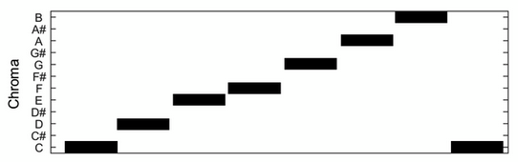
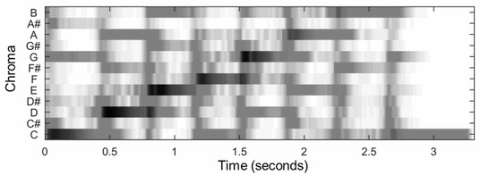

Data: Chroma Features.

Slide 7
Summary of Computational Methods
Data Mining: Obtain Chroma Features of Songs.
Compute homological features in chroma features via persistence.
Obtain pair-wise Bottleneck distances between persistence diagrams of songs.
Perform clustering based on pair-wise Bottleneck distances.
Perform dimension reduction for visualisation.
Asses success of found clusters.

Slide 8
Topological Aspects
Persistent Homology of chroma features.
Homological features reflect common compositional structures in songs.
Birth and Death times of homological features reflect chord progression and root key in musical compositions.
Bottleneck distance between persistence diagrams of songs.
Allow a measure of similarity between structure of song compositions.

Slide 9
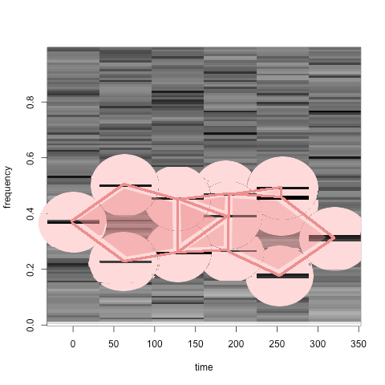
Topological Aspects
Persistent Homology of chroma features.

Slide 10
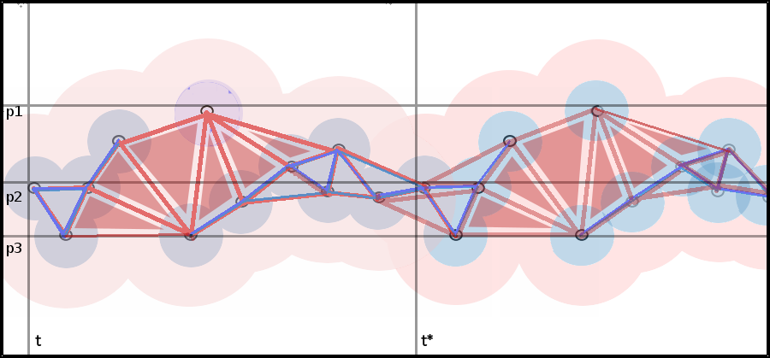
Topological Aspects
Persistent Homology of chroma features.

Slide 11
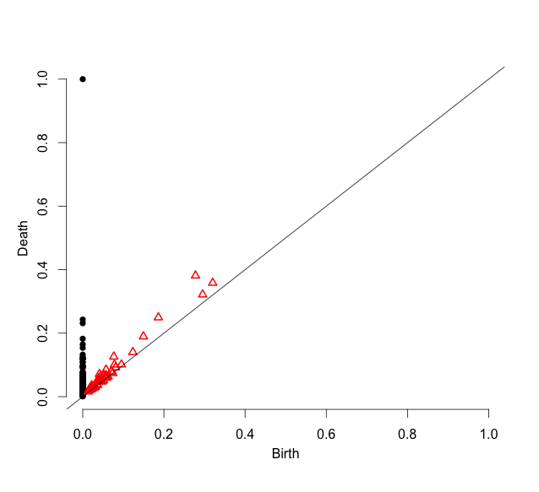
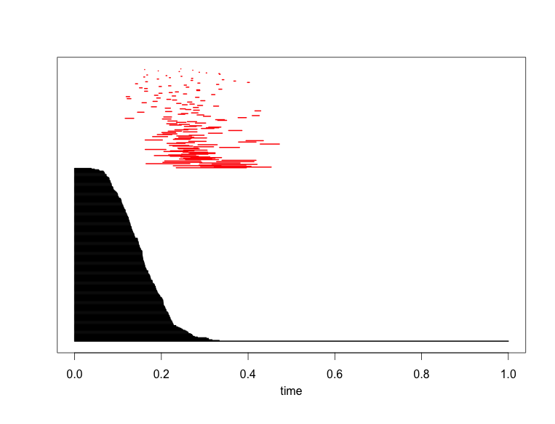
Topological Aspects
Persistent Homology of Chroma Features.
Example: Preachin’ by Son House

Slide 12
Classification via Clustering
Based on pair-wise Bottleneck distance matrix.
Cluster with kMeans and kMedoid.
Visualisation via multi-dimensional scaling.

Slide 13
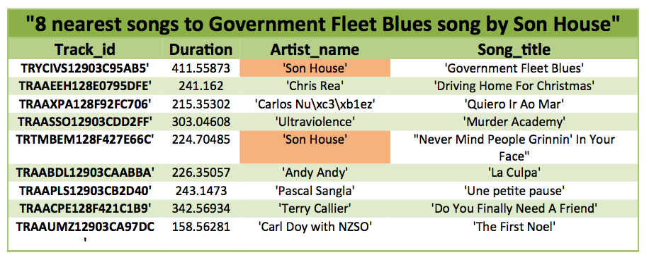
Results: Nearest in Bottleneck Distance

Slide 14
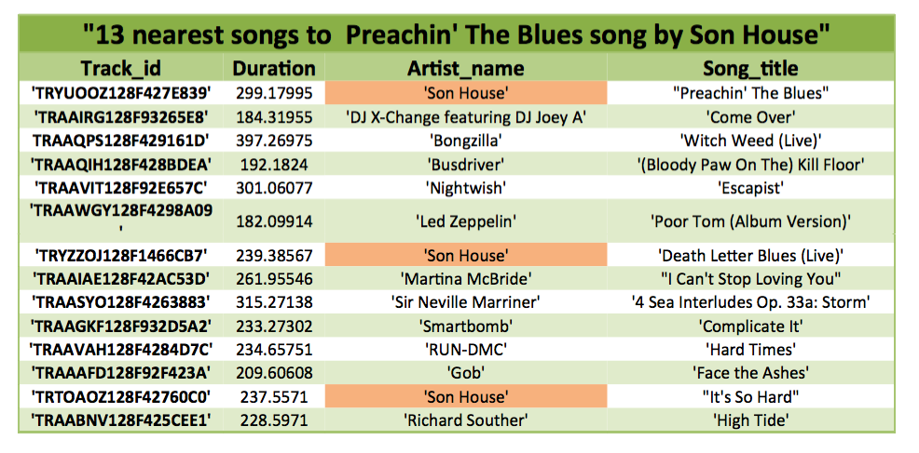
Results: Nearest in Bottleneck Distance

Slide 15
Results: Multi-Dimensional Scaling and kMeans Clustering

Slide 16
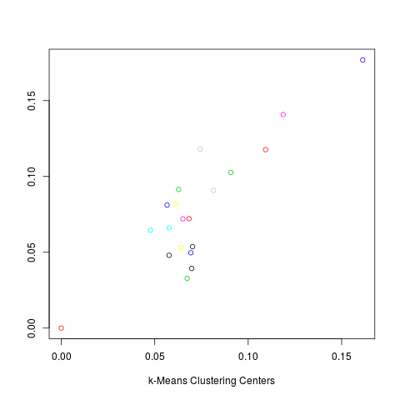
Results: kMeans Clustering Centers

Slide 17
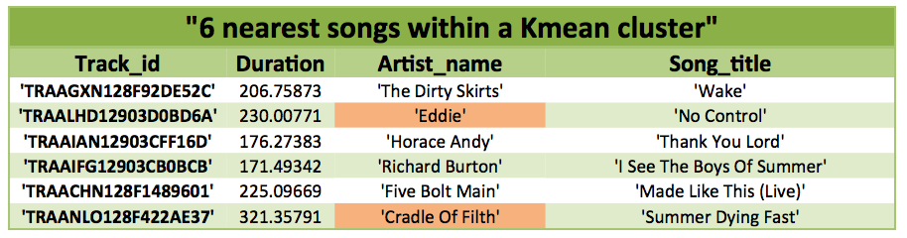
Results: kMeans cluster example
Issues:
Results similar genre but potentially coincidince.
Cluster centers change every time clustering performed.
Solution:
kMedoid Clustering- more robust outliers.

Slide 18
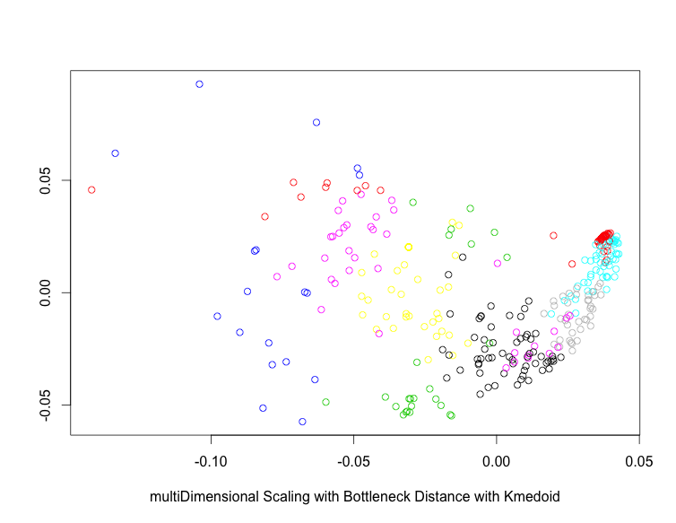
Results Multi-Dimensional Scaling and kMedoid Clustering

Slide 19
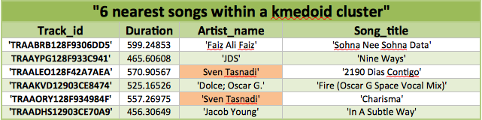
Results Multi-Dimensional Scaling and kMedoid Clustering
Identified songs by same artist despite songs having been randomly chosen from 1,000,000 songs.
Let’s listen.

Slide 20
Future Directions
Apply p-Wasserstein Metric:
kMedoid showed sensitivity to outliers, maybe P-Wasserstein better since sensitive to details of bijection between corresponding points of persistence diagram.
Introduce cut off for intesity with chroma features.
Use true pitch composition instead of chroma features since in order to capture inversion.
Train on fundemental chords, chord progressions, time signatures, and introduce timbre.

Slide 21
References
“Thierry Bertin-Mahieux, Daniel P.W. Ellis, Brian Whitman, and Paul Lamere. The Million Song Dataset. In Proceedings of the 12th International Society for Music Information Retrieval Conference (ISMIR 2011), 2011.”
Edelsbrunner, Herbert, and John Harer. Computational topology: an introduction. American Mathematical Soc., 2010.

Slide 22
Questions

