Slide 1
Song Classification via Homology of Chroma Features
Samuel Leventhal and Zahra Fahimfar

Slide 2
Background

Slide 3
Motivation
Demonstrate a novel means of song classification.
Provide a new perspective to studying music composition.

Slide 4
Music Theory
View music in terms of pitch, intensity, and time signatures.

Slide 5
Approach: Data
Initial ideas:
Chroma Features.

Slide 6

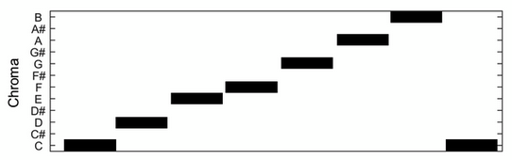
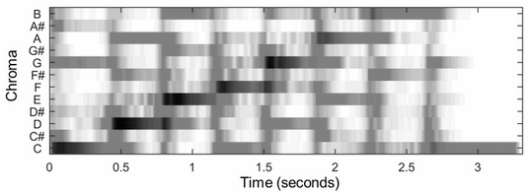

Data: Chroma Features.

Slide 7
Summary of Computational Methods
Data Mining: Obtain Chroma Features of Songs.
Compute homological features in chroma features via persistence.
Obtain pair-wise Bottleneck distances between persistence diagrams of songs.
Perform clustering based on pair-wise Bottleneck distances.
Perform dimension reduction for visualisation.
Asses success of found clusters.

Slide 8
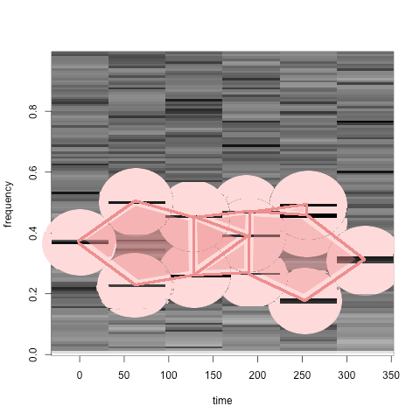
Topological Aspects
Persistent Homology of chroma features.

Slide 9
Topological Aspects
Persistent Homology of chroma features.
Homological features reflect common compositional structures in songs.
Birth and Death times of homological features reflect time signatures of musical compositions.
Bottleneck distance between persistence diagrams of songs.
Allow a measure of similarity between structure of song compositions.

Slide 10
Classification via Clustering
Based on pair-wise Bottleneck distance matrix
kMeans:
kMedoid:
Visualisation via multi-dimensional scaling.

Slide 11
Results: Nearest in Bottleneck Distance

Slide 12
Results: Multi-Dimensional Scaling and kMeans Clustering

Slide 13
Results Multi-Dimensional Scaling and kMedoid Clustering

Slide 14
Reflections

Slide 15
Future Directions
Apply p-Wasserstein Metric.
Introduce cut off for intesity with chroma features.
Use true pitch composition instead of chroma features.
Train on fundemental chords, chord progressions, time signatures, and introduce timbre.

Slide 16
References

Slide 17
Questions

