Slide 1
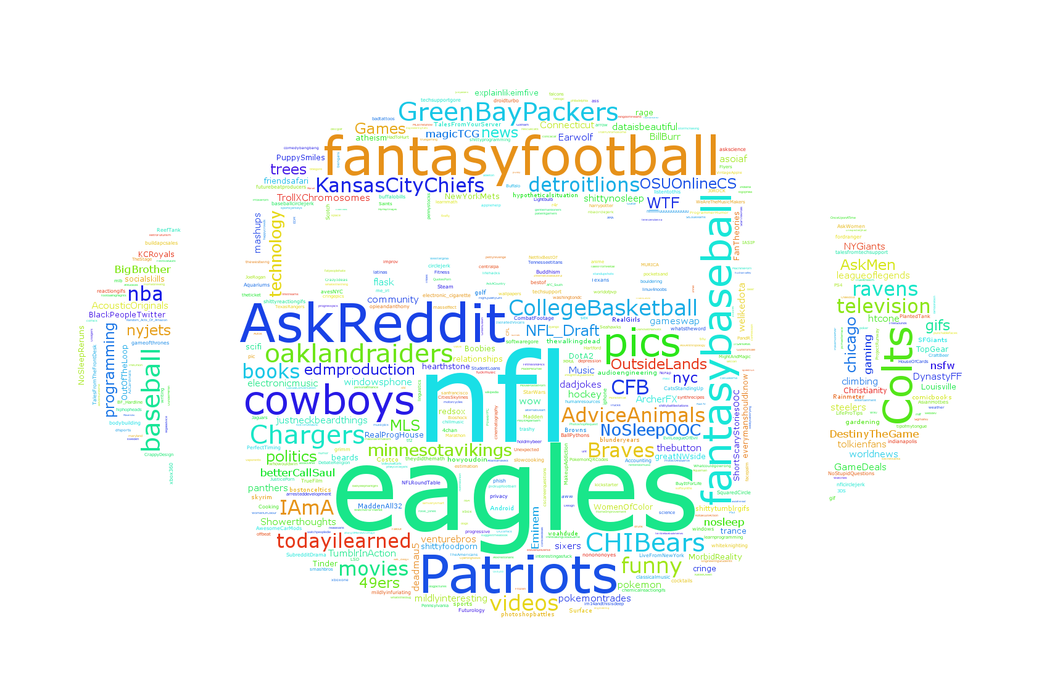
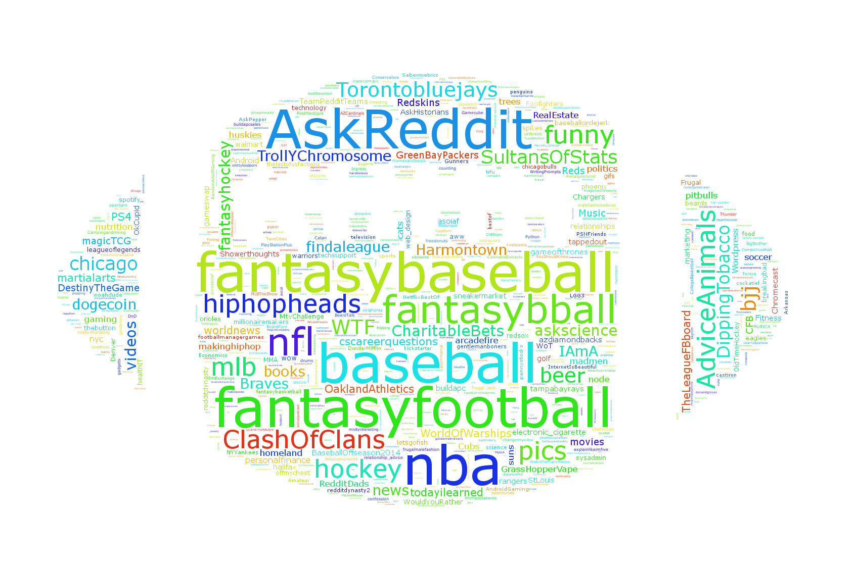
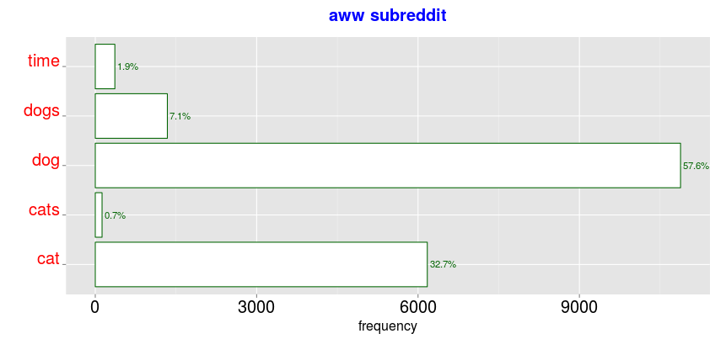
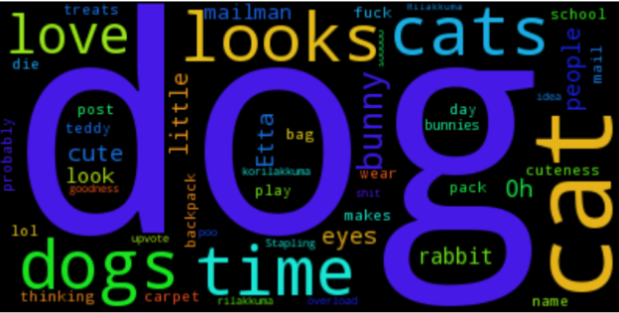
Reddit or Not
Michael Matheny, Nicolas Bertagnolli, Mathew Arndt
Introduction
Clustering
Similarity of Posts
Reddit is a very rich site where users are allowed to post just about anything. This project examined relationships between the users of reddit and their posts, and between the posts themselves. The hope was that it might be possible to uncover interesting relationships that could lead to better modeling of internet forums. This project explored reddit data by examining three questions:
What words appear most frequently in specific subreddits?
Can user posting habits be used to uncover relationships in subreddit relatedness?
How similar are high ranking posts?
All data was collected in a live stream from Reddit.
To find groups of users with similar interests reddit users were sampled and then clustered based on the number of comments that they had posted in each subreddit.
Similarity of texts was assessed using n-grams 1-4 on reddit comments that had more than 100 likes. The average Jaccard similarity was used to determine how related a group of posts was.
N-gram | 1 | 2 | 3 | 4
Similarity | .025 | 2.24e⁻³ | 1.75e⁻³ | 1.57e⁻³
Table 1 – Similarity of posts with more than 100 likes taken from all of Reddit.
N-gram | 1 | 2 | 3 | 4
Similarity | .042 | .017 | .017 | .016
Figure ?? – Wordle representation of k-means clustering of reddit users. (Left) cluster of users who post and follow professional sports. (Right) Users who are involved in fantasy sports leagues.
Table 2 – Similarity of posts with more than 1000 likes taken from all of Reddit.
N-gram | 1 | 2 | 3 | 4
Similarity | .054 | .022 | .021 | .020
Algorithm | Parameters | Time (sec)
k-means | - | 287
k-means SVD | k = 60 | 13
k-means JLT | k = 100 | 28
k-means LSH | B=6, r = 30 | 283
Table 3 – Comparison of clustering implementations. Hyperparameters that gave the same average distance between points as vanilla k-means were used to assess speed.
Table 3 – Similarity of posts with more than 100 likes taken from subreddit worldnews
Conclusions
We find:
The words alone do not give a good indicator of post likeability.
Most of the similarity comes from posts with a very large number of likes (>1000)
It is possible to uncover relationships between reddit posts by examining user postings
Frequency of words often converge to one or a few most frequent words.
Frequent Words
The frequent words were found using Misra-Gries algorithm and k = 200 counters (0.5 % error). When the algorithm traverses the entire subreddit, one word or a few words dominate. Here is one such result from the awww subreddit:

