Slide 1
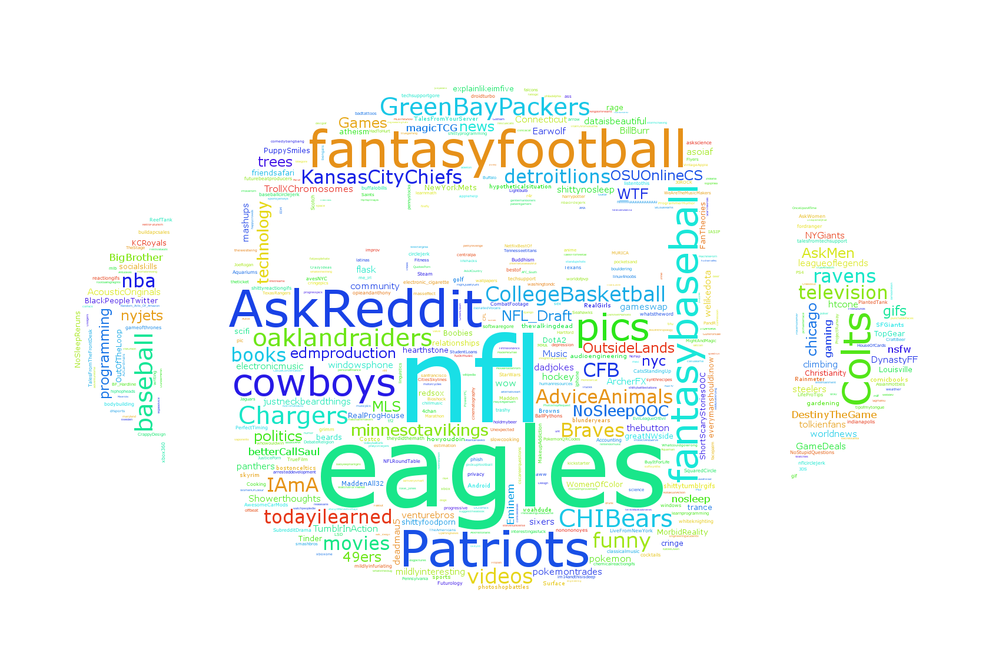
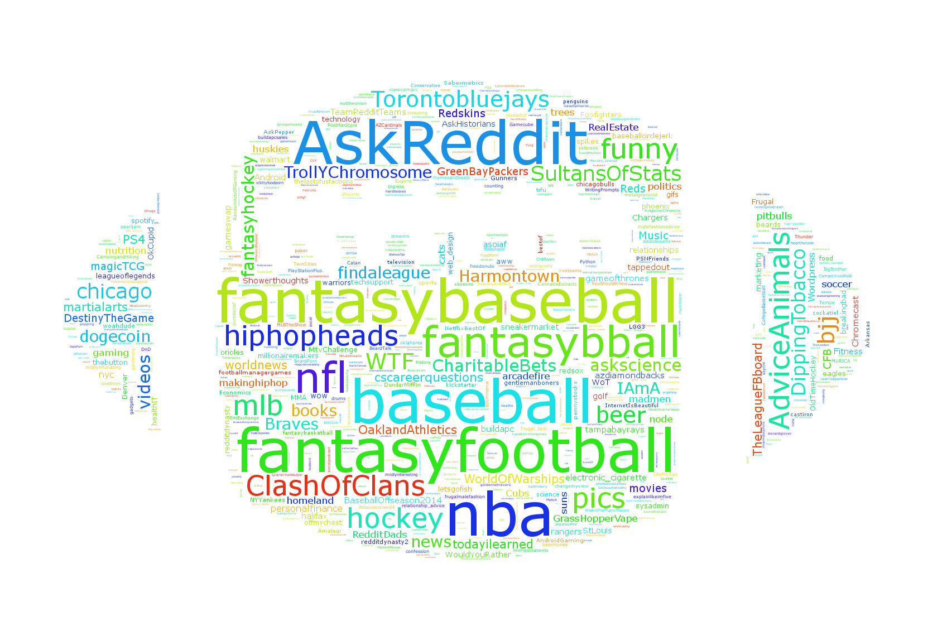
Reddit or Not
Micheal Matheny, Nicolas Bertagnolli, Mathew Ardnt
Introduction
Clustering
Similarity of Posts
Reddit is a very rich site where users are allowed to post just about anything. This project examined relationships between the users of reddit and their posts, and between the posts themselves. The hope was that it might be possible to uncover interesting relationships that could lead to better modeling of internet forums. This project explored reddit data by examining three questions:
What words appear most frequently in specific subreddits?
Can user posting habits be used to uncover relationships in subreddit relatedness?
How similar are high ranking posts?
All data was collected in a live stream from Reddit.
We want to find groups of users with similar interests. To do this we decided to sample reddit users and then cluster the users based on the number of comments that they had posted in each subreddit. To cluster the user data we represent each user as a vector where the number of comments in a subreddit gives the value at an index in the vector. The matrix containing all the user comments after removing deleted users is approximately 20000 users by 30000 subreddits, but it is extremely sparse with only around .1% of the elements nonzero. We use cosine distance as our distance metric for the data since we only want to compare users interests.
Similarity of texts was assessed using n-grams 1-4 on reddit comments that had more than 100 likes. The average Jaccard similarity was used to determine how related a group of posts was.
N-gram | 1 | 2 | 3 | 4
Similarity | .025 | 2.24e⁻³ | 1.75e⁻³ | 1.57e⁻³
Table 1 – Similarity of posts with more than 100 likes taken from all of Reddit.
N-gram | 1 | 2 | 3 | 4
Similarity | .042 | .017 | .017 | .016
Table 2 – Similarity of posts with more than 1000 likes taken from all of Reddit.
N-gram | 1 | 2 | 3 | 4
Similarity | .054 | .022 | .021 | .020
Table 3 – Similarity of posts with more than 100 likes taken from subreddit worldnews
Frequent Words
More Clustering
Conclusions

