Slide 1
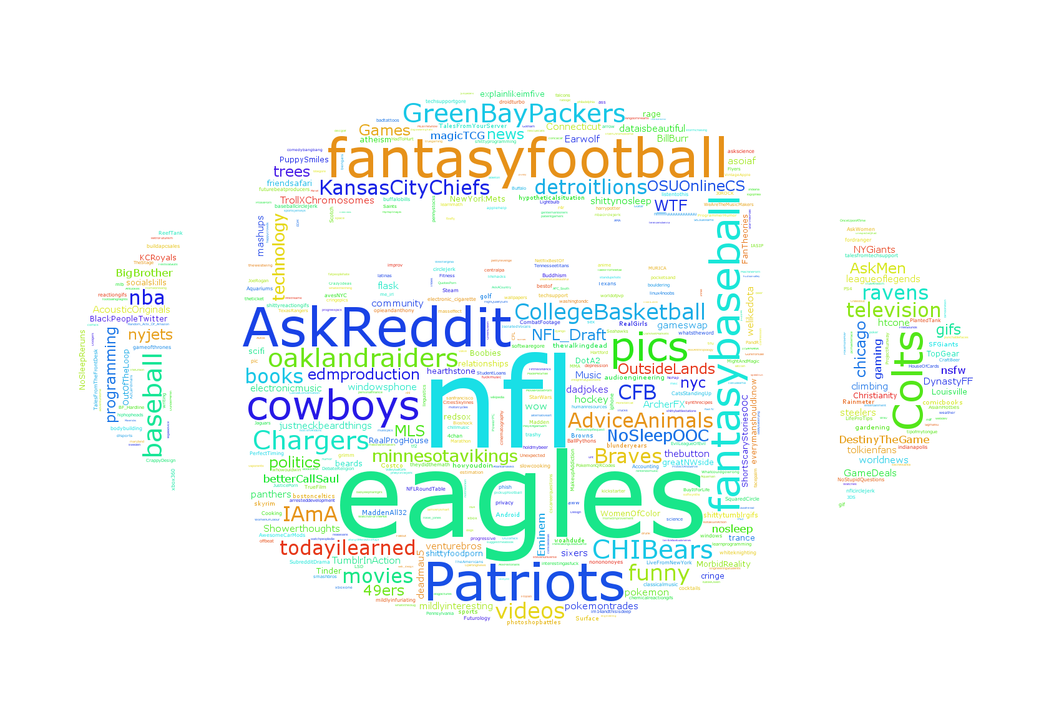
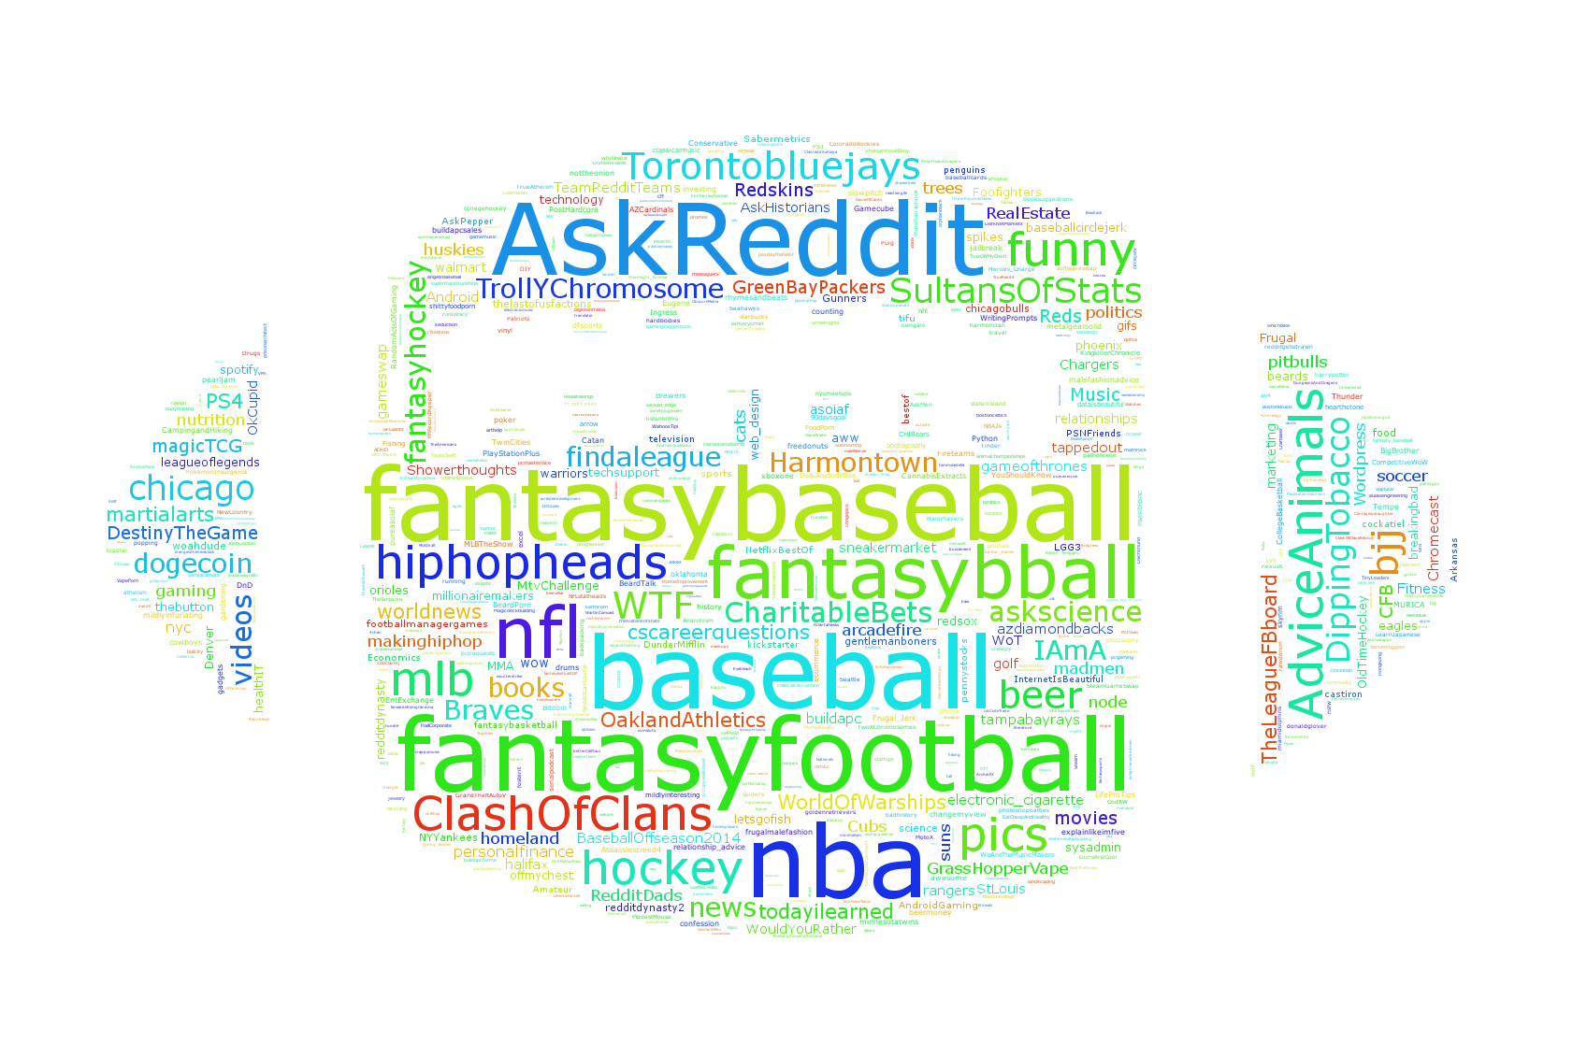
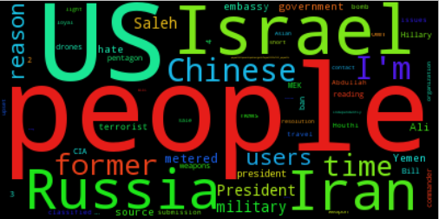
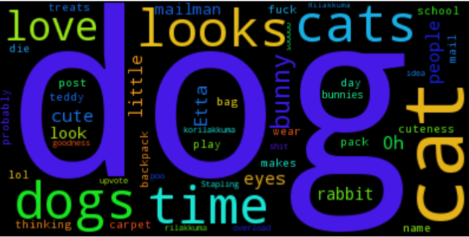
Reddit or Not
Michael Matheny, Nicolas Bertagnolli, Mathew Arndt
Introduction
Clustering
Similarity of Posts
Reddit is a very rich site where users are allowed to post just about anything. This project examined relationships between the users of reddit and their posts, and between the posts themselves. The hope was that it might be possible to uncover interesting relationships that could lead to better modeling of internet forums. This project explored reddit data by examining three questions:
What words appear most frequently in specific subreddits?
Can user posting habits be used to uncover relationships in subreddit relatedness?
How similar are high ranking posts?
All data was collected in a live stream from Reddit using Python.
To find groups of users with similar interests reddit users were sampled and then clustered based on the number of comments that they had posted in each subreddit using
Cosine similiarity.
Similarity of texts was assessed using n-grams 1-4 on reddit comments that had more than 100 likes. The average Jaccard similarity was used to determine how related a group of posts was.
N-gram | 1 | 2 | 3 | 4
Similarity | .025 | 2.24e⁻³ | 1.75e⁻³ | 1.57e⁻³
Table 4 – Similarity of posts with more than 100 likes taken from all of Reddit.
N-gram | 1 | 2 | 3 | 4
Similarity | .042 | .017 | .017 | .016
Figure 3 – Word cloud representation of k-means clustering of reddit users. Words are subreddit names. (Left) cluster of users who post and follow professional sports. (Right) Users who are involved in fantasy sports leagues.
Table 5 – Similarity of posts with more than 1000 likes taken from all of Reddit.
N-gram | 1 | 2 | 3 | 4
Similarity | .054 | .022 | .021 | .020
The data set used for generating user clusters was roughly 30000 users with 32000 subreddits, but very sparse with only .12% of the entries non zero. Ordinary k-means was very slow, so we tried other methods:
Dimensionality Reduction
Singular Value Decomposition
Johnson Lindenstruass Transform
Subsampling
Mini Batch Kmeans
Acceleration Structures
Kmeans with Locality Sensitive Hashing
Frequent Words
Table 6 – Similarity of posts with more than 100 likes taken from subreddit worldnews
Conclusions
We find:
Individual subreddits have their own distinct set of commonly occurring words.
Most users comment only in the default subreddits. The remaining users form micro communities that each have a set of very specific interests (fantasy football or aquariums).
Words alone do not give a good indicator of post likeability and the posts with the highest mutual similarities have a very large number of likes (>1000)
In the future we would like to look at using user clusters to define low dimensional embeddings of users. It would also be interesting to use Misra-Gries to assess post similarity and compare this method to that of the Jaccard similarity.
Figure 1 – Most frequently occuring words k=200. All common words were removed, i.e. “the,” “If,” “and”, etc.
(Left) worldnews. (Right) awww subreddit.
Word | Frequency | Proportion
People | 284 | .095
US | 65 | .022
Israel | 24 | .008
Russia | 13 | .004
Word | Frequency | Proportion
Dog | 284 | .576
Cat | 65 | .327
Dogs | 24 | .071
time | 13 | .019
Algorithm | Parameters | Time (sec)
k-means | - | 287
k-means SVD | k = 60 | 13
k-means JLT | k = 100 | 32
Mini batch | Sample=5000 | 7.2
k-means LSH | B=6, r = 30 | 283
Table 3 – Comparison of clustering implementations. Hyperparameters that gave within .01 average distance of what vanilla k-means attains were used to assess speed.
Table 1 – Break down of word frequency for the worldnews subreddit and awww subreddit .

