Slide 1
Prophet
Prophet time series = Trend + Seasonality + Holiday + error
Trend models non periodic changes in the value of the time series.
Seasonality is the periodic changes like daily, weekly, or yearly seasonality.
Holiday effect which occur on irregular schedules over a day or a period of days.
Error terms is what is not explained by the model.

Slide 2
Advantages
Accommodates seasonality with multiple periods
Prophet is resilient to missing values
Best way to handle outliers in Prophet is to remove them
Fitting of the model is fast
Intuitive hyper parameters which are easy to tune

Slide 3
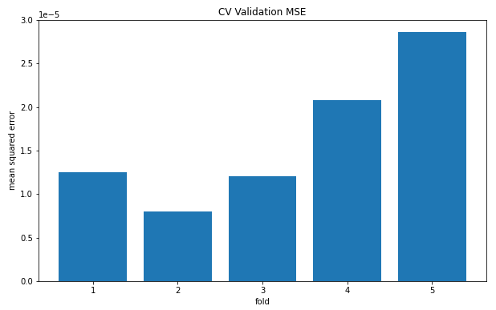
Result – CV performance

Slide 4
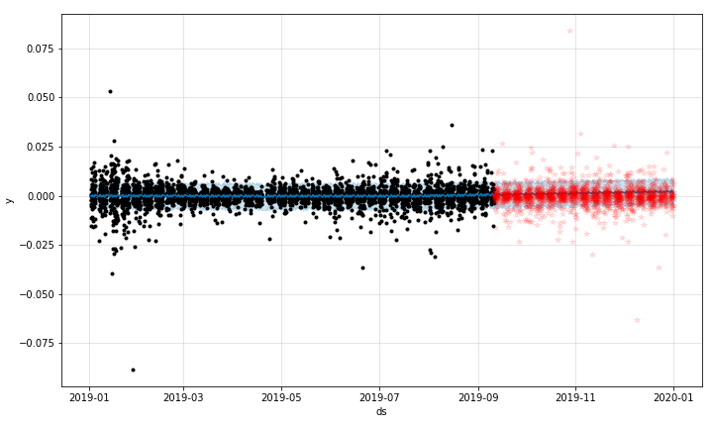
Result – Final Model

Slide 5
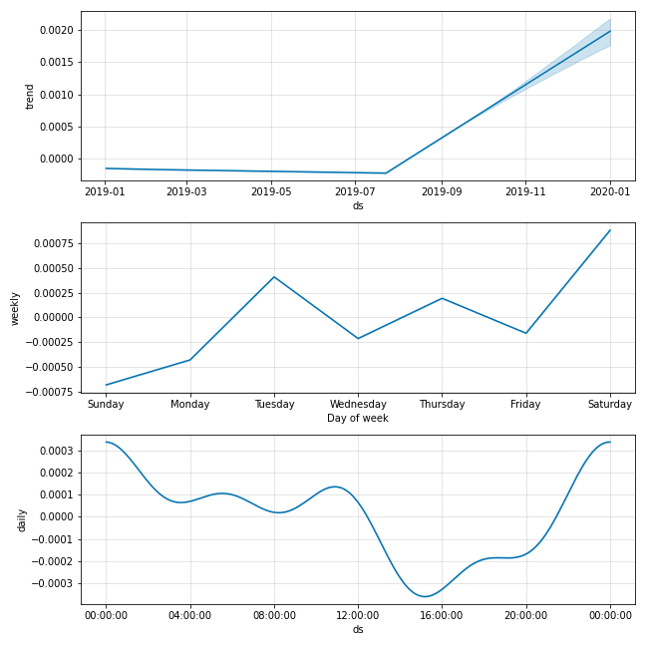
Result – Final Model
Trend
Seasonality (weekly & daily)

Slide 6
Reference
Paper: https://peerj.com/preprints/3190/
Package: https://facebook.github.io/prophet/
Medium blog: https://towardsdatascience.com/time-series-prediction-using-prophet-in-python-35d65f626236

