Slide 1

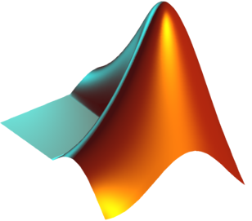
4
An introduction to Python using MATLAB as a foundation
Luke Gregor

Slide 2


You should have Python installed
If not then get Anaconda
Cross platform (Win, Mac, Linux)
Spyder IDE (the best one I’ve found so far)
Includes the entire Scipy stack and some more!
Or Enthought Python / Canopy
Cross platform (Win, Mac, Linux)

Slide 3
In this course thingy we will…
See why I prefer Python and sometimes not…
Spot the differences
Use MATLAB to demonstrate how to do things in Python
Import data: tab txt, csv, netcdf
Manipulate data using Numpy/Scipy
Plot some data using Matplotlib
Create maps using Basemap
Look at some other things I’ve found useful

Slide 4
The Good
The Bad
SIDE NOTE: We’ll be using Python 2.7.6
It has huge online support:
http://stackoverflow.com/
http://docs.python.org/2/
help(?)
It’s versatile and powerful
Speed is comparable to MATLAB
A tick on the CV
It’s a bit more difficult to learn than MATLAB
Working with matrices is slightly more bulky
No built in IDE
Bad programming is slower than MATLAB (e.g. bad loops)

Slide 5
Syntactical Differences
 | MATLAB | PYTHON
Commenting | % | #
Indentation | Whatever you want | Structure is important
Data types | Double array/matrix Character Structured arrays Cell Arrays | List String Dictionaries Numpy Arrays (more on this later)
Indexing | Starts at 1 X(5:end); X(1:end-4); X(:, 2:5); | Starts at 0 X[4:] X[:-4] X[:, 1:5]
Printing output | X ‘string’ | print X print ‘string’
Importing Packages | addpath(folderName); | import sys sys.append(folderName) import packageName
For more of these comparisons visit http://wiki.scipy.org/NumPy_for_Matlab_Users

Slide 6
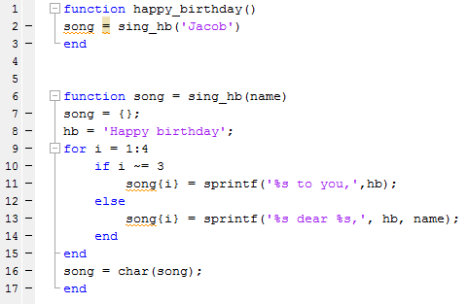
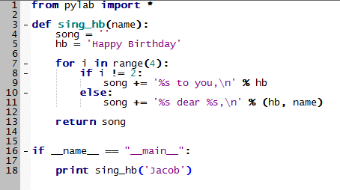
Happy Birthday to you
MATLAB
PYTHON

Slide 7

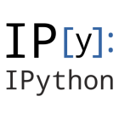



What are the options for IDEs?
+
SciTE
+
notebook

Slide 8
Open IPython Notebook
Get the Notebook files from this github repository:
0. Introduction
Numpy and Arrays
Download all files

