Slide 1

Machine Learning I Predicting the Stock Market
By Eric goldman and matt wilchek

Slide 2
Initial Planning
Financial Modelling – a classic in predictive analytics
Kaggle competitions
Common agreement that sentiment of news data can impact stock variance
About the Original Kaggle Dataset:
News Data: 9,950 records of news headlines from 8/8/2008 to 7/1/2016
Stock Data: 1,990 records of DJI stock data from 8/8/2008 to 7/1/2016 that includes the Open, High, Low, Close, Volume of trade
~5 news headlines per stock data record

Slide 3
The s.m.a.r.t. question
Objective: Proof of concept to predict any stock performance for current day and following day, based on history and the assumption news sentiment has a significant relationship.
Specific: How accurate can the prediction for a stock be?
Measurable: How to effectively rate best variables for a prediction model?
Achievable: Historical data available to make a train/test model.
Relevant: Form a baseline for stock market prediction / disrupt formal investment business processes with modern statistical algorithms
Time-Scaled: Data sets are fairly extensive, but will require to have functionality for collection of present day data

Slide 4
Requirement Process
Collect news headlines on from present day and run a sentiment algorithm on it
Collect present day stock data for any ticker
Create a predictive model using machine learning that is not over-fit using train/test
Hyper-parameter tune the most significant sentiment tied to present stock data; classify most significant sentiment
Effectively visualize results to review accuracy of the model
Automate everything to run on a daily basis, effectively improving the predictive model more and more over time

Slide 5
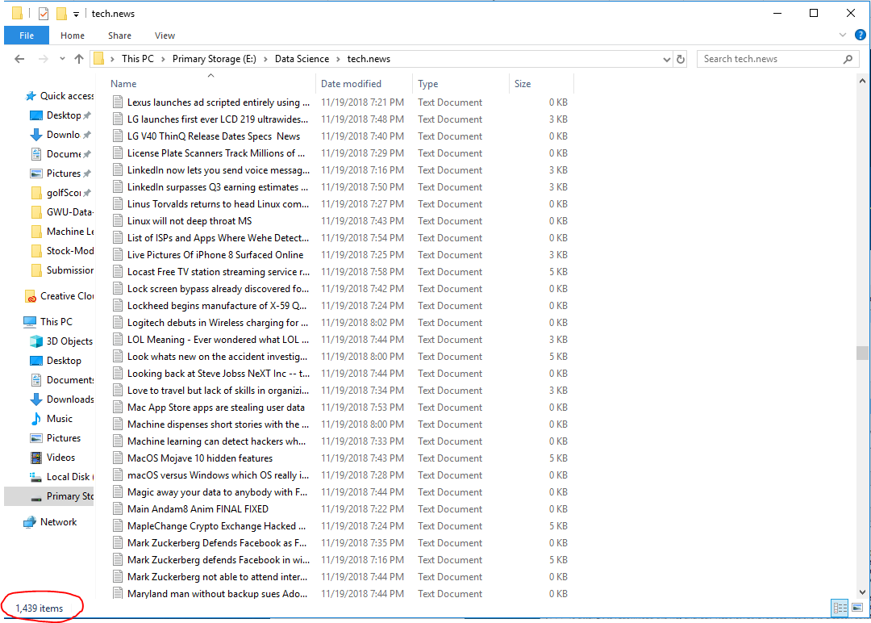
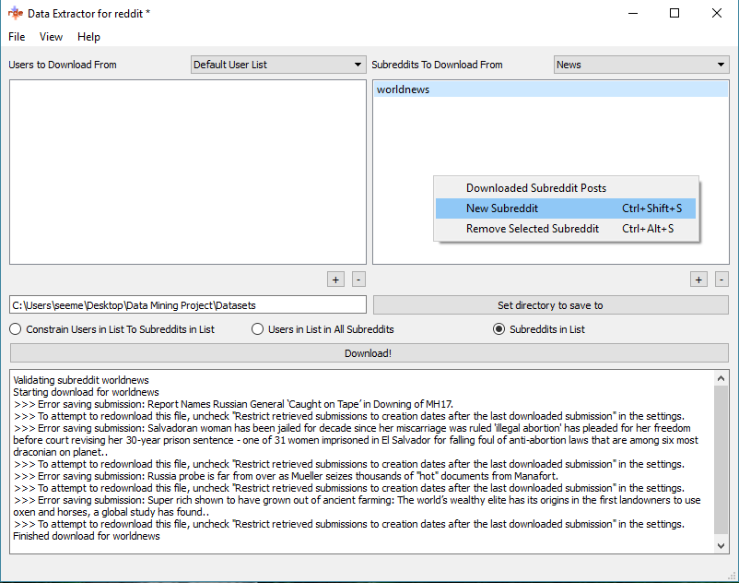

Web scraping
Reddit Web Scraper that can extract 1000 news headlines from specified sub-reddit forum
Leverages Reddit API called ‘PRAW’
Packaged with PyQT to have a simple GUI to run with
https://github.com/NSchrading/redditDataExtractor

Slide 6
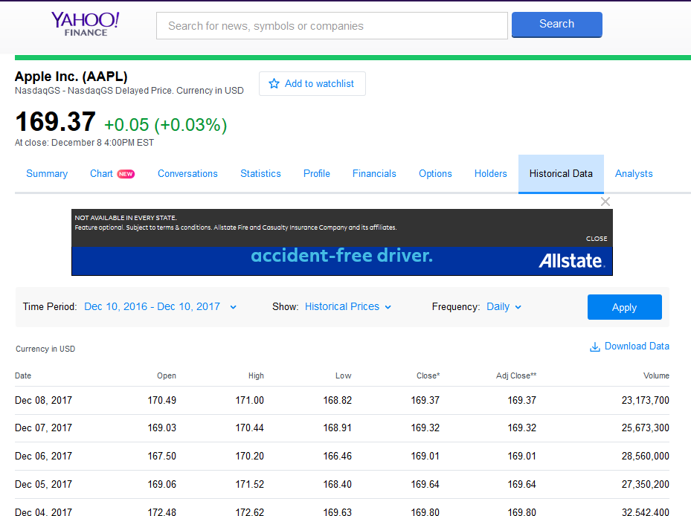
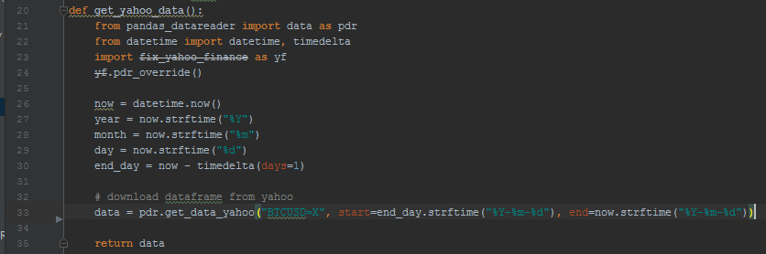
Yahoo Finance API
Yahoo offers a Python library to access stock data
Can be used to retrieve any stock ticker data in a given timeframe
Used to continue update our data for train/test
https://pypi.python.org/pypi/fix-yahoo-finance
Ticker
Time-frame for Collection

Slide 7
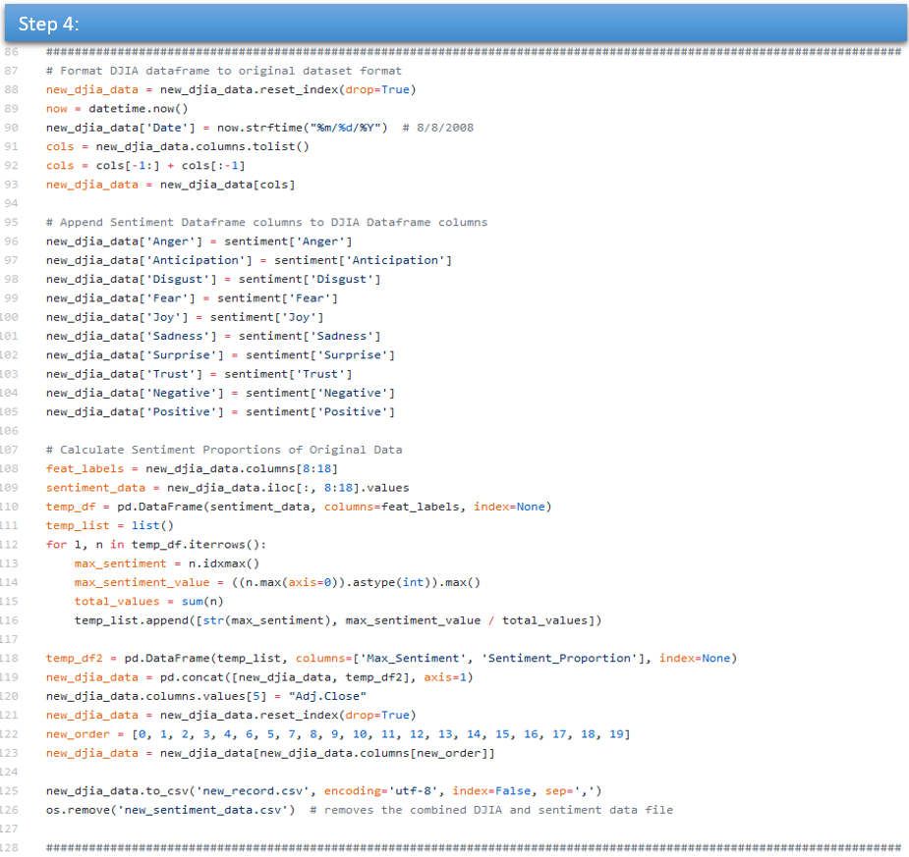
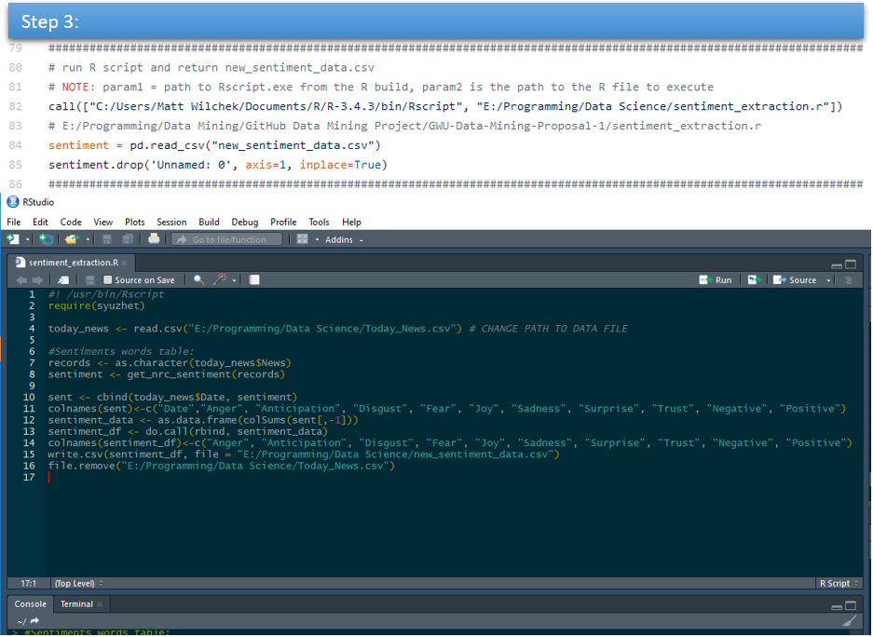
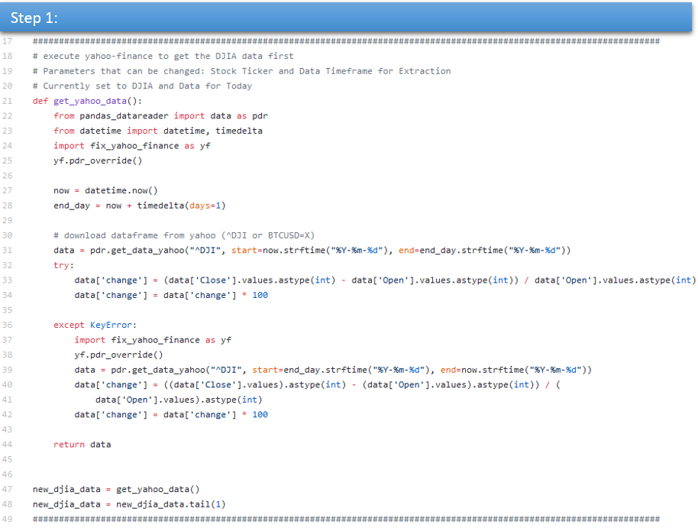
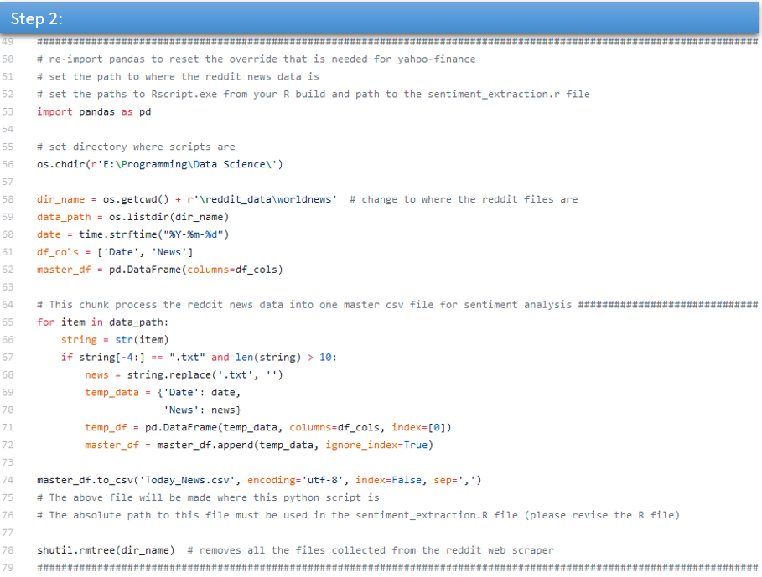
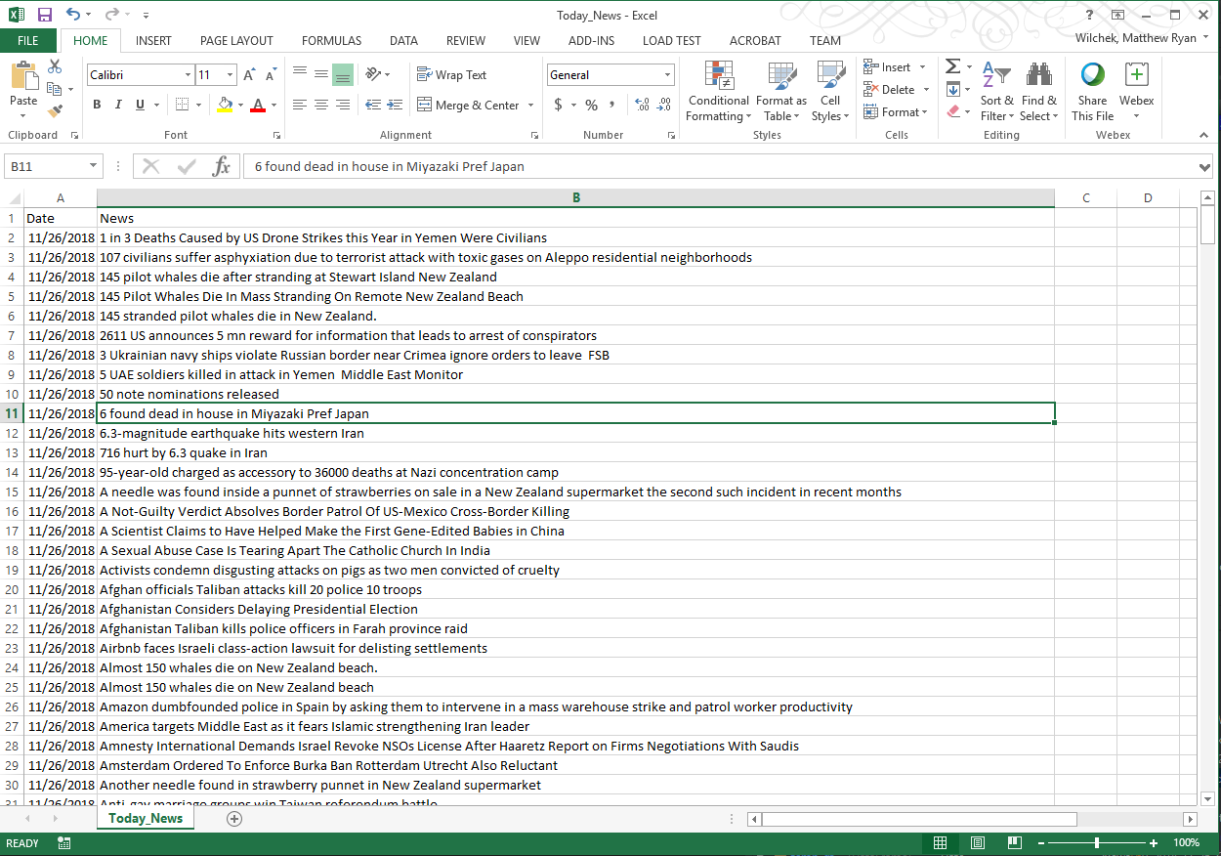
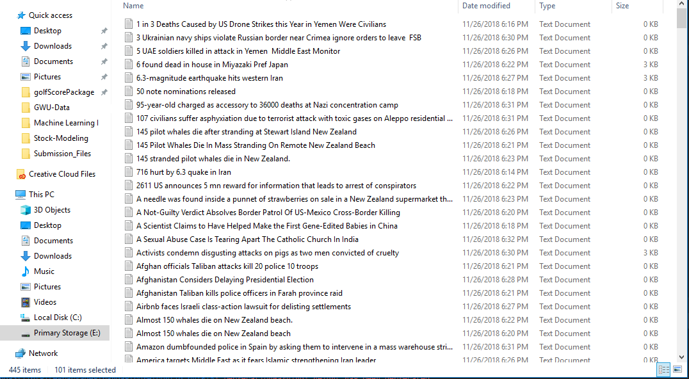
Joining Datasets
Requirements:
Needed to combine new news data with new stock data, then add to master dataset
Needed to be executed independently from modelling script to easily collect new data
Needed to use sentiment algorithm from previous Kaggle analysis
https://github.com/mwilchek/Stock-Modeling/blob/master/process_reddit.py

Slide 8
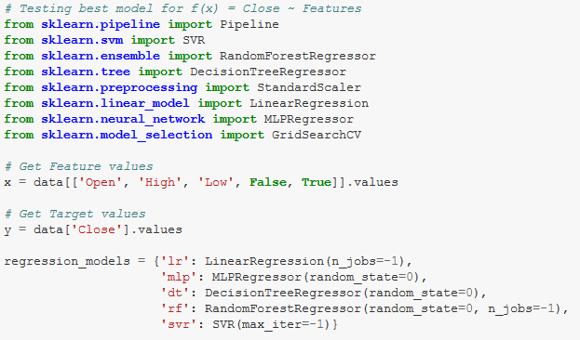
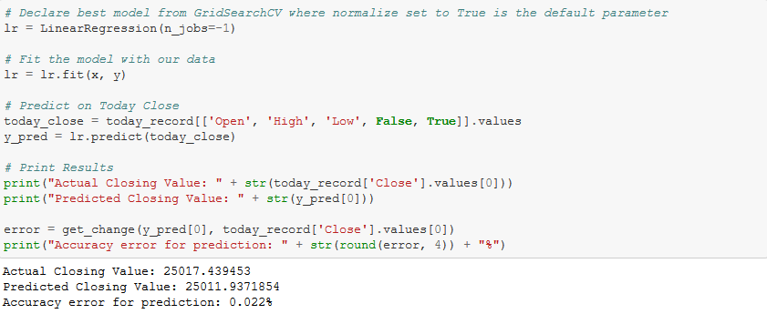
Pipeline Modelling and Results
First explored modelling using 5 different regressors against ‘Close’ and its features
Compared using GridSearchCV with ‘negative mean squared error’ for accuracy
Sklearn’s Linear Regression model scored the best
Rank | Name | Negated Mean Square Error
1 | Linear Regression | -2,954
2 | SVR | -8,390
3 | Decision Tree | -2,360,217
4 | Random Forest | -2,401,253
5 | MLP | -138,227,235

Slide 9
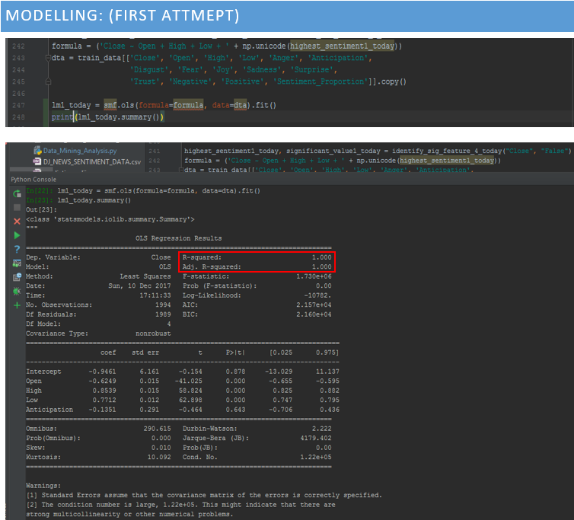
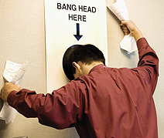
OLS Regression
Make 6 separate models to predict ‘Close,’ ‘High,’ ‘Low’ stock values
3 to predict for current day
3 to predict for following day
Include most significant sentiment value for each based on Random Forest Regressor results
Perform Ordinary Least Squares Regression and fit it with model
Test model with present and estimated following day record
Review Results

Slide 10
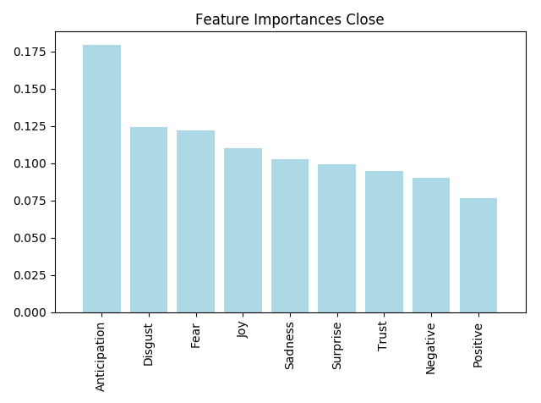
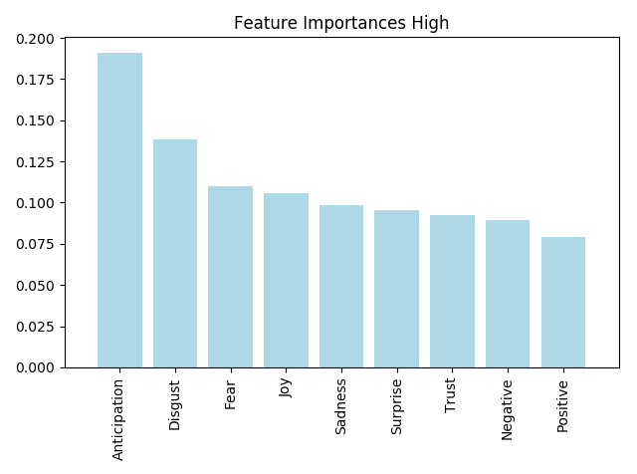

OLS Hyper-parameter Tuning
Tune the most significant sentiment vs. stock data to include with modelling
Decision Tree Regressor vs. Random Forest Regressor from sklearn
Just focusing on ‘Close,’ ‘High,’ ‘Low’ stock values and sentiment
Must include newest record in master dataset (from previous steps)

Slide 11
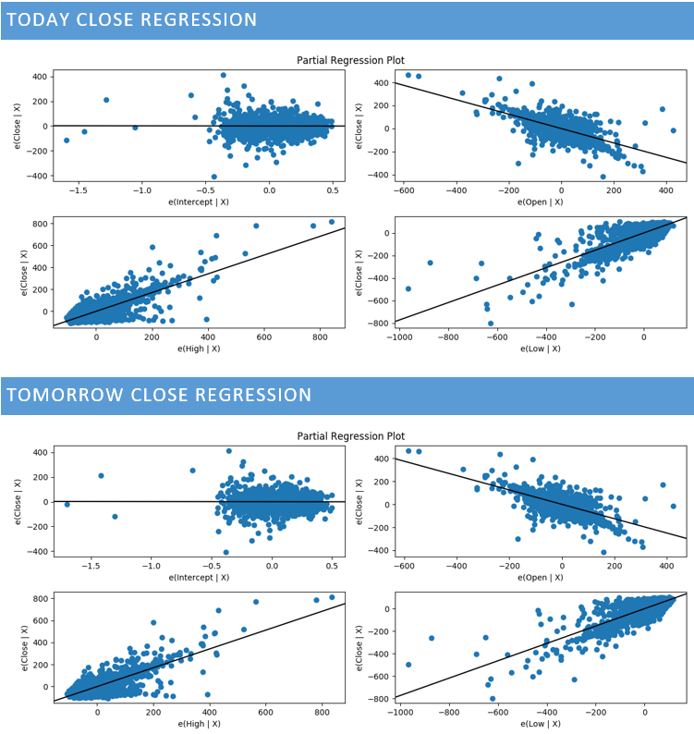
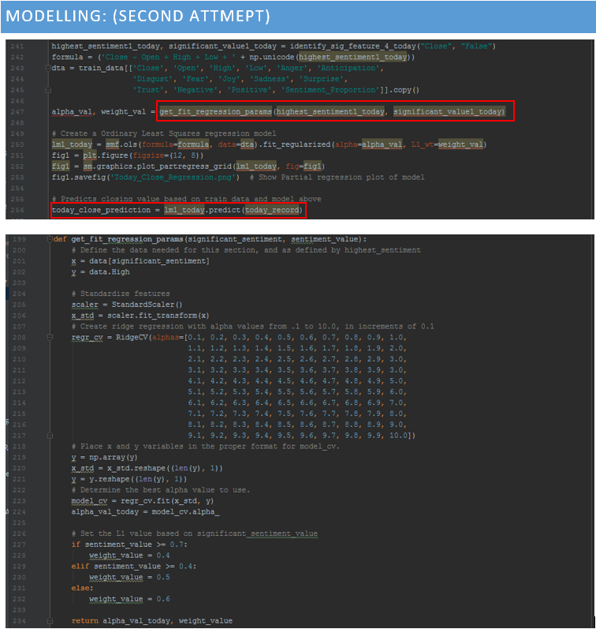

Revised modeling
To avoid over fitting we needed to regularize
Requirements for : statsmodels.regression.linear_model.OLS.fit_regularized
alpha : scalar or array-like
L1_wt: scalar
Perform Ridge Regression using sklearn to get best alpha and L1_wt parameters for each regularized model
Revise model
Predict stock data
Review Results

Slide 12
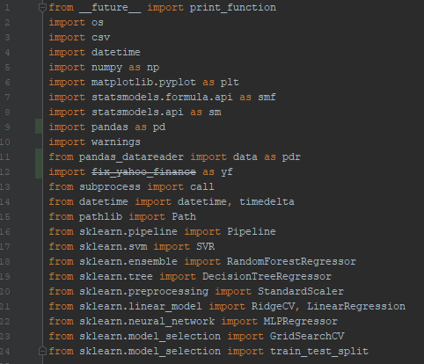
Automation
To give more credibility to our model and more accurate predictions, we automated our entire project
3 unique separate scripts in Python and R
5 data files and 6 graphs made automatically
Directions: Just need to download today’s news data, and click ‘Run’ on 1 script (Stock_Data_Modeling.py - 695 lines of code)
Review: Easily re-run models with a Jupyter
Notebook to see quick results
Required Libraries:
https://github.com/mwilchek/Stock-Modeling/blob/master/Stock_Data_Modeling.py

Slide 13
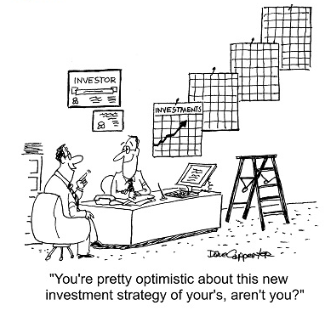
Take it to the next level
Create a Dashboard to visualize modelling results (perhaps near-real time prediction results of today as stocks change)
Capability to execute python scripts from it to download, model, and update new predictions
Upgrade flat files to a database (eventually those files will get too huge)
Add accuracy visualizations
Collect news data from additional sources than just reddit; might be a bit bias
Maybe actually test small investments based on results?

Slide 14
Questions?
https://github.com/mwilchek/Stock-Modeling

