Slide 1
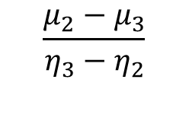
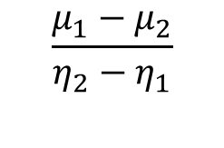
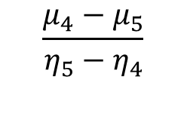
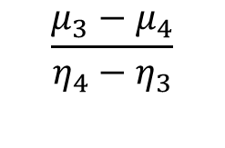
1
2
3
4
5
$$\frac{μ_{1}−μ_{2}}{η_{2}−η_{1}}$$
$$\frac{μ_{2}−μ_{3}}{η_{3}−η_{2}}$$
$$\frac{μ_{3}−μ_{4}}{η_{4}−η_{3}}$$
$$\frac{μ_{4}−μ_{5}}{η_{5}−η_{4}}$$
v

