Slide 1
Introduction to Data Mining
Introduction
Huiping Cao

Slide 2
Why this course?
According to a McKinsey report¹, McKinsey predicts a great effect of big data in employment, where 140, 000 – 190,000 workers with “deep analytical” experience will be needed in the U.S.; furthermore, 1.5 million managers will need to become data-literate.
1. M. Manyika et al. Big Data: The next frontier for innovation, competition, and productivity. McKinsey Global Institute. May 2011.

Slide 3
Syllabus
Principles
  Classical problems and algorithms, tools R
  A research direction
Go through syllabus
  Workload
  S/U option

Slide 4
Outline
Motivations
What is data mining
Origins of data mining
Typical data mining tasks
Challenges
Notes:
Why not traditional data analysis techniques?
Massive amount of data
Non-traditional nature of the data even the data set is small
The questions that need to be answered cannot be addressed using existing techniques

Slide 5
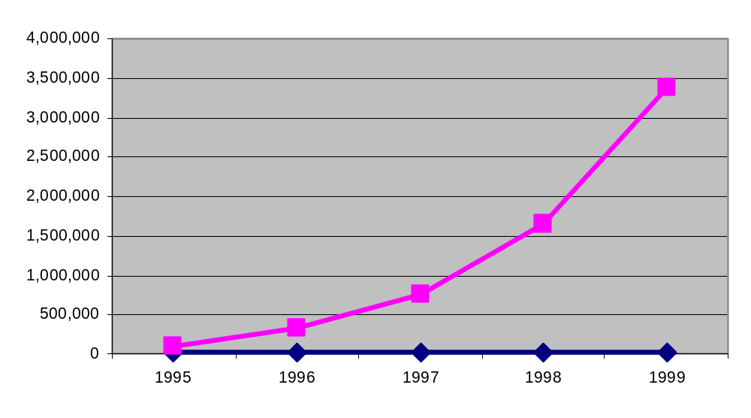
Motivation
Vast amount
Human analysts may take weeks to discover useful information
Much of the data is never analyzed at all
The Data Gap
Total new disk (TB) since 1995
Number of analysts
From: R. Grossman, C. Kamath, V. Kumar, “Data Mining for Scientific and Engineering Applications”
Notes:
There is often information “hidden” in the data that is
not readily evident
Human analysts may take weeks to discover useful information
Much of the data is never analyzed at all

Slide 6
Data growth
Worldwide information is more than doubling every two years
1.8 zettabytes or 1.8 trillion gigabytes projected to be created and replicated in 2011
Courtesy of Zdnet
http://www.zdnetasia.com/data-volume-to-hit-1-8zb-in-2011-62301103.htm
Notes:
http://www.zdnetasia.com/data-volume-to-hit-1-8zb-in-2011-62301103.htm

Slide 7
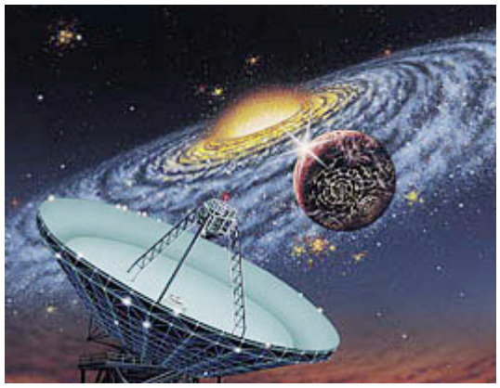
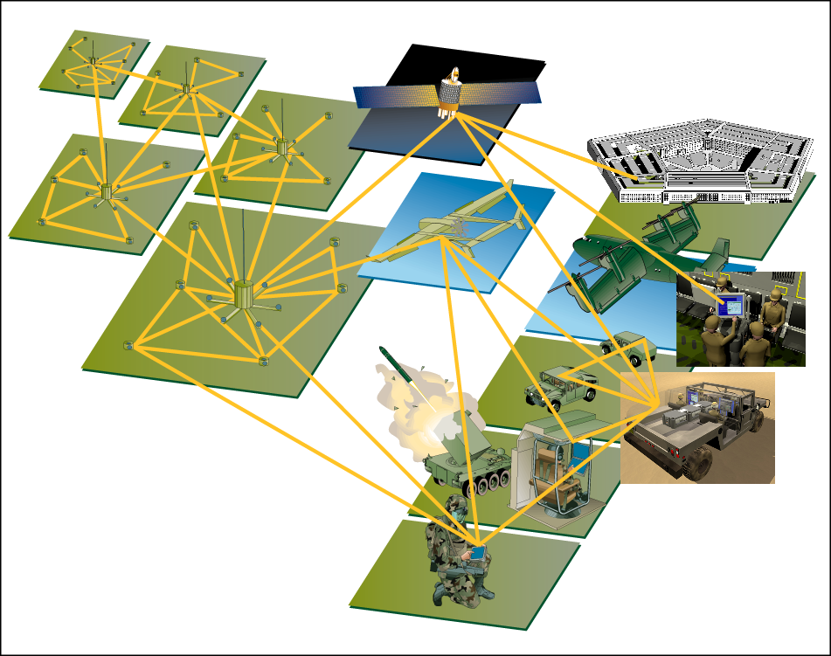
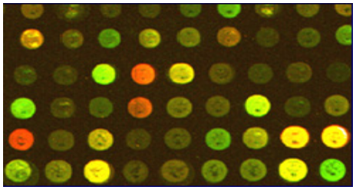
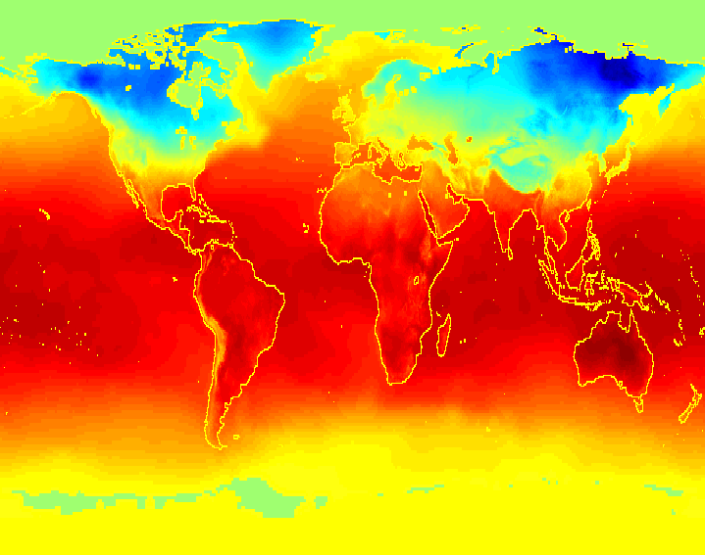
Applications
Data collected and stored at
enormous speed
  remote sensors on a satellite
  telescopes scanning the skies
  microarrays generating gene
  expression data
  scientific simulations
  generating terabytes of data
Data mining may help scientists
  in classifying and segmenting data
  in hypothesis formation

Slide 8
What is Data Mining
Many definitions
  Non-trivial extraction of implicit, previously unknown and potentially useful information from data
  Exploration & analysis, by automatic or semi-automatic means, of large quantities of data in order to discover meaningful patterns

Slide 9
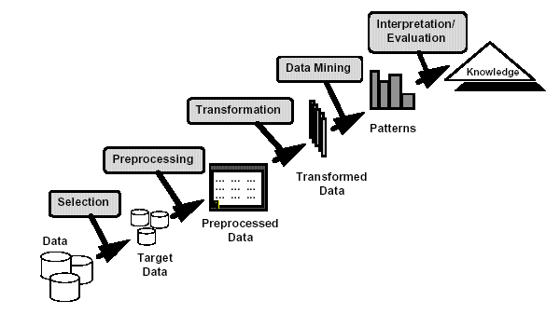
What is Data Mining (cont.)
Knowledge discovery

Slide 10
What is Data Mining (cont.)
Information retrieval
  Look up phone number in phone directory
  Query a Web search engine for information about “Amazon”

Slide 11
Origins of Data Mining
Traditional Techniques may be unsuitable
  Enormity of data
  High dimensionality
  of data
  Heterogeneous,
  distributed nature
  of data
Statistics/
AI
Machine Learning/
Pattern
Recognition
Data Mining
Database systems

Slide 12
Data Mining Tasks
Prediction Methods
  Use some variables to predict unknown or future values of other variables.
    Target, dependent variable
    Explanatory, independent variable
Description Methods
  Find human-interpretable patterns that describe the data.
From [Fayyad, et.al.] Advances in Knowledge Discovery and Data Mining, 1996

Slide 13
Data Mining Tasks (cont.)
Classification [Predictive]
Clustering [Descriptive]
Association Rule Discovery [Descriptive]
Sequential Pattern Discovery [Descriptive]
Anomaly Detection [Predictive]
Others (topic modeling, social media analysis, etc.)

Slide 14
Classification: Application
Fraud Detection
  Goal: Predict fraudulent cases in credit card transactions.
  Approach:
    Use credit card transactions and the information on its account-holder as attributes.
      When does a customer buy, what does he buy, how often he pays on time, etc
    Label past transactions as fraud or fair transactions. This forms the class attribute.
    Learn a model for the class of the transactions.
    Use this model to detect fraud by observing credit card transactions on an account.

Slide 15
Classification: Definition
Given a collection of records (training set )
  Each record contains a set of attributes, one of the attributes is the class.
Find a model for class attribute as a function of the values of other attributes.
Goal: previously unseen records should be assigned a class as accurately as possible.
  A test set is used to determine the accuracy of the model.
Notes:
Usually, the given data set is divided into training and test sets, with training set used to build the model and test set used to validate it.

Slide 16


Classification Example
categorical
categorical
continuous
class
Test
Set
Learn
Classifier
Training
Set
Model

Slide 17
Classification: Application (S.S.)
Direct Marketing
  Goal: Reduce cost of mailing by targeting a set of consumers likely to buy a new cell-phone product.
  Approach:
    Use the data for a similar product introduced before.
    We know which customers decided to buy and which decided otherwise. This {buy, don’t buy} decision forms the class attribute.
    Collect various demographic, lifestyle, and company-interaction related information about all such customers.
      Type of business, where they stay, how much they earn, etc.
    Use this information as input attributes to learn a classifier model.
From [Berry & Linoff] Data Mining Techniques, 1997

Slide 18
Classification: Application
Sky Survey Cataloging
  Goal: To predict class (star or galaxy) of sky objects, especially visually faint ones, based on the telescopic survey images (from Palomar Observatory).
      3000 images with 23,040 x 23,040 pixels per image.
  Approach:
    Segment the image.
    Measure image attributes (features) - 40 of them per object.
    Model the class based on these features.
    Success Story: Could find 16 new high red-shift quasars, some of the farthest objects that are difficult to find!
From [Fayyad, et.al.] Advances in Knowledge Discovery and Data Mining, 1996

Slide 19



Classifying Galaxies
Courtesy: http://aps.umn.edu
Early
Class:
Stages of Formation
Attributes:
Image features,
Characteristics of light waves received, etc.
Intermediate
Late
Data Size:
72 million stars, 20 million galaxies
Object Catalog: 9 GB
Image Database: 150 GB

Slide 20
Clustering: Application
Document Clustering:
  Goal: To find groups of documents that are similar to each other based on the important terms appearing in them.
  Approach: To identify frequently occurring terms in each document. Form a similarity measure based on the frequencies of different terms. Use it to cluster.
  Gain: Information Retrieval can utilize the clusters to relate a new document or search term to clustered documents.

Slide 21
Clustering Definition
Given a set of data points, each having a set of attributes, and a similarity measure among them, find clusters such that
  Data points in one cluster are more similar to one another.
  Data points in separate clusters are less similar to one another.
Similarity measures:
  Euclidean distance if attributes are continuous.
  Other problem-specific measures.

Slide 22
Illustrating Clustering
Euclidean Distance Based Clustering in 3-D space.
Intracluster distances
are minimized
Intercluster distances
are maximized

Slide 23
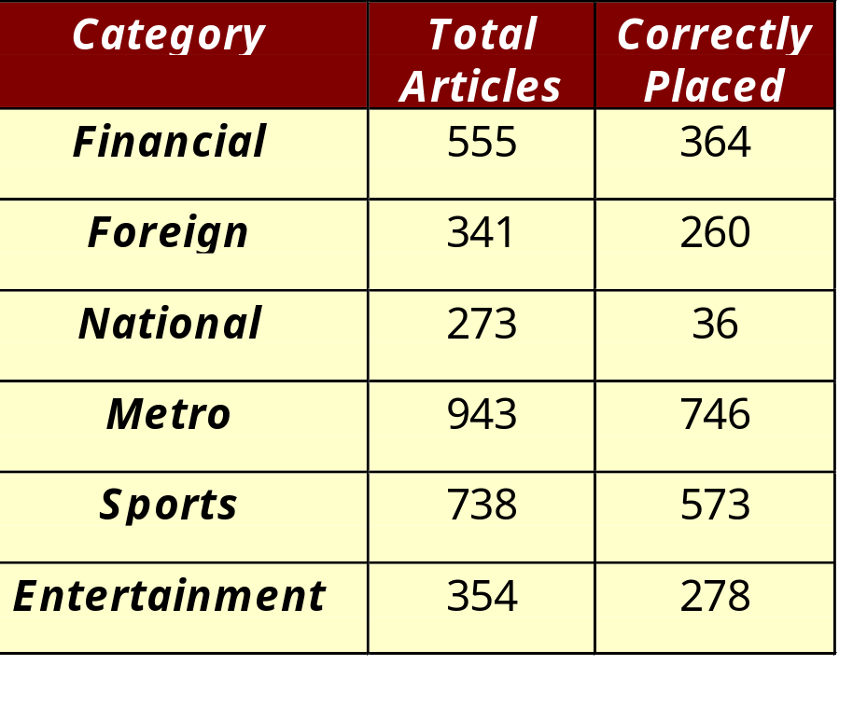
Illustrating Document Clustering
Clustering Points: 3204 Articles of Los Angeles Times.
Similarity Measure: How many words are common in these documents (after some word filtering).

Slide 24
Clustering: Application (S.S.)
Market Segmentation:
  Goal: subdivide a market into distinct subsets of customers where any subset may conceivably be selected as a market target to be reached with a distinct marketing mix.
  Approach:
    Collect different attributes of customers based on their geographical and lifestyle related information.
    Find clusters of similar customers.
    Measure the clustering quality by observing buying patterns of customers in same cluster vs. those from different clusters.

Slide 25

Association Rule Discovery: Definition
Given a set of records each of which contain some number of items from a given collection;
  Produce dependency rules which will predict occurrence of an item based on occurrences of other items.
Rules Discovered:
{Milk} --> {Coke}
{Diaper, Milk} --> {Beer}

Slide 26
Association Rule Discovery: Application
Supermarket shelf management.
  Goal: To identify items that are bought together by sufficiently many customers.
  Approach: Process the point-of-sale data collected with barcode scanners to find dependencies among items.
  A classic rule --
    If a customer buys diaper and milk, then he is very likely to buy beer.
    So, don’t be surprised if you find six-packs stacked next to diapers!

Slide 27
Association Rule Discovery: Application
Inventory Management:
  Goal: A consumer appliance repair company wants to anticipate the nature of repairs on its consumer products and keep the service vehicles equipped with right parts to reduce on number of visits to consumer households.
  Approach: Process the data on tools and parts required in previous repairs at different consumer locations and discover the co-occurrence patterns.

Slide 28
Association Rule Discovery: Application
Marketing and Sales Promotion:
  Let the rule discovered be
  {Bagels, … } --> {Potato Chips}
  Potato Chips as consequent => Can be used to determine what should be done to boost its sales.
  Bagels in the antecedent => Can be used to see which products would be affected if the store discontinues selling bagels.
  Bagels in antecedent and Potato chips in consequent => Can be used to see what products should be sold with Bagels to promote sale of Potato chips!

Slide 29
Sequential Pattern Discovery: Definition
Given is a set of objects, with each object associated with its own timeline of events, find rules that predict strong sequential dependencies among different events.
Rules are formed by first discovering patterns. Event occurrences in the patterns are governed by timing constraints.
(A B) (C) (D E)
(A B) (C) (D E)
<= xg
>ng
<= ws
<= ms

Slide 30
Sequential Pattern Discovery: Examples
In telecommunications alarm logs,
  (Inverter_Problem Excessive_Line_Current)
  (Rectifier_Alarm) --> (Fire_Alarm)
In point-of-sale transaction sequences,
  Computer Bookstore:
  (Intro_To_Visual_C) (C++_Primer) --> (Perl_for_dummies)
  Athletic Apparel Store:
  (Shoes) (Racket, Racketball) --> (Sports_Jacket)

Slide 31





Deviation/Anomaly Detection
Detect significant deviations from normal behavior
Applications:
  Credit Card Fraud Detection
  Network Intrusion
  Detection
Typical network traffic at University level may reach over 100 million connections per day

Slide 32
Other application areas
Text mining
  Web, documents, XML
Social media analysis
Graph mining
Sequential data
  Time series
  Spatiotemporal data

Slide 33
Topic model
Computer Methods Number Two Principle Design Access Processing Advantage important | chemistry Synthesis oxidation Reaction Product Organic Conditions Cluster Modecule studies | cortex Stimulus Fig Vision Neuron Recordings Visual Stimuli Recorded motor | orbit Dust jupiter Line System Solar Gas Atmospheric mars ﬁeld | Infection Immune Aids Infected Viral Cells Vaccine Antibodies Hiv parasite
Five topics from a LDA model fit to Science from 1980-2002
Courtesy of David M. Blei and Jon D. Lafferty “Topic Models” 2009.
Notes:
TOPIC MODELS
DAVID M. BLEI PRINCETON UNIVERSITY
JOHN D. LAFFERTY

Slide 34
Challenges of Data Mining
Scalability
Dimensionality
Complex and heterogeneous Data
Data distribution
  Communication, result consolidation, security
Privacy preserving

Slide 35
Reading
1. H. V. Jagadish, Johannes Gehrke, Alexandros Labrinidis, Yannis Papakonstantinou, Jignesh M. Patel, Raghu Ramakrishnan, Cyrus Shahabi: Big data and its technical challenges. Commun. ACM (CACM) 57(7):86-94 (2014)
2. Vasant Dhar: Data science and prediction. Commun. ACM (CACM) 56(12):64-73 (2013)

Slide 36
References
Journals
  TDKE, DMKD, DKE, KAIS
  VLDBJ, IS (domain-specific)
Conferences
  KDD, ICDM, SDM, PAKDD, PKDD
  Databases
    SIGMOD, VLDB, ICDE, EDBT, SSDBM, DEXA, SSTD
  Machine learning/Artificial intelligence
    ICML, AAAI
  Information retrieval
    SIGIR
  Misc: WWW, CIKM

Slide 37
References
WEKA: http://www.cs.waikato.ac.nz/ml/weka/
R: http://www.r-project.org/
RapidMiner: http://rapidminer.com/products/rapidminer-studio/
Apache Hahout: a scalable machine learning library https://mahout.apache.org/
MATLAB: http://www.mathworks.com/
SPSS: http://www-01.ibm.com/software/analytics/spss/
SAS (Statistical Analysis System): http://www.sas.com/
STATA (Data Analysis and Statistical Software): http://www.stata.com/
Database management systems

