Slide 1


Datathon: Exploring NY Property Sales

Slide 2
Overview
Goal:
Explore spatiotemporal trends of NYC property sales
Construct a predictive model for house prices
Visualizing and analyzing our predictions

Slide 3
Price of different locations over time

Slide 4
Sales for different price ranges

Slide 5
Model
Data preprocessing:
Feature transformations, outlier removal
Models compared:
Linear Regression, Random Forest, XGBoost
Best model: XGBoost
Result: RMSE: ~ 267k (std dev: 450k over our data)

Slide 6
Visualizing predictions from our model
plots/rmse.html

Slide 7
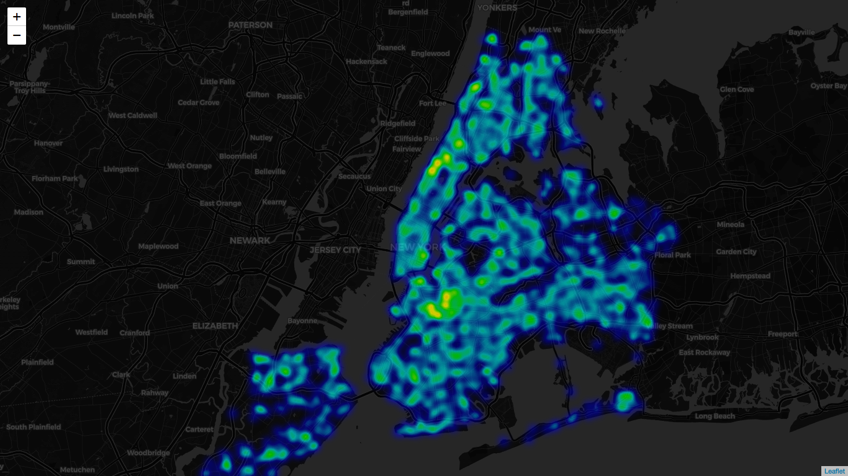
RATS!!

