Slide 1
DATA SCIENCE PROFESSIONAL CERTIFICATE CAPSTONE PROJECT Global Economics
James Chan, Ayoub Mharzi, Daria Ulybina, Cat Din Tran Meagan Thompson

Slide 2
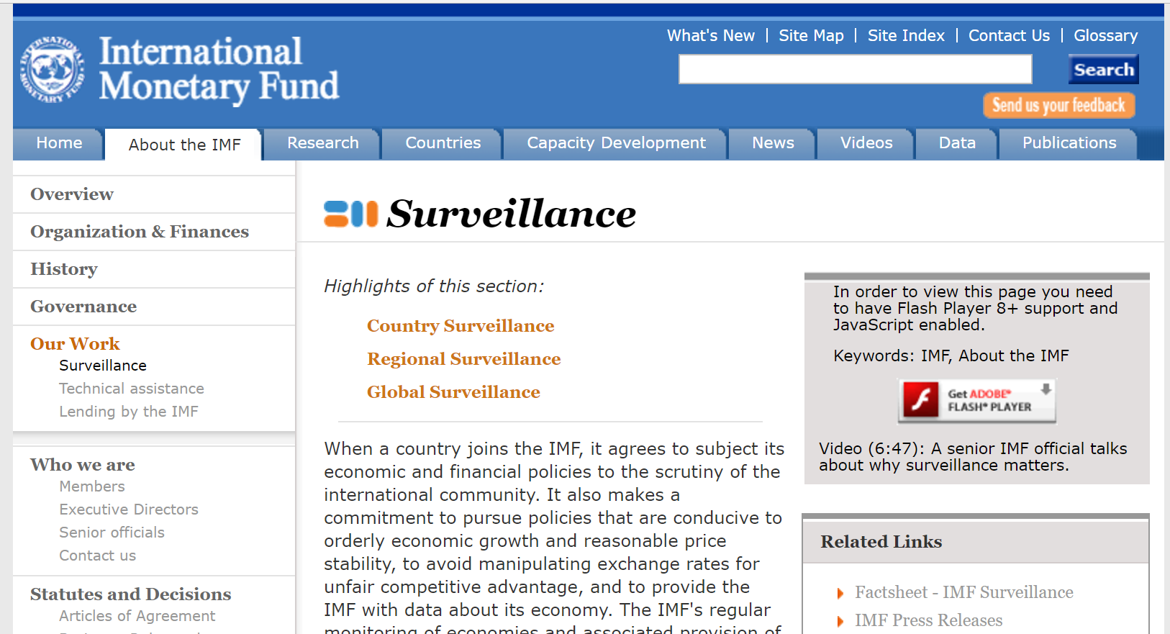
International Monetary Fund (IMF) overview
IMF Surveillance is an annual process that results in Article IV reports
~ one report/year for member countries (186 members)
assessments of the member country’s economic and fiscal policies
recommendations on financial policies are used internally and by country authorities, other institutions, and companies

Slide 3
Problem and Hypothesis
Article IV reports are available to download via the IMF publications website, but are not tagged meaningfully
An economist searching for recommendations based on key economic indicators would have to use brute force methods to find similar economic indicators from different areas of the world or different time periods
Hypothesis: An application can be created which would allow a user to find similar economic situations and recommendations through space and time using Natural Language Processing and Machine Learning algorithms on Article IV reports.

Slide 4
Approach: Data science pipeline
Data Ingestion
Data Munging and Wrangling
Computation and Analyses
Reporting and Visualization
Modeling and Application

Slide 5
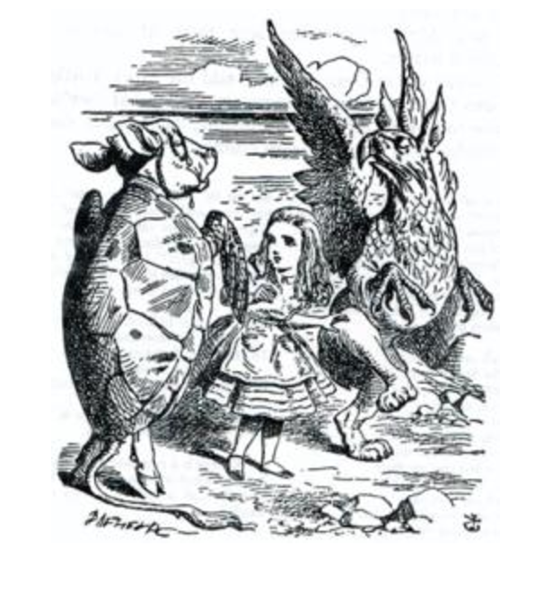


Data ingestion
Download PDFs
BeautifulSoup
Requests library
Storage
Data stored on Amazon Cloud
Outputs
“log” file: txt file containing list of downloaded documents
Summary table: CSV file containing metadata

Slide 6
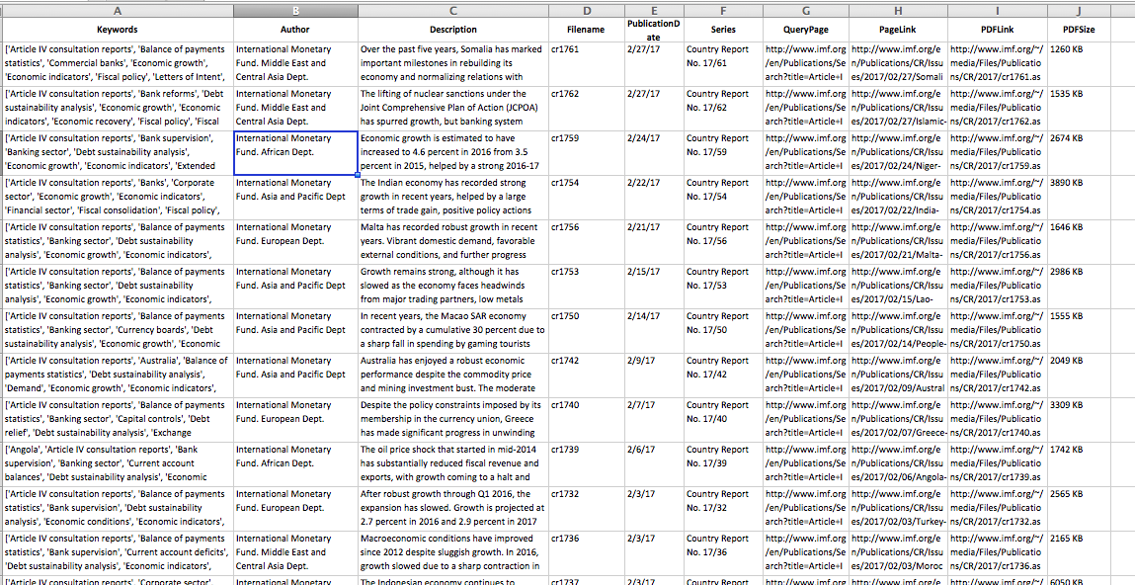
Summary table example
Screenshot of the outputs for ingestion?

Slide 7
Data Munging & Wrangling
Data Ingestion
Data Munging and Wrangling
Computation and Analyses
Reporting and Visualization
Modeling and Application

Slide 8
Wrangling 1: pdf-iculties
pdfminer (https://github.com/euske/pdfminer/) to convert PDFs to HTML
Problems:
Some documents did not process
Processing hung on specific documents causing script to not run on following document
Solution:
Difficulties in processing due to text and table alignment in specific documents, solved by adding a timer that would move to the next document after a specified time period
Final extraction: 372 HTML Article IV reports from 2013 - 2017

Slide 9
Wrangling 2 – extracting content
Didn’t want to run clustering on entire document, more concerned with main topics, like “fiscal” or “monetary”
HTML tags were not well structured and we could identify no path for generic extraction of text related to main article
After several approaches, we observed that the only thing in common to all the HTML files was how the Tables of Contents were identified.
Tables of Contents extracted by creating a python script that looped through the HTML documents
Output was a list of txt files named after the source document
Notes:
After a quick look at the created tables of content, we observed that all the main topics are discussed before that “Staff appraisal” of each Article IV.

Slide 10
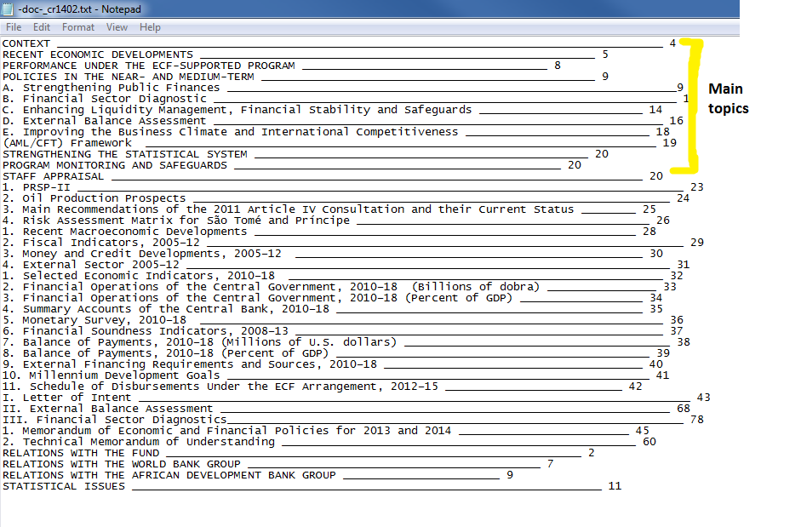
Table of contents
Notes:
we observed that all the main topics are discussed before that “Staff appraisal” of each Article IV.

Slide 11
Wrangling 3 – creating JSON dictionary for tables of contents
Creating a JSON dictionary of the Table of Contents, to
simplify and have a better structure
target only main topics (everything above “Staff Appraisals”)
Python script looped through txt files, creating a large JSON dictionary, structured:
{“Document1 name”: [“Topic 1”,” Topic 2”,…], “Document2 name”: [“Topic 1”,” Topic 2”,..], …}

Slide 12
Wrangling 4 – JSON dictionary of text for each topic
BeautifulSoup, JSON, collections
Create script using regular expressions (regex) to extract chunks of text between two topics, using “STAFF APPRAISAL” as a stop phrase
Python script generated one JSON dictionary containing all of the documents, structured:
[ {“content”: [ {“head”: “topic1 title”, “tail”: “topic1 text body”}, {“head”: “topic2 title”, “tail”: “topic2 text body”}…..], “doc”: “ Document 1 name”}, {“content”: [ {“head”: “topic1 title”, “tail”: “topic1 text body”}, {“head”: “topic2 title”, “tail”: “topic2 text body”}…..], “doc”: “ Document 2 name”} ….]

Slide 13
Wrangling 5 – adding year and country
We needed to add country name and publication year to each object inside the dictionary
This information was stored in the summary table created at the download of the PDF documents. We created a JSON object structured as follow: {“document1 id”: [“Country name”, “publication year”], “document2 id”: [“Country name”, “publication year”] ...}
Then merged this dictionary with the one containing the topics and texts using the document id as a reference for the merge.

Slide 14
Computation & Analysis
Data Ingestion
Data Munging and Wrangling
Computation and Analyses
Reporting and Visualization
Modeling and Application

Slide 15
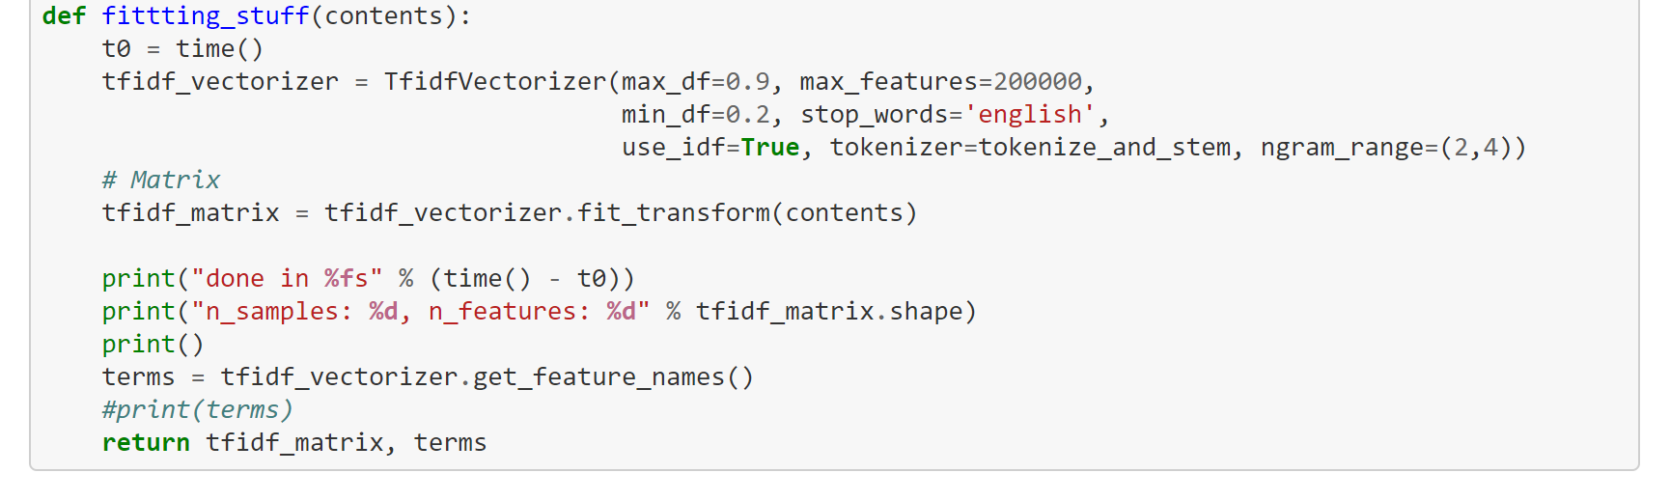
Computation & Analysis
Preprocessing
NLTK list of English stop words
Snowball stemming
Tf-idf: defined term frequency-inverse document frequency (tf-idf) vectorizer parameters and then converted the synopses list to tf-idf matrix
Count word occurrence by document -> document-term matrix
applied the term frequency-inverse document frequency weighting

Slide 16
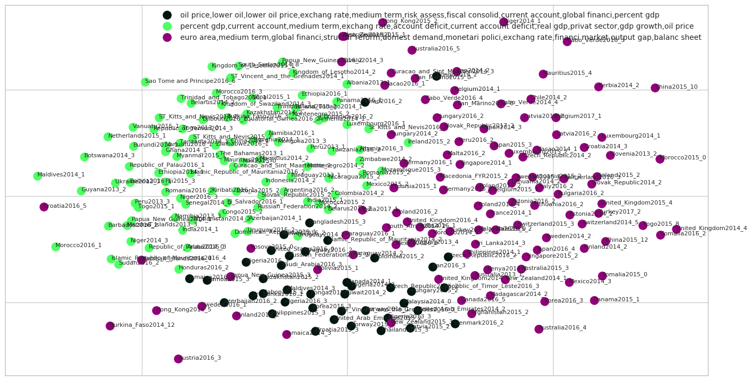
Computation & analysis
Labeling text chunks(based of headers)
Labeling based off clusters of text (k-means)

Slide 17
Modeling & application
Data Ingestion
Data Munging and Wrangling
Computation and Analyses
Reporting and Visualization
Modeling and Application

Slide 18
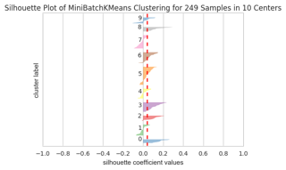
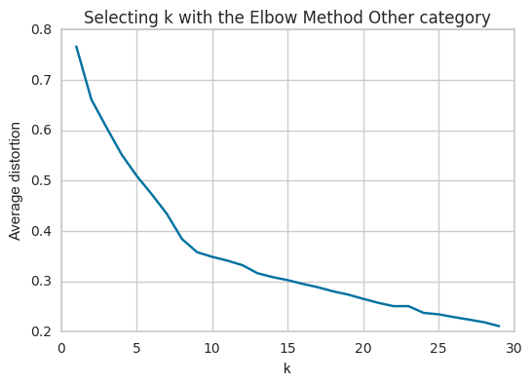
Modeling & application
K-means clustering
K=5
Hyperparameter tuning

Slide 19
Reporting & Visualization
Data Ingestion
Data Munging and Wrangling
Computation and Analyses
Reporting and Visualization
Modeling and Application

Slide 20
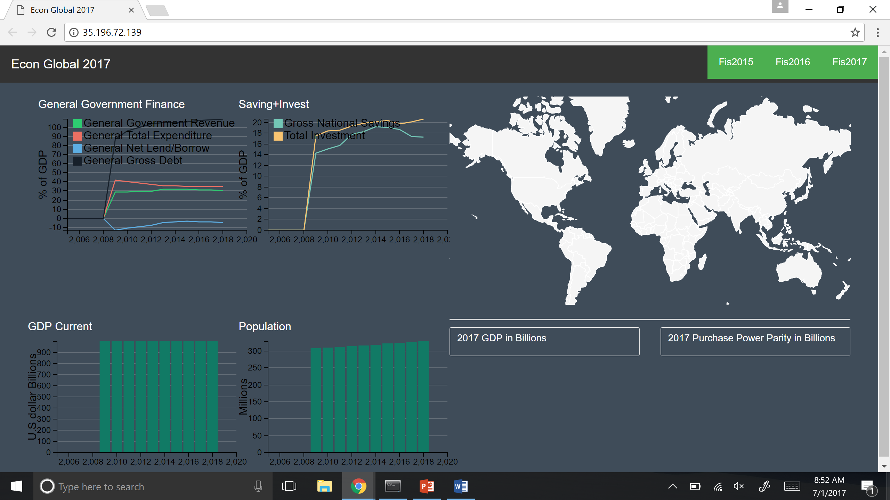
Reporting & visualization

Slide 21
Lessons learned
Don’t mess with PDFs! This isn’t entirely true, but we did learn that there is not a standard way of extracting text from PDFs and without some subject matter expertise to guide you, it is difficult to decide what is important
Never underestimate the time it takes to process and wrangle the data so it is useful for your application
Confirmed 80% rule of cleaning and wrangling data
Version control is very important

