Slide 1

Application
Architecture
Legislation Explore Group
Ed Gilliland
Mai Phuong Huynh
Mark Kindig
Jan Spoor

Slide 2
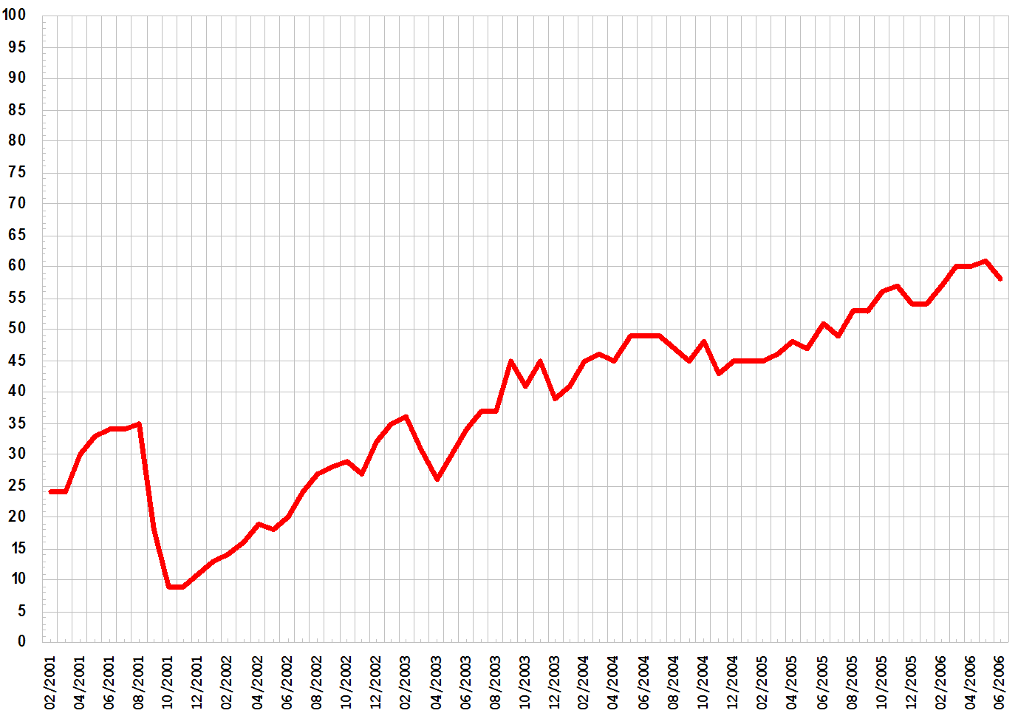
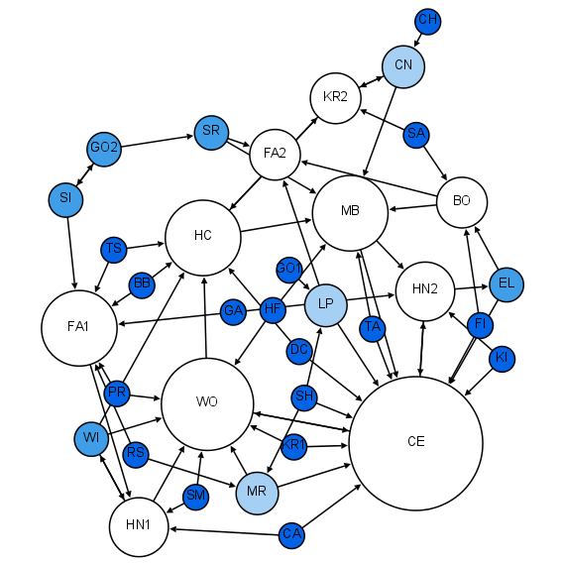
Architecture Overview
Notes:
Will try Sunlight Data Services API, but it appears that the data are also available as download.
Will try storing data in MSSQL DB, but may just store wrangled data in CSV
Sunlight Data Services (or download CSV)
Data Ingestion:
Open States API
Influencer Explorer API
Data Munging and
Wrangling
JSON formatted WORM storage (or CSV stored to hard drives)
SQL (or CSV)
Computation and Analysis
Time series graph of certain bills
Reporting and Visualization
Modeling and Application
Predictive modeling of certain variables that will enable bill to pass
September 26, 2015
V1.0

Slide 3
Backup Slides

Slide 4
Architecture Overview
Sunlight Data Services
Data Ingestion:
Open States API
Influencer Explorer API
Data Munging and
Wrangling
JSON formatted WORM storage
Time series graph of certain bills
Computation and Analysis
Reporting and Visualization
Modeling and Application
Predictive modeling of certain variables that will enable bill to pass

