Slide 1
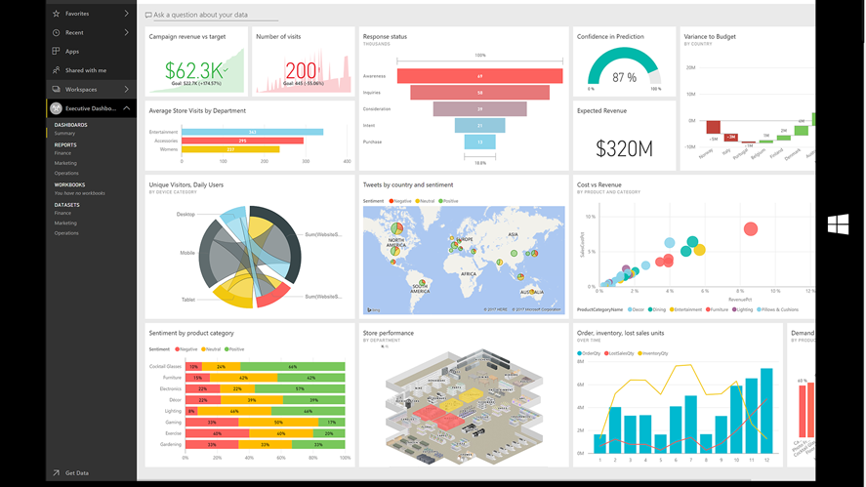
Power BI Visual Challenge
-Be Creative, Informative and Interesting-
1st Place: Free Elite Subscription to On-Demand Training ($1295 Value) and a $100 Gift Card to Amazon!
2nd Place: $50 Gift Card to Amazon

