Slide 1

Who Wrote This? Classifying the Source of a News Article
Stephen M. Lee

Slide 2

Goal
Put the news into context...
… using NLP to categorize the source.

Slide 3

Motivation
Fake News.
You can’t improve what you don’t measure.
Hunt Allcott & Matthew Gentzkow, 2017. "Social Media and Fake News in the 2016 Election," Journal of Economic Perspectives, vol 31(2), pages 211-236.

Slide 4

Motivation
What does “fake” news mean?
Not always so simple to decide…
Context and perspective matter!
Make a “GPS” for news.

Slide 5
Problem Setup
News Classification
Input: A news article from one of three sources: Fox; Vox; or PBS.
Question: Who wrote the article?

Slide 6
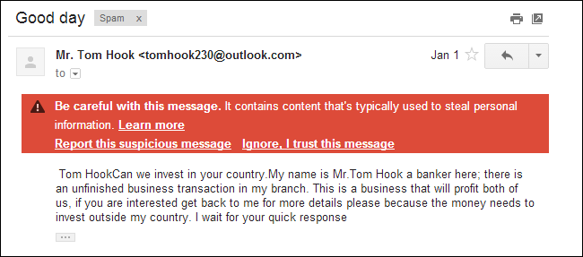
Related Work
Email spam filters.
Early analytical work.
TF-IDF
Latent Semantic Analysis
Recently, recurrent neural networks (RNN).^{1, 2, 3}
Hochreiter, Sepp, and Jürgen Schmidhuber. "Long short-term memory." Neural computation 9.8 (1997): 1735-1780.
Yang, Zichao, et al. "Hierarchical attention networks for document classification." Proceedings of the 2016 Conference of the North American Chapter of the Association for Computational Linguistics: Human Language Technologies. 2016.
3. Zhou, Xinjie, Xiaojun Wan, and Jianguo Xiao. "Attention-based LSTM network for cross-lingual sentiment classification." Proceedings of the 2016 conference on empirical methods in natural language processing. 2016..

Slide 7
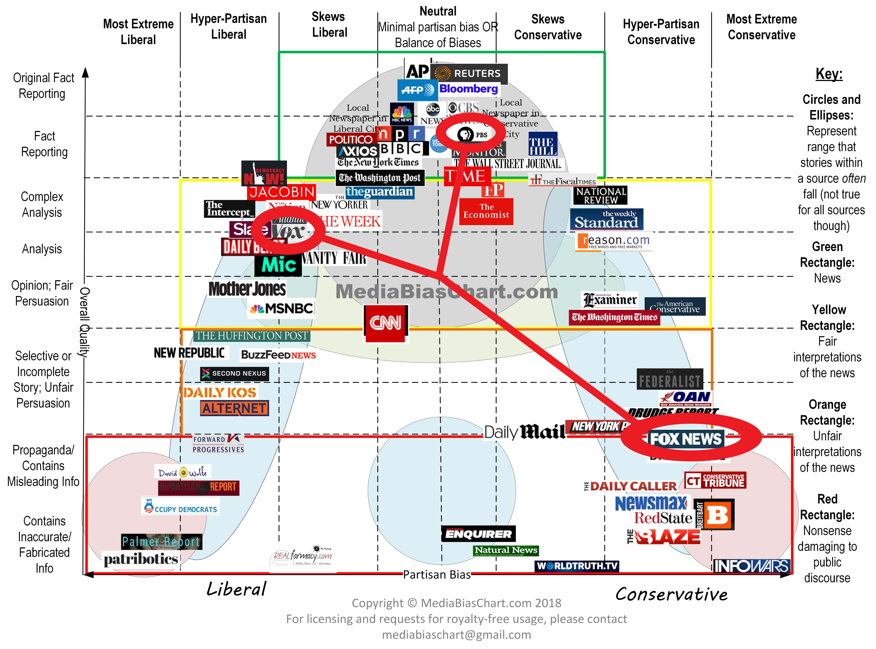

Slide 8
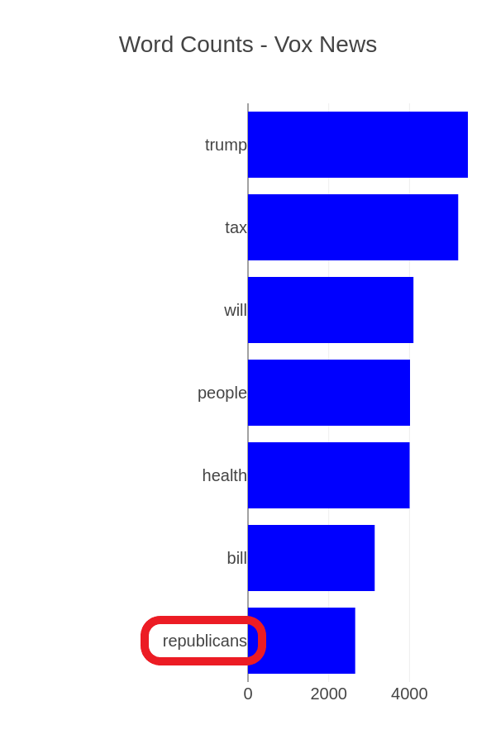
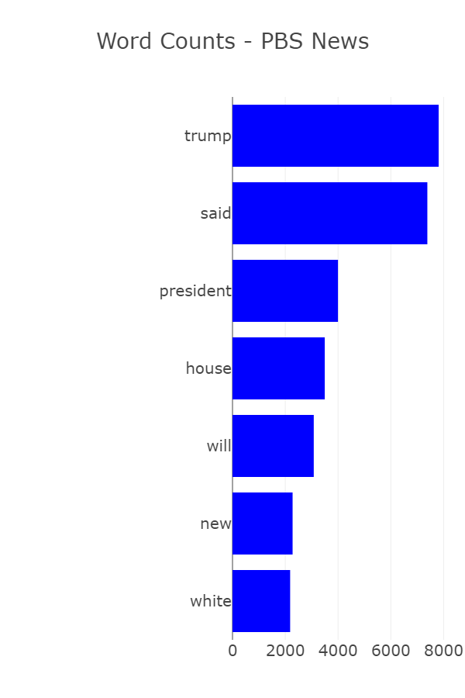
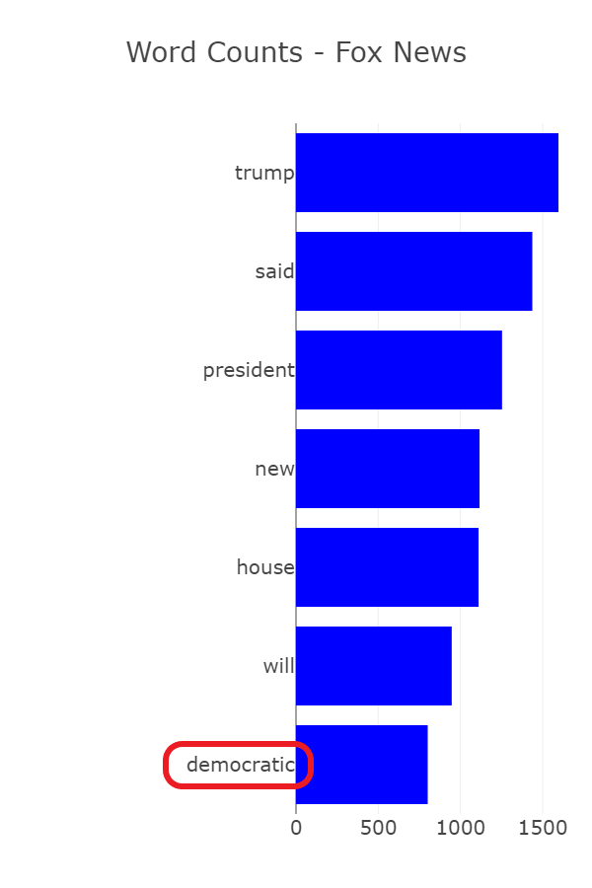
Data and Insights

Slide 9
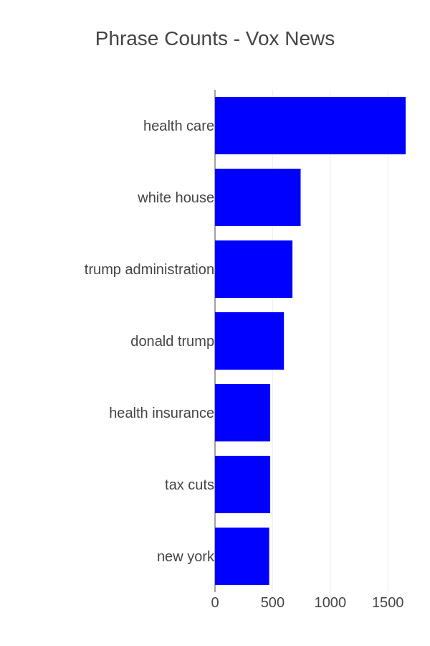
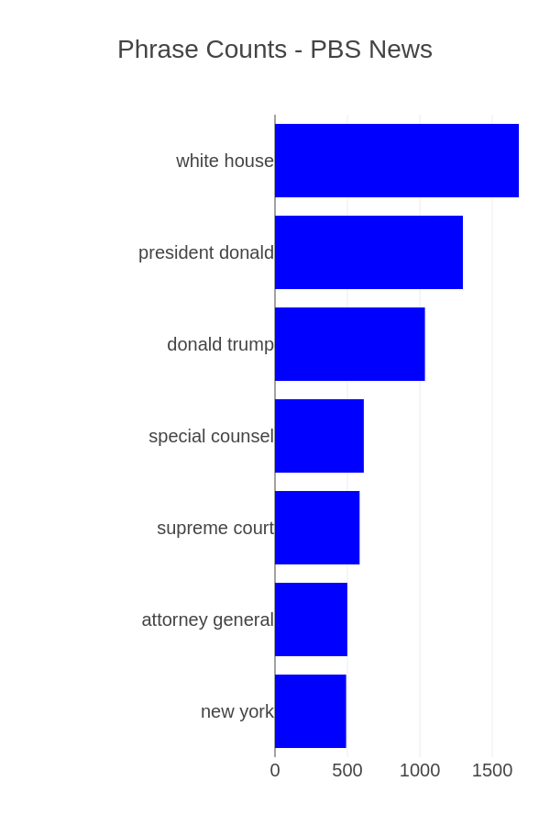
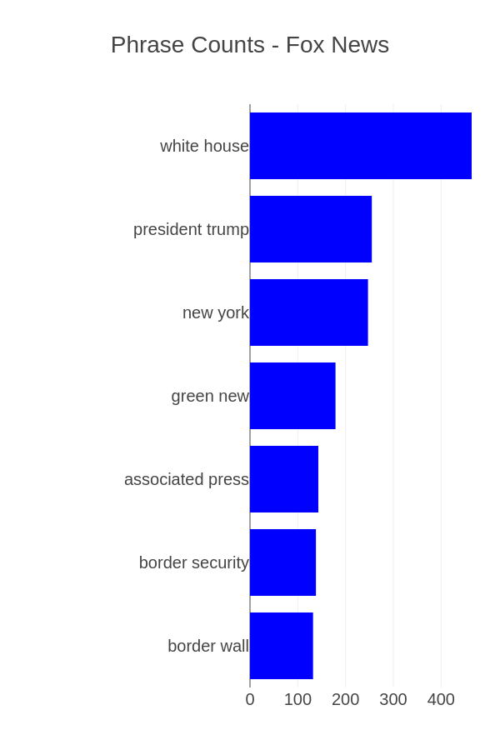
Data and Insights

Slide 10
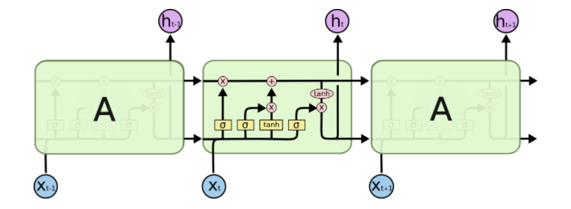
Baseline Solution
Bidirectional LSTM
500 words of each article
“GloVe” word embeddings
Classify
Fox-Vox
Fox-PBS
Vox-PBS
Fox-Vox-PBS
2. http://colah.github.io/posts/2015-08-Understanding-LSTMs/

Slide 11
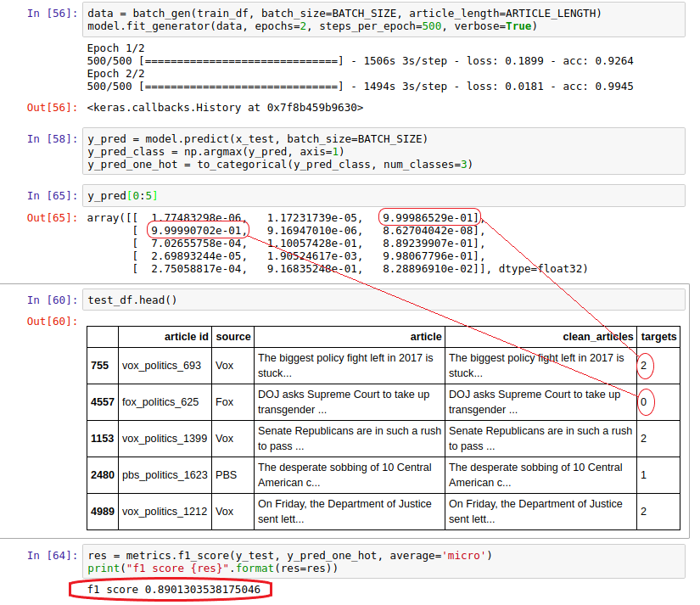
Key Results
Fox-Vox Classifier
F1 Score → 0.991
Fox-PBS Classifier
F1 Score → 0.980
Vox-PBS Classifier
F1 Score → 0.895
Fox-Vox-PBS Classifier
F1 Score → 0.890

Slide 12
Future Work
More news sources.
More news topics.
Attention and Transformer based models.
Bidirectional Encoder Representations from Transformers (BERT)
Web based interface.

Slide 13
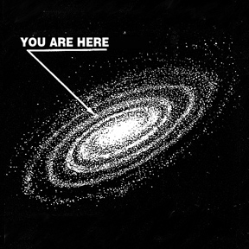
Conclusion and Discussion
Different news sources may actually have quantifiably distinct styles.
If implemented as a web app, this classifier could help readers “locate” bias.
Over time, readers could keep track of the types of news they read and discover their own implicit biases.

Slide 14
Thank you
Stephen M. Lee
smlee@memphis.edu

