Slide 1
Flipping homes in King County
Utku Kale and Kevin Fagan

Slide 2
Agenda
Data explanation, area exploration
Target zip codes
Price prediction per square foot

Slide 3
Goal
Here we will explore where and how to buy, renovate, and resell homes in King County, Washington.
All data is sourced from https://data.kingcounty.gov/
First we will locate the best zip codes to operate in by comparing low quality homes and high quality homes within each zip code and finding the areas where the difference is the highest.
Outliers were removed via 1.5*IQR.

Slide 4
Zip code selection

Slide 5
Top 5 zip codes
Zip | Jurisdiction | Mean difference in price
98039 | Menina | $2.284mm
98004 | Bellvue | $1.411mm
98112 | Seattle | $1.213mm
98077 | Woodinvile | $942m
98109 | Seattle | $798m
The list of zip codes to target does not change when using mean or median.

Slide 6
What can and cannot be improved
We had to focus on features that can be improved.
Bedrooms
Bathrooms
Square foot living area
Number of floors
Heat source
Square foot above grade
Square foot basement
Square foot garage
Square foot patio
Year renovated
Class
VIF analysis identified coliniarity between several of the square footage variables, so we focused on square footage livable, which had the strongest correlation.
Year renovated and class will be improved by nature of renovating.

Slide 7
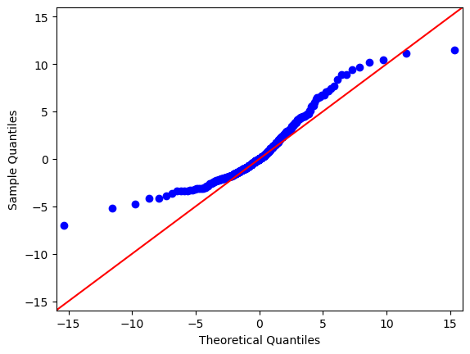
Simple sqft_living / price

Slide 8
Area surrounding University of Washington
Our best model was for 98109, the area surrounding the University of Washington, Seattle.
We identified a coefficient of $751 per square foot added.
We also identified an increase in value of $1.16mm by upgrading from electric to gas/solar heating.

Slide 9
Thank you
Utku Kale
Kevin Fagan

