Slide 1
Everyone wants a studio

Slide 2
I used movie data to determine the most profitable genres.
Data sources:
IMDB for genre information
The Numbers for budget and box office information
Profits are global gross revenue minus production budget

Slide 3
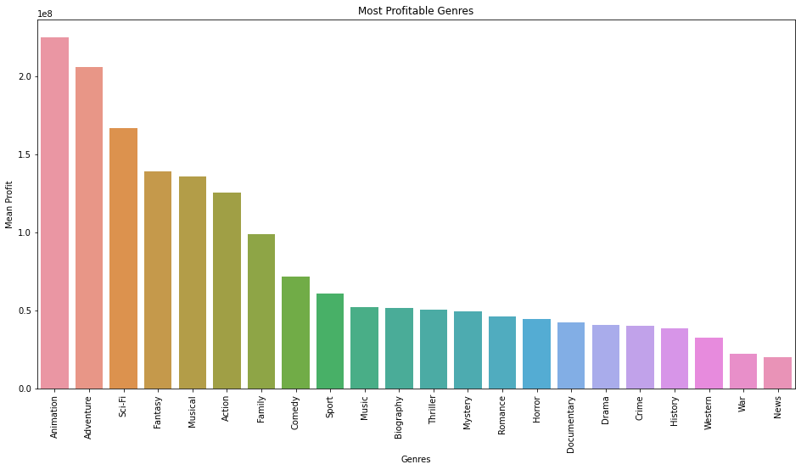
On average, animated movies have the highest profits

Slide 4
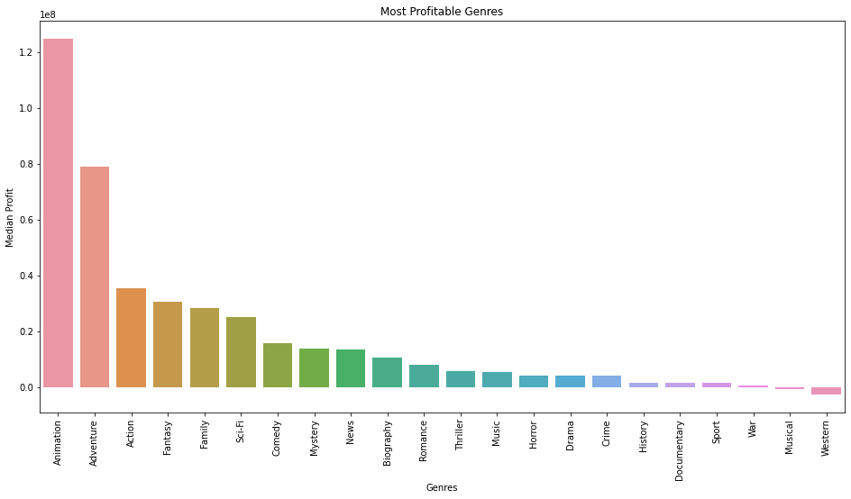
Median values are significantly lower, indicating skewed data

Slide 5
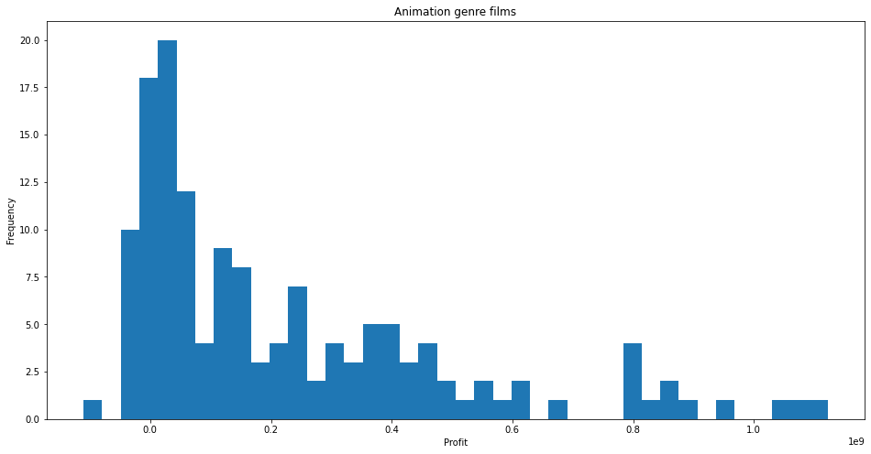
In all genres, the averages are distorted by very profitable outliers.
As you can see, animated movies are more likely to make very little or even lose money.
There are very few examples of making > $1mmm.

Slide 6
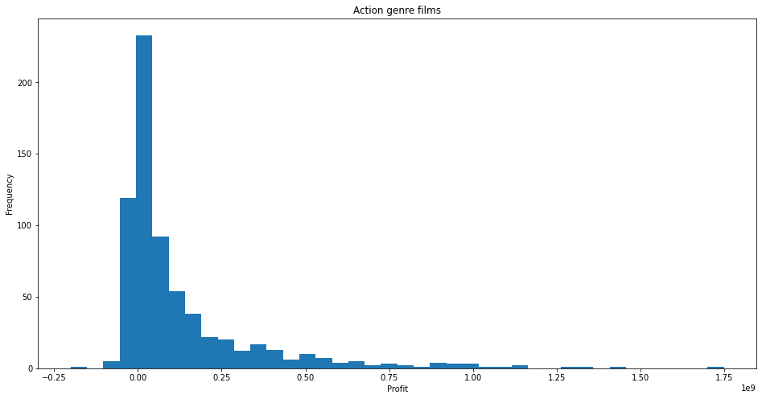
Action movies have even more profitable outliers.

Slide 7
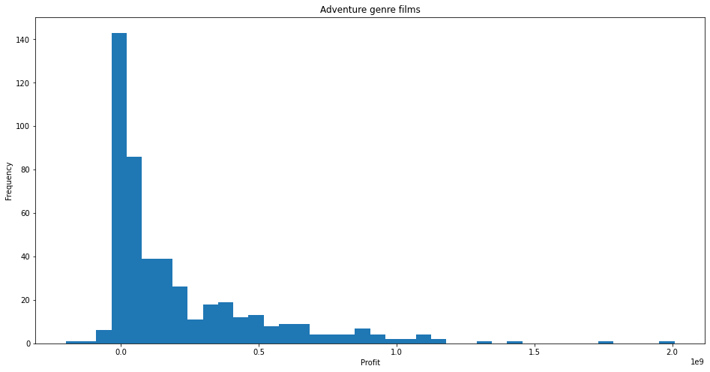
Adventure movies show a similar pattern, with examples up to $2mmm.

Slide 8
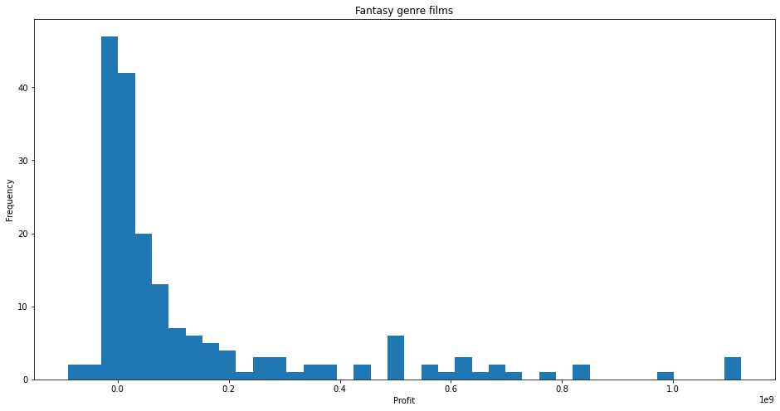

Slide 9
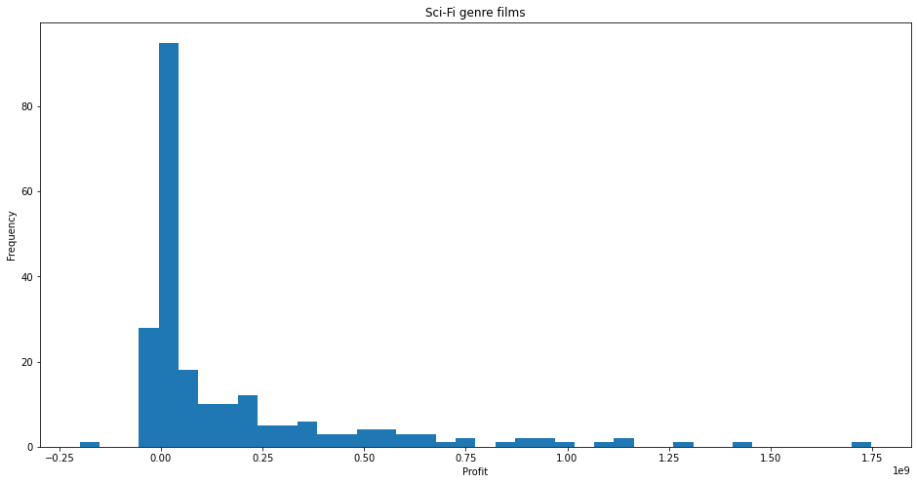
Sci-fi at least has a mode greater than zero.

Slide 10
No genre guarantees success
Some genres lend themselves to potential success
I recommend producing sci-fi action adventure film, possibly animated.

Slide 11
Next we will explore directors to target.
Director data was taken from IMDB
Profits were taken from The Numbers

Slide 12
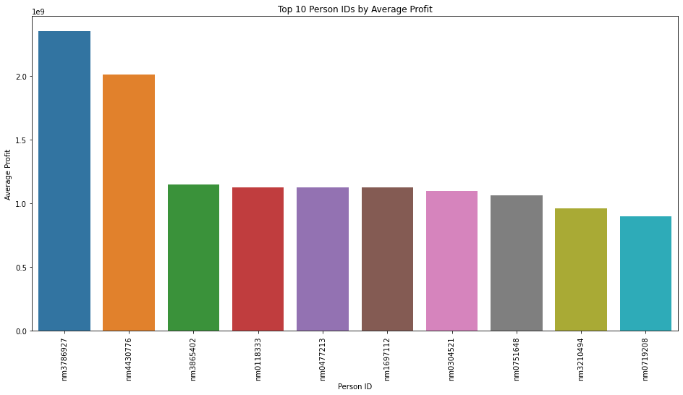
If we use a similar process to find the top 10 directors by mean profit, we find that the top director averaged over $2mmm per film. Unfortunately, that director only works in Japanese and hasn’t worked since 2011.

Slide 13
Median profit per movie is not helpful either, as many directors have only directed one or two movies.
Instead, we need to find directors who have shown repeatable profitablity.

Slide 14
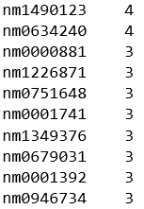
Translating the person_ids through IMDB, these directors are:
James Wan, who has experience with animated, action and adventure movies.
Christopher Nolan, who has experience with action, adventure and sci-fi movies.
Jon M Chu, who has experience with action, adventure and sci-fi movies
Michael Bay, who has experience with animated, action, adventure and sci-fi movies.
Peter Jackson, who has experience with action, adventure and sci-fi movies.
David Yates, who has experience with action, adventure and fantasy movies.
Kenneth Branagh, who has experience with action, adventure and fantasy movies.
Mike Mitchell, who has experience with animation, action, adventure and sci-fi movies.
Francis Lawrence, who has experiece with action, adventure and sci-fi.
Steven Spielberg, who has experience with animation, action, adventure and sci-fi movies.
I recommend starting negotiations with these directors, starting with those that have animation experience if an animated film is persued.
Instead, I found the directors with the most appearances in the top 10% of profits.

Slide 15
Next we will look at release languages vs profitablity.
Language data comes from IMDB
Note: IMDB language data comes in code, most are ISO 639 language codes, but some, including the most profitable (qbn), are not.
QBN is assumed to be Bengali (BN) with a leading modifier.
Profits come from The Numbers

Slide 16
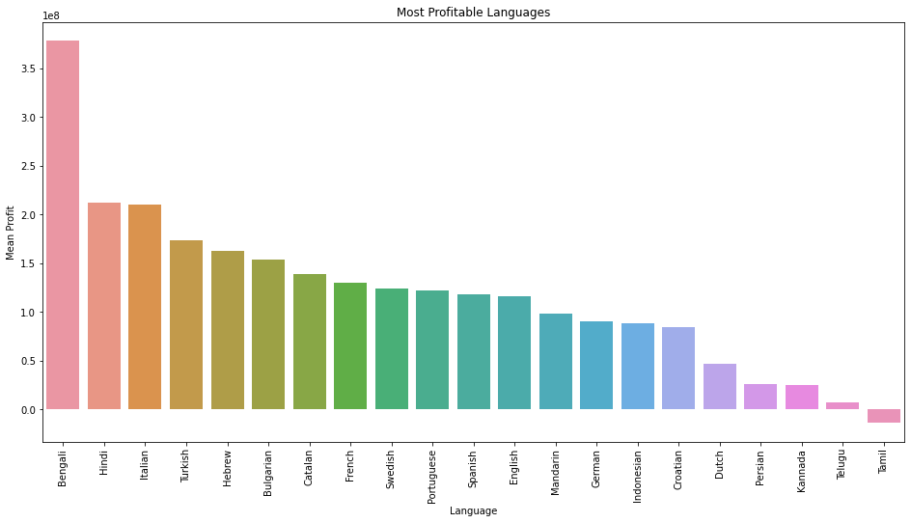
A movie should be released in as many of the top languages as possible.

Slide 17
Next steps include:
Finding the top writers to hire for our target genres
Identifying the best market segments to target and MPAA rating to persue

Slide 18
Looking through the dataset, many of the most profitable movies include IP that we don’t have access to (especially franchises).
Going forward, it would be beneficial to study whether or not establishing or acquiring your own franchise is feasible.

Slide 19
China has become the biggest market for movies after passing Japan in 2012 and North America in 2019. CNBC
Using individual market revenue, we can identify other growing markets.
Using economic data, like World Bank Analytical Classifications, we can make predictions about other markets with a growing middle class and increasing disposable income to try to be the first studio to achieve success in new markets.

