Slide 1
Bigfeet everywhere Kevin Fagan

Slide 2
Introduction
Business problem.
Is bigfoot scary?
The Bigfoot Field Research organization maintains a record of self-reported bigfoot sightings. Currently, as each report comes in, researchers manually classify them into 3 classes.
Goal
Do sentiment analysis on the reports to see how people feel about bigfoot.
Create an NLP model to automatically classify reports as they come in.
Find BIGFEET.

Slide 3
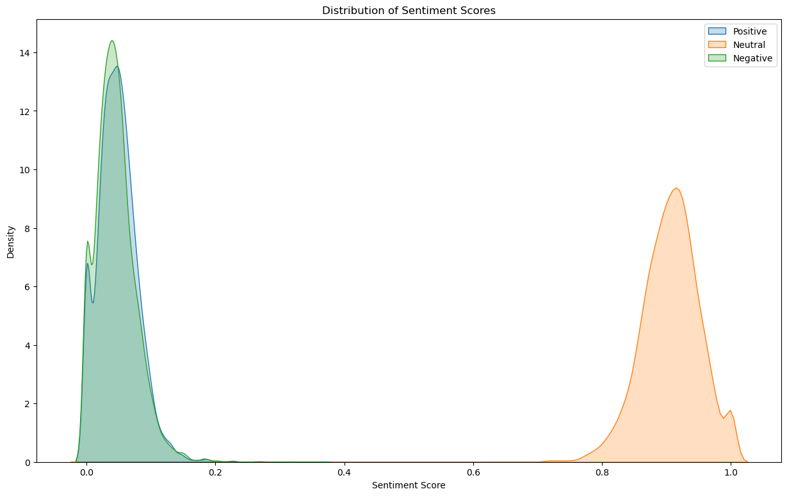
Sentiment analysis
NLTK

Slide 4
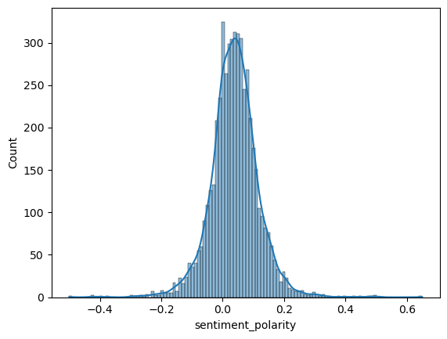
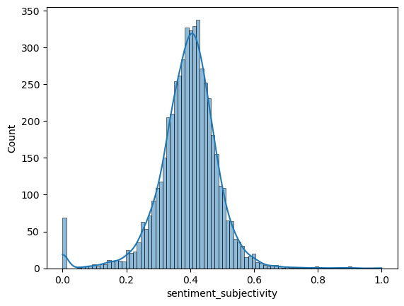
Sentiment analysis
TextBlob

Slide 5
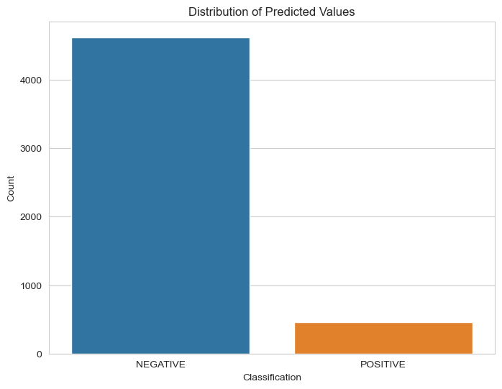
Sentiment analysis
Flair

Slide 6
Classification
We were able to create an linear regression model that achieved ~%78 accuracy to classify the reports.
Some issues with the data, the classifications are somewhat vague.
Class A reports involve clear sightings in circumstances where misinterpretation or misidentification of other animals can be ruled out with greater confidence.
Incidents where a possible sasquatch was observed at a great distance or in poor lighting conditions and incidents in any other circumstance that did not afford a clear view of the subject are considered Class B reports.

Slide 7
Next steps.
We can manually reclassify the current reports. BFRO researchers play somewhat fast and loose with the definition of Class A.
We’ve determined that the most common month for sightings is October, and the most common state is Washington, so that’s where we’ll look.
www.bfro.net
They have a bigfoot hunt coming up next month in New Jersey.

Slide 8
Questions
Kevin Fagan
kevinmfagan@gmail.com
linkedin.com/kevin_m_fagan

Slide 9
The reports are gold.
My then girlfriend, and eventual ex wife were bowling in a mixed bowling league that ended around 7 PM. We chatted with some teammates and friends for a few moments then left. I had two beers during the three games, along with several cans of pop. Melody was in a mood and she wanted to go out to the forest and relax. We stopped by the local Jim Dandy and picked up two specials, (a burger and very small drink) and headed to the Shawnee Forest. I suggested Picnic Point and that is where we went. Our car was a VW bug that she drove. I had finished my burger and drink and she gave me her drink, she drank like a bird, and never finished anything. We got to the point, drove around the circle so the car was pointing back out the way we came. We got out of the car, I placed the drink on the roof of the passenger side, while she was getting the blanket I trotted over to a nice tree, just over the lip of the hill to release some of the liquids I had consumed. I had just began to relieve myself when it started. I had commented as we got out of the car how quiet it was, no birds, no sounds of any kind. As I began to do my thing there were three loud crashes, down the hill in front of me, coming straight up. Now, these crashes, were strides, you could tell something big and heavy was striding up the hillside. The strides stopped, I looked up, Melody asked if I heard that, I nodded and put my free finger to my lips, indicating quiet, I was trying to fix the exact location. Then several more strides and it stopped again. Ok, I was zipped and ready to move and slowly backing towards the car, eyes fixed on the direction of the sound. Mel asked me if I had any idea what that was, as I said, the sounds were obviously strides, not a deer crashing through the brush. I answered I did not know. Then there was a low sound, almost like a growl, and what ever it was, it was coming up the hill now, very hard and very fast. We both said "let's get the hell out of here." As we jumped in the car, I, out of habit, grabbed the cup off the roof and placed it between my legs. Let pause the narration for a moment, for a personal description. I am a very curious fellow, I am not one to turn tail and run...that part of my nature took hold for a second and I suggested since we were in the car, let's wait and see what pops up over the hillside...Melody would have none of that..she was driving and we were leaving, period. As I looked at her to argue the point, there was a thump on the car, she had already started it, she popped the clutch and the car lurched. There was a flash of something that went by my window, she screamed, I told her to drive it was just my cup falling off the roof...yes, the same cup I secured between my legs. We sped back into town and went to the local Moose Lodge where I was a member. There were several reasons, one, I wlll try to explain later, I was shaking uncontrollably...two we had friends there, and three they had the best set of floodlights in the city, I wanted to see the car. We got to the lodge, I got out and looked at the car. The car was very dusty and dirty. On the top of the car was an enormous hand print, very obvious it was a hand, fingers, not claws. One the right rear side quarter panel was another hand print. Whatever it was had been looking in that small window that all Beetles had. On the door on my side, in the dust, you can see where fingers had slid down the side. The only thing I could think of was is reached for the door as we lurched away, that was the flash and the second thump. Several friends saw this, we went back out later that night, but were turned away by the Rangers, forest closed after dark. Far and away the scariest part of all this..when we were in the car and heard the first thump, I turned in my seat and looked in the direction of that thump, that meant I looked out that little window...I must have looked it straight in the eyes. I say must because I don't remember, I remember turning to look, turning back and urging her to drive, but I cannot tell you what I saw that night. It just happened so quickly! I have not had a good night sleep since...I used to be at home in the woods, and I still have fun, until the sun begins to go down, or I get "a feeling."

