Slide 1
BANK MARKETING CAMPAIGN
A Business Analytics Case Study on Term Deposit Subscription Behaviour
Patricia Fagbola | AnalystLab Data Analytics Internship | Week 5 Case Study

Slide 2
Business Problem Statement
Marketing campaigns are costly, yet not every customer contacted responds positively. The bank ran a telemarketing campaign encouraging customers to subscribe to a term deposit and some customers subscribed while others did not.
The question this case study answers:
Which customer characteristics and campaign strategies are associated with a higher likelihood of term deposit subscription and how can this be used to improve future campaigns?

Slide 3
Dataset Overview
UCI Bank Marketing Dataset — telemarketing campaign for a term deposit product
11,162
17
47.4%
52.6%
Total Records
Columns
Subscribed (Yes)
Did Not Subscribe
Key columns
Demographics
Financial profile
age, job, marital, education
balance, housing, loan, default
Campaign contact
Prior campaign & target
contact, month, duration, campaign
pdays, previous, poutcome, deposit
Target variable: deposit did the customer subscribe to a term deposit? (yes / no)

Slide 4
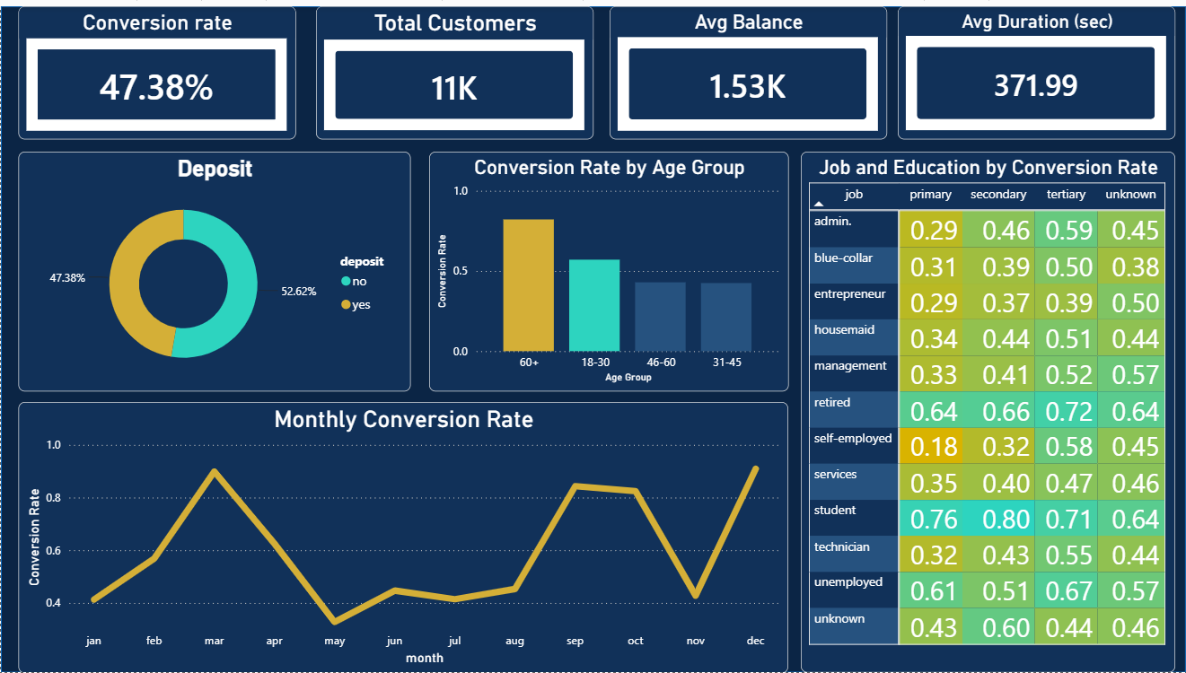
Key Visualization — Overview & Customer Segments

Slide 5
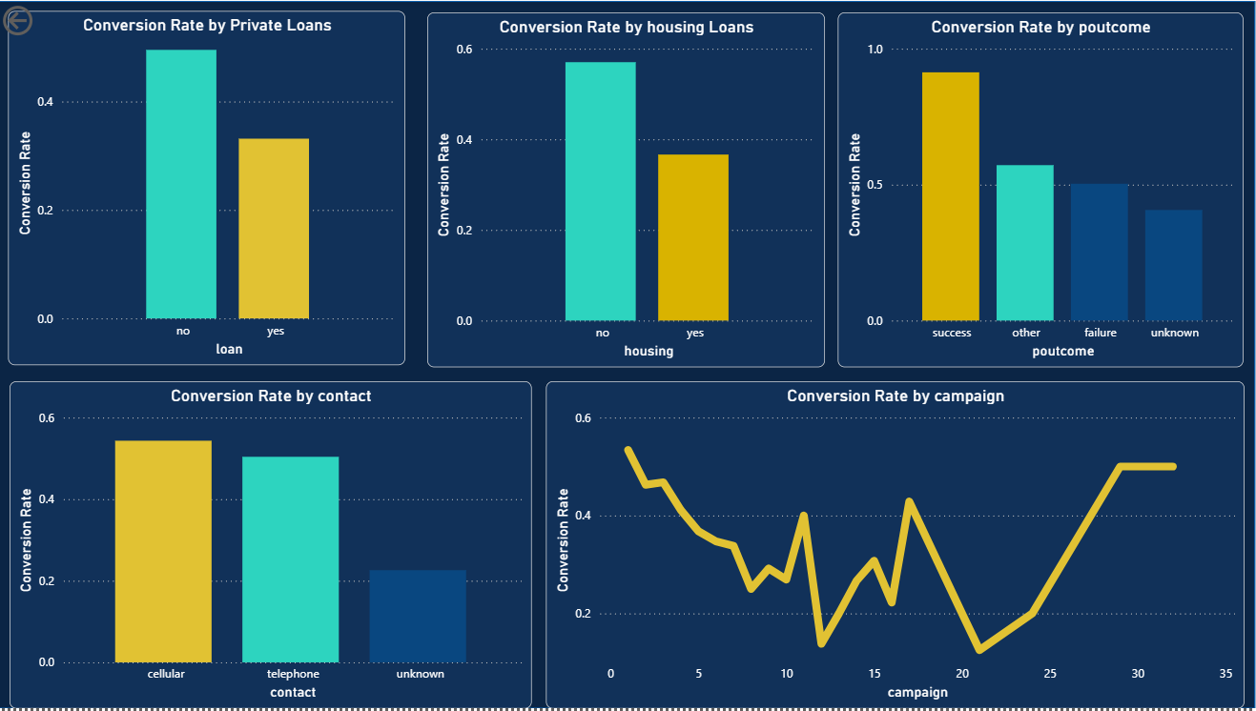
Key Visualization — Financial Profile & Contact Strategy

Slide 6
Major Findings -Key Drivers
Ranked by strength of impact on conversion rate
01
Previous campaign outcome
02
Job type
Past subscribers convert at 91.32%, nearly double the 47.4% average, but are just 9.6% of contacts.
Students convert at 74.72% vs. 36.42% for blue-collar workers — a 2x gap.
03
Age (U-shaped)
04
Education level
Customers 60+ and 18-30 convert higher than the 31-60 middle-age range.
Tertiary education outperforms primary across most job categories.
05
Loan status
06
Contact method
Customers without a housing or personal loan convert roughly 2x more.
Cellular contact outperforms telephone and unknown methods.

Slide 7
Business Insights
Past subscribers are a warm lead — Convert at 91.32% vs. a 47.4% average, yet are under 10% of total contacts.
Profession matters — Students (74.72%) and retirees (66.32%) convert roughly 2x more than blue-collar workers (36.42%).
It's life stage, not just age — Young and old convert better; middle-aged customers, likely juggling more financial commitments, convert less.
Education correlates with conversion — Possibly reflects financial literacy or familiarity with savings products.
Existing debt lowers conversion — Loan holders convert at roughly half the rate of those without.
Channel and frequency matter — Cellular outperforms telephone; conversion drops sharply after a few contacts.
Conversion peaks in December and March — Likely tied to year-end bonus and savings behaviour; contact volume should be checked.

Slide 8
Recommendations
1
Re-engage past subscribers
2
Investigate the profession gap
Converts at 91.32% but is only 9.6% of contacts; prioritize renewed outreach.
Reason unclear research before targeting by job type.
3
Re-think messaging for middle-aged customers
4
Simplify the pitch
Test offers suited to their financial stage.
Spend more time explaining term deposit benefits clearly.
5
Explore the loan/debt link
6
Prioritize cellular contact
Investigate before designing offers for indebted customers.
Highest-converting channel; keep telephone as backup only.
7
Cap contact attempts at 2-3 calls
8
Time campaigns around Dec & March
Conversion drops sharply after that; redirect effort to new leads.
Concentrate outreach and staffing in these peak months.

Slide 9
Conclusion
Prior engagement history, profession, age, education, existing debt, and contact strategy all shape a customer's likelihood to subscribe. Some relationships point to clear next steps — re-engaging past subscribers, favouring cellular contact, and limiting repeated outreach — while others call for further investigation.
Together, these findings give the bank a practical, evidence-based foundation for improving future term deposit campaigns.
Patricia Fagbola | AnalystLab Data Analytics Internship

