Slide 1


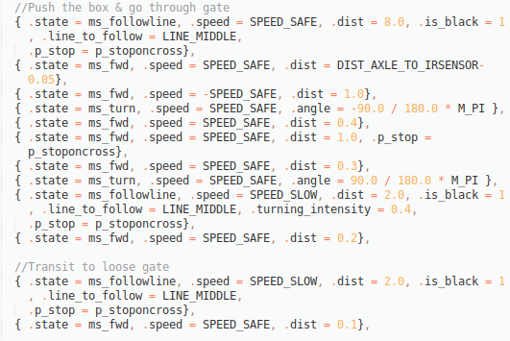
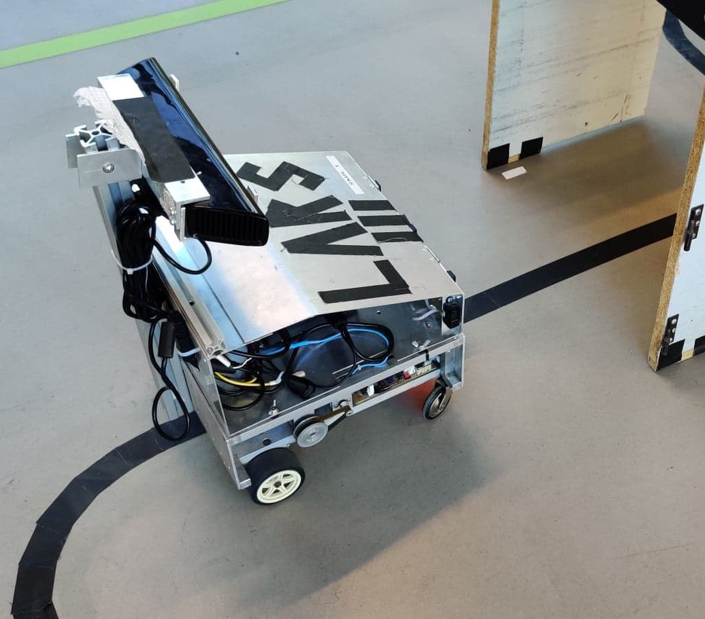
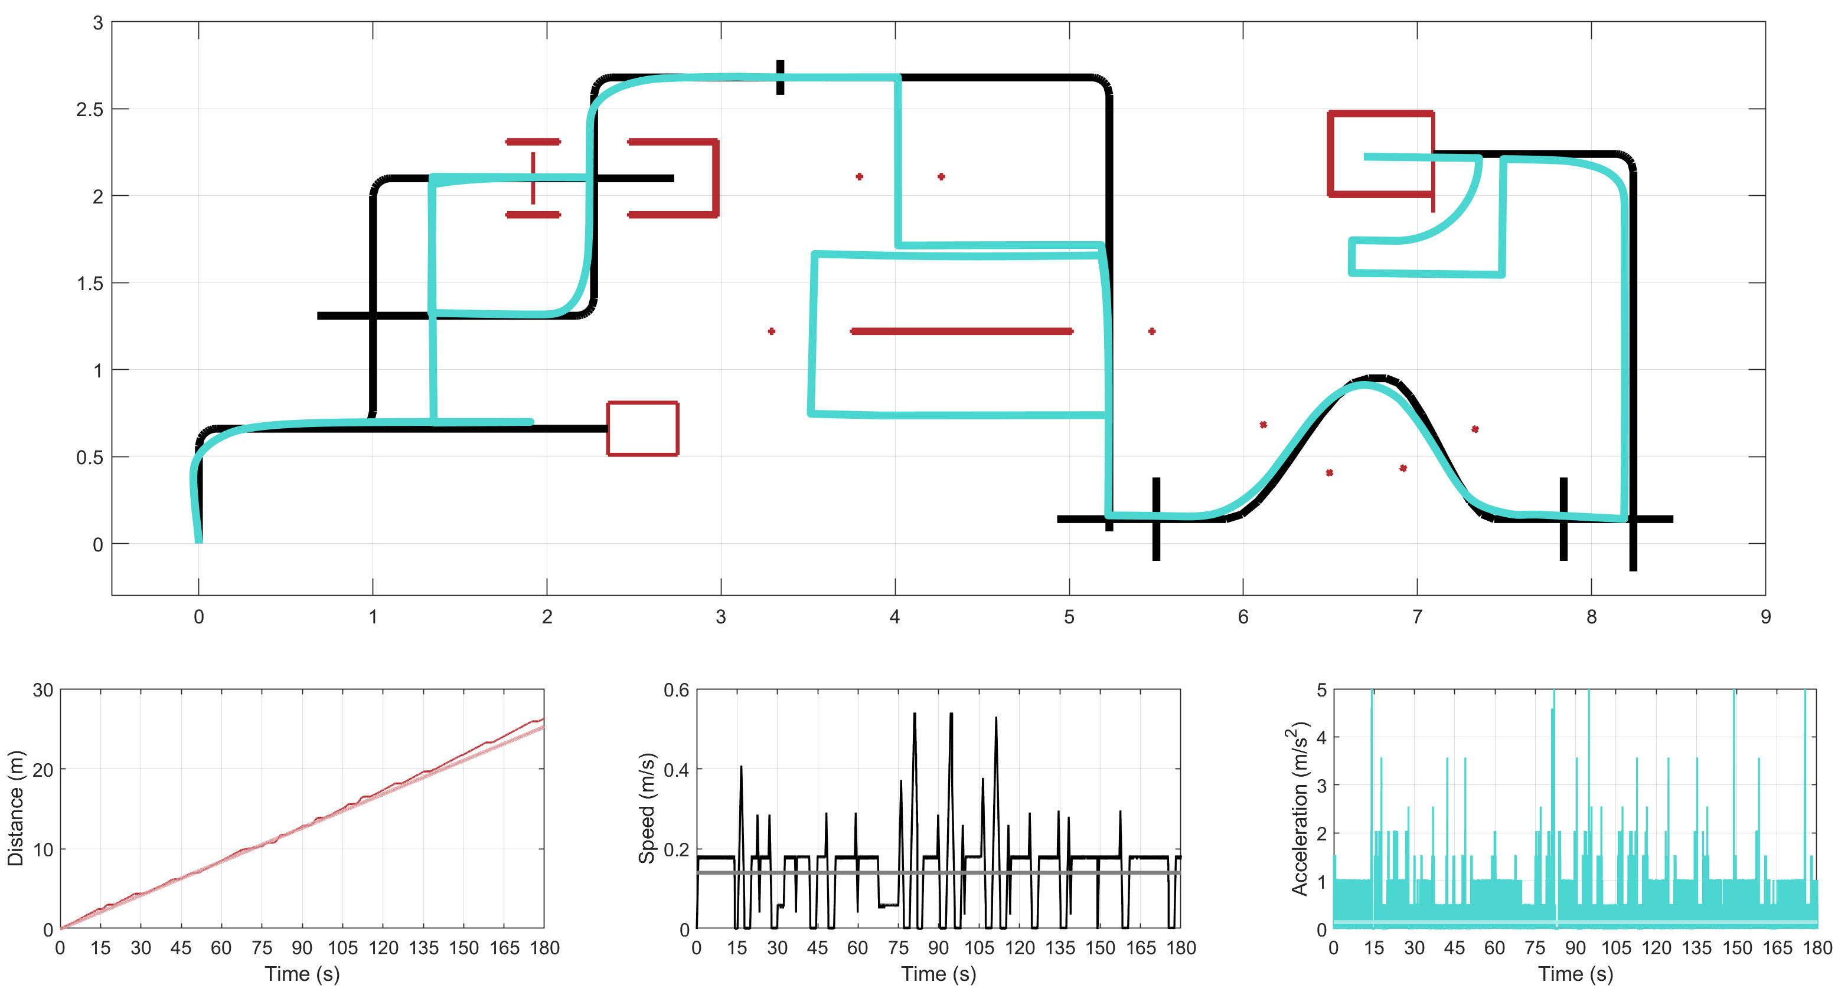

Team 20
Jeremy Paul Coffelt, s191731, Joachim Mortensen, s175179, Peter Tønder Blendstrup, s175210
LARS – the LARS Ain’t a Robust System – is a robot which drives a preset course and is relatively easy to configure
LARS is a reimagining of DTU Electro’s beloved SMR-CL, with support for full control through an advanced predicate system written entirely in C.
The program, developed and fine-tuned on a SMR robot marked Lars, thus the name, follows a sequence of commands. For movement it has commands for going forward, turning, and following a line, with parameters for distance, angle and aggressiveness respectively, as well as top speed. Each of these can be equipped with a predicate on internal or sensor data to halt precisely as needed.
Data includes odometry, reflection-sensors for lines on the floor, and laser and IR for distance measurement.
Robust configuration allows complex and intricate solutions.
Configuration system expands possibilities.
When implementing the configuration system (pictured above), much inspiration was taken from SMR-CL, as a solution had to be implemented in both languages. Creating a system that would allow for SMR-CL to be inserted with minimal changes would ease the implementation, as a solution could be made in SMR-CL and then be converted to C. Expanding functionality beyond the aforementioned drive, turn and followline is very easy with the predicate system, where any custom calculations can be run each cycle. One example of this is following the wall, which is implemented through two different predicates, one for finding the wall, and one for finding the end of the wall.
LARS going at top speed with no deviation whatsoever (artist’s rendition)
Success through simulation
The system is developed around a realistic simulation, and was smoothly transitioned to the real world.
Although the implementation in the simulator performed exactly as expected, many safeguards were implemented to ensure proper operation on the real robot. This lead to an improved performance requiring only minimal tweaks and fixes, rather than an overhaul of the whole procedure.
Map of the final course used in the SMR simulator, with simulated path.

