Slide 1

Diamond Price Prediction
by: Fagr Ahmed

Slide 2
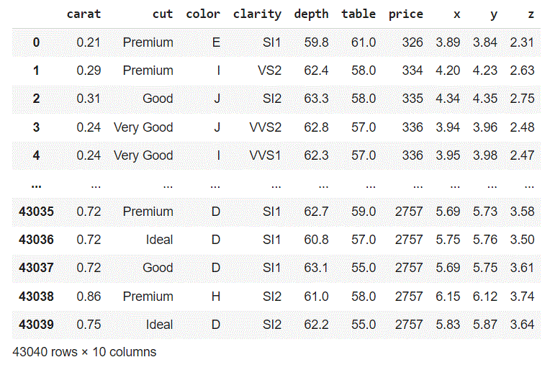
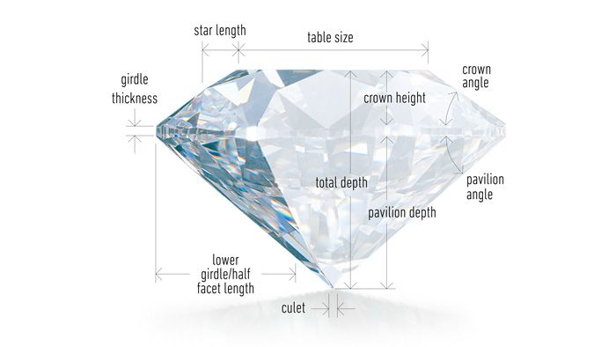
Dataset:
Dataset contain 43040 diamond and 10 attributes:
1-Carat (weight of diamond)
2-Cut (quality)
3-Color
4-Clarity
5- Depth
6-Table
7-Price
8-X (length)
9-Y(width)
10-Z(depth)

Slide 3
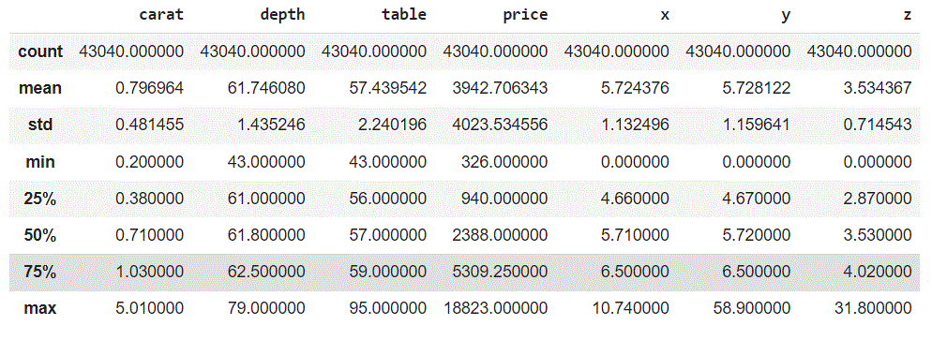
Discover Dataset:
1-ZERO Value
from the description of the data found min value of “x”,”y”,”z” = 0
this indicates that there is a dimensionless diamonds
so need to drop this rows

Slide 4
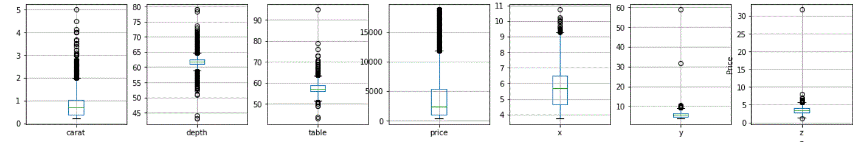
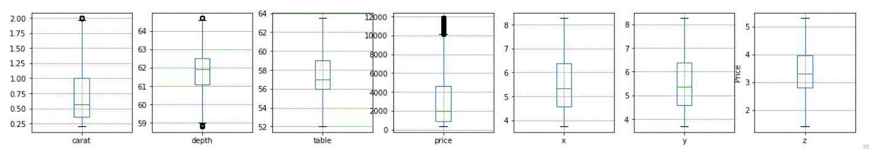
Discover Dataset:
To calculate outliers using IQR
IQR=Q3-Q1
Min Outliers=Q1-(1.5*IQR)
Max Outliers=Q3+(1.5*IQR)
then drop the rows which bigger than Max and smaller than Min
2-Outliers

Slide 5
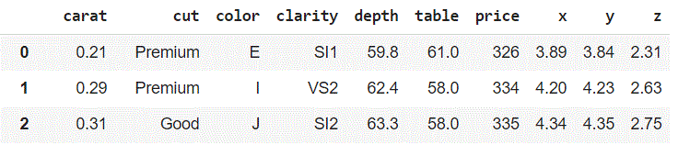
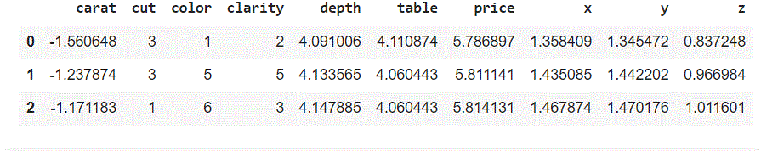
Discover Dataset:
“Cut ”,”Color” and “Clarity” Categorical data
using Label Encoder to convert Categorical data to Numerical data.
3-Categorical Data & Numerical Data

Slide 6
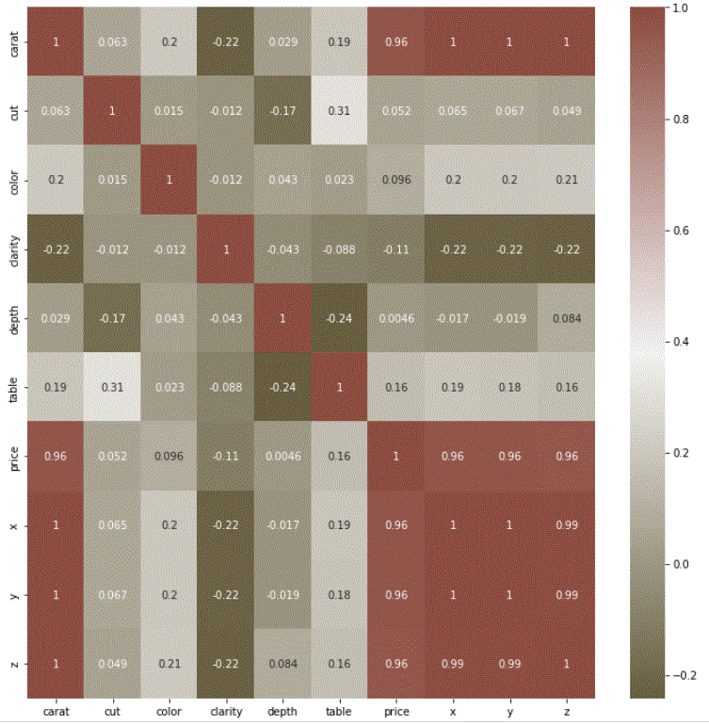
Discover Dataset:
4-Correlation Matrix
“Carat”,”X”,Y” and “Z” have a high Correlation with the target
“Clarity”and “Cut” have a low Correlation with the target

Slide 7
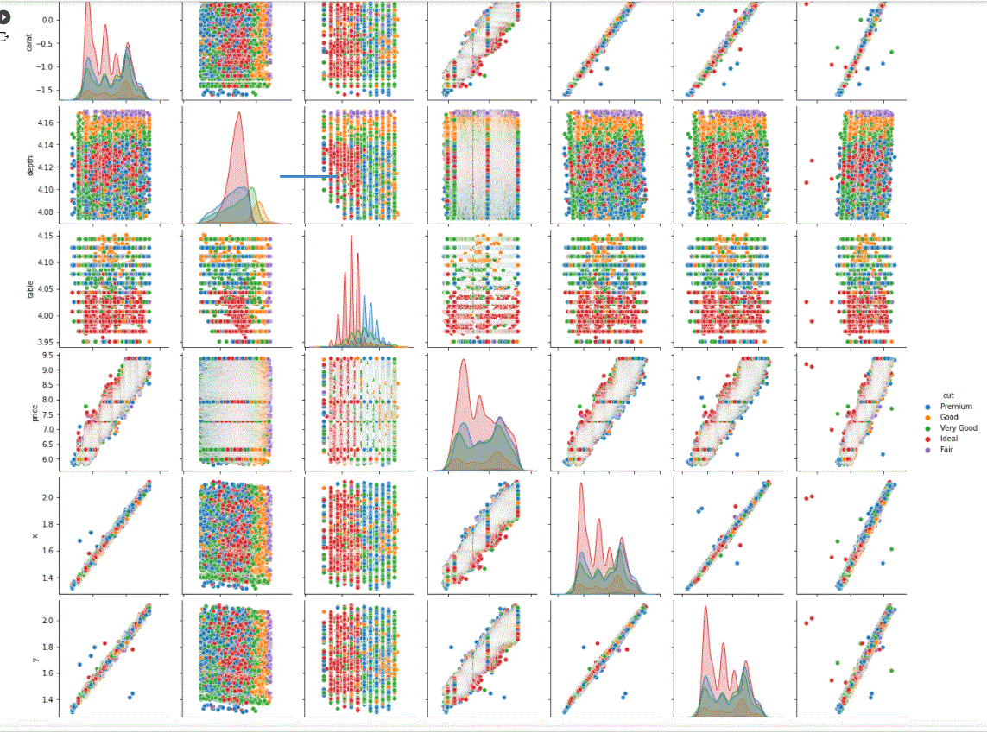
Discover Dataset:
5-Pair Plot
the relation between data and target(Price) Linear relation

Slide 8
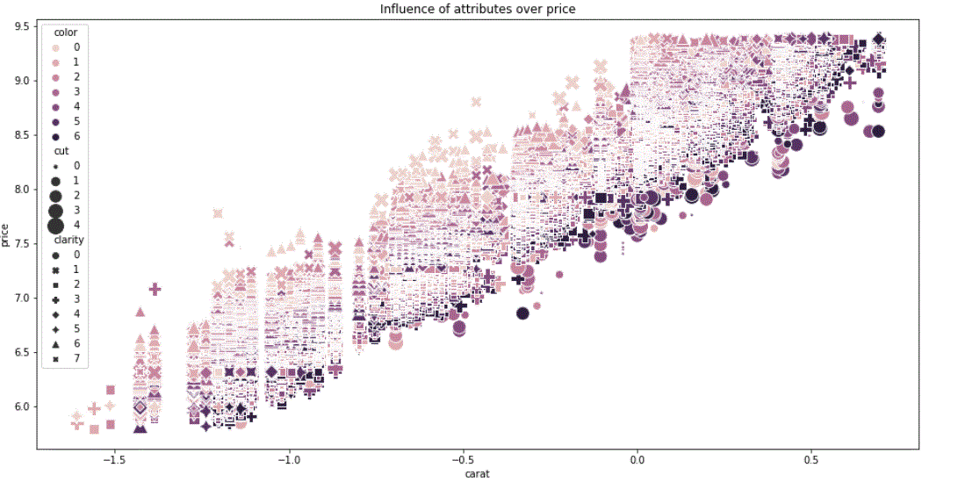
Discover Dataset:
6-Influence of attributes over target
The more attributes, the higher the price

