Slide 1
BANKING SERVICES

Slide 2
Table of contents
01
02
03
Abstract
Introduction
Literature Review
04
05
Business Model
Problem Statement

Slide 3
07
08
06
Objectives
Block Diagram
Technology Used
09
10
Conclusion
Reference

Slide 4
Guide Details: Prof: Preeti Patil
Team Members
Advait Bothe-TU4F2223052 (A-46)
Geet Bari-TU4F2223056 (A-49)
Jay Karia-TU4F2222060 (A-53)
Arya Humane – TU4F2223064 (A-55)

Slide 5



Slide 6
This project aims to develop a comprehensive software solution for a bank's business model, focusing on enhancing the efficiency and user experience of daily transactions for customers and streamlining backend operations for bank employees.
Utilizing HTML, CSS, and JavaScript for the front end and Node.js for the backend, this software will offer a user friendly interface for customers to manage their banking activities and an administrative interface for bank staff to monitor transactions and access critical data.
Additionally, the project will include an investment management segment, allowing customers to explore and engage in various investment opportunities offered by the bank.

Slide 7



Slide 8
In today's fast paced digital world, the banking industry is continually evolving to meet the increasing demands for convenience, security, and efficiency.
This project proposes the development of a banking software application that caters to both customer facing and backend operations.
The goal is to provide a seamless experience for users conducting everyday transactions and to facilitate bank employees in managing and overseeing these transactions.
The front end of the application will be designed using HTML, CSS, and JavaScript to ensure a responsive and intuitive user interface.
The backend will leverage Node.js to handle data processing, security, and server side logic. By integrating these technologies, the project aims to deliver a robust and scalable solution that can adapt to the dynamic needs of the banking sector.

Slide 9



Slide 10
Journal Title | Published on | Author | Problems | Objectives
A Research on Security Vulnerabilities in Online and Mobile Banking Systems | 2022 | Nilay Yildirim, Asaf Varol | Security risks in mobile and online banking due to technological innovations and security gaps | Examine security threats and security measures in mobile and online banking systems
Online banking users' perceptions in South Africa: An exploratory empirical study | 2023 | Mathias Mujinga Mariki, M. Eloff, Jan H. Kroeze | Security risks and low adoption of online banking services | Investigate factors influencing users' adoption and acceptance of online banking in South Africa
Online banking in India: Attacks and preventive measures to minimize risk | February 2022 | Rajeshree Khande, Yashwant Patil | Online banking frauds and lack of effective detection mechanisms | Discuss various types of online banking attacks and preventive measures to minimize risks and handle these attacks
User Authentication Model based on Mobile Phone IMEI Number: A Proposed Method Application for Online Banking System | August 2022 | Waleed A. Hammood, Ruzaini Abdullah Arshah, Salwana Mohamad Asmara, Omar A. Hammood | Financial frauds and inadequate user authentication methods | Propose a new authentication model for online banking using the mobile phone IMEI number, addressing gaps in current research and improving security without using username and password
A Proposed Framework to Help Blind People by Using Online Service Safely: Focus on Safe Online Banking Service | May 2023 | Ahmad Alenezi | Challenges for blind or visually impaired users in accessing online banking services | Design and test the Blind Banking Services Framework (BBSF) to enable blind users to perform banking activities independently and safely

Slide 11



Slide 12
A bank's primary function is to accept deposits from customers, lend money to borrowers, and provide various financial services. Here's a step by step overview of how a bank operates:
Accepting Deposits:
Savings Accounts: Customers deposit money into savings accounts, earning a small interest.
Checking Accounts: Customers deposit money for easy access and everyday transactions, usually with no or very low interest.
2. Providing Loans:
Personal Loans: Loans given to individuals for personal use, such as buying a car or paying for education.
Mortgages: Long term loans for purchasing real estate, secured by the property itself.
Business Loans: Loans provided to businesses for capital expenditure or operational needs.

Slide 13
3. Offering Financial Services:
Credit Cards: Banks issue credit cards, earning interest and fees on balances.
Investment Services: Offering investment products such as mutual funds, stocks, bonds, and advisory services.
Insurance Products: Selling various insurance policies (life, health, property) through partnerships.
4. Transaction Processing:
Facilitating electronic transfers, bill payments, and other transactions, often for a fee.

Slide 14
PROFIT ASPECTS
LOSS ASPECTS
Interest Income:
Loan Interest: The primary source of income is the interest charged on loans and mortgages. The interest rate on loans is higher than the interest paid on deposits, creating a profit margin (net interest margin).
Non Performing Loans (NPLs):
Loan Defaults: When borrowers fail to repay their loans, the bank incurs losses.
Provisioning: Banks must set aside funds to cover potential loan losses, impacting profitability.
Fees and Commissions:
Service Fees: Fees for account maintenance, overdrafts, ATM use, and wire transfers.
Transaction Fees: Fees for processing transactions, credit card usage, and foreign exchange.
Operating Costs:
Salaries and Benefits: High costs associated with staff compensation and benefits.
Infrastructure: Expenses related to maintaining branches, ATMs, technology, and security systems.

Slide 15
PROFIT ASPECTS
LOSS ASPECTS
Investment Income:
Securities: Income from investments in government and corporate bonds, equities, and other securities.
Trading: Profits from trading activities, including foreign exchange and derivatives.
Interest Rate Risk:
Interest Rate Fluctuations: Changes in interest rates can affect the bank's net interest margin, impacting profitability.
Mismatch: Differences in the maturity profiles of assets (loans) and liabilities (deposits) can lead to interest rate risks
Other Services:
Insurance Premiums: Earnings from selling insurance products.
Asset Management: Fees from managing assets for high net worth individuals and institutional clients.
Regulatory Compliance:
Compliance Costs: Expenses related to adhering to regulatory requirements, including capital adequacy and anti money laundering laws.
Penalties: Fines and penalties for non compliance with regulations.

Slide 16
Despite the potential for losses, banks generally operate as profit
earning businesses due to their ability to generate revenue from a
variety of sources and manage risks effectively. Here’s why banks are
typically profitable:
Diversified Income Streams: Banks have multiple revenue streams, including interest income, fees, commissions, and investment income. This diversification helps cushion against losses in any one area.
Risk Management: Banks employ sophisticated risk management techniques to minimize the impact of loan defaults, interest rate fluctuations, and operational risks.
Economies of Scale: Large banks benefit from economies of scale, allowing them to spread costs over a larger customer base and offer competitive pricing.

Slide 17
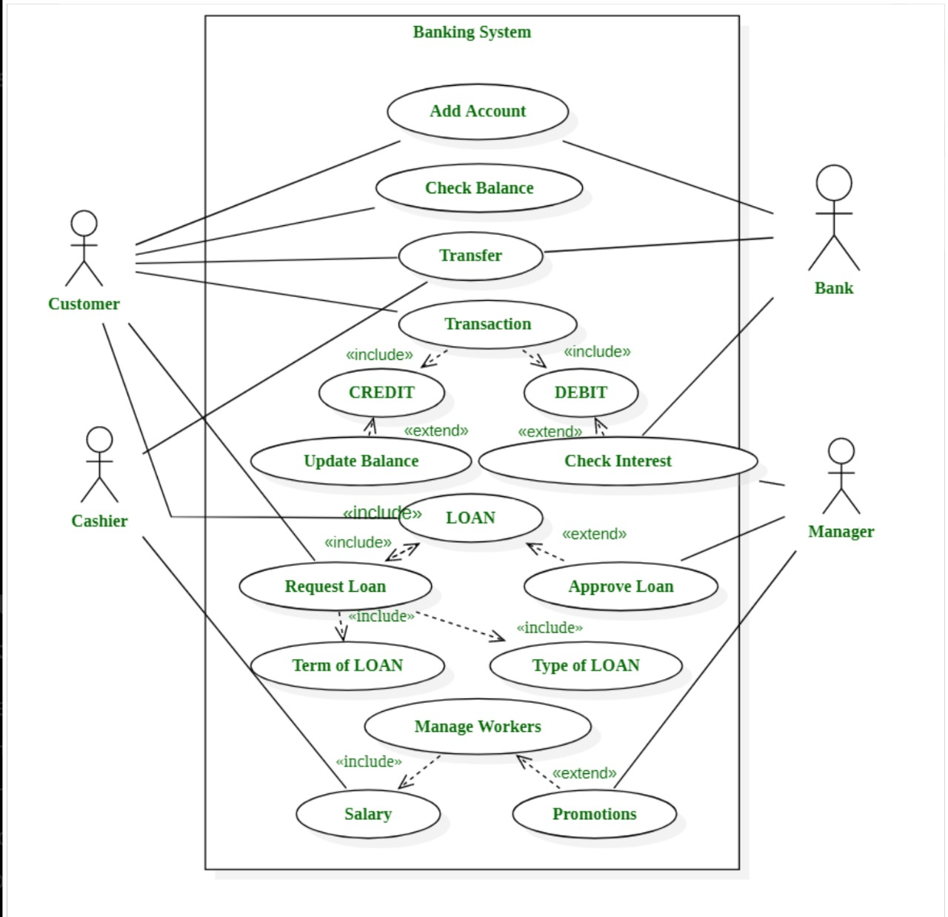

Slide 18
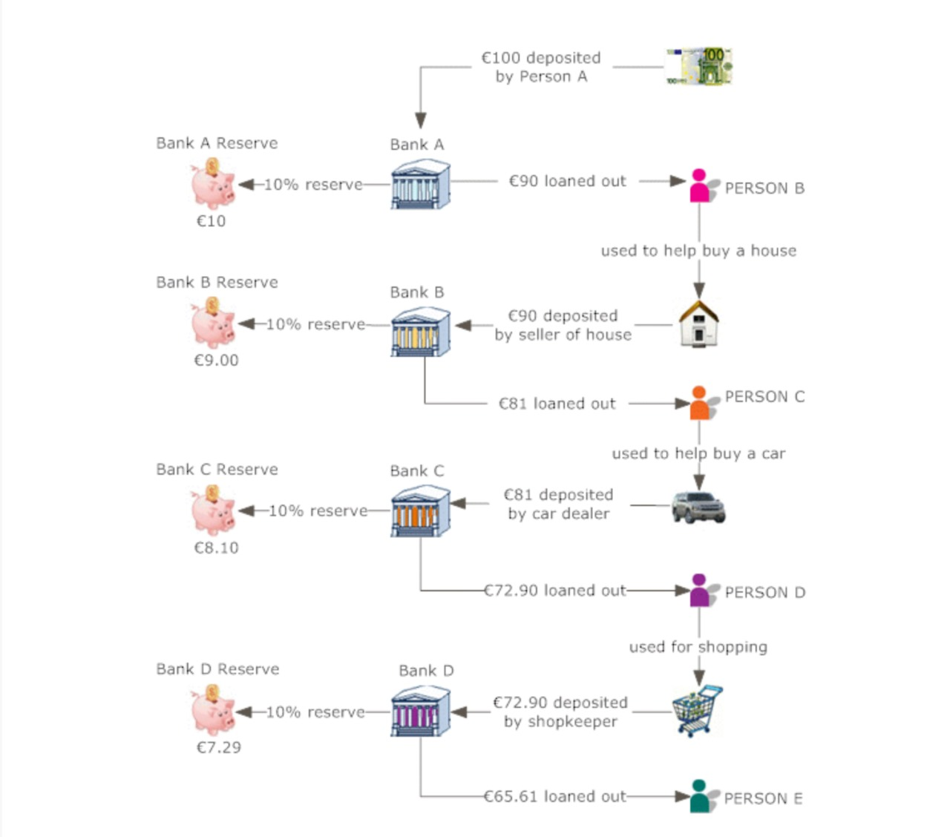

Slide 19



Slide 20
The current banking systems often suffer from fragmented user interfaces and inefficient backend operations, leading to a suboptimal user experience for customers and increased operational burdens for bank employees.
This project aims to address these issues by developing a cohesive software solution that streamlines daily transactions, provides a user friendly interface, and offers comprehensive tools for bank employees to monitor and manage banking activities effectively.
Security Issues: Banks are vulnerable to cyber attacks such as phishing, malware, and ransomware, along with data breaches that can lead to identity theft and financial loss.
Regulatory Compliance: Banks face complex and costly regulations, including KYC requirements that demand extensive documentation and verification processes.
Customer Experience: There are issues with providing consistent and accessible service across different channels, and traditional banks often fail to meet modern customer expectations for quick, personalized, and seamless experiences.
Financial Inclusion: A significant portion of the global population, especially in developing countries, lacks access to traditional banking services, and high fees can make banking services unaffordable for low-income individuals.
Trust and Reputation: Scandals, mismanagement, and unethical behavior damage banks' reputations, eroding customer trust and making it difficult to retain customers.

Slide 21



Slide 22
1. Develop a User Friendly Front End:
Design and implement an intuitive interface for customers using HTML, CSS, and JavaScript.
2. Efficient Backend System:
Utilize Node.js to create a robust backend capable of handling complex transactions and data management securely.
3. Comprehensive Transaction Monitoring:
Provide bank employees with tools to monitor customer transactions and access crucial data for operational efficiency.
4. Investment Management Features:
Integrate a segment for investment opportunities, allowing customers to engage in various financial products offered by the bank.
5. Ensure Security and Compliance:
Implement industry standard security measures to protect user data and ensure compliance with relevant regulations.

Slide 23



Slide 24
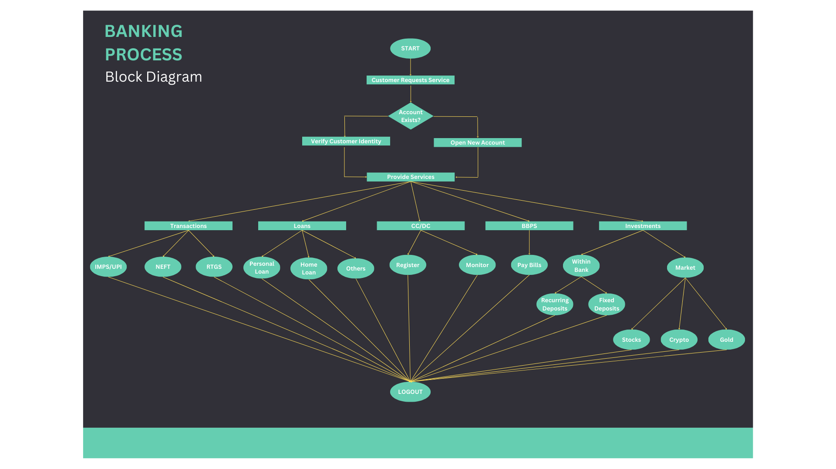

Slide 25



Slide 26
Frontend Technologies
1. HTML5 and CSS3
HTML5: The latest version of the HTML standard, used for structuring and presenting content on the web. It supports multimedia elements like audio and video without needing additional plugins.
CSS3: The latest version of the Cascading Style Sheets language, used for styling and designing web pages. It allows for the creation of responsive designs that work across various devices and screen sizes.
2. JavaScript
JavaScript: A high-level, dynamic programming language used to create interactive effects within web browsers. It allows for real-time updates, form validations, and asynchronous communication with the server.
3. Frontend Frameworks/Libraries
React.js: A popular JavaScript library for building user interfaces, particularly single-page applications where the UI needs to be fast and interactive.

Slide 27
Backend Technology
Node.js: A runtime environment that allows the execution of JavaScript code on the server side. It uses an event-driven, non-blocking I/O model, making it lightweight and efficient for building scalable network applications.
Database Technology
PostgreSQL: A powerful, open-source relational database management system (RDBMS) known for its stability, scalability, and support for advanced SQL features such as foreign keys, joins, views, triggers, and stored procedures.
Security Technologies
OAuth2
For secure authorization and payment
Payment and Transaction Processing
Payment Gateways
Billdesk, CCAvenue, RazorPay: For handling online transactions.
User Authentication and Management
Auth0
For authentication and authorization.

Slide 28



Slide 29
Enhanced User Experience: The proposed banking software project will significantly improve the user experience by providing a streamlined, intuitive interface for customers to manage their daily transactions effortlessly. The use of HTML, CSS, and JavaScript ensures a responsive and user friendly design, making banking more accessible and convenient.
Efficient Backend Operations: By leveraging Node.js for the backend, the project ensures robust, efficient, and secure data processing and management. This will enable the bank to handle high volumes of transactions seamlessly, improving overall operational efficiency and reliability.
Comprehensive Transaction Monitoring: The inclusion of tools for bank employees to monitor transactions and access critical data will enhance transparency and control over banking operations. This will help in quickly identifying and addressing any issues, ensuring the smooth functioning of the bank’s services.
Diverse Investment Opportunities: The integrated investment management segment will provide customers with easy access to various financial products, encouraging informed investment decisions. This feature will not only add value to the customers' banking experience but also promote financial growth and diversification.
Sustainable Profitability: By addressing both the front end user experience and back end operational efficiency, the project supports the bank's overall goal of sustainable profitability. The comprehensive approach ensures that the bank can effectively manage risks, reduce operational costs, and capitalize on diverse revenue streams, thus reinforcing its position as a profitable and customer centric financial institution.

Slide 30



Slide 31
1. Journal: A Research on Security Vulnerabilities in Online and Mobile Banking Systems
Author: Nilay Yildirim, Asaf Varol
Published on: 2020
2. Journal: Online banking users' perceptions in South Africa: An exploratory empirical study
Author: Mathias Mujinga Mariki, M. Eloff, Jan H. Kroeze
Published on: 2021
3. Journal: Online banking in India: Attacks and preventive measures to minimize risk
Author: Rajeshree Khande, Yashwant Patil
Published on: February 2021
4. Journal: User Authentication Model based on Mobile Phone IMEI Number: A Proposed Method Application for Online Banking System
Author: Waleed A. Hammood, Ruzaini Abdullah Arshah, Salwana Mohamad Asmara, Omar A. Hammood
Published on: August 2021
5. Journal: A Proposed Framework to Help Blind People by Using Online Service Safely: Focus on Safe Online Banking Service
Author: Ahmad Alenezi
Published on: May 2023

Slide 32
THANK YOU
359

