Slide 1
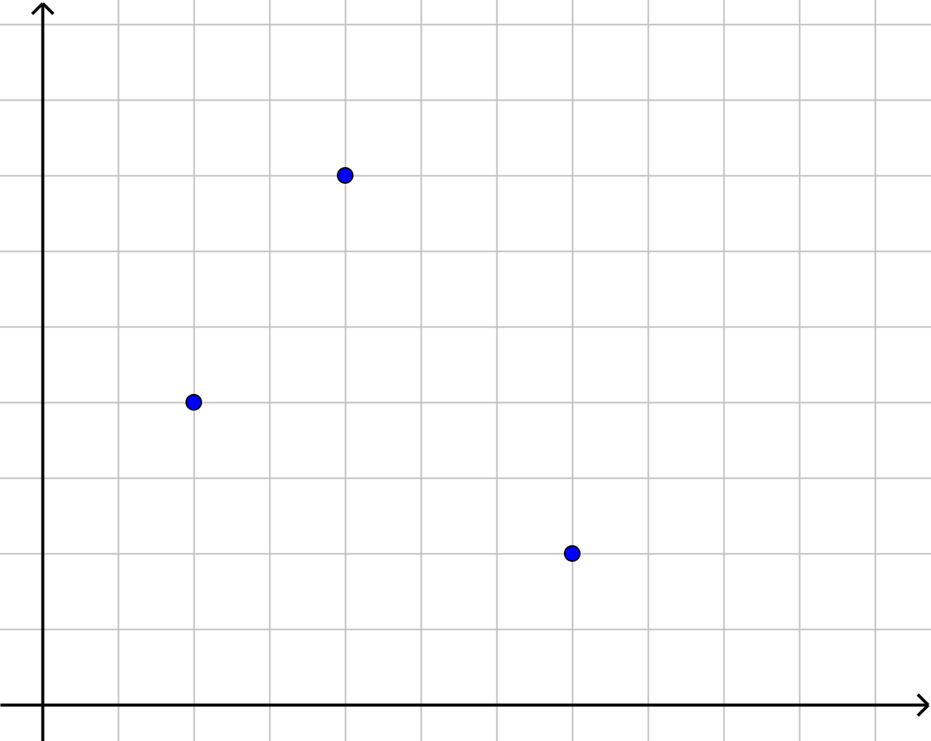
1 2 3 4 5 6 7 8 9 10
1
2
3
4
5
6
7
8
9
(7,2)
(2,4)
(4,7)

