Slide 1
Project Title
Urban Ride : Online Car Rental Management System
Members:
1426 : Ikrama Kathiyara
1437 : Rudra Padhiyar
1452 : Fahad Shaikh
Mentor: Prof. Shreyas Trivedi

Slide 2
Project Proposal & Planning
We aim to develop a car rental platform , that lets users rent cars for a specific time.
The system will provide administrative tools for managing vehicles , bookings and users.

Slide 3
Problem Statment
Traditional car rental systems often rely on manual or semi-digital processes that are inefficient, time-consuming, and prone to errors.
Customers lack access to real-time vehicle availability, while service providers face challenges in managing bookings and vehicle data.
This project proposes the development of a web-based car rental platform to streamline rental operations and improve user experience.

Slide 4
System Analysis (Existing System)
The existing car rental systems primarily rely on manual processes or basic digital tools such as phone calls , paper records , and spreadsheets.
Customers are required to contact the rental service provider directly to inquire about vehicle availability, pricing and booking details
Real examples of existing systems and how we are different:
Olacabs : does not allow self-drive
Zoomcar : does not allow web platform

Slide 5
System Analysis (Proposed System)
The proposed system is a web-based car rental platform designed to overcome the limitations of the existing system by automating rental operationss and providing a centralized digital solution
The system allows customers to browse available vehicles, make booking online , and manage their reservations conveniently.
Administrators can manage vehicles , users, and bookings through a secure dashboard

Slide 6
Modules and submodules
User Module:
User registration/login/logout
User profile management
Password reset and authentication
Role management
Car module:
Add/Remove cars
Update car information
Manage car availability status

Slide 7
Modules and submodules
Booking Module:
Search available cars
Select rental date and duration
Create new Booking
Modify booking details
Cancel booking
Booking confirmation and status update
Admin module:
Admin login
Manage users
Manage cars
Manage bookings

Slide 8
Technical Specification
Frontend:
HTML,CSS,JS
ReactJS
Backend:
NodeJS
Firebase

Slide 9
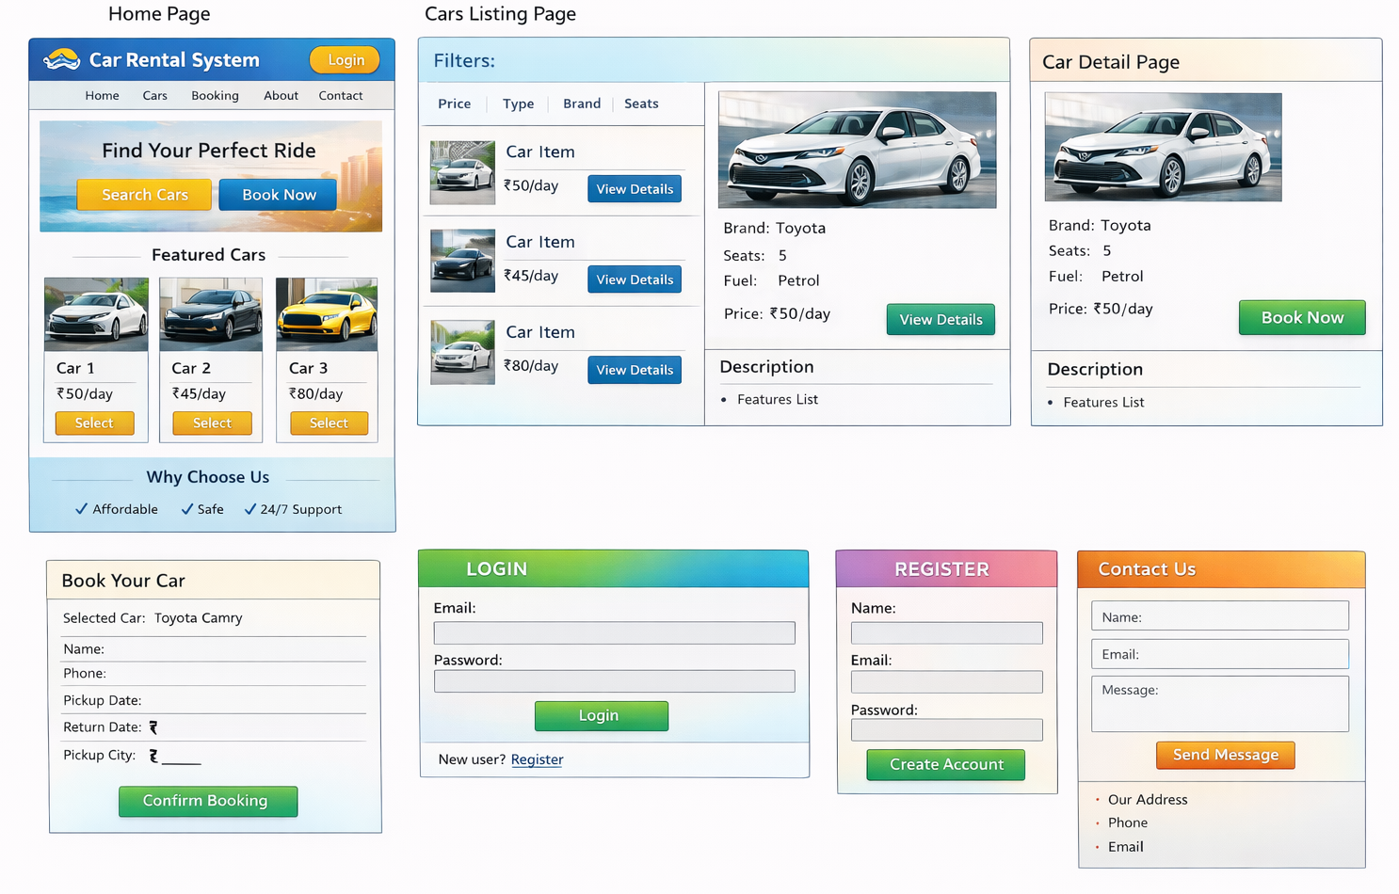
System Design

Slide 10
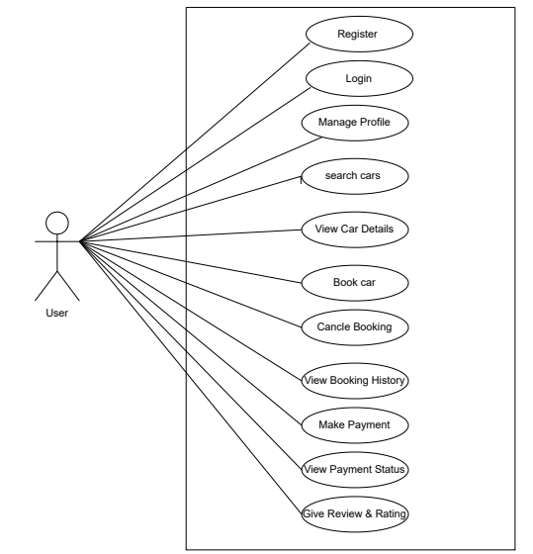
Use-Case Diagram

Slide 11
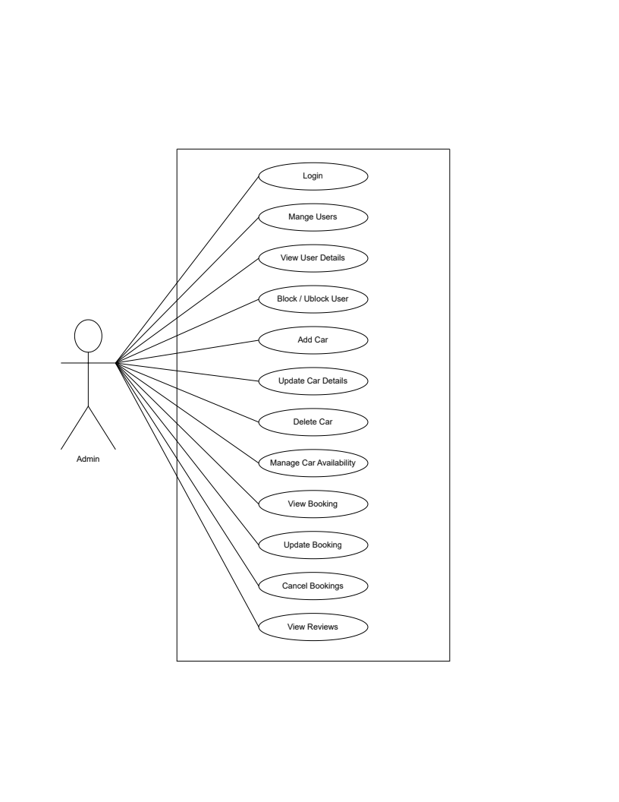
Admin use-case

Slide 12
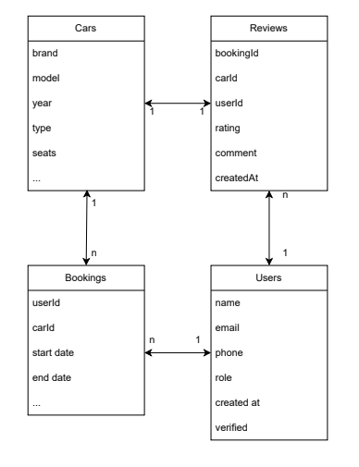
Class Diagram

Slide 13
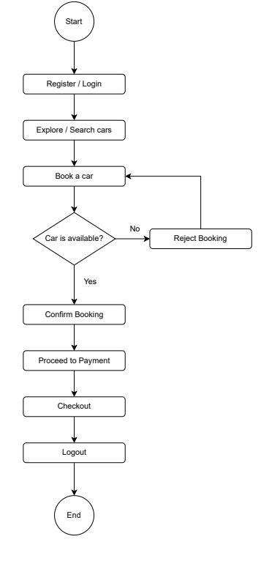
Activity Diagram

Slide 14
Data Dictionary
users collection
userId : number | Id of user
name : string | Name of the user
email : string | Email of the user
phone : number | Phone number of the user
role : string | Role of the user
createdAt : Timestamp | Timestamp of creation time
profileImage : string | Profile image of user
verified : bool | The user has verified his email or not

Slide 15
cars collection
carId : number | Id of car
brand : string | Brand of the car
model : string | model of the car
year : number | Year of purchase
type : number | type of car
seats : number | seats of card
fuelType : string | diesel or petrol
transmission : string | manual or auto gear
pricePerDay : number | price per day
location : string | location of car , includes object with city and area
images : string | images of car
features : string | list of features of car
isAvailable : bool | car is available or not
createdAt : timestamp | timestamp of car entry creation

Slide 16
bookings collection
bookingId : number | Id of booking
userId : number | id of user who booked car
carId : number | id of car being booked
startDate : timestamp | starting of the booking
endDate : timestamp | ending of the booking
totalDays : number | total days of the booking
pricePerDay : number | price per day
totalPrice : number | total price of the booking
status : string | status of the booking(pending,confirm,cancelled)
pickupLocation : string | pickup location of car
createdAt : timestamp | booking time

Slide 17
reviews collection
reviewId : number | id of review
bookingId : number | id of booking
carId : number | car which was booked
userId : number | user who booked the car
rating : number | rating
comment : string | text describing the review
createdAt : timestamp | time of review

