Slide 1

Extraction Transformation Loading
Advanced Database Management

Slide 2
Putting the pieces together
Data
(Tier 0)
Data Warehouse Server
(Tier 1)
OLAP Servers
(Tier 2)
Clients
(Tier 3)
Semistructured
Sources

MOLAP
Query/Reporting

Meta
Data
www data
⓪
①
①
Extract
Transform
Load
(ETL)
Data
Warehouse

⓪
⓪
Analysis
①
①
⓪
①
⓪
⓪
①
①
①
⓪
①
Archived
data
⓪
Business
Users
ROLAP
IT
Users
Data Mining

Operational
Data Bases
①
⓪
Data sources
Data Marts
Tools
Business Users
{Comment: All except ETL washed out look}

Slide 3
The ETL Cycle
EXTRACT
The process of reading data from different sources.
TRANSFORM
The process of transforming the extracted data from its original state into a consistent state so that it can be placed into another database.
LOAD
The process of writing the data into the target source.

MIS Systems
(Acct, HR)
TRANSFORM
CLEANSE
Data Warehouse
www data
Legacy
Systems
EXTRACT
LOAD
Archived data

Other indigenous applications
(COBOL, VB, C++, Java)
OLAP
Temporary
Data storage

Slide 4
ETL Processing
ETL is independent yet interrelated steps.
It is important to look at the big picture.
Data acquisition time may include…
Extracts
from
source
systems
Data
Movement
Data
Transfor-
mation
Data
Cleansing
Data
Loading
Index
Mainte-
nance
Statistics
Collection
Note: Backup will come as other
elements after “Statistical collection”
Backup
Back-up is a major task, its a DWH not a cube

Slide 5
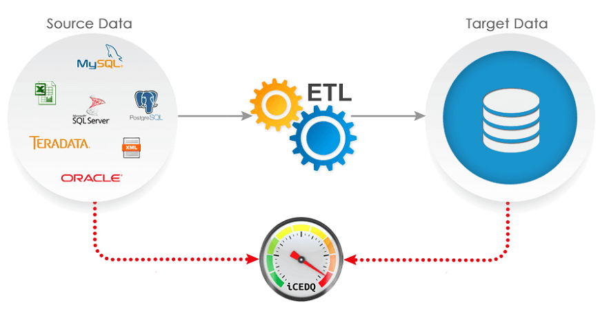
Overview of Data Extraction
First step of ETL, followed by many.
Source system for extraction are typically OLTP systems.
A very complex task due to number of reasons:
Very complex and poorly documented source system.
Data has to be extracted not once, but number of times.
The process design is dependent on:
Which extraction method to choose?
How to make available extracted data for further processing?

Slide 6
Types of Data Extraction
Logical Extraction
Full Extraction
Incremental Extraction
Physical Extraction
Online Extraction
Offline Extraction
Legacy vs. OLTP

Slide 7
Logical Data Extraction
Full Extraction
The data extracted completely from the source system.
No need to keep track of changes.
Source data made available as-is with any additional information.
Incremental Extraction
Data extracted after a well defined point/event in time.
Mechanism used to reflect/record the temporal changes in data (column or table).
Sometimes entire tables off-loaded from source system into the DWH.
Can have significant performance impacts on the data warehouse server.

Slide 8
Physical Data Extraction…
Online Extraction
Data extracted directly from the source system.
May access source tables through an intermediate system.
Intermediate system usually similar to the source system.
Offline Extraction
Data NOT extracted directly from the source system, instead staged explicitly outside the original source system.
Data is either already structured or was created by an extraction routine.
Some of the prevalent structures are:
Flat files
Dump files
Redo and archive logs
Transportable table-spaces

Slide 9
Physical Data Extraction
Legacy vs. OLTP
Data moved from the source system
Copy made of the source system data
Staging area used for performance reasons

Slide 10
Data Transformation
Basic tasks
Selection
Splitting/Joining
Conversion
Summarization
Enrichment

Slide 11
Data Transformation Basic Tasks
Selection

Slide 12
Data Transformation Basic Tasks
Splitting/joining

Slide 13
Data Transformation Basic Tasks
Conversion

Slide 14
Data Transformation Basic Tasks: Conversion Example-1
Convert common data elements into a consistent form i.e. name and address.
Translation of dissimilar codes into a standard code.
Field format Field data
First-Family-title Muhammad Ibrahim Contractor
Family-title-comma-first Ibrahim Contractor, Muhammad
Family-comma-first-title Ibrahim, Muhammad Contractor
F/NO-2
F-2
FL.NO.2
FL.2
FL/NO.2
FL-2
FLAT-2
FLAT#
FLAT,2
FLAT-NO-2
FL-NO.2
Natl. ID NID
National ID NID
FLAT No. 2

Slide 15
Data Transformation Basic Tasks: Conversion Example-2
Data representation change
EBCIDIC to ASCII
Operating System Change
Mainframe (MVS) to UNIX
UNIX to NT or XP
Data type change
Program (Excel to Access), database format (FoxPro to Access).
Character, numeric and date type.
Fixed and variable length.

Slide 16
Data Transformation Basic Tasks
Summarization

Slide 17
Data Transformation Basic Tasks
Enrichment

Slide 18
Data Transformation Basic Tasks: Enrichment Example
Data elements are mapped from source tables and files to destination fact and dimension tables.
Default values are used in the absence of source data.
Fields are added for unique keys and time elements.
Parsed Data
First Name: HAJI MUHAMMAD
Family Name: IBRAHIM
Title: GOVT. CONT.
Firm: K. S. ABDULLAH & BROTHERS
Firm Location: ABDULLAH MANZIL
Road: MAMOOJI ROAD
Phone: 051-67855
City: RAWALPINDI
Code: 46200
Input Data
HAJI MUHAMMAD IBRAHIM, GOVT. CONT.
K. S. ABDULLAH & BROTHERS,
MAMOOJI ROAD, ABDULLAH MANZIL
RAWALPINDI, Ph 67855

Slide 19
Aspects of Data Loading Strategies
Need to look at:
Data freshness
System performance
Data volatility
Data Freshness
Very fresh low update efficiency
Historical data, high update efficiency
Always trade-offs in the light of goals
System performance
Availability of staging table space
Impact on query workload
Data Volatility
Ratio of new to historical data
High percentages of data change (batch update)

Slide 20
Three Loading Strategies
Once we have transformed data, there are three primary loading strategies:
Full data refresh with BLOCK INSERT or ‘block slamming’ into empty table.
Incremental data refresh with BLOCK INSERT or ‘block slamming’ into existing (populated) tables.
Trickle/continuous feed with constant data collection and loading using row level insert and update operations.

