Slide 1
Indexing & B-Trees
(Lecture 05)
B-Trees
Spring-2☺23

Slide 2
Motivation
When data is too large to fit in the main memory, then it is retrieved on need basis from the disk.
Thus for large files, the number of disk accesses becomes important.
A disk access is unbelievably expensive compared to a typical computer instruction (mechanical limitations).
One disk access is worth 200,000 computer instructions.
The number of disk accesses will dominate the running time of the solution.

Slide 3
Motivation (contd.)
Secondary memory (disk) is divided into equal-sized blocks (typical size are 512, 2048,4096, or 8192 bytes).
The basic I/O operation transfers the contents of one disk block to/from RAM.
Our goal is to devise multi way search tree that will minimize file access ( by exploring disk block read).

Slide 4
Multi way search trees(of order m)
A generalization of Binary Search Trees.
Each node has at most m children.
If k ≤ m is the number of children, then the node has exactly k-1 keys.
The tree is ordered.

Slide 5
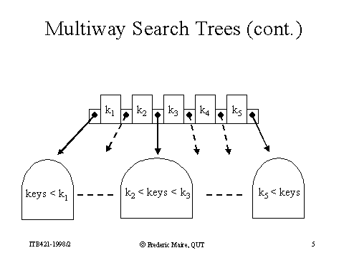

Slide 6
B-Trees
A B-tree of order m is m-way search tree.
B-Trees are balanced search trees designed to work well on direct access secondary storage devices.
B-Trees are similar to Red-Black Trees, but are better at minimizing disk I/O operations.
All leaves are on the same level.

Slide 7
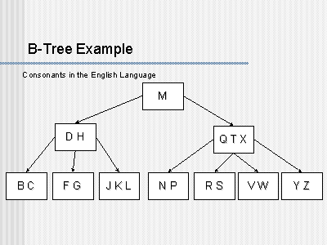

Slide 8
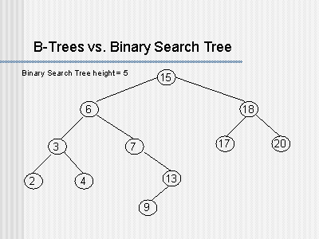

Slide 9
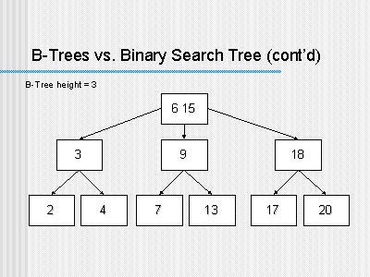

Slide 10
B-Tree Properties
B-Tree is a rooted tree with root[T] with the following properties:
1- Every node x has the following fields.
a-n[ x], the number of keys currently stored in x.
b-The n[ x] keys, themselves stored in non decreasing (Ascending) order.
key₁[x] ≤ key₂[x] ≤ … ≤ key _{n} [x].
c-Leaf[ x], a Boolean value that is TRUE if x is leaf, and false if x is internal node.

Slide 11
Properties Contd…
2- if x is an internal node, it also contains n[ x]+1 pointers to its children. Leaf node contains no children.
3- The keys key_{i}[ x] separate the range of keys stored in each sub tree : if k₁ is any key stored in the sub tree with root c₁[ x], then:
k₁≤ key₁[x] ≤ k₂ ≤ key₂[x] ≤…key _{n[ x]} [ x] ≤ k_{n[x]+1}
4- Each leaf has the same depth, which is the height of the tree h.

Slide 12
Properties Contd…
5- There are lower and upper bound on the number of keys a node can contain.
These bounds can be expressed in terms of a fixed integer t ≥2, called the minimum degree of B-Tree.
Why t cant be 1?

Slide 13
Properties Contd…
a- Every node other than the root must have at least t-1 keys, Every internal node other than root, thus has at least t children. If the tree is non empty, the root must have at least one key.
b-Every node can contain at most 2t-1 keys. Therefore, an internal node can have at most 2t children. We say a node is full if it contains exactly 2t-1 keys.

Slide 14
Height of a B-Tree
What is the maximum height of a B-Tree with N entries?
This question is important, because the maximum height of a B-Tree will give an upper bound on the number of disk accesses.

Slide 15
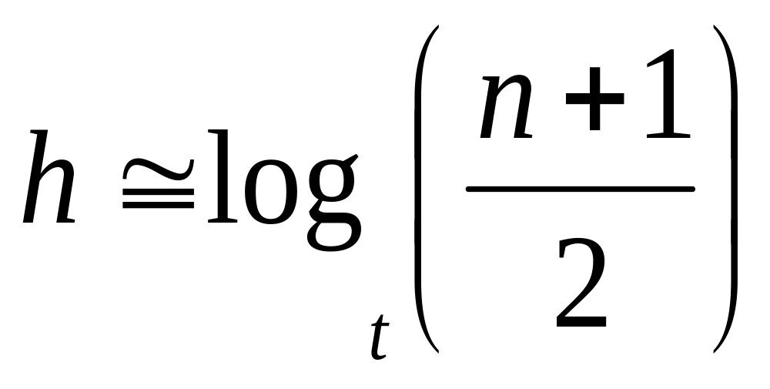
Height of a B-Tree.
If n ≥ 1, than for any n-key B-Tree T of height h and minimum degree t ≥ 2,

Slide 16
root[T]
# of nodes
1
1
t-1
t-1
2
t
t
t-1
t-1
t-1
t-1
2t
t
t
t
t
t-1
t-1
t-1
t-1
t-1
t-1
t-1
t-1
2t²
A B-Tree of height 3 containing minimum possible keys

Slide 17
proof
Number of nodes is minimized, when root contains one key and all other nodes contain t-1 keys.
2 nodes at depth 1, 2t nodes at depth 2, 2t² nodes at depth 3 and so on.
At depth h, there are 2t^{h-1} nodes.

Slide 18
Numerical Example
For N= 2,000,000 (2 Million), and m=100, the maximum height of a tree of order m will be only 3, whereas a binary tree would be of height larger than 20.

Slide 19
Operation on B-Trees
Searching a B-Tree.
Creating an empty B-Tree.
Splitting a node in B-Tree.
Inserting a Key into B-Tree.
Deleting a Key from B-Tree.

Slide 20
Searching a B-Tree
It is much like searching a BST, except that instead of making a binary or “two way” decision at each node, we make a multi way branching decision according to number of children.
In other words, at each internal node x, we make an (n[x]+1)-way branching decision.

Slide 21
Searching (Contd.)
B-TREE-SEARCH takes as input a pointer to the root node x of a sub tree and a key k to be searched for in that sub tree.
The top level call is thus of the form B-TREE-SEARCH( root[T], k).
If k is in the B-Tree, this procedure returns the ordered pair (y, i), consisting of a node y and an index i, such that key_{i}[y]=k.

Slide 22
Searching( Contd.)
The nodes encountered during the recursion forms a path downward from the root of the tree.
The number of disk pages accessed by procedure is therefore
      O(h)=O(log_{t}(n))
Since n[ x] ≤ 2t, thus time taken to search within each node is O(t), and the total CPU time is O(t*h)=O(t log(n))

Slide 23
Splitting a node in B-Tree
Inserting a key into B-Tree is significantly more complicated than inserting a key into BST
Fundamental operation used during insertion is splitting of a full node y (having 2t-1 keys) around its median key key_{i} [y] into two nodes having t-1 keys each.
The median key moves up into y ’s parent.

Slide 24
Splitting (contd..)
y ‘s parent must be non-full prior to splitting of y.
If y has no parent, then the tree grows in height by one.
So splitting is the mean by which B-Tree grows.

Slide 25
Splitting (contd..)
If a node becomes full, it is necessary to perform a split operation.
The B-TREE-SPLIT-CHILD algorithm will run in O(t), where t is constant.

Slide 26
Splitting (contd..)
… N W …
… N S W …
P Q R S T U V
P Q R
T U V

Slide 27
Insertion in a B-Tree
To perform an insertion in a B-tree, the appropriate node for the key must be located using an algorithm similar to B-Tree-Search
Next, the key must be inserted into the node
If the node is not full prior to the insertion, no special action is required

Slide 28
Insertion in a B-Tree (cont…)
Splitting the node results in moving one key to the parent node, what if the parent node is full?
Then parent has to be split too.
This process may repeat all the way up to the root and may require splitting the root node
This approach requires two passes. The first pass locates the node where the key should be inserted; the second pass performs any required splits on the ancestor nodes

Slide 29
Insertion in a B-Tree (cont…)
Since each access to a node may correspond to a costly disk access, it is desirable to avoid the second pass by ensuring that the parent node is never full
To accomplish this, the algorithm splits any full nodes encountered while descending the tree
Is there a problem?

Slide 30
Insertion in a B-Tree (cont…)
This approach may result in unnecessary split operations
But it guarantees that the parent never needs to be split and eliminates the need for a second pass up the tree
What is the penalty?
Since a split runs in linear time, it has little effect on the O(t log_{t} n) running time of B-Tree-Insert.

Slide 31
Initial Tree and Assume t=3
Minimum Number of keys at any internal node =
t-1 = 2
Maximum Number of keys at any node =
2t-1 = 5
G M P Q X
A C D E
J K
N O
R S T U V
Y Z
Inserting B
G M P X
A B C D E
J K
N O
R S T U V
Y Z

Slide 32
Inserting L
G M P X
A B C D E
J K L
N O
R S U V
Y Z
Inserting F
Node is already full
We have to split it
first
Is it as much simple?

Slide 33
Inserting F
G M P X
A B C D E
J K L
N O
R S U V
Y Z
Median: Split here, C will move to parent node
C G M P X
A B
D E F
J K L
N O
R S U V
Y Z
What will happen if we want to insert T?
What will happen if we want to insert Q?

