Slide 1
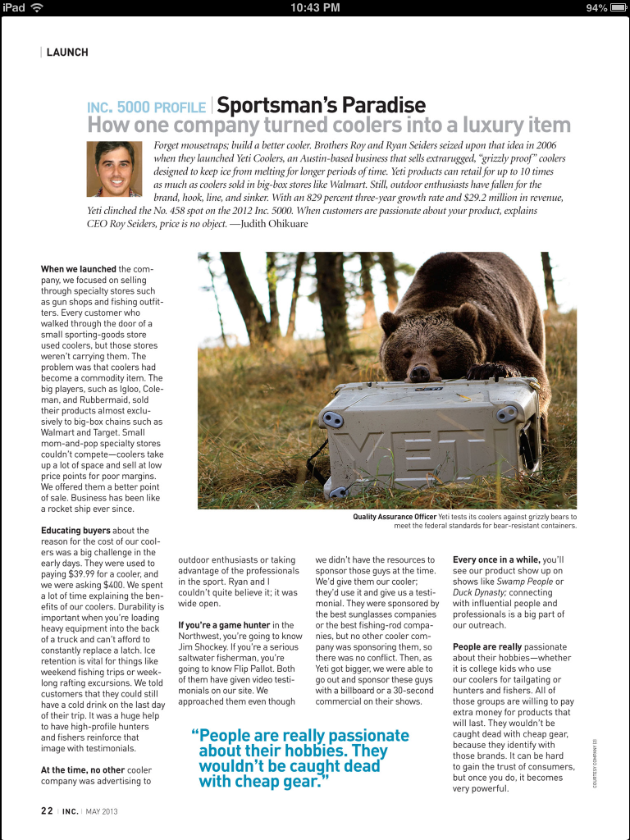
Todo (WIREFRAME A):

Slide 2
Todo (WIREFRAME A):
A1
A2
B1
B2 C1
B2 C2
B2 C2
B2 C3
B2 C4
A3

Slide 3

Todo (WIREFRAME B):

Slide 4
Todo (WIREFRAME B):
A1
A2
B1 C1 D1
B1 C1 D2
B1 C1 D3
B2 R1
B2 R2
B1 C2 D4
B1 C2 D5
B2 R3
B1 C3 D6
B1 C4 D7
B2 R4
B1 C4 D8
B1 C4 D9
B2 R5
E

Slide 5

Todo (WIREFRAME C):

Slide 6
Todo (WIREFRAME C):
R1
R2
R3
R4 C1
R4 C2

