Slide 1
SOFTWARE DESIGN & DEVELOPMENT ASSESSMENT
CampusCare
Smart Campus Complaint & Maintenance Management System
Centralizing student issue reporting, administrative triage, and maintenance staff resolution through a transparent role-based workflow.
TEAM DETAILS (EDITABLE PLACEHOLDERS)
COURSE & INSTITUTION DETAILS
• [Student Name 1] — [Student ID 1]
• [Student Name 2] — [Student ID 2]
• [Student Name 3] — [Student ID 3] (Optional)
Role Scope: Academic Functional Prototype (HTML5 / CSS3 / Vanilla JS)
Course: [Course Code & Course Title]
Faculty Mentor: [Faculty Name & Designation]
Department: [Department Name]
Institution: [University / College Name]
Date: [Presentation Date]

Slide 2
SLIDE 2 / 7
Problem Statement & Project Objectives
Addressing fragmented campus maintenance reporting with structured digital accountability
Current Campus Challenges
CampusCare Core Objectives
• Informal Reporting Channels
Broken projectors, electrical faults, water leaks, Wi-Fi drops, and sanitation issues are reported verbally or via scattered chat groups.
• Missing Ownership & Audit Trail
Without ticket IDs or technician assignment records, complaints stall or get duplicated.
• Lack of Triage & Student Feedback
Urgent hazards lack prioritization and students cannot verify resolution status.
• Transparency
Real-time 4-stage tracking, assigned technician visibility, and final resolution notes for students.
• Accountability
Strict role isolation ensuring technicians manage only their assigned tasks and provide completion notes.
• Organization & Efficiency
Centralized Admin dashboard with priority levels (Low–Urgent), category analytics, search, and filters.
MANDATORY FOUR-STAGE COMPLAINT WORKFLOW
1. Pending
Student submits
2. Assigned
Admin sets priority & staff
3. In Progress
Technician begins repair
4. Resolved
Resolution notes recorded
CampusCare • Smart Campus Complaint & Maintenance Management System (Academic Prototype)

Slide 3
SLIDE 3 / 7
Functional & Non-Functional Requirements
Ten specific, testable requirements mapped directly to implemented CampusCare capabilities
Functional Requirements (FR1 – FR7)
NFR1 — Security & Data Integrity
ID | Requirement | Implemented Behavior
FR1 | Demo Role Auth | Select Student / Admin / Staff role & demo profile; route to authorized view.
FR2 | Complaint Submit | Validate Title, 6 Categories, Description, <=500 KB image; auto-ID CMP-YYYY-XXXX.
FR3 | Student Tracking | View personal KPIs, category chart, search/filters, staff & resolution notes.
FR4 | Admin Triage | View all tickets; set Priority (Low–Urgent), assign staff, manage/delete records.
FR5 | Staff Workflow | View assigned-only tasks; update In Progress -> Resolved with required notes.
FR6 | Access Control | Enforce strict role & ownership boundaries on screens, modals, and mutations.
FR7 | Persistence & Reset | Persist complaints & session in LocalStorage across reloads; Reset Demo Data.
HTML-escape all user text before DOM rendering (XSS defense), validate image MIME/500 KB limits, and auto-recover corrupted LocalStorage JSON.
NFR2 — Usability & Accessibility
Consistent dark-navy SaaS UI, desktop sidebar & mobile drawer responsiveness, clear status badges, empty states, toasts, and keyboard focus rings.
NFR3 — Zero-Dependency Portability
Pure HTML5, CSS3, and Vanilla JavaScript requiring zero paid APIs, backends, or build steps; inline SVG icons & system font fallback offline.
CampusCare • Smart Campus Complaint & Maintenance Management System (Academic Prototype)

Slide 4
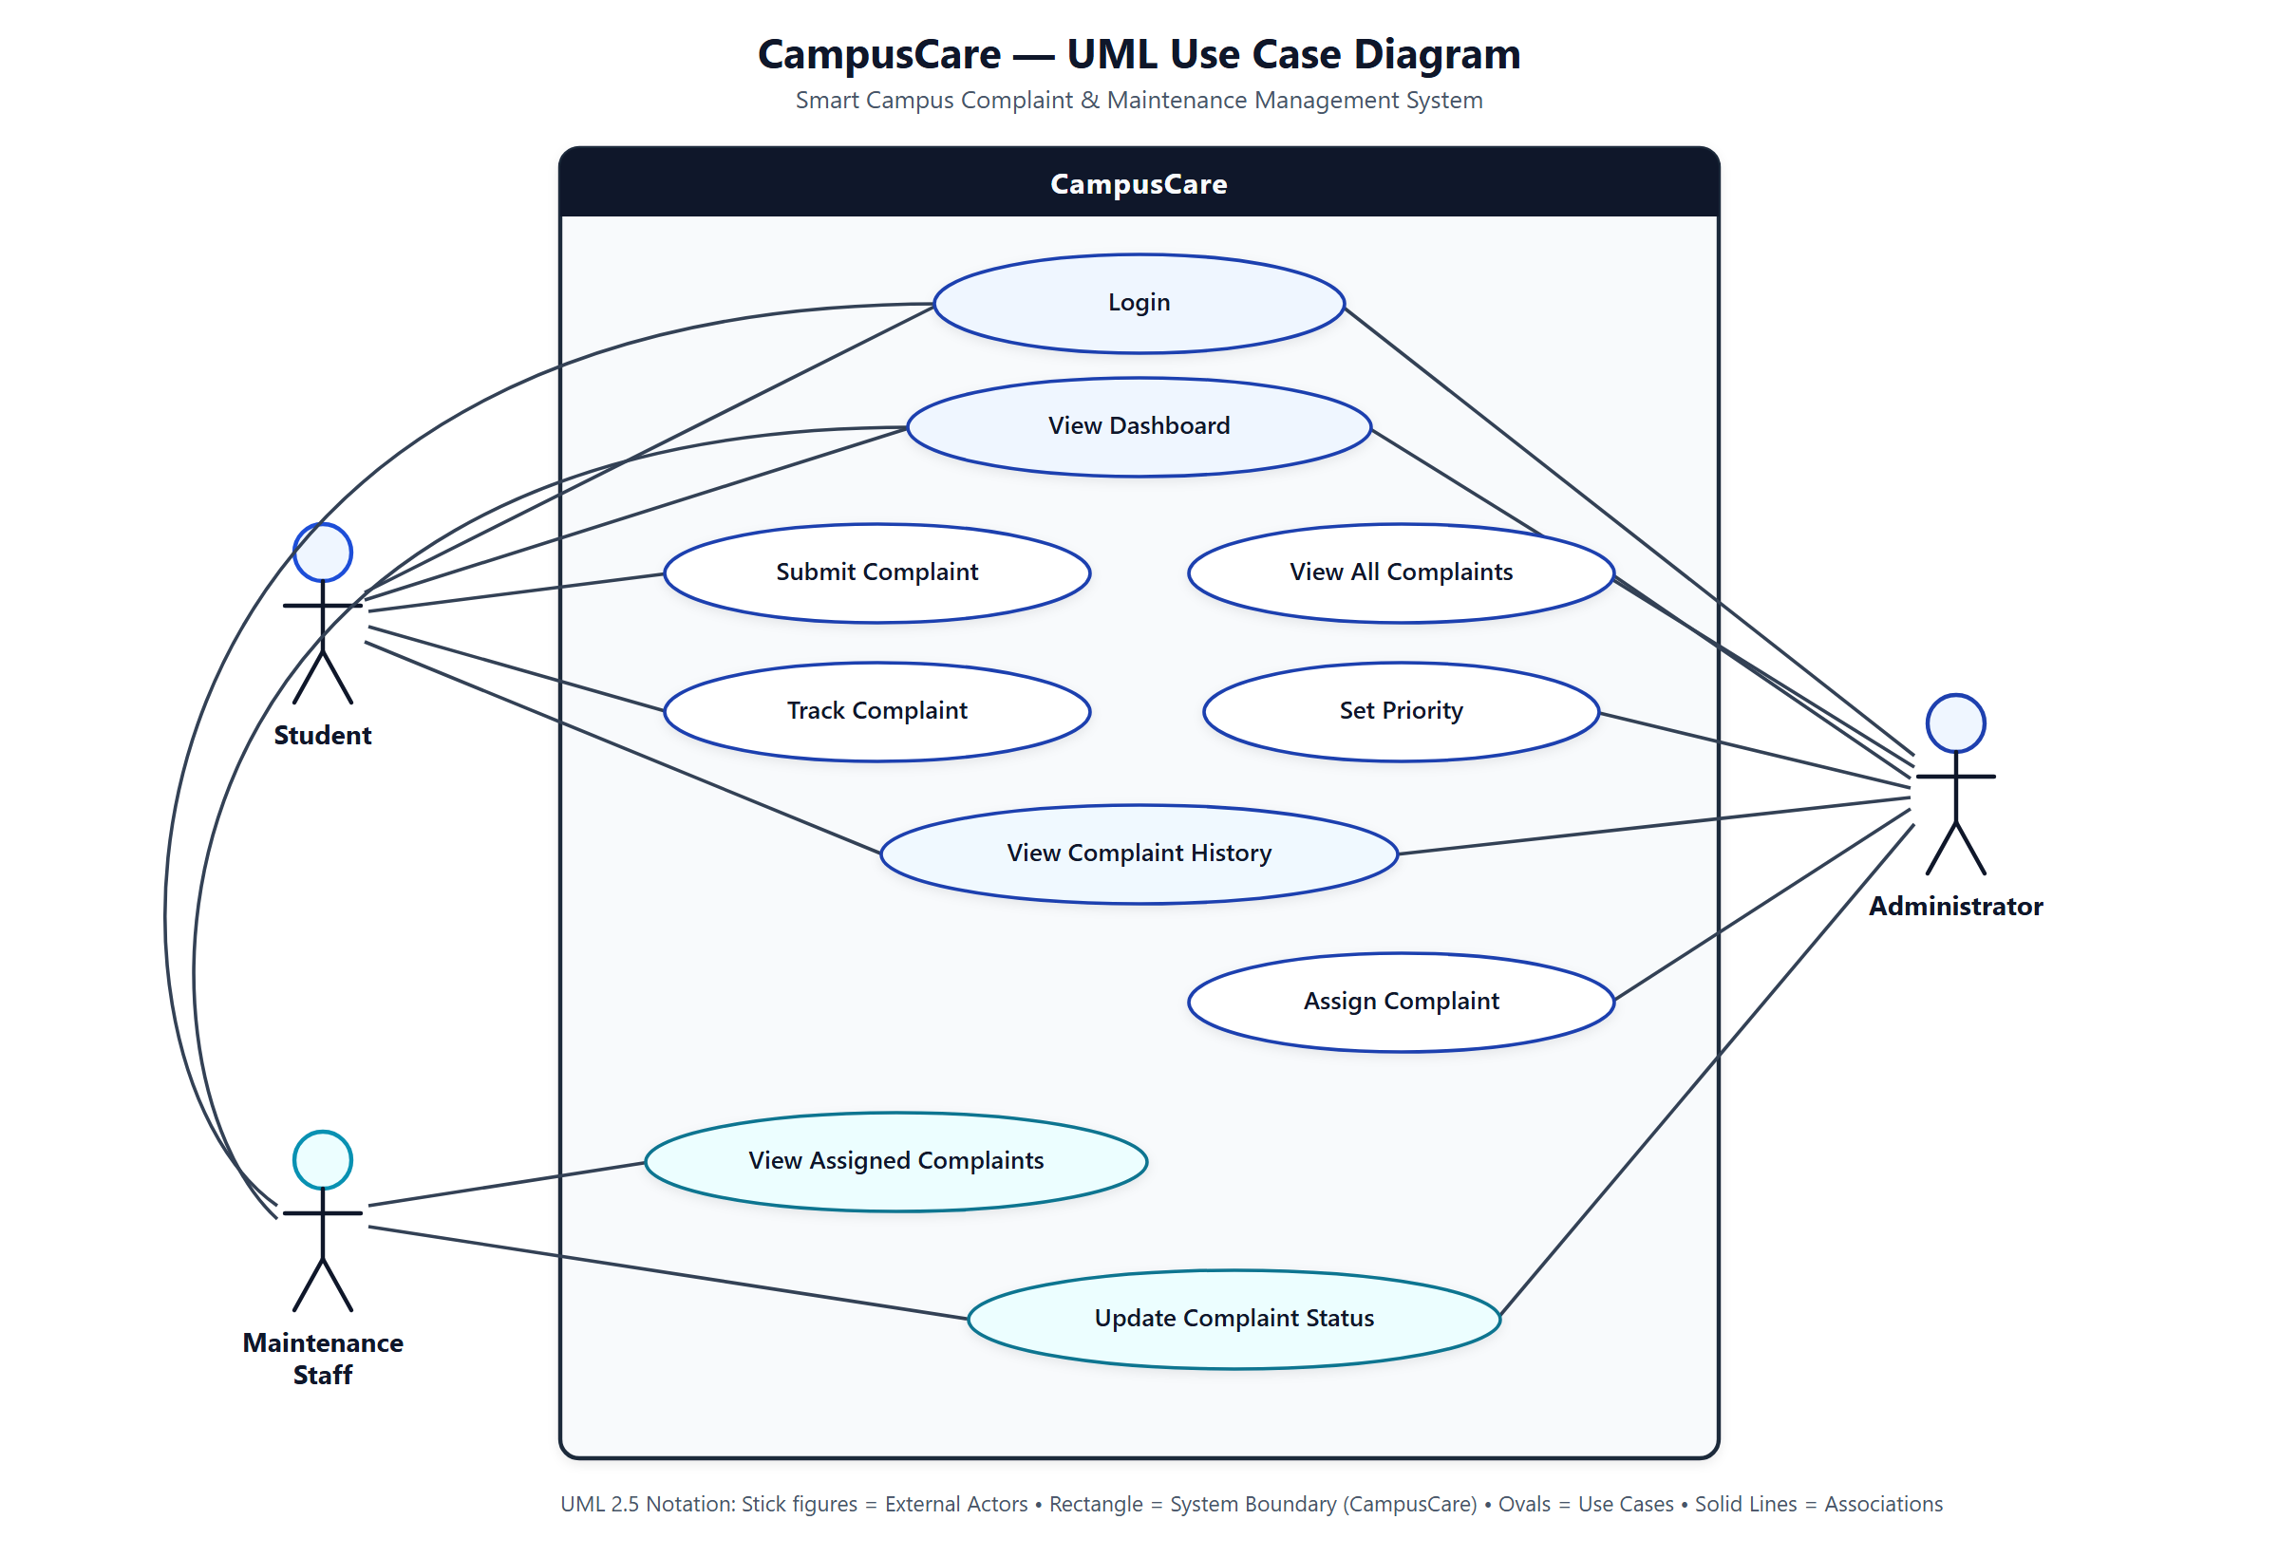
SLIDE 4 / 7
UML Use Case Diagram
Three actors interacting with ten core CampusCare use cases inside a single system boundary
Key UML Elements
System Boundary:
CampusCare encloses all 10 functional use cases.
Student Actor:
Login, View Dashboard, Submit Complaint, Track Complaint, View Complaint History.
Administrator Actor:
Login, View Dashboard, View All Complaints, Set Priority, Assign Complaint, View History, Update Status.
Maintenance Staff Actor:
Login, View Dashboard, View Assigned Complaints, Update Complaint Status.
CampusCare • Smart Campus Complaint & Maintenance Management System (Academic Prototype)

Slide 5
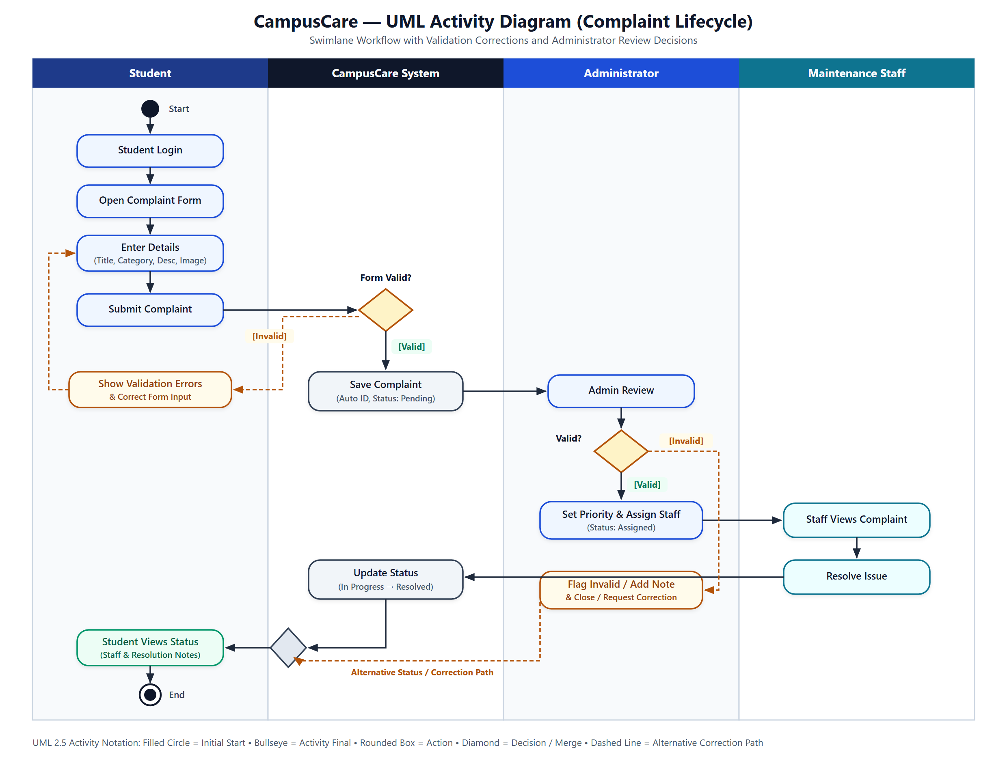
SLIDE 5 / 7
UML Activity Diagram (Complaint Lifecycle)
Swimlane workflow modeling validation corrections, Administrator validity decisions, and resolution
Lifecycle Flow & Decision Paths
1. Four Swimlane Partitions
Separates Student, CampusCare System, Administrator, and Maintenance Staff responsibilities.
2. Form Validation Decision
Invalid inputs loop back with inline error guidance until valid; valid submissions save with unique ID & Pending status.
3. Admin Review Decision (Valid?)
[Valid] routes to Set Priority & Assign Staff -> Staff Resolves -> Update Status.
[Invalid] routes via alternative note/close correction path.
4. Convergence & Closure
Merge diamond feeds into Student Views Status and UML Activity Final node.
CampusCare • Smart Campus Complaint & Maintenance Management System (Academic Prototype)

Slide 6
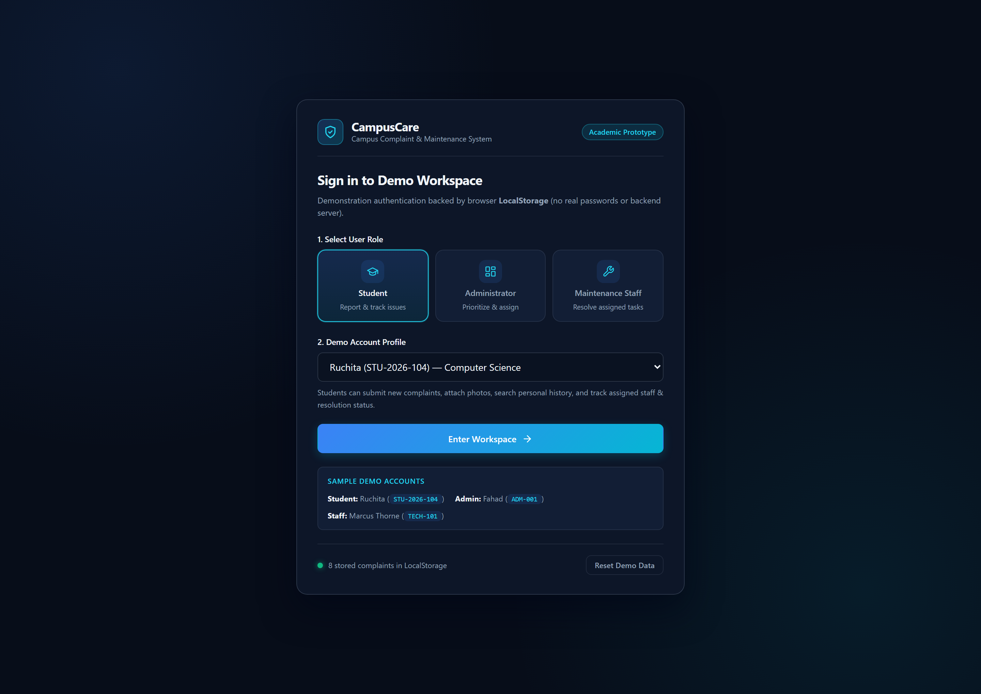
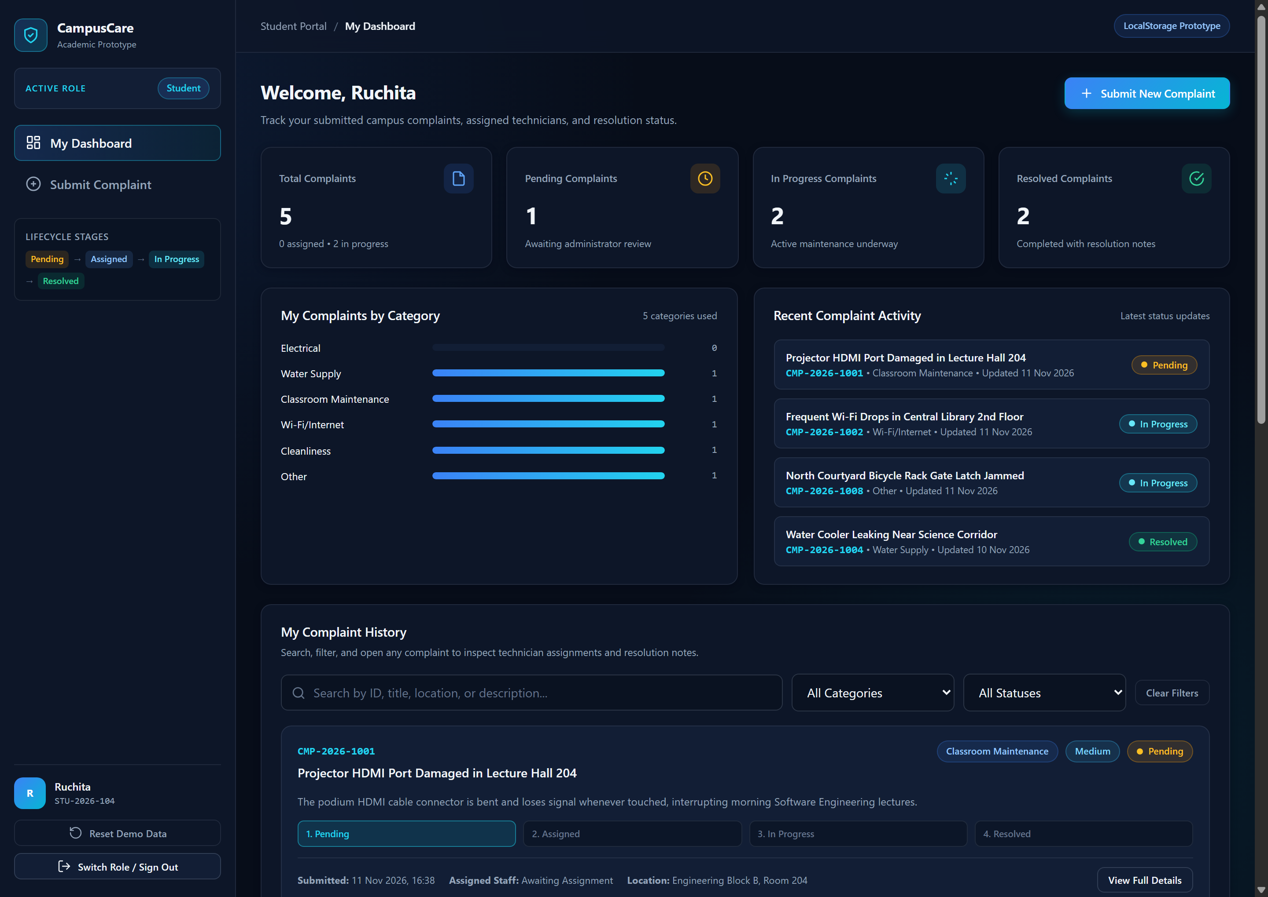
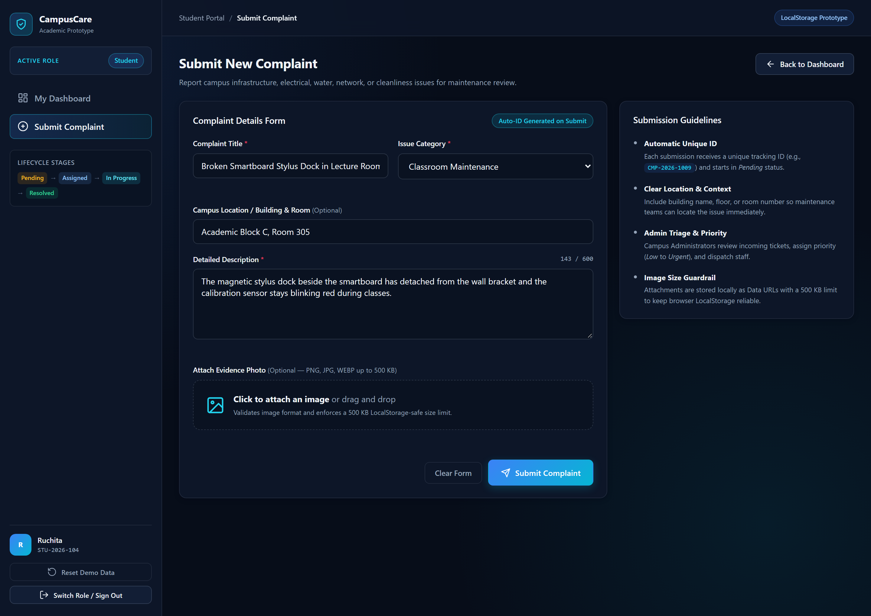
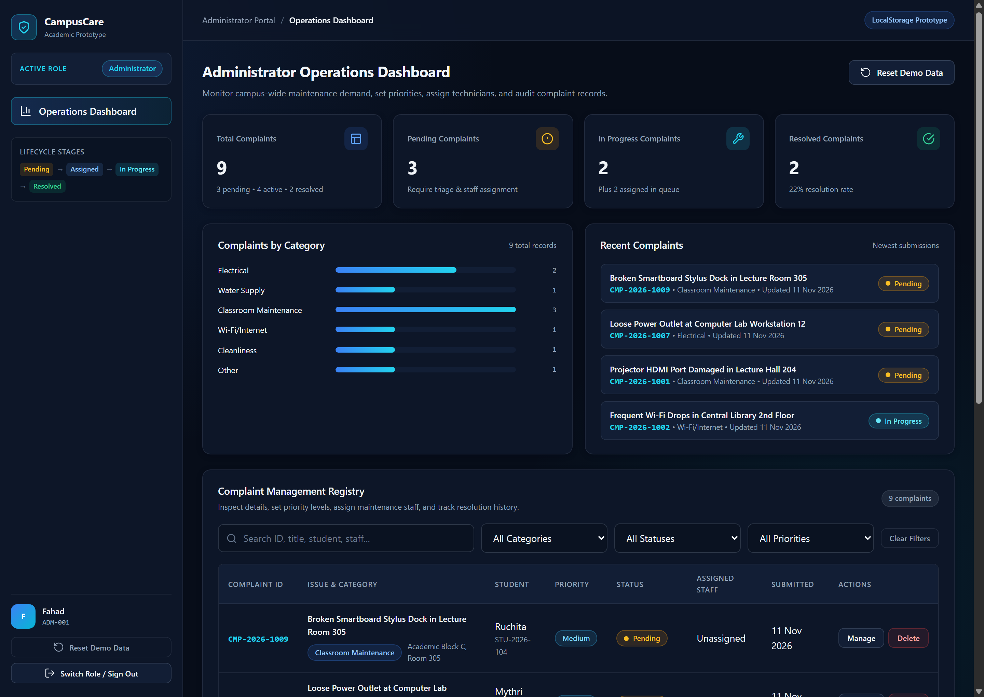
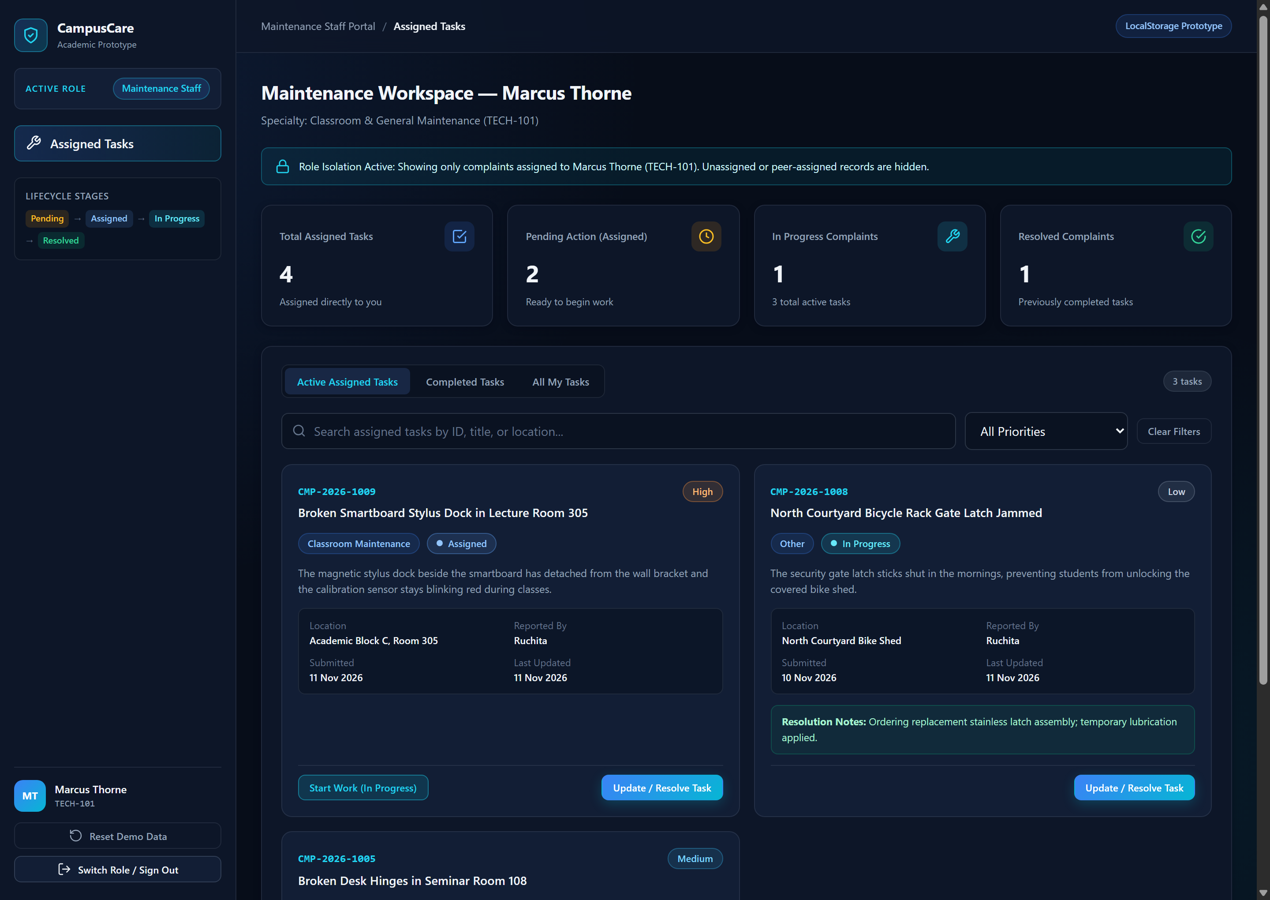
SLIDE 6 / 7
Implemented UI Screens & Workflow
Five functional, responsive dark-navy SaaS screens captured directly from the working application
1. Role-Based Demo Login
2. Student Dashboard
3. Complaint Submission Form
4. Administrator Operations Dashboard
5. Maintenance Staff Workspace
CampusCare • Smart Campus Complaint & Maintenance Management System (Academic Prototype)

Slide 7
SLIDE 7 / 7
Conclusion, Design Rationale & Future Enhancements
Delivering a verified, zero-dependency campus complaint prototype within a single-day sprint
Design Justification
Key Benefits & Verification
Limitations & Roadmap
• Right-Sized Architecture
HTML5, CSS3, and Vanilla JS run immediately via index.html with zero build complexity or paid infrastructure.
• Security & Resilience
Escapes all rendered text against XSS, validates images (500 KB cap), and recovers corrupted LocalStorage JSON.
• Strict Role Isolation
Navigation and data handlers enforce Student, Admin, and Staff ownership boundaries.
• End-to-End Traceability
Every ticket tracks Pending -> Assigned -> In Progress -> Resolved with full timestamped audit history.
• Verified Quality
16/16 automated headless Chrome checks passed across desktop & mobile (390px) with 0 console errors.
• Presentation Ready
Built-in Reset Demo Data modal ensures repeatable live demonstrations.
• Prototype Limitations
LocalStorage is single-browser scoped (~5 MB limit) and uses demonstration authentication.
• Backend & University SSO
Upgrade to PostgreSQL + REST API with institutional OAuth 2.0 authentication.
• Smart Alerts & QR Codes
Add automated email/SMS updates, SLA escalations, and classroom QR tags for instant reporting.
CampusCare • Smart Campus Complaint & Maintenance Management System (Academic Prototype)

