Slide 1



PRESIDENCY UNIVERSITY
Leading the future of learning and innovation
AI Climate Risk Intelligence Platform
Course: Computer Science and Technology
Notes:
1

Slide 2

AI Climate Risk Intelligence Platform
Predicting Environmental Hazards with Machine Learning
Mohamed Fahad
20241CSG0033
Mohammed Rayyan Ilyas
20241CSG0032
Course
Computer Science and Technology
Date
12 June 2026
Notes:
2

Slide 3
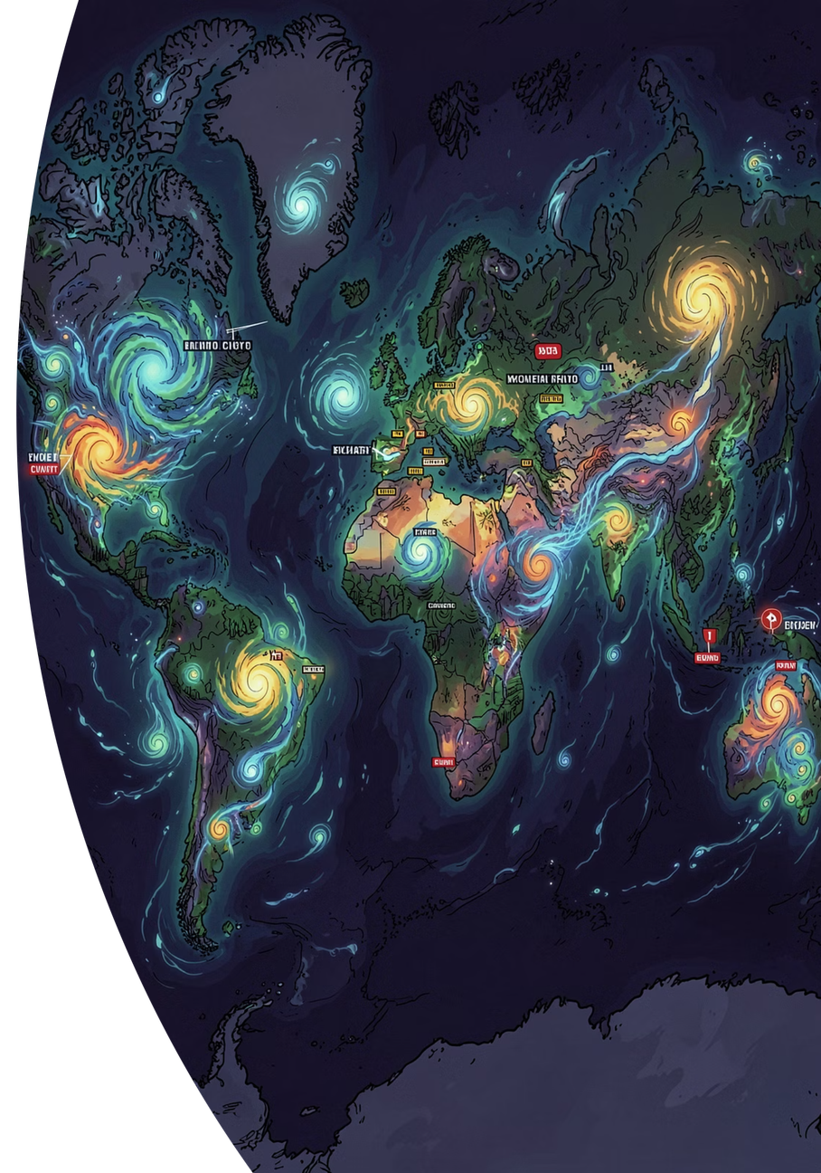


The Problem
Climate-related hazards are increasing globally at an unprecedented rate. Emergency services, agriculture, and critical infrastructure need real-time risk intelligence — yet existing tools are too complex, slow, or not AI-powered to respond effectively.
🌍 Growing Threat
Climate-related hazards are increasing globally, putting lives and livelihoods at greater risk every year.
⚡ Urgent Need
Emergency services, agriculture, and infrastructure need real-time risk intelligence to act before disasters strike.
🔧 The Gap
Existing tools are too complex or not AI-powered — they cannot translate raw data into actionable decisions fast enough.
Goal: Turn raw weather data into an instant, actionable hazard score.
Notes:
3

Slide 4
What the Platform Does
Massive Data Ingestion
Automated ML Comparison
Risk Score Output
Ingests 533,312 real meteorological records for training and prediction.
Trains and compares 3 ML models automatically to select the best performer.
Outputs a Climate Hazard Risk Score (0–100) from 7 weather inputs.
5-Day Forecast
Accessible Interface
Provides a 5-Day Forecast with predicted risk trends for proactive planning.
Accessible via a secure, role-based web dashboard + mobile-ready PWA.
Notes:
4

Slide 5

Parameters Used to Calculate the Risk Index
The platform uses 7 meteorological parameters as inputs to the ML model. Wind Speed dominates as the primary risk driver, contributing over 85% of the model's predictive power.
Parameter
Unit
Role in Risk
Importance
💨 Wind Speed
km/h
Primary driver — high winds = storm/cyclone risk
85.6%
☀️ Global Solar Radiation
W/m²
Heat stress & drought risk indicator
9.4%
🌡️ Min Temperature
°C
Frost & cold-wave hazard detection
2.0%
🌡️ Max Temperature
°C
Heatwave & wildfire risk signal
1.4%
🌡️ Mean Temperature
°C
Overall thermal condition of the day
0.7%
🌀 Atmospheric Pressure
hPa
Low pressure = storm system approaching
0.9%
🧭 Wind Bearing
degrees
Wind direction — affects storm path
0.04%
🟢 0–33 · Low Risk
🟡 34–66 · Moderate Risk
🔴 67–100 · High Risk
Notes:
5

Slide 6
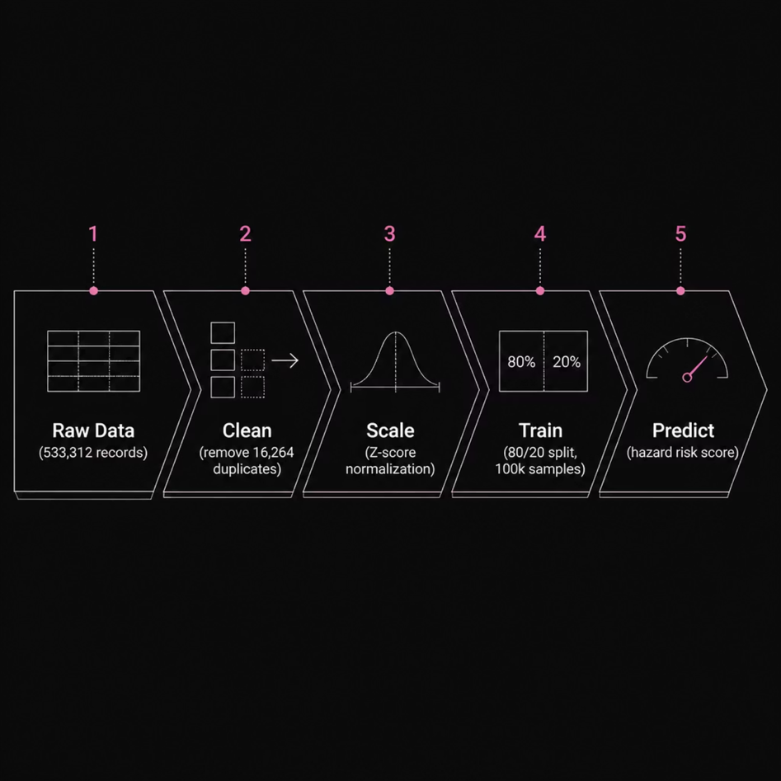
Dataset & Data Pipeline
Data Processing Steps
Step
Detail
Raw Records
533,312 rows
Duplicates Removed
16,264 → 517,048 clean records
Outlier Handling
IQR Capping (1.5× IQR rule)
Scaling
StandardScaler (Z-score)
Training Sample
100,000 records (80/20 train-test split)
7 Input Features: Pressure · Solar Radiation · Temp Mean/Min/Max · Wind Speed · Wind Bearing
Target: normalized_label — a hazard index (0–1 scale, shown as 0–100)
Notes:
6

Slide 7
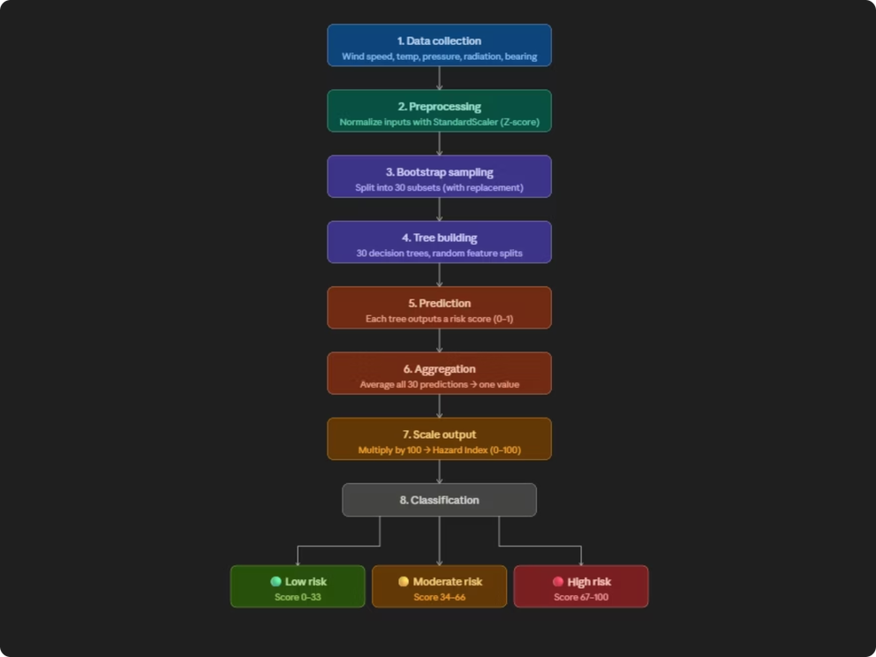
The Algorithm: Random Forest Regressor
Input — 7 weather parameters are collected (Wind Speed, Temperature, Pressure, Radiation, Wind Bearing)
Preprocessing — Inputs are normalized using StandardScaler (Z-score) so all features are on the same scale
Bootstrap Sampling — The dataset is randomly split into 30 subsets (one per tree) with replacement
Tree Building — Each subset trains its own Decision Tree, using a random selection of features at each split node
Prediction — Every tree independently predicts a risk score (0–1)
Aggregation — All 30 tree predictions are averaged into one final output
Scaling Output — The averaged value is multiplied by 100 to produce the final Hazard Index (0–100)
Classification — Score is categorized with emojis:
🟢 0–33 → Low Risk
🟡 34–66 → Moderate Risk
🔴 67–100 → High Risk
Notes:
7

Slide 8
Platform Features
Dashboard
Live KPIs and Chart.js risk trend charts
Risk Calculator
7-parameter form → animated 0–100 gauge + AI explanation
5-Day Forecast
Multi-output Random Forest predicting risk + weather per day
Data Explorer
Paginated 517k-row grid with search, sort, filter, CSV/Excel export
PDF Reports
Auto-generated risk assessment PDFs with GPU metadata
Security
JWT authentication + Admin / User role-based access control
Admin Panel
Trigger retraining from UI · Audit logs · GPU diagnostics (H200)
PWA
Offline-capable via Service Worker caching
Notes:
8

Slide 9
Conclusion
Real-World Uses
Current Limitations
🌾 Agriculture
🚨 Emergency Services
Fixed geographic dataset (not global yet)
Flat-file database (not production-scale)
Predict wind & heat harvest risk
Storm early-warning system
Future Work
Live weather API integration (OpenWeatherMap / NOAA)
LSTM / Transformer models for better forecasting
Cloud deployment (GCP / AWS) + mobile push alerts
🏗️ Infrastructure
Construction safety during extreme weather
Key Result: Random Forest achieved 89.27% accuracy (R²) on 517,048 real climate records — turning raw weather data into life-saving risk intelligence.
Notes:
9

