Slide 1
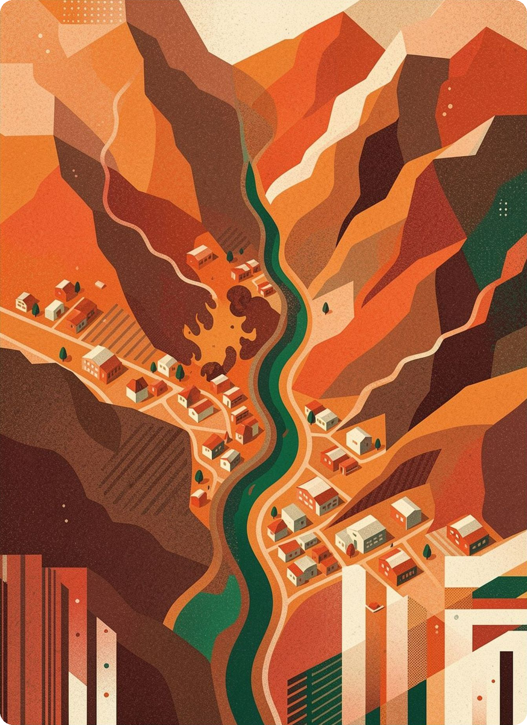
Alluvion
Agentic post-fire debris-flow early warning
An autonomous platform to watch burned hillsides, predict where the next storm turns them deadly, and draft targeted warnings — before disaster strikes.
THE GOOGLE EARTH AI STACK
Earth Engine
Gemini
WeatherNext
AlphaEarth
FireSat
Post-fire debris-flow hazard → downstream impact → targeted warning

Slide 2
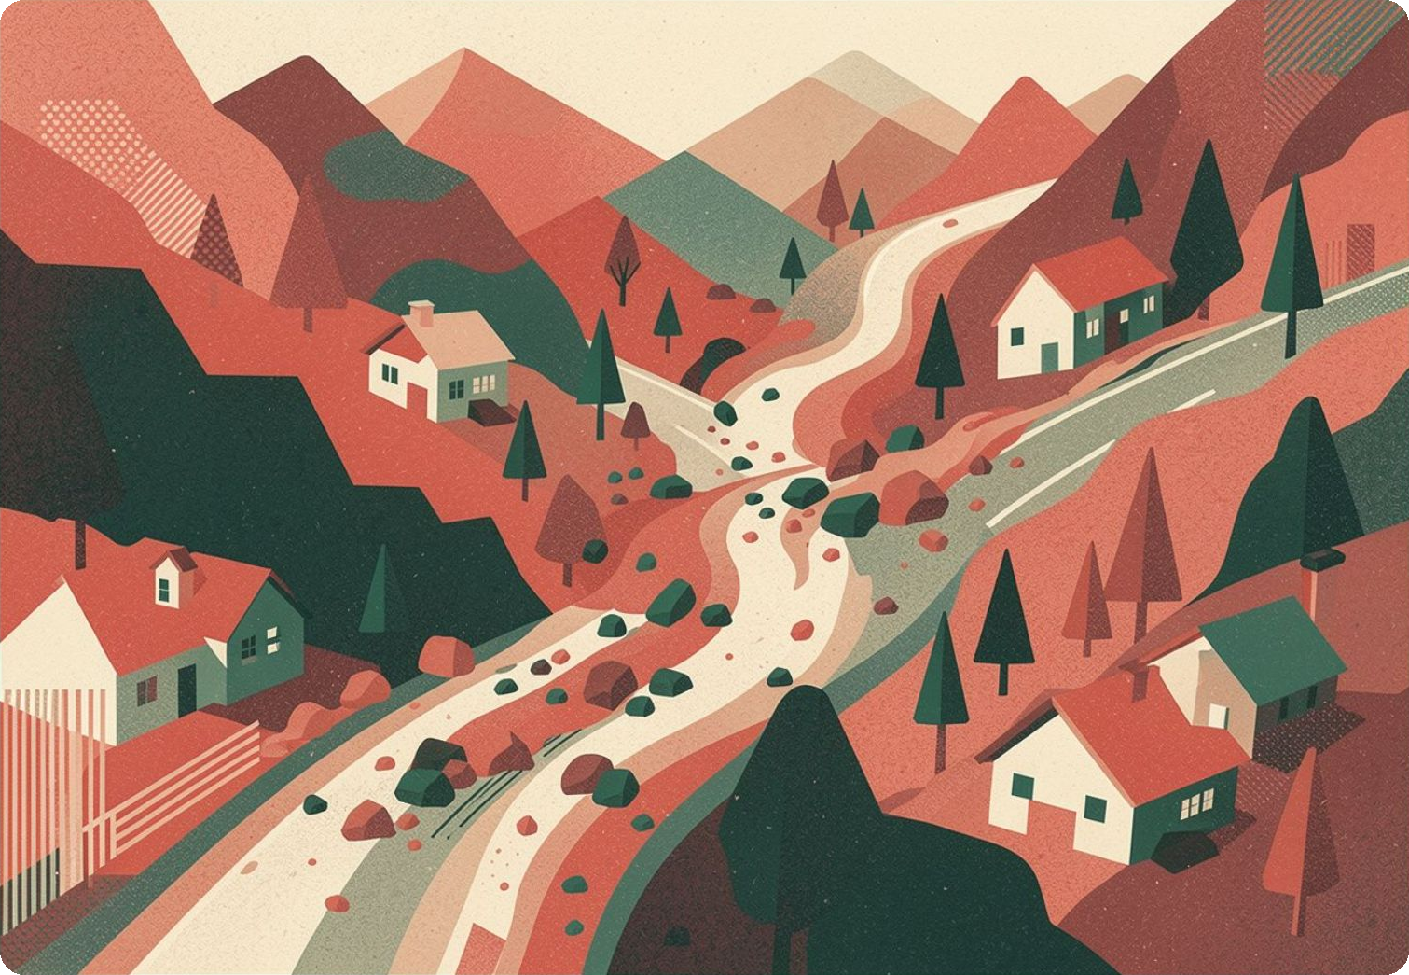
THE PROBLEM
Wildfires don't end when the flames die
When a fire strips a slope bare and bakes the soil, the next intense rain doesn't soak in — it races downhill, gathering ash, soil and boulders into a debris flow: a fast, deadly river of mud that can bury the homes, roads and rivers below. They move faster than a person can run and hit with little warning.
A recently burned valley after the storm — the runout path where debris spreads over the homes below.
MONTECITO, CALIFORNIA — JANUARY 2018, weeks after the Thomas Fire
23
400+
680,000 m³
1 storm
lives lost in minutes
homes damaged or destroyed
mud & boulders mobilized
before the fire was even contained

Slide 3



THE SOLUTION
Alluvion: from burn scar to targeted warning
Alluvion is designed around three questions, answered in order — like a triage doctor. The physics already exists; today it's run by hand, basin by basin. Alluvion runs it as a continuous, automated watch.
01
02
03
PERCEIVE
ASSESS
ACT
Is this hillside dangerous?
How likely — and what would it hurt?
What should we tell people?
Detect the burn scar, slope and soil erodibility straight from before/after satellite imagery.
Run the official USGS physics for a debris flow, then look downhill at the people, roads, rivers and farmland in its path.
Gemini drafts a clear, plain-language warning. A human approves and sends it to responders.
It won't stop debris flows — it points responders to where they must act, before the storm arrives.

Slide 4


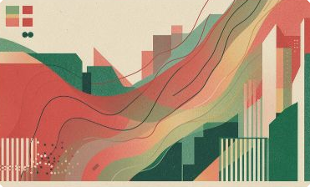


THE SCIENCE — GROUNDED, NOT INVENTED
Real USGS physics, at the speed of software
Alluvion is grounded in the official USGS Staley (2017) M1 model — the same equation USGS and the National Weather Service use to issue real debris-flow warnings. We apply it, not reinvent it.
THE MODEL
P = eˣ ⁄ (1 + eˣ)
x = B + C₁(T·R) + C₂(F·R) + C₃(S·R)
T — Terrain
SRTM slope × burn map
Fraction of upslope that is steep (≥23°) and burned
Rain multiplies every term. A primed hillside is harmless until the rain comes.
F — Fire
Sentinel-2 / Landsat
How severe the burn was (dNBR burn-severity index)
S — Soil
OpenLandMap
How easily the ground washes away (K-factor)
R — Rain
GPM IMERG · WeatherNext
Peak 15-minute rainfall burst — the trigger

Slide 5
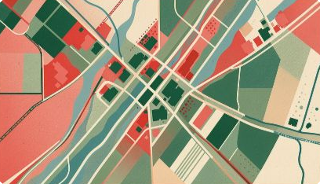
THE KEY IDEA
Occurrence vs. Risk — hazard isn't harm
OCCURRENCE
RISK = OCCURRENCE × EXPOSURE
Will a flow happen at all?
Will it hurt something?
Pure physics from burn + slope + soil + rain. It doesn't care whether anyone lives nearby.
Occurrence weighted by what's downstream, split into four categories: People & property · Roads & facilities · Waterways & ecosystem · Farmland.
Occurrence (hazard)
Risk to people
Montecito
dense town below
~ high
VERY HIGH
Grizzly Creek
remote canyon
~ high
near zero
Same physical hazard, opposite consequences. Alluvion separates the two — so attention can go where lives, water and land are actually at stake.

Slide 6





THE AGENTIC WORKFLOW
A watchman that runs the loop itself
›
›
›
›
PERCEIVE
ASSESS
DECIDE
ACT
MONITOR
Detect fires & burn scars from satellite imagery.
Physics + downstream exposure → occurrence & risk.
A 50% gate; Gemini weighs the picture, sets severity.
Gemini writes the warning; a human approves & dispatches.
Re-check on every fresh rain update, until the storm passes.
CONTINUOUS LOOP — cheap to re-run: burn, slope and soil are computed once; only the new rain number changes
Gemini reasons, but never fabricates.
By design, every number is locked in code before Gemini is called — it writes the prose around the facts, and can read the satellite image directly (it's multimodal). Generate and Send stay separate steps, so a person always approves before anything is sent.

Slide 7


THE GOOGLE EARTH AI STACK
Composed from Google's planetary AI stack
AVAILABLE
AVAILABLE
AVAILABLE
Google Earth Engine
Gemini
WeatherNext
Petabytes of satellite data + planetary compute — the backbone for the whole pipeline.
Multimodal reasoning to read the numbers and the satellite image, and write the warning.
DeepMind's sharp precipitation forecasts for the forward-looking path.
ROADMAP
ROADMAP
FireSat
AlphaEarth Foundations
5×5 m fire detection every 20 min — the autonomous trigger for the loop.
Geospatial embeddings to generalize burn & terrain understanding worldwide.
Open datasets on Earth Engine: Sentinel-2 · Landsat · SRTM · OpenLandMap · GPM IMERG · WorldPop · GHSL · TIGER · HydroSHEDS · USDA Cropland Data Layer

Slide 8
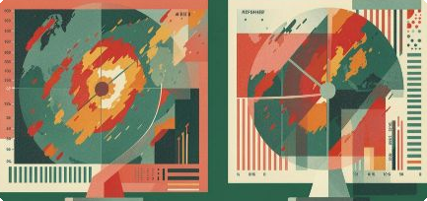

THE VALIDATION CASE
Our first test: replay Montecito, blind
The benchmark: feed Alluvion only data that existed before January 9, 2018 — no peeking. It should detect the burn scar, replay the real storm hour by hour, and raise a warning the moment rain crosses each basin's threshold.
Detect
Burn scar and the five dangerous creeks, from before/after imagery.
Replay the real storm
The actual rainfall that night, climbing to its true 4:30 AM peak.
Warn ahead of the flows
≈ 12.5 hours
The bar: flag the four eastern creeks well before the flows arrive.
of lead time the physics makes available
The window between rain crossing the danger threshold and the flows hitting — the head start Alluvion is designed to turn into evacuations and road closures.
Montecito is the first of five blind replays — Station Fire, Dolan, CZU Lightning Complex and Holy Fire follow the same test.

Slide 9

THE PAYOFF
Turning lead time into targeted action
Buys lead time
Focuses scarce resources
Evacuate the right neighborhoods, close the right roads and pre-stage debris basins — hours to days ahead.
Flags the handful of burns that combine high hazard with real things worth protecting downstream.
Speaks plain language
Runs on public data
Gemini turns analysis into a warning a non-expert can act on — tailored to residents, responders or water managers.
No proprietary datasets — so it can extend anywhere the open Earth-observation data reaches.
Built for the people who act on it: USGS · National Weather Service · local emergency management · water & land agencies

Slide 10

TRANSPARENT BY DESIGN
Honest about the ceiling — safe by design
Safe by design
What it can't do
Numbers come from code, never the AI.
Forecast-dependent accuracy
Coarse forecasts blur short, intense rain bursts. A weak forecast delays a warning — it doesn't create a false one.
Currently US-scoped, and static by nature
Soil erodibility data (K-factor) covers the US today, and reflects conditions at the time it was mapped rather than in real time. As soils shift and new regions are added, the model's inputs will need refreshing to stay accurate
A predictive tool, not a countermeasure
Alluvion flags where and when to act — it can't stop a flow. Evacuations and closures stay human calls, made earlier.
Gemini writes prose around facts locked before it's ever called — nothing to misremember.
A human approves every warning.
Generate and Send stay separate; nothing dispatches on its own.
A fixed go/no-go threshold.
The AI refines and explains — it can't silently lower a warning the data warrants.

Slide 11
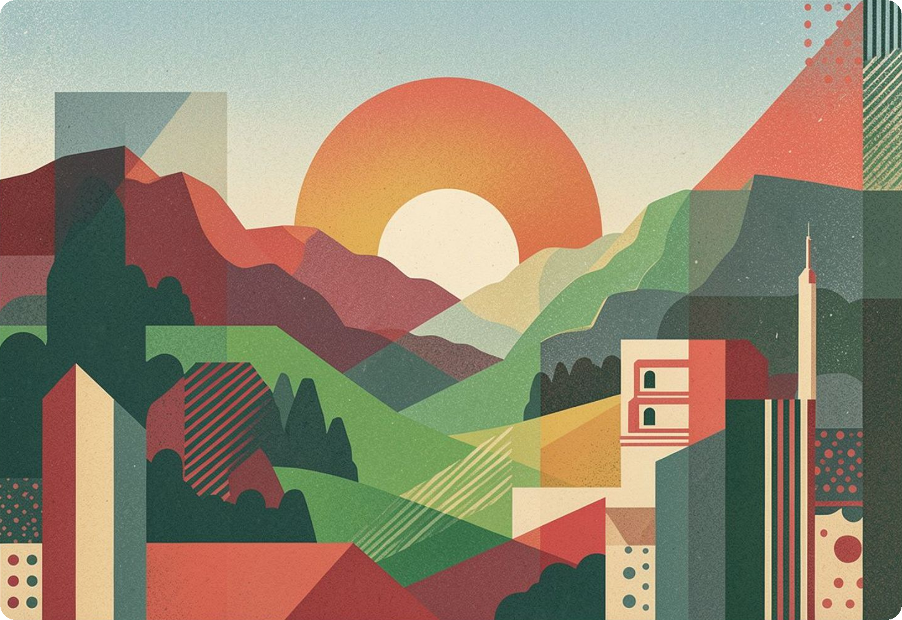
THE ASK
The pieces exist. The pipeline doesn’t.
EXISTS TODAY
Detection and physics, apart
Google finds the fire. USGS holds the debris-flow physics. Each runs on its own, and neither is watching continuously.
NOT YET BUILT
One pipeline, always watching
A system that connects detection to physics automatically — watching every burn scar, re-checking with every storm.
Alluvion
This program builds that connection — turning two separate pieces into one continuous pipeline.
From the moment of the burn to the warning that saves a life — the whole chain, on one planetary stack.

