Slide 1



Consumer Goods Ad_Hoc Insights

Slide 2
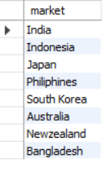
Provide the list of markets in which customer "Atliq Exclusive" operates its business in the APAC region.
SELECT DISTINCT market
FROM dim_customer
WHERE customer = "Atliq Exclusive" AND region = "APAC";

Slide 3

What is the percentage of unique product increase in 2021 vs. 2020? The final output contains these fields, unique_products_2020, unique_products_2021, percentage_chg.
WITH cte AS (
SELECT COUNT(DISTINCT CASE
WHEN fiscal_year = 2020 THEN product_code END) AS unique_products_2020, COUNT(DISTINCT CASE
WHEN fiscal_year = 2021 THEN product_code END) ASunique_product_2021
FROM fact_sales_monthly)
SELECT *, ROUND((unique_product_2021-unique_products_2020)*100/unique_products_2020,1) AS percentage_chg
FROM cte;

Slide 4
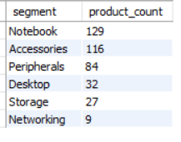
Provide a report with all the unique product counts for each segment and sort them in descending order of product counts. The final output contains 2 fields, segment, product_count.
SELECT segment, COUNT(DISTINCT product_code) AS product_count
FROM dim_product
GROUP BY segment
ORDER BY product_count DESC;

Slide 5
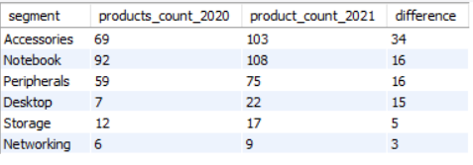
Follow-up: Which segment had the most increase in unique products in 2021 vs 2020? The final output contains these fields, segment, product_count_2020, product_count_2021, difference.
WITH cte AS (
SELECT p.segment, COUNT(DISTINCT CASE
WHEN s.fiscal_year = 2020 THEN s.product_code END) AS products_count_2020, COUNT(DISTINCT CASE
WHEN s.fiscal_year = 2021 THEN s.product_code END) AS product_count_2021
FROM fact_sales_monthly s
JOIN dim_product p
ON p.product_code = s.product_code
GROUP BY p.segment)
SELECT *, product_count_2021-products_count_2020 AS differenceFROM cteORDER BY difference DESC;

Slide 6

Get the products that have the highest and lowest manufacturing costs. The final output should contain these fields, product_code, product, manufacturing_cost.
SELECT m.product_code, product, ROUND(manufacturing_cost,1) AS manufacturing_cost
FROM dim_product p
JOIN fact_manufacturing_cost m
ON m.product_code = p.product_code
WHERE manufacturing_cost = (SELECT MAX(manufacturing_cost) FROM fact_manufacturing_cost) OR
manufacturing_cost = (SELECT MIN(manufacturing_cost) FROM fact_manufacturing_cost)
ORDER BY manufacturing_cost DESC;

Slide 7
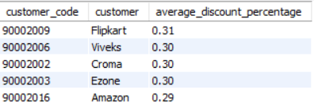
Generate a report which contains the top 5 customers who received an average high pre_invoice_discount_pct for the fiscal year 2021 and in the Indian market. The final output contains these fields, customer_code, customer, average_discount_percentage.
SELECT pre.customer_code, c.customer, ROUND(AVG(pre.pre_invoice_discount_pct),2) AS average_discount_percentage
FROM dim_customer c
JOIN fact_pre_invoice_deductions pre
ON pre.customer_code = c.customer_code
WHERE pre.fiscal_year = 2021 AND c.market = "India“
GROUP BY c.customer, pre.customer_code
ORDER BY average_discount_percentage DESC
LIMIT 5;

Slide 8
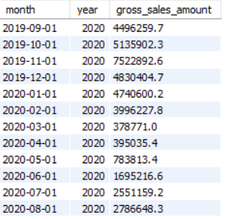
Get the complete report of the Gross sales amount for the customer “Atliq Exclusive” for each month . This analysis helps to get an idea of low and high-performing months and take strategic decisions. The final report contains these columns: Month, Year, Gross sales Amount.
SELECT s.date AS month, s.fiscal_year AS year, ROUND(SUM(s.sold_quantity*g.gross_price),1) AS gross_sales_amount
FROM dim_customer c
JOIN fact_sales_monthly s
ON s.customer_code = c.customer_code
JOIN fact_gross_price g
ON g.product_code = s.product_code AND g.fiscal_year = s.fiscal_year
WHERE c.customer = "Atliq Exclusive“
GROUP BY s.date, s.fiscal_year
ORDER BY s.date ASC;

Slide 9
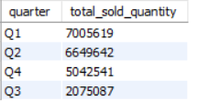
In which quarter of 2020, got the maximum total_sold_quantity?
The final output contains these fields sorted by the total_sold_quantity, Quarter, total_sold_quantity.
SELECT CASE
WHEN MONTH(date) IN (9, 10, 11) THEN "Q1"
WHEN MONTH(date) IN (12, 1, 2) THEN "Q2"
WHEN MONTH(date) IN (3, 4, 5) THEN "Q3"
ELSE "Q4"
END AS quarter,
SUM(sold_quantity) AS total_sold_quantity
FROM fact_sales_monthly s
WHERE s.fiscal_year = 2020
GROUP BY quarter
ORDER BY total_sold_quantity DESC;

Slide 10
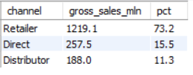
Which channel helped to bring more gross sales in the fiscal year 2021 and the percentage of contribution?
The final output contains these fields, channel, gross_sales_mln, percentage.
WITH cte AS (
SELECT c.channel,s.fiscal_year, ROUND(SUM(s.sold_quantity*g.gross_price)/1000000, 1) AS gross_sales_mln
FROM dim_customer c
JOIN fact_sales_monthly s
ON s.customer_code = c.customer_code
JOIN fact_gross_price g
ON g.product_code = s.product_code AND g.fiscal_year = s.fiscal_year
GROUP BY c.channel, s.fiscal_year)
SELECT channel, gross_sales_mln, ROUND(((gross_sales_mln)/(SELECT SUM(gross_sales_mln)
FROM cte WHERE fiscal_year = 2021))*100,1) AS pct
FROM cteWHERE fiscal_year = 2021
ORDER BY gross_sales_mln DESC;

Slide 11
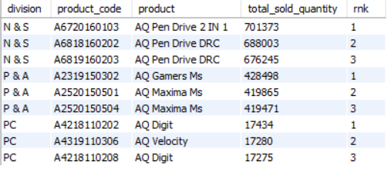
Get the Top 3 products in each division that have a high total_sold_quantity in the fiscal_year 2021?
The final output contains these fields, division, product_code, product, total_sold_quantity, rank_order.
WITH cte AS (
SELECT p.division, p.product_code, p.product, SUM(s.sold_quantity) AS total_sold_quantity
FROM dim_product p
JOIN fact_sales_monthly s
ON s.product_code = p.product_code
WHERE fiscal_year = 2021
GROUP BY p.division, p.product_code, p.product),
cte1 AS (
SELECT *, RANK() OVER (PARTITION BY division ORDER BY total_sold_quantity DESC) AS rnk
FROM cte)SELECT * FROM cte1WHERE rnk < 4;

