Slide 1
Welcome

Slide 2

Library Management System Database

Slide 3
Submitted To:
Dr. Md Mostofa Kamal Rasel
Assistant Professor
Department of Computer Science and Engineering
Submitted By:
Name | ID
Fahad Ahammed | 2020-2-60-174

Slide 4
Objectives:
Tracking activities of all members
Location of books
Proper understanding about ERD, RS and relations between entity set.

Slide 5
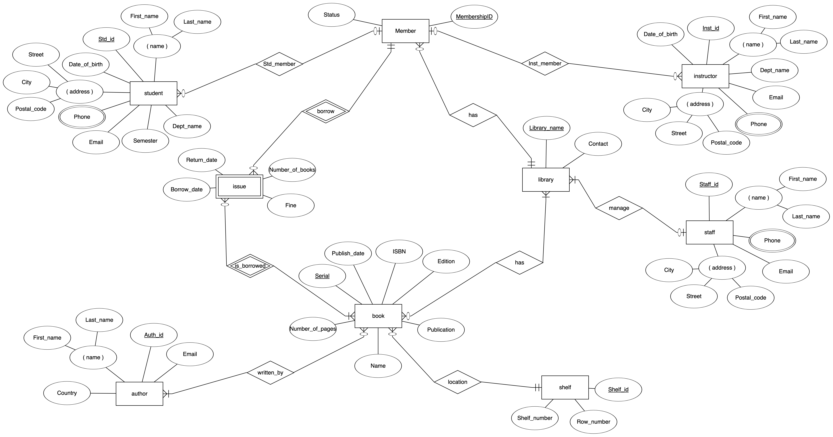
ER Diagram

Slide 6
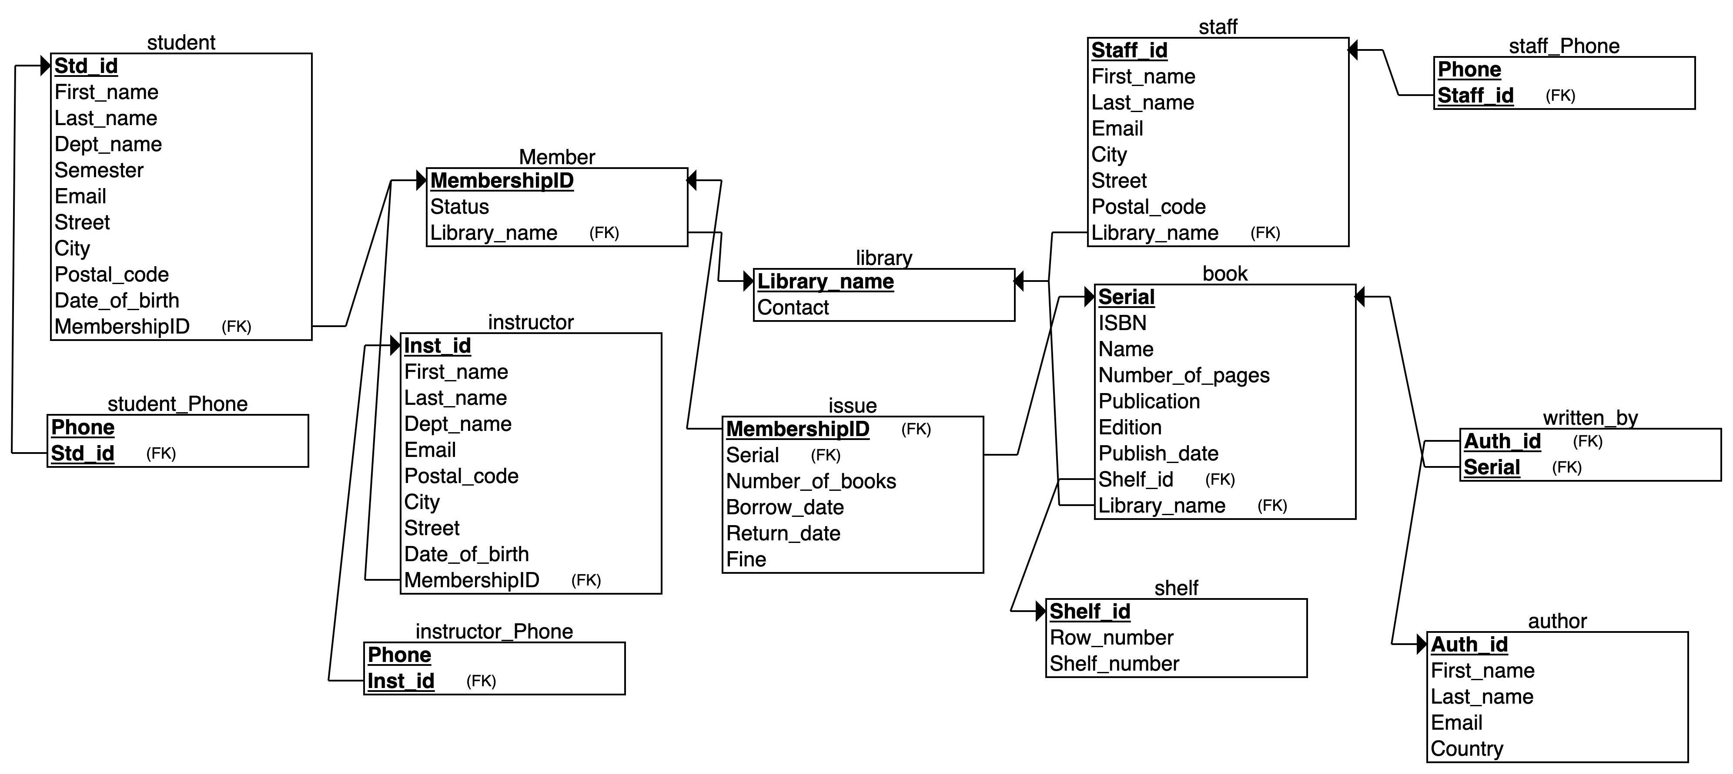
Relational Schema

Slide 7
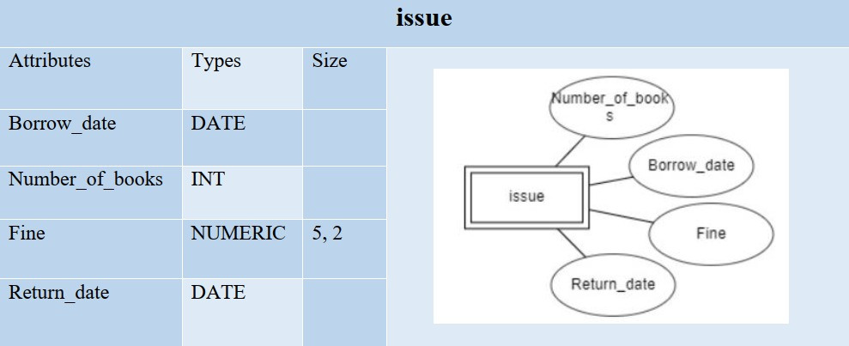
Entity set
Strong entity set
Weak entity set
Weak entity set

Slide 8
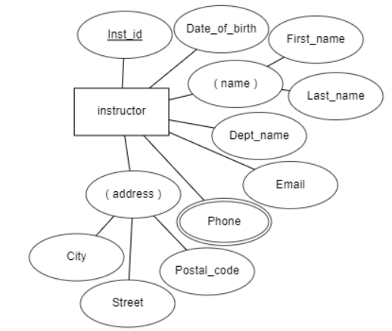
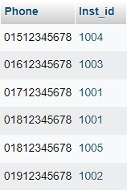
Multivalued Attributes
Instructor Phone Table

Slide 9
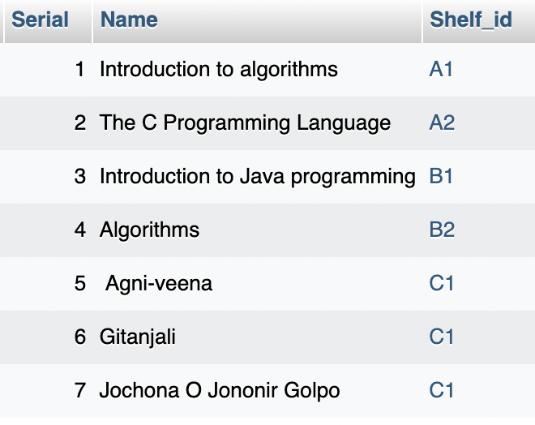
Auto increment
Table

Slide 10
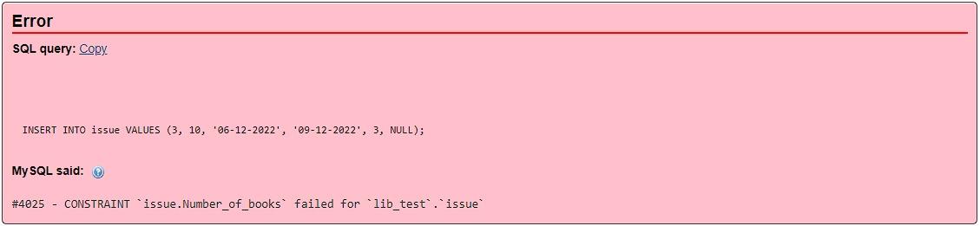
Check
Output

Slide 11
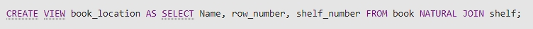
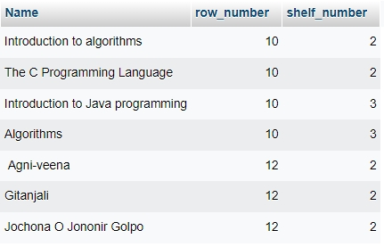
View to find book location

Slide 12
Thank You

