Slide 1
Digital Image Processing
Image Enhancement
Point Processing
Instructor Name
Dr. Muhammad Sharif

Slide 2
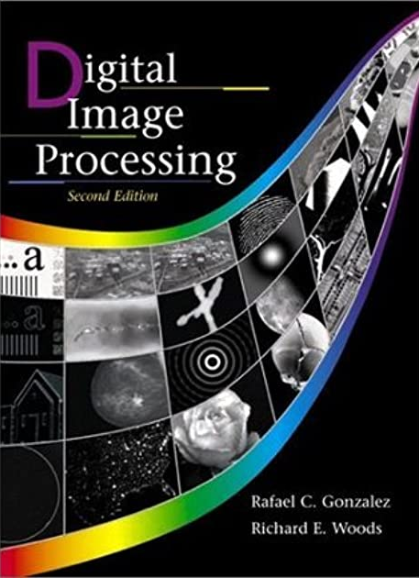
Material Reference
Images and Material
From
Rafael C. Gonzalez and Richard E. Wood,
Digital Image Processing, 2nd Edition.& Internet Resources
2

Slide 3
Contents
In this lecture we will look at image enhancement point processing techniques:
What is point processing?
Negative images
Thresholding
Logarithmic transformation
Power law transforms
Grey level slicing
Bit plane slicing

Slide 4
Basic Spatial Domain Image Enhancement
Most spatial domain enhancement operations can be reduced to the form
g (x, y) = T[ f (x, y)]
where f (x, y) is the input image, g (x, y) is the processed image and T is some operator defined over some neighbourhood of (x, y)
Origin
x
(x, y)
y
Image f (x, y)

Slide 5
Point Processing
The simplest spatial domain operations occur when the neighbourhood is simply the pixel itself
In this case T is referred to as a grey level transformation function or a point processing operation
Point processing operations take the form
s = T ( r )
where s refers to the processed image pixel value and r refers to the original image pixel value

Slide 6
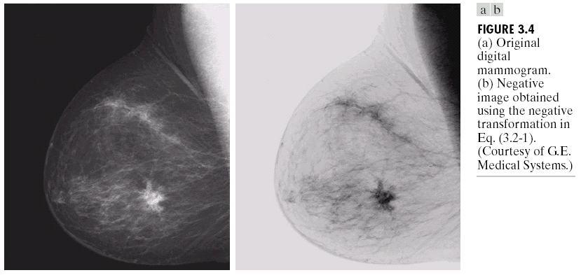
Point Processing Example: Negative Images
Negative images are useful for enhancing white or grey detail embedded in dark regions of an image
Note how much clearer the tissue is in the negative image of the mammogram below
Original Image
s = 1.0 - r
Negative Image

Slide 7
Point Processing Example: Negative Images (cont.…)
Original Image
x
Enhanced Image
x
y
Image f (x, y)
y
Image f (x, y)
s = intensity_{max} - r

Slide 8
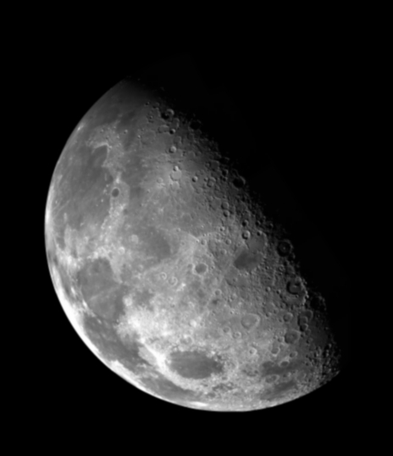

Point Processing Example: Thresholding
Thresholding transformations are particularly useful for segmentation in which we want to isolate an object of interest from a background
1.0
r > threshold
s =
0.0
r <= threshold

Slide 9
Point Processing Example: Thresholding (cont.…)
Original Image
x
Enhanced Image
x
y
Image f (x, y)
y
Image f (x, y)
1.0 r > threshold
s =
0.0 r <= threshold

Slide 10
Intensity Transformations

Slide 11
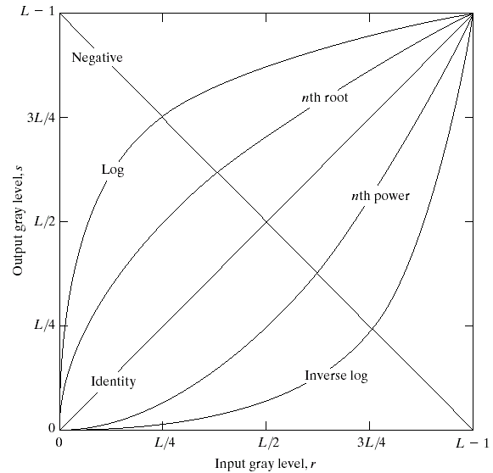
Basic Grey Level Transformations
There are many different kinds of grey level transformations
Three of the most common
are shown here
Linear
Negative/Identity
Logarithmic
Log/Inverse log
Power law
n^{th} power/n^{th} root

Slide 12
Logarithmic Transformations
The general form of the log transformation is
s = c * log(1 + r)
The log transformation maps a narrow range of low input grey level values into a wider range of output values
The inverse log transformation performs the opposite transformation

Slide 13
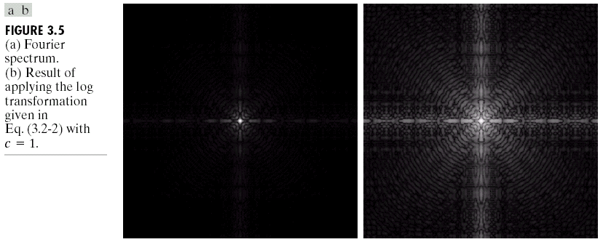
Logarithmic Transformations (cont.…)
Log functions are particularly useful when the input grey level values may have an extremely large range of values
In the following example the Fourier transform of an image is put through a log transform to reveal more detail
s = log(1 + r)

Slide 14
Logarithmic Transformations (cont.…)
Original Image
x
Enhanced Image
x
y
Image f (x, y)
y
Image f (x, y)
s = log(1 + r)
We usually set c to 1
Grey levels must be in the range [0.0, 1.0]

Slide 15
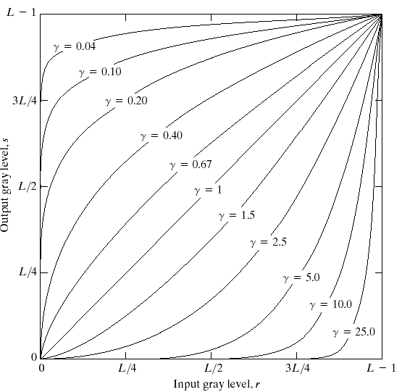
Power Law Transformations
Power law transformations have the following form
s = c * r ^{γ}
Map a narrow range of dark input values into a wider range of output values or vice versa
Varying γ gives a whole family of curves

Slide 16
Power Law Transformations (cont.…)
Original Image
x
Enhanced Image
x
y
Image f (x, y)
y
Image f (x, y)
s = r ^{γ}
We usually set c to 1
Grey levels must be in the range [0.0, 1.0]

Slide 17
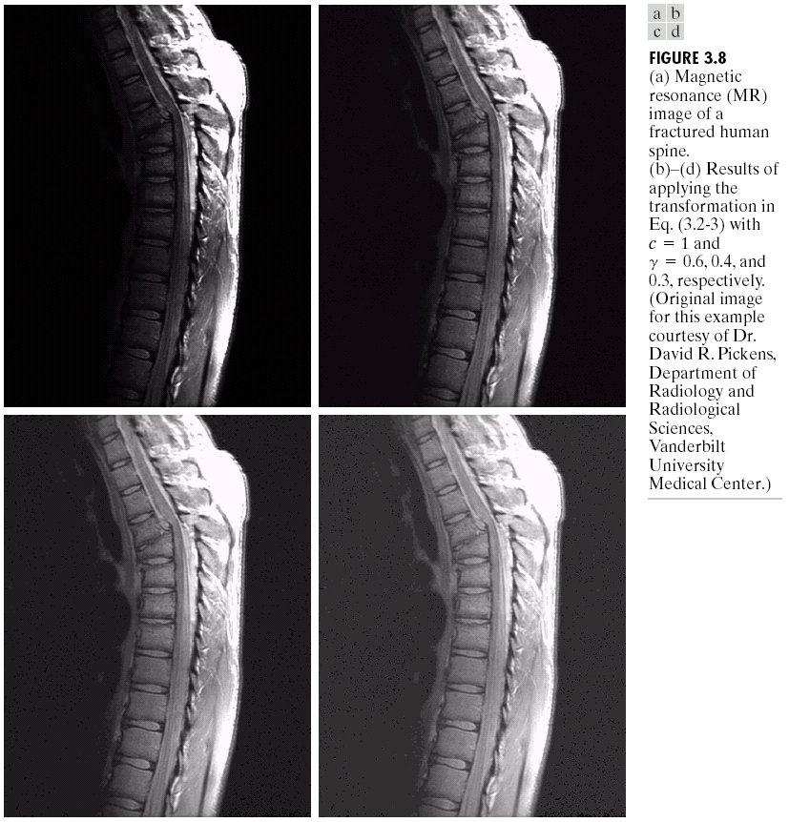
Power Law Example

Slide 18
Power Law Example (cont.…)
γ = 0.6

Slide 19
Power Law Example (cont.…)
γ = 0.4

Slide 20
Power Law Example (cont.…)
γ = 0.3

Slide 21
Power Law Example (cont.…)
The images to the right show a magnetic resonance (MR) image of a fractured human spine
Different curves highlight different detail
s = r ^{0.6}
s = r ^{0.4}
s = r ^{0.3}

Slide 22
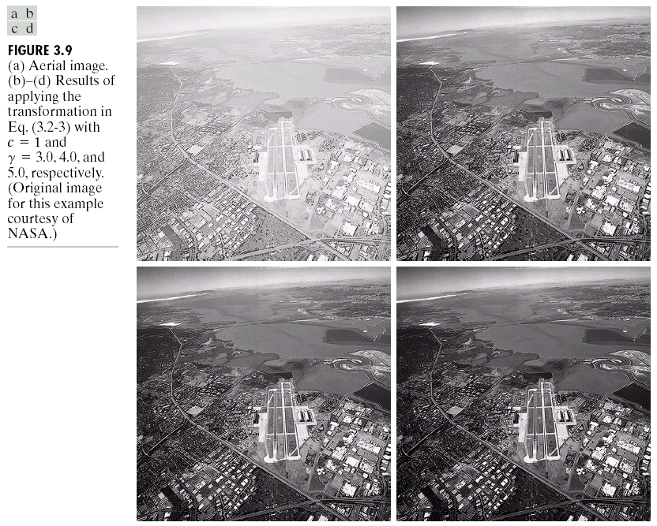
Power Law Example

Slide 23
Power Law Example (cont.…)
γ = 5.0

Slide 24
Power Law Transformations (cont.…)
An aerial photo of a runway is shown
This time power law transforms are used to darken the image
Different curves highlight different detail
s = r ^{3.0}
s = r ^{4.0}
s = r ^{5.0}

Slide 25
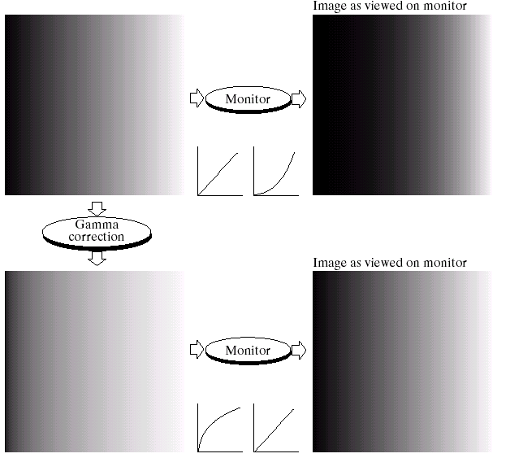
Gamma Correction
Many of you might be familiar with gamma correction of computer monitors
Problem is that display devices do not respond linearly to different intensities
Can be corrected using a log transform

Slide 26
More Contrast Issues

Slide 27
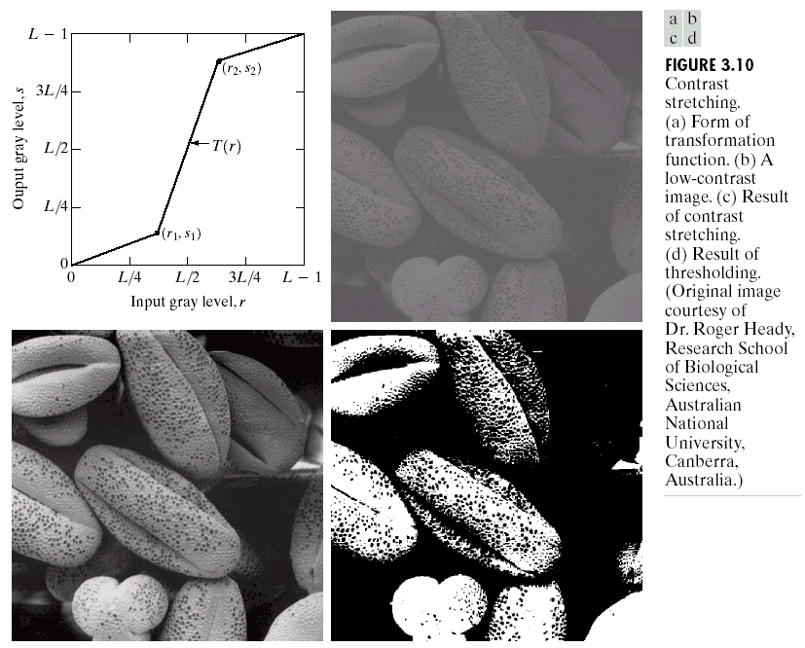
Piecewise Linear Transformation Functions
Rather than using a well defined mathematical function we can use arbitrary user-defined transforms
The images below show a contrast stretching linear transform to add contrast to a poor quality image

Slide 28
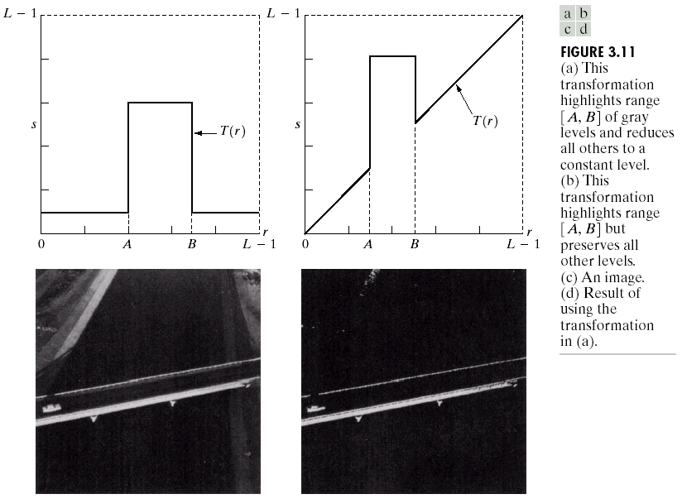
Gary Level Slicing
Highlights a specific range of grey levels
Similar to thresholding
Other levels can be suppressed or maintained
Useful for highlighting features in an image

Slide 29
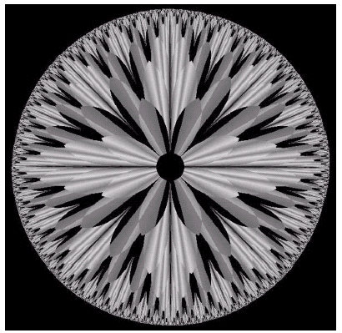
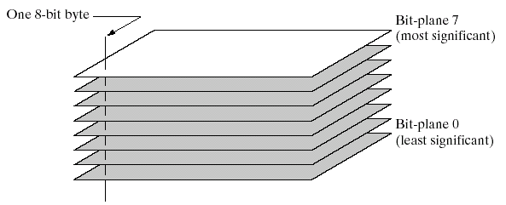
Bit Plane Slicing
Often by isolating particular bits of the pixel values in an image we can highlight interesting aspects of that image
Higher-order bits usually contain most of the significant visual information
Lower-order bits contain subtle details

Slide 30
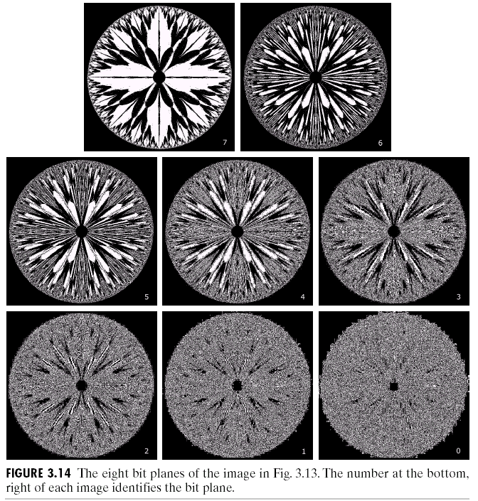
Bit Plane Slicing (cont.…)
[10000000]
[01000000]
[00100000]
[00001000]
[00000100]
[00000001]

Slide 31
Bit Plane Slicing (cont.…)
[10000000]
[01000000]
[00100000]
[00001000]
[00000100]
[00000001]

Slide 32
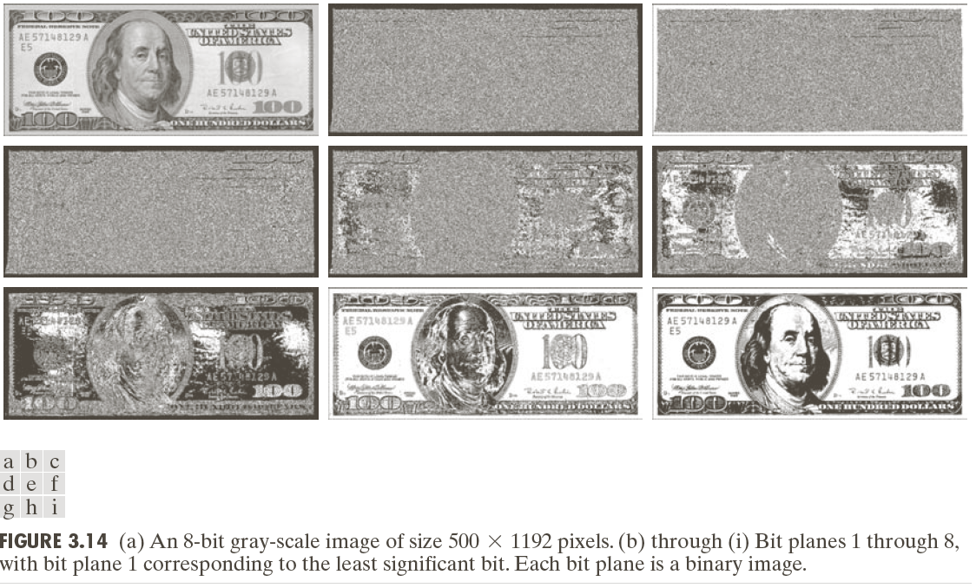

Slide 33
Bit Plane Slicing (cont.…)

Slide 34
Bit Plane Slicing (cont.…)

Slide 35
Bit Plane Slicing (cont.…)

Slide 36
Bit Plane Slicing (cont.…)

Slide 37
Bit Plane Slicing (cont.…)

Slide 38
Bit Plane Slicing (cont.…)

Slide 39
Bit Plane Slicing (cont.…)

Slide 40
Bit Plane Slicing (cont.…)

Slide 41
Bit Plane Slicing (cont.…)

Slide 42
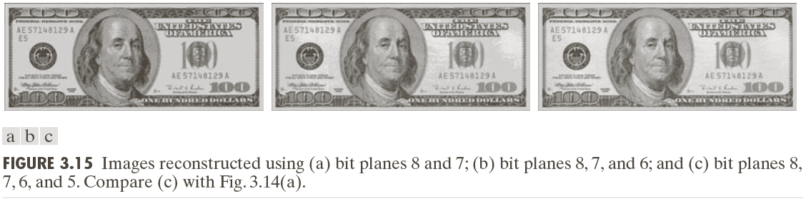
Bit Plane Slicing (cont.…)
Reconstructed image using only bit planes 8 and 7
Reconstructed image using only bit planes 8, 7 and 6
Reconstructed image using only bit planes 7, 6 and 5

Slide 43
Summary
We have looked at different kinds of point processing image enhancement
Next time we will start to look at neighbourhood operations – in particular filtering and convolution

Slide 44
THANK YOU

