Slide 1
Digital Image Processing
Image Enhancement
Spatial Filtering 1
Instructor Name
Dr. Muhammad Sharif

Slide 2
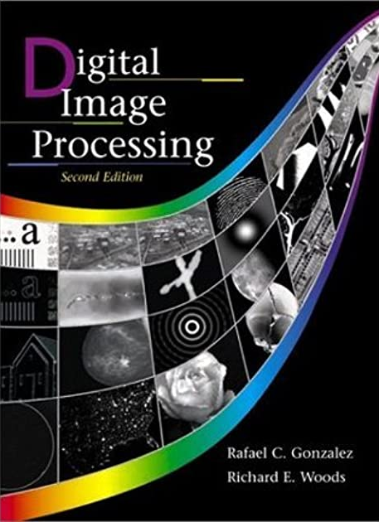
Material Reference
Images and Material
From
Rafael C. Gonzalez and Richard E. Wood,
Digital Image Processing, 2nd Edition.& Internet Resources
2

Slide 3
Contents
In this lecture we will look at spatial filtering techniques:
Neighbourhood operations
What is spatial filtering?
Smoothing operations
What happens at the edges?
Correlation and convolution

Slide 4
Neighbourhood Operations
Neighbourhood operations simply operate on a larger neighbourhood of pixels than point operations
Neighbourhoods are mostly a rectangle around a central pixel
Any size rectangle and any shape filter are possible
Origin
x
Neighbourhood
(x, y)
y
Image f (x, y)

Slide 5
Simple Neighbourhood Operations
Some simple neighbourhood operations include:
Min: Set the pixel value to the minimum in the neighbourhood
Max: Set the pixel value to the maximum in the neighbourhood
Median: The median value of a set of numbers is the midpoint value in that set (e.g. from the set [1, 7, 15, 18, 24] 15 is the median). Sometimes the median works better than the average

Slide 6
Simple Neighbourhood Operations Example
Original Image
x
Enhanced Image
x
123
127
128
119
115
130
140
145
148
153
167
172
133
154
183
192
194
191
194
199
207
210
198
195
164
170
175
162
173
151
y
y

Slide 7
The Spatial Filtering Process
a
b
c
r
s
t
d
e
f
*
u
v
w
g
h
i
x
y
z
Original Image Pixels
Filter
Simple 3*3 Neighbourhood
e
3*3 Filter
e_{processed} = v*e + r*a + s*b + t*c + u*d + w*f + x*g + y*h + z*i
y
Image f (x, y)
The above is repeated for every pixel in the original image to generate the filtered image

Slide 8
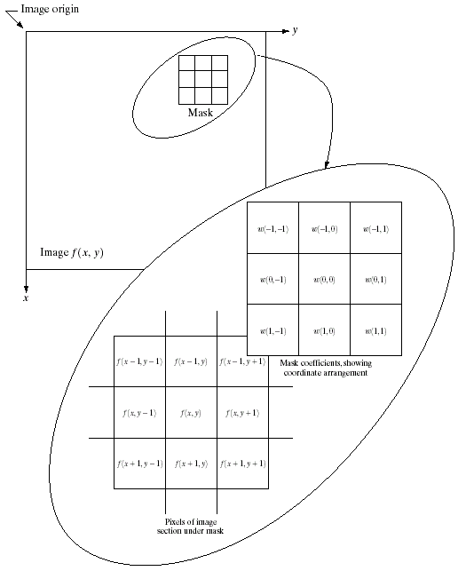
Spatial Filtering: Equation Form
Filtering can be given in equation form as shown above
Notations are based on the image shown to the left

Slide 9
Smoothing Spatial Filters
One of the simplest spatial filtering operations we can perform is a smoothing operation
Simply average all of the pixels in a neighbourhood around a central value
Especially useful in removing noise from images
Also useful for highlighting gross detail
¹/₉ | ¹/₉ | ¹/₉
¹/₉ | ¹/₉ | ¹/₉
¹/₉ | ¹/₉ | ¹/₉
Simple averaging filter

Slide 10
Smoothing Spatial Filtering
104
100
108
¹/₉
¹/₉
¹/₉
99
106
98
*
¹/₉
¹/₉
¹/₉
95
90
85
¹/₉
¹/₉
¹/₉
¹/₉
¹/₉
¹/₉
Original Image Pixels
Filter
Simple 3*3 Neighbourhood
104
100
108
3*3 Smoothing Filter
¹/₉
¹/₉
¹/₉
99
106
98
¹/₉
¹/₉
¹/₉
95
90
85
e = ¹/₉*106 + ¹/₉*104 + ¹/₉*100 + ¹/₉*108 + ¹/₉*99 + ¹/₉*98 + ¹/₉*95 + ¹/₉*90 + ¹/₉*85
= 98.3333
y
Image f (x, y)
The above is repeated for every pixel in the original image to generate the smoothed image

Slide 11
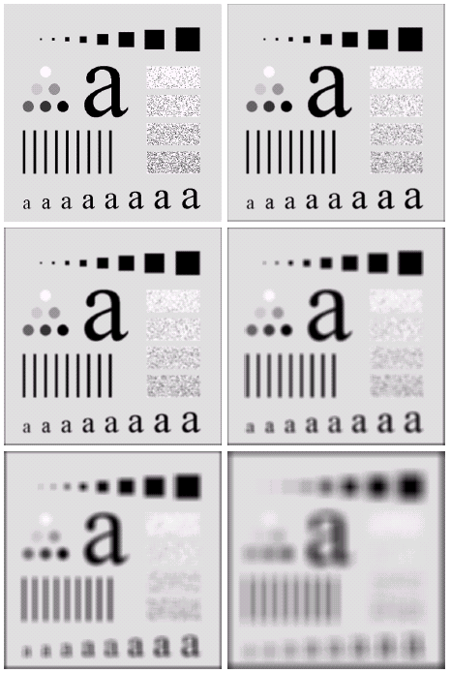
Image Smoothing Example
The image at the top left is an original image of size 500*500 pixels
The subsequent images show the image after filtering with an averaging filter of increasing sizes
3, 5, 9, 15 and 35
Notice how detail begins to disappear

Slide 12
Weighted Smoothing Filters
More effective smoothing filters can be generated by allowing different pixels in the neighbourhood different weights in the averaging function
Pixels closer to the central pixel are more important
Often referred to as a weighted averaging
¹/₁₆ | ²/₁₆ | ¹/₁₆
²/₁₆ | ⁴/₁₆ | ²/₁₆
¹/₁₆ | ²/₁₆ | ¹/₁₆
Weighted averaging filter

Slide 13
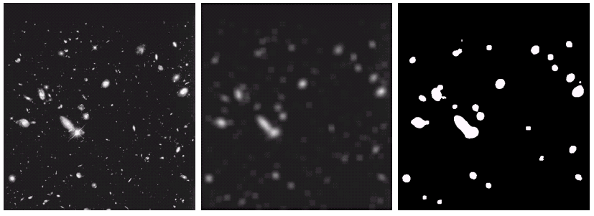
Another Smoothing Example
By smoothing the original image we get rid of lots of the finer detail which leaves only the gross features for thresholding
Original Image
Smoothed Image
Thresholded Image

Slide 14
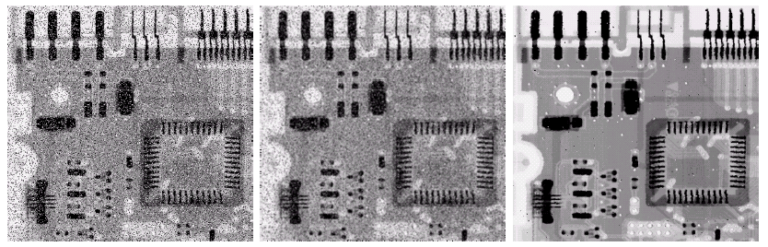
Averaging Filter Vs. Median Filter Example
Filtering is often used to remove noise from images
Sometimes a median filter works better than an averaging filter
Original Image With Noise
Image After Averaging Filter
Image After Median Filter

Slide 15
Simple Neighbourhood Operations Example
x
123
127
128
119
115
130
140
145
148
153
167
172
133
154
183
192
194
191
194
199
207
210
198
195
164
170
175
162
173
151
y

Slide 16
Strange Things Happen At The Edges!
At the edges of an image we are missing pixels to form a neighbourhood
Origin
x
e
e
e
e
e
e
e
y
Image f (x, y)

Slide 17
Strange Things Happen At The Edges! (cont.…)
There are a few approaches to dealing with missing edge pixels:
Omit missing pixels
- Only works with some filters
- Can add extra code and slow down processing
Pad the image
- Typically with either all white or all black pixels
Replicate border pixels
Truncate the image
Allow pixels wrap around the image
- Can cause some strange image artefacts

Slide 18
Simple Neighbourhood Operations Example
x
123
127
128
119
115
130
140
145
148
153
167
172
133
154
183
192
194
191
194
199
207
210
198
195
164
170
175
162
173
151
y

Slide 19
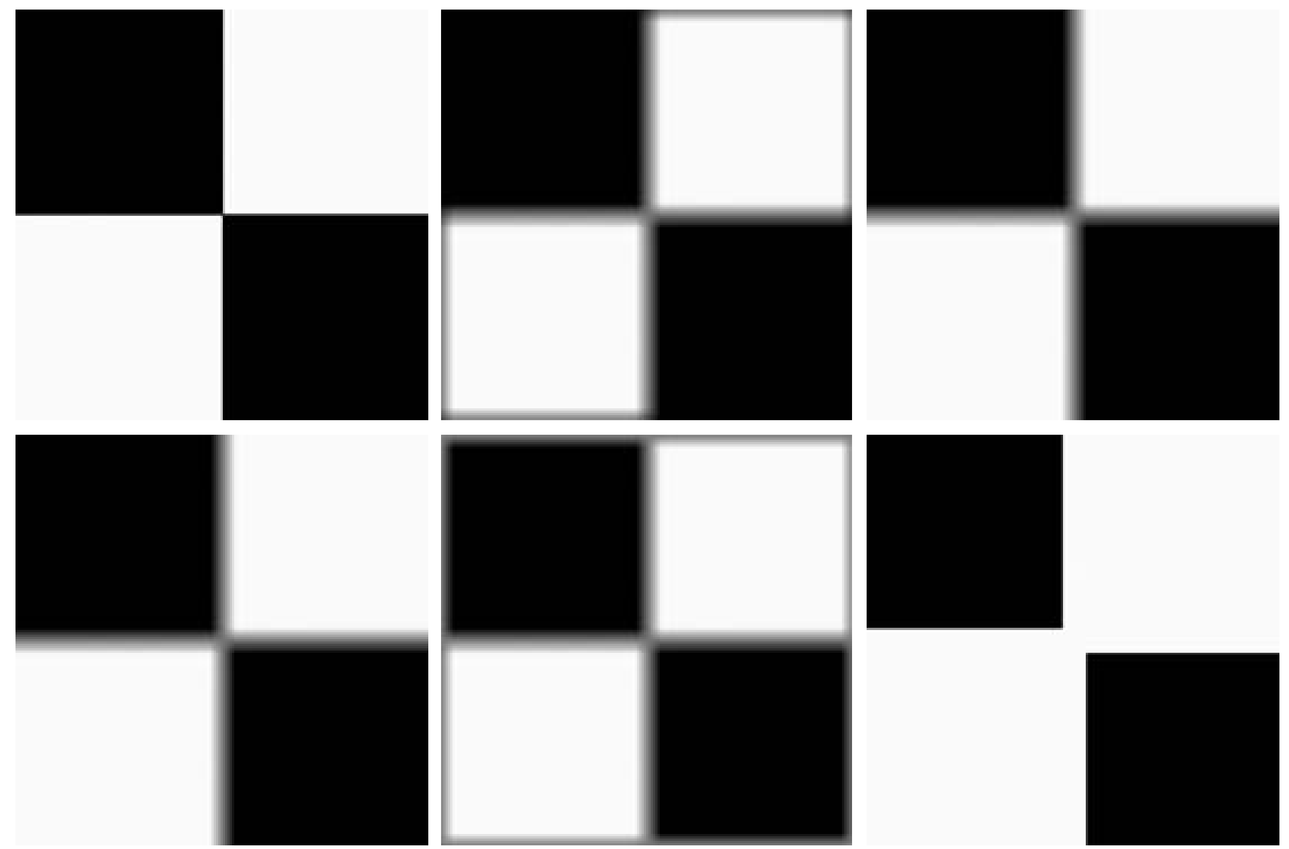
Strange Things Happen At The Edges! (cont.…)
Filtered Image: Zero Padding
Original Image
Filtered Image: Replicate Edge Pixels
Filtered Image: Wrap Around Edge Pixels

Slide 20
Correlation & Convolution
The filtering we have been talking about so far is referred to as correlation with the filter itself referred to as the correlation kernel
Convolution is a similar operation, with just one subtle difference
For symmetric filters it makes no difference
a
b
c
r
s
t
e_{processed} = v*e + z*a + y*b + x*c + w*d + u*e + t*f + s*g + r*h
d
e
e
*
u
v
w
f
g
h
x
y
z
Original Image Pixels
Filter

Slide 21
Summary
In this lecture we have looked at the idea of spatial filtering and in particular:
Neighbourhood operations
The filtering process
Smoothing filters
Dealing with problems at image edges when using filtering
Correlation and convolution
Next time we will looking at sharpening filters and more on filtering and image enhancement

Slide 22
THANK YOU

