Slide 1
Digital Image Processing
Image Enhancement
Spatial Filtering 2
Instructor Name
Dr. Muhammad Sharif

Slide 2
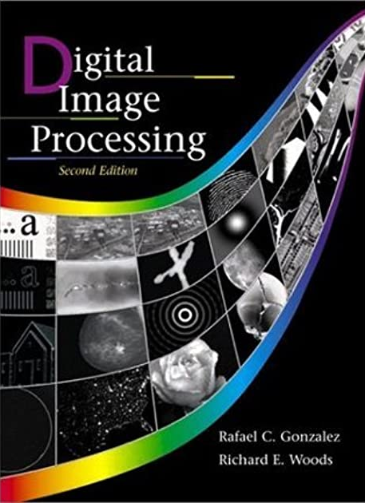
Material Reference
Images and Material
From
Rafael C. Gonzalez and Richard E. Wood,
Digital Image Processing, 2nd Edition.& Internet Resources
2

Slide 3
Contents
In this lecture we will look at more spatial filtering techniques
Spatial filtering refresher
Sharpening filters
- 1st derivative filters
- 2nd derivative filters
Combining filtering techniques

Slide 4
Spatial Filtering Refresher
a
b
c
r
s
t
d
e
f
*
u
v
w
g
h
i
x
y
z
Original Image Pixels
Filter
Simple 3*3 Neighbourhood
e
3*3 Filter
e_{processed} = v*e + r*a + s*b + t*c + u*d + w*f + x*g + y*h + z*i
y
Image f (x, y)
The above is repeated for every pixel in the original image to generate the smoothed image

Slide 5
Sharpening Spatial Filters
Previously we have looked at smoothing filters which remove fine detail
Sharpening spatial filters seek to highlight fine detail
- Remove blurring from images
- Highlight edges
Sharpening filters are based on spatial differentiation

Slide 6
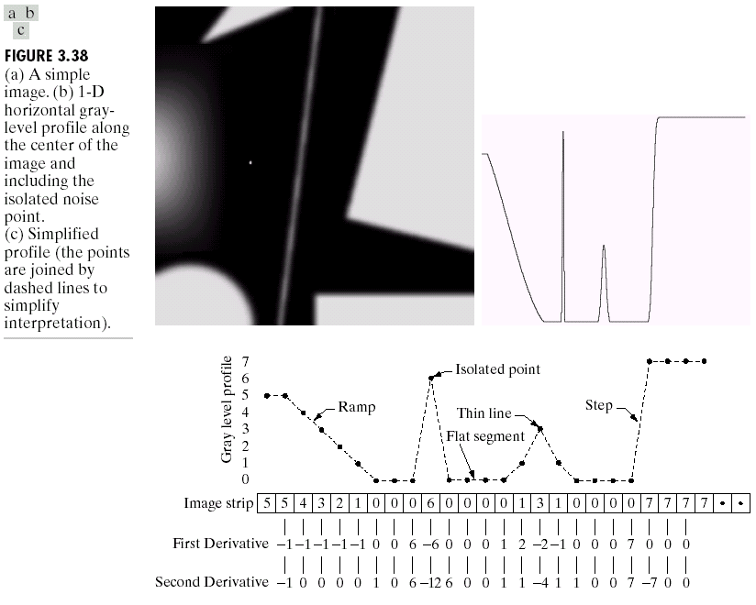
Spatial Differentiation
Differentiation measures the rate of change of a function
Let’s consider a simple 1 dimensional example

Slide 7
Spatial Differentiation
A
B

Slide 8
1st Derivative
The formula for the 1st derivative of a function is as follows:
It’s just the difference between subsequent values and measures the rate of change of the function

Slide 9
1st Derivative (cont.…)
5 | 5 | 4 | 3 | 2 | 1 | 0 | 0 | 0 | 6 | 0 | 0 | 0 | 0 | 1 | 3 | 1 | 0 | 0 | 0 | 0 | 7 | 7 | 7 | 7
 | 0 | -1 | -1 | -1 | -1 | 0 | 0 | 6 | -6 | 0 | 0 | 0 | 1 | 2 | -2 | -1 | 0 | 0 | 0 | 7 | 0 | 0 | 0

Slide 10
2nd Derivative
The formula for the 2nd derivative of a function is as follows:
Simply takes into account the values both before and after the current value

Slide 11
2nd Derivative (cont.…)
5 | 5 | 4 | 3 | 2 | 1 | 0 | 0 | 0 | 6 | 0 | 0 | 0 | 0 | 1 | 3 | 1 | 0 | 0 | 0 | 0 | 7 | 7 | 7 | 7
 | -1 | 0 | 0 | 0 | 0 | 1 | 0 | 6 | -12 | 6 | 0 | 0 | 1 | 1 | -4 | 1 | 1 | 0 | 0 | 7 | -7 | 0 | 0

Slide 12
Using Second Derivatives For Image Enhancement
The 2nd derivative is more useful for image enhancement than the 1st derivative
Stronger response to fine detail
Simpler implementation
We will come back to the 1st order derivative later on
The first sharpening filter we will look at is the Laplacian
Isotropic
One of the simplest sharpening filters
We will look at a digital implementation

Slide 13
The Laplacian
The Laplacian is defined as follows:
where the partial 1st order derivative in the x direction is defined as follows:
and in the y direction as follows:

Slide 14
The Laplacian (cont.…)
So, the Laplacian can be given as follows:
We can easily build a filter based on this
0
1
0
1
-4
1
0
1
0

Slide 15
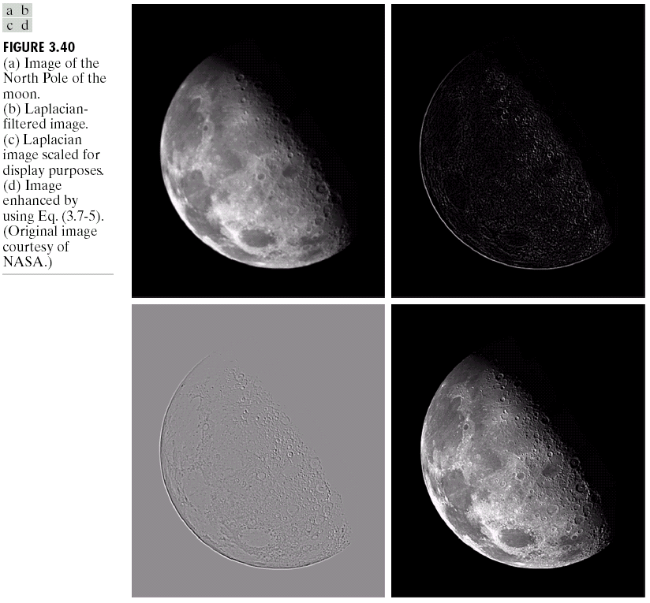
The Laplacian (cont.…)
Applying the Laplacian to an image we get a new image that highlights edges and other discontinuities
Original Image
Laplacian Filtered Image
Laplacian Filtered Image Scaled for Display

Slide 16
But That Is Not Very Enhanced!
The result of a Laplacian filtering is not an enhanced image
We have to do more work in order
to get our final image
Subtract the Laplacian result from
the original image to generate our
final sharpened enhanced image
Laplacian Filtered Image Scaled for Display

Slide 17
Laplacian Image Enhancement
In the final sharpened image edges and fine detail are much more obvious
-
=
Original Image
Laplacian Filtered Image
Sharpened Image

Slide 18
Laplacian Image Enhancement

Slide 19
Simplified Image Enhancement
The entire enhancement can be combined into a single filtering operation

Slide 20
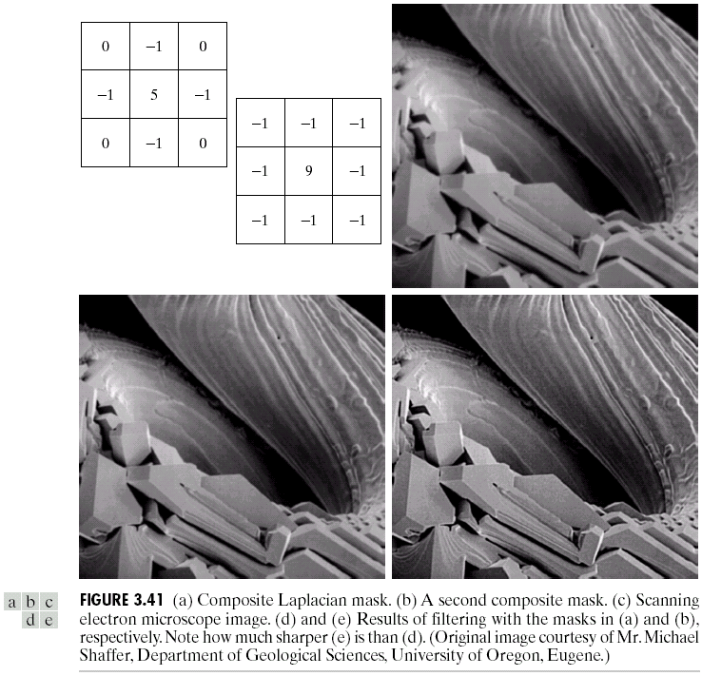
Simplified Image Enhancement (cont.…)
This gives us a new filter which does the whole job for us in one step
0
-1
0
-1
5
-1
0
-1
0

Slide 21
Simplified Image Enhancement (cont.…)

Slide 22
Variants On The Simple Laplacian
There are lots of slightly different versions of the Laplacian that can be used:
0
1
0
1
1
1
Simple Laplacian
Variant of Laplacian
1
-4
1
1
-8
1
0
1
0
1
1
1
-1
-1
-1
-1
9
-1
-1
-1
-1

Slide 23
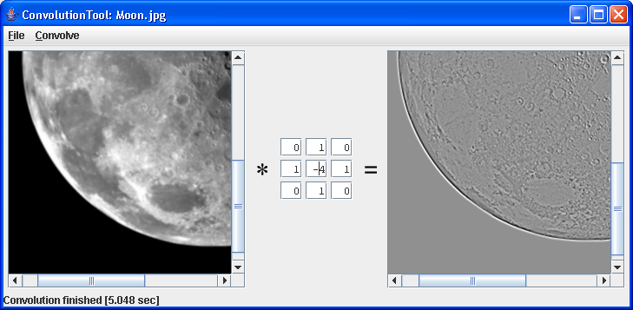
Simple Convolution Tool In Java
A great tool for testing out different filters
From the book “Image Processing tools in Java”
Available from webCT later on today
To launch: java ConvolutionTool Moon.jpg

Slide 24
1st Derivative Filtering
Implementing 1st derivative filters is difficult in practice
For a function f(x, y) the gradient of f at coordinates (x, y) is given as the column vector:

Slide 25
1st Derivative Filtering (cont.…)
The magnitude of this vector is given by:
For practical reasons this can be simplified as:

Slide 26
1st Derivative Filtering (cont.…)
There is some debate as to how best to calculate these gradients but we will use:
which is based on these coordinates
z₁
z₂
z₃
z₄
z₅
z₆
z₇
z₈
z₉

Slide 27
Sobel Operators
Based on the previous equations we can derive the Sobel Operators
To filter an image it is filtered using both operators the results of which are added together
-1
-2
-1
-1
0
1
0
0
0
-2
0
2
1
2
1
-1
0
1

Slide 28
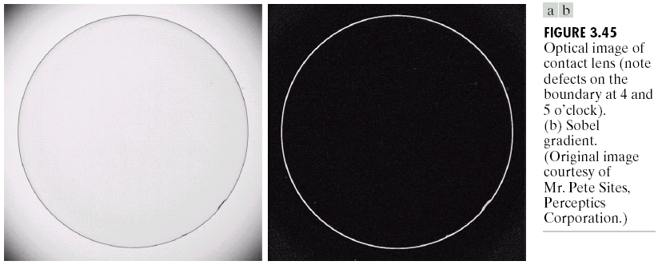
Sobel Example
Sobel filters are typically used for edge detection
An image of a contact lens which is enhanced in order to make defects (at four and five o’clock in the image) more obvious

Slide 29
1st & 2nd Derivatives
Comparing the 1st and 2nd derivatives we can conclude the following:
1st order derivatives generally produce thicker edges
2nd order derivatives have a stronger response to fine detail e.g. thin lines
1st order derivatives have stronger response to grey level step
2nd order derivatives produce a double response at step changes in grey level

Slide 30
Summary
In this lecture we looked at:
Sharpening filters
- 1st derivative filters
- 2nd derivative filters
Combining filtering techniques

Slide 31
THANK YOU

