Slide 1
Digital Image Processing
Digital Imaging Fundamentals
Instructor Name
Dr. Muhammad Sharif

Slide 2
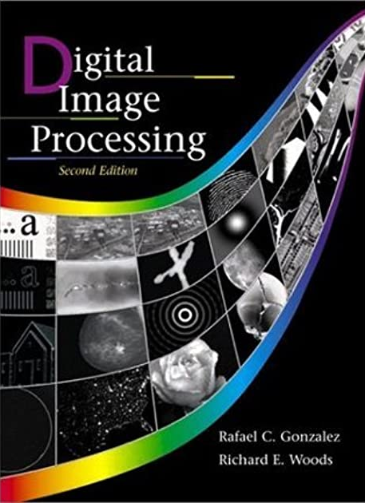
Material Reference
Images and Material
From
Rafael C. Gonzalez and Richard E. Wood,
Digital Image Processing, 2nd Edition.& Internet Resources
2

Slide 3
Contents
This lecture will cover:
Recap
The human visual system
Light and the electromagnetic spectrum
Image representation
Sampling, quantisation and resolution
3

Slide 4
Human Visual System
The best vision model we have!
Knowledge of how images form in the eye can help us with processing digital images
We will take just a brief overview of the human visual system
4

Slide 5
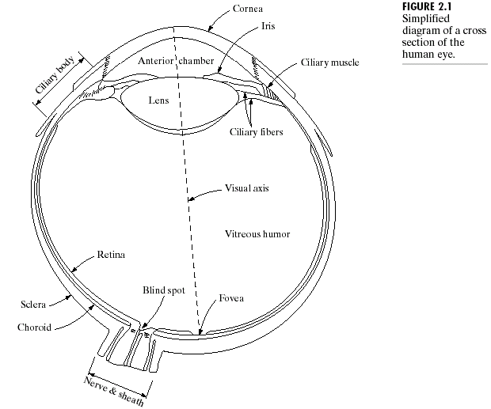
Structure Of The Human Eye
The lens focuses light from objects onto the retina
5

Slide 6
Structure Of The Human Eye...
The retina is covered with light receptors called cones (6-7 million) and rods (75-150 million)
Cones are concentrated around the fovea and are very sensitive to colour
Rods are more spread out and are sensitive to low levels of illumination

Slide 7

Blind-Spot Experiment
Draw an image similar to that below on a piece of paper (the dot and cross are about 6 inches apart)
Close your right eye and focus on the cross with your left eye
Hold the image about 20 inches away from your face and move it slowly towards you
The dot should disappear!
7

Slide 8
Blind-Spot Experiment
8

Slide 9
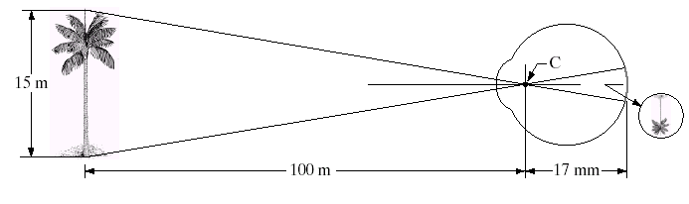
Image Formation In The Eye
Muscles within the eye can be used to change the shape of the lens allowing us focus on objects that are near or far away
An image is focused onto the retina causing rods and cones to become excited which ultimately send signals to the brain
9

Slide 10
Brightness Adaptation & Discrimination
The human visual system can perceive approximately 10¹⁰ different light intensity levels
However, at any one time we can only discriminate between a much smaller number – brightness adaptation
Similarly, the perceived intensity of a region is related to the light intensities of the regions surrounding it
10

Slide 11

Brightness Adaptation & Discrimination (cont.…)
11

Slide 12
Brightness Adaptation & Discrimination (cont.…)
12

Slide 13
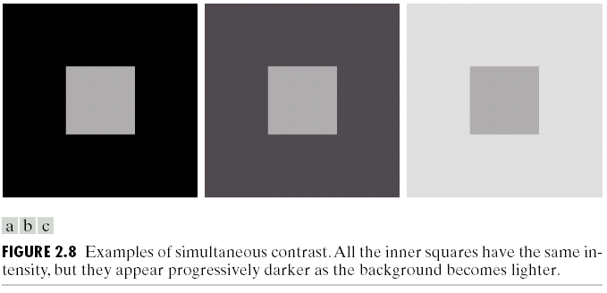
Brightness Adaptation & Discrimination (cont.…)
An example of simultaneous contrast
13

Slide 14
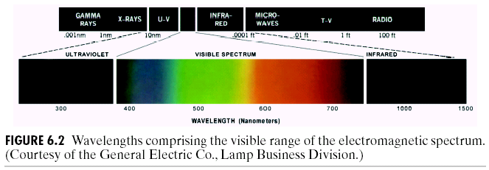
Light And The Electromagnetic Spectrum
Light is just a particular part of the electromagnetic spectrum that can be sensed by the human eye
The electromagnetic spectrum is split up according to the wavelengths of different forms of energy
14

Slide 15
Reflected Light
The colours that we perceive are determined by the nature of the light reflected from an object
For example, if white light is shone onto a green object most wavelengths are absorbed, while green light is reflected from the object
White Light
Colours Absorbed
Green Light
15

Slide 16
Sampling, Quantisation And Resolution
In the following slides we will consider what is involved in capturing a digital image of a real-world scene
Sampling and quantisation
Resolution
16

Slide 17
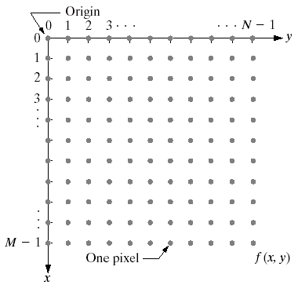
Image Representation
Before we discuss image acquisition recall that a digital image is composed of M rows and N columns of pixels each storing a value
Pixel values are most often grey levels in the range 0-255(black-white)
We will see later on that images can easily be represented as matrices
17

Slide 18
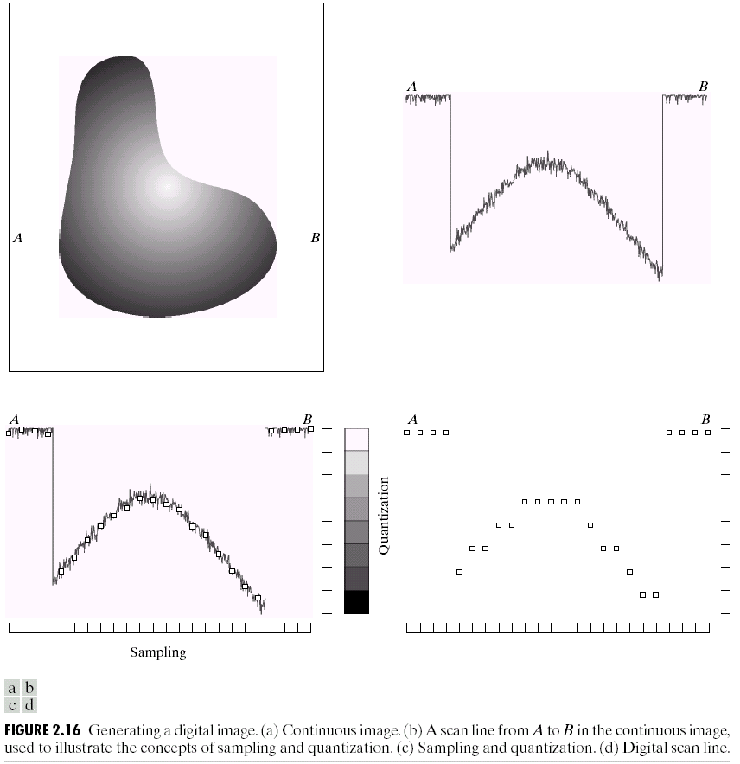
Image Sampling And Quantisation
A digital sensor can only measure a limited number of samples at a discrete set of energy levels
Quantisation is the process of converting a continuous analogue signal into a digital representation of this signal
18

Slide 19
Image Sampling And Quantisation
19

Slide 20

Image Sampling And Quantisation
20
Notes:
Analogue Vs digital
Think of the volume knob on your stereo
Records Vs CDs Vs Mp3s
Nyquist theory etc talks about how much sampling we need to do

Slide 21
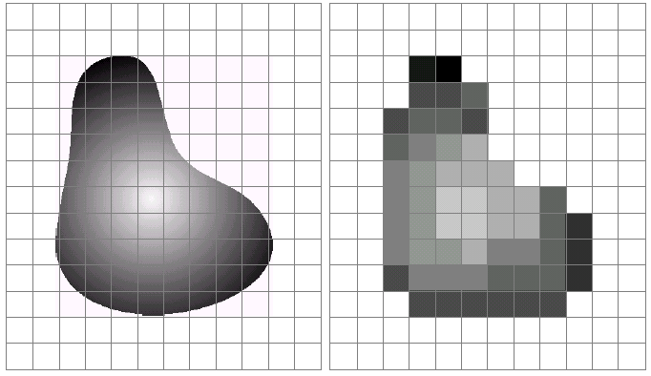
Image Sampling And Quantisation (cont.…)
Remember that a digital image is always only an approximation of a real-world scene
21

Slide 22
Image Representation
22

Slide 23
Image Representation
23

Slide 24
Image Representation
24

Slide 25
Image Representation
25

Slide 26
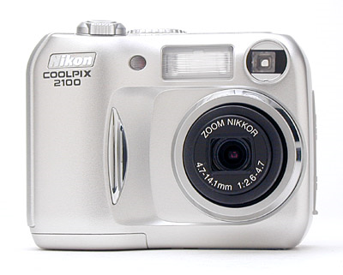
Spatial Resolution
The spatial resolution of an image is determined by how sampling was carried out
Spatial resolution simply refers to the smallest discernible detail in an image
Vision specialists will often talk about pixel size
Graphic designers will talk about dots per inch (DPI)
5.1 Megapixels
26

Slide 27
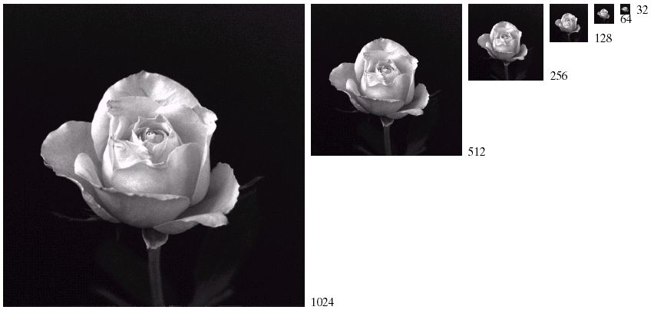
Spatial Resolution (cont.…)
27

Slide 28
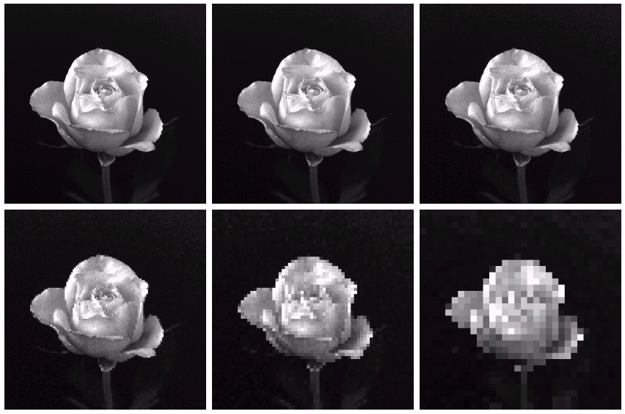
Spatial Resolution (cont.…)
1024 * 1024
512 * 512
256 * 256
128 * 128
64 * 64
32 * 32
28

Slide 29
Intensity Level Resolution
Intensity level resolution refers to the number of intensity levels used to represent the image
The more intensity levels used, the finer the level of detail discernible in an image
Intensity level resolution is usually given in terms of the number of bits used to store each intensity level
29

Slide 30
Intensity Level Resolution: Cont.
Number of Bits
Number of Intensity Levels
Examples
1
2
0, 1
2
4
00, 01, 10, 11
4
16
0000, 0101, 1111
8
256
00110011, 01010101
16
65,536
1010101010101010
30

Slide 31
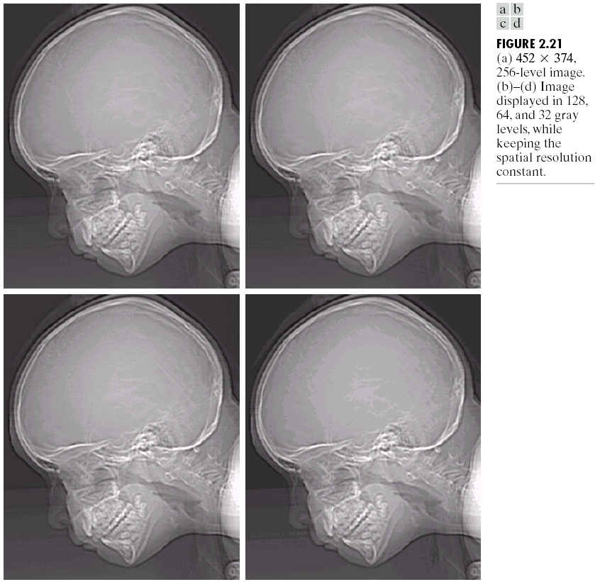
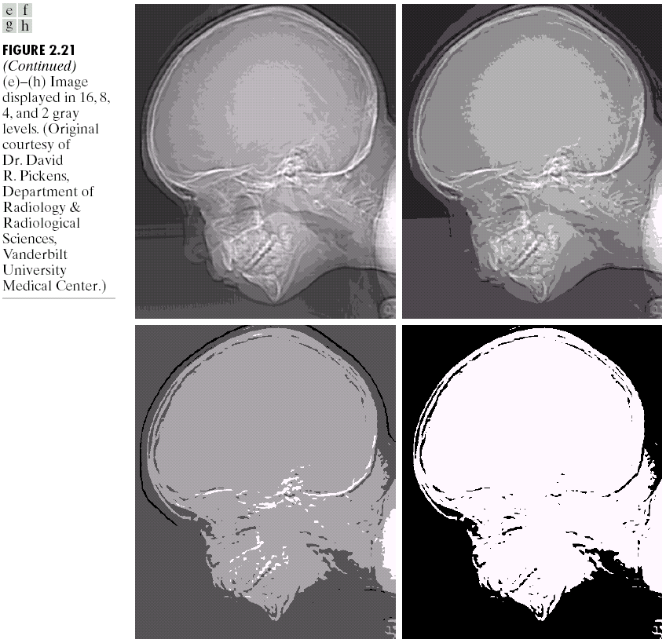
Intensity Level Resolution (cont.…)
256 grey levels (8 bits per pixel)
128 grey levels (7 bpp)
64 grey levels (6 bpp)
32 grey levels (5 bpp)
16 grey levels (4 bpp)
8 grey levels (3 bpp)
4 grey levels (2 bpp)
2 grey levels (1 bpp)
31

Slide 32
Resolution: How Much Is Enough?
The big question with resolution is always how much is enough?
This all depends on what is in the image and what you would like to do with it
Key questions include
Does the image look aesthetically pleasing?
Can you see what you need to see within the image?
32

Slide 33
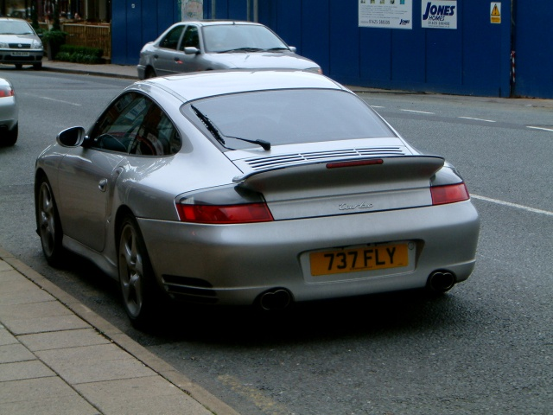

Resolution: How Much Is Enough? (cont.…)
The picture on the right is fine for counting the number of cars, but not for reading the number plate
33

Slide 34
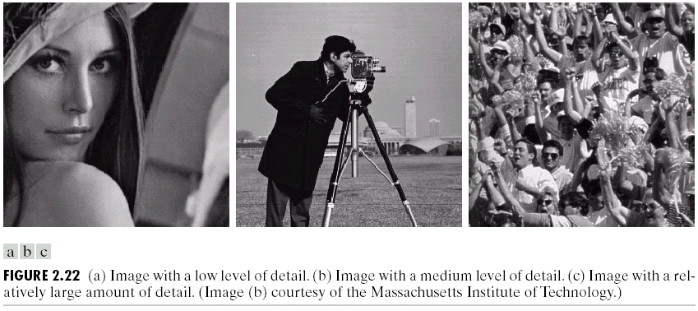
Intensity Level Resolution (cont.…)
Low Detail
Medium Detail
High Detail
34

Slide 35
Intensity Level Resolution (cont.…)
35

Slide 36
Intensity Level Resolution (cont.…)
36

Slide 37
Intensity Level Resolution (cont.…)
37

Slide 38
Summary
We have looked at:
Human visual system
Light and the electromagnetic spectrum
Image representation
Sampling, quantisation and resolution
Next time we start to look at techniques for image enhancement
38

Slide 39
Next Lecture
What is image enhancement?
Different kinds of image enhancement
Histogram processing
Point processing
Neighbourhood operations
39

Slide 40
THANK YOU

