Slide 1





Pointers

Slide 2
What are pointers
Pointers are variables that contain memory addresses as their values
A variable name directly references a value
A pointer indirectly indirectly refers to a value
A pointer must be declared before its use.

Slide 3
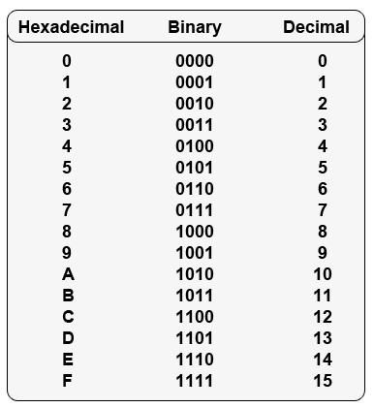
Hexadecimal System
The hexadecimal numeral system, often shortened to "hex", is a numeral system made up of 16 symbols (base 16)
The standard numerical system is base 10
Hexadecimal number are written as: 0x5Fh

Slide 4
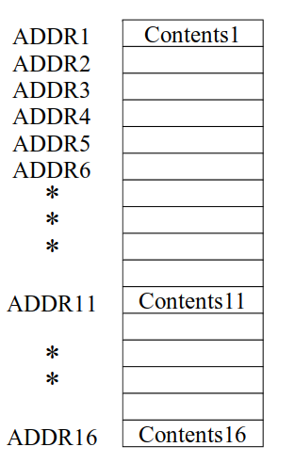
Concepts
Memory can be considered as a linear set of data
Variables directly refer to the values
Pointer have a value of the address of a given location

Slide 5
Use of “&” and “*”
Pointers are defined as var pointer *int
The & operator gives out the memory address of a variable, this is called referencing
The * operator gives out value of the variable, this is called de-referencing

Slide 6
Thank you listening, see you in next lecture !

