Slide 1





GoLang Ultimate Bootcamp
Beginner to Pro

Slide 2

Hello!
I am Fahad Ali Sarwar
I will be your instructor for this course
You can find me at fahad.ali.sarwar@gmail.com

Slide 3
Advantages of GO
Statically typed
Memory safety
Garbage collection
Structural typing
Supports concurrency
All the big tech giants are embracing it
Open source by nature
Very Fast
Cross platform

Slide 4
Language Design
Similar to the design of C with improved brevity and simplicity
Fast compilation times, remote package management (go get ) and online documentation
Supports networking and Multiprocessing

Slide 5
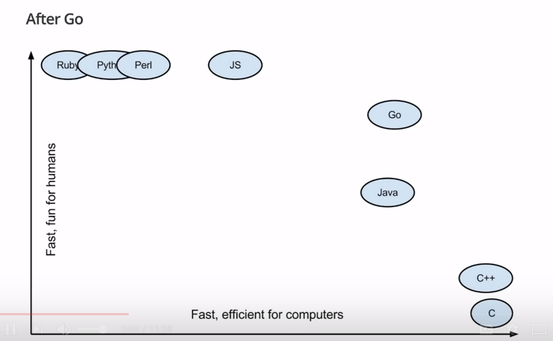
GO vs other languages

