Slide 1





GoLang Ultimate Bootcamp
Beginner to Pro

Slide 2

Hello!
I am Fahad Ali Sarwar
I will be your instructor for this course
You can find me at fahad.ali.sarwar@gmail.com

Slide 3
Advantages of GO
Statically typed
Memory safety
Garbage collection
Structural typing

Slide 4
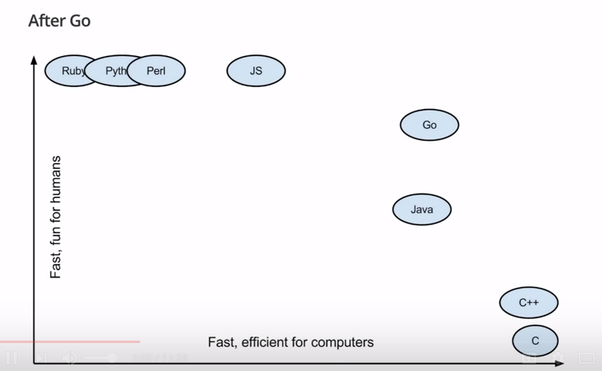
GO vs other languages

