Slide 1





Installation

Slide 2
Installation of GO in linux

Slide 3
Environment Variable
GOROOT
GOPATH
GOBIN

Slide 4
GOROOT
Location of your Go Installation
It is used to find standard libraries
In Windows it is set automatically by the installer
In Linux sometimes you have to set it manually
A good idea is to install golang in directory “usr/local” in linux, so GOROOT should point to this directory

Slide 5
GOPATH
In other programming languages you can put your sourcecode anywhere
In Go, you can put it anywhere but you have to tell the compiler where your source code is located.
GOPATH is the root of your workspace where your project files are located.
In Linux, its usually “/home/[username]/go”

Slide 6
Setting up GOPATH
export PATH=$PATH:/usr/local/go/bin

Slide 7
GOBIN
This points to a directory where your binaries will be present when you compile them
In Linux it, usually refers to your workspace “/home/[username]/go/bin”

Slide 8

Go Workspace
In your workspace “/home/[username]/go”, create these three folders
Source
code
Contains all
Your Executables
Location of
compiled packages

Slide 9
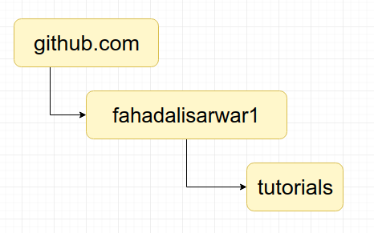
GO Folder Structure conventions

Slide 10
Thank you listening, see you in next lecture !

