Slide 1





Conditionals

Slide 2
Flow control
The order in which the statements are executed

Slide 3
Conditionals
Conditionals let us move flow control of a program from one point to another.
Types of conditionals
  If statements
  For loops
  Switch statements

Slide 4
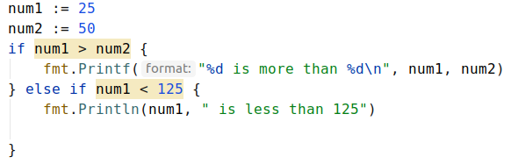
If statement

Slide 5
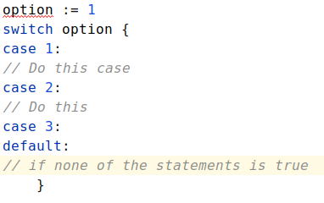
Switch Statements

Slide 6
Thank you listening, see you in next lecture !

