Slide 1





Loops

Slide 2
Loops
Three component loop
While loop
Inifinte loop
Foe each loop
Exiting a loop

Slide 3

Three Component Loop
Loop Condition
initialization
Post Loop
Condition

Slide 4
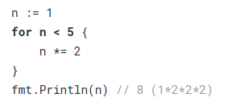
While Loop

Slide 5
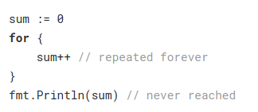
Infinite Loop

Slide 6
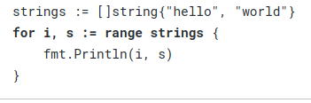
Range loop

Slide 7
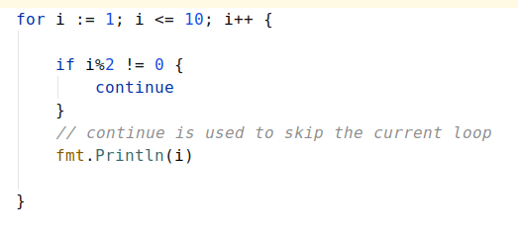
Breaking a loop

Slide 8
Thank you listening, see you in next lecture !

