Slide 1
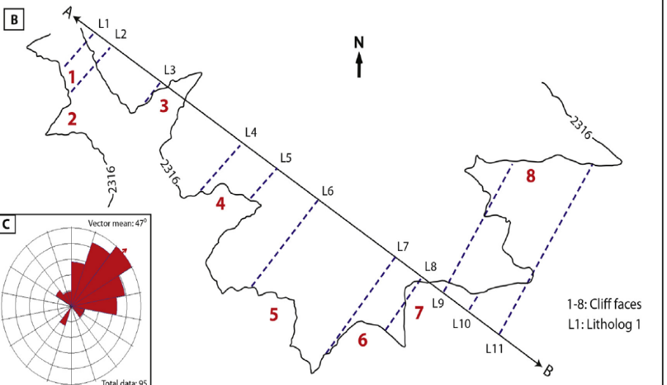
Left
Downstream
Right
L12
Upstream Lithologs Locations: L2, L3, L4, L5, L6, L7, L8, L10
Upstream
Ignore 1-8 (red font, bold): they are canyon numbers
Downstream Lithologs Locations: L12, L9, L11

